Slide 1
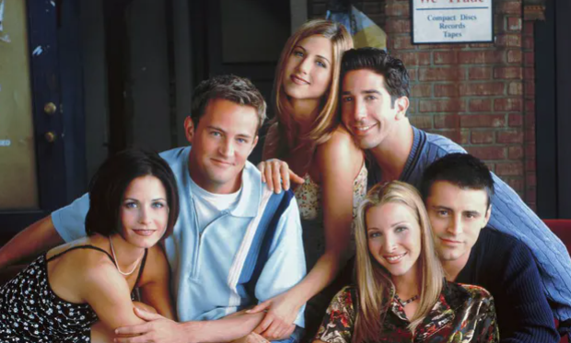
Ice Breaking Time - Friends Quiz
Warming Up Time

Slide 2
Ice Breaking Time
What's the title of the Friends theme song?
I’II be there for those
I’II be there for you
I’II be there for that
I’II be there for them
Warming Up Time

Slide 3
Ice Breaking Time
What is Janice most likely to say?
Oh…good…heavens
Oh…my…days
Oh…my…God
How…you…doing
Warming Up Time

Slide 4
Ice Breaking Time
What hangs on Monica’s purple door?
A yellow coat hook
A yellow picture frame
A mirror with a yellow frame
A large yellow key
Warming Up Time

Slide 5
Ice Breaking Time
In which city is Friends set?
Los Angeles
New York City
Miami
Seattle
Warming Up Time

Slide 6
Ice Breaking Time
Who is the odd one out?
Ross Geller
Joseph Francis Tribbiani
David Schwimmer
Chandler Muriel Bing
Warming Up Time

Slide 7
Ice Breaking Time
What's the name of the coffee shop used by the characters?
Brown’s of Brockley
Central Cafe
Central Perk
Deja Brew Cafe
Warming Up Time

Slide 8
Ice Breaking Time
Who plays Phoebe’s brother?
Brad Pitt
Tom Selleck
Bruce Willis
Giovanni Ribisi
Warming Up Time

Slide 9
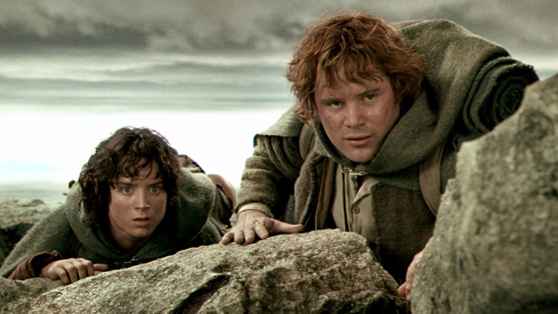
Friendship
The Book of Proverbs
True Friends

Slide 10
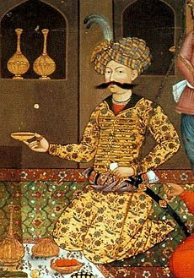
Introduction
Sermon Outline

Slide 11
Introduction
Friendship and the gospel
Exodus 33:11; Isaiah 41:8; Matthew 11:9; Luke12:4; John 15:13; Romans 5:8, Proverbs 18:24
Sermon Outline

Slide 12
Introduction
Friendship and the gospel
The different types of friendships
Sermon Outline
Matthew 7:13-14; Proverbs 27:17, 13:20, 1:8-19; 1 Corinthians 15:33; Romans 12:1; Proverbs 17:17, 27:6

Slide 13
Introduction
Friendship and the gospel
The different types of friendships
Sermon Outline
Matthew 7:13-14; Proverbs 27:17, 13:20, 1:8-19; 1 Corinthians 15:33; Romans 12:1; Proverbs 17:17, 27:6
2 Do not conform to the pattern of this world, but be transformed by the renewing of your mind. Then you will be able to test and approve what God's will is—his good, pleasing and perfect will. – Romans 12:2

Slide 14
Introduction
Friendship and the gospel
The different types of friendships
Sermon Outline
Matthew 7:13-14; Proverbs 27:17, 13:20, 1:8-19; 1 Corinthians 15:33; Romans 12:1; Proverbs 17:17, 27:6
Living unfriendly and friendless lives is both a rejection of God’s purpose for us as his image, and a dehumanizing tragedy. – Vaughan Roberts

Slide 15
Introduction
Friendship and the gospel
The different types of friendships
A friendship worth avoiding
Sermon Outline

Slide 16
Among my many friends, one had been able to touch me in a way I had never been touched before. Our friendship encouraged me to allow myself to be loved and cared for with greater trust and confidence…soon I discovered that the enormous space that had been opened for me could not be filled by the one who had opened it. I became possessive, needy and dependant, and when the friendship finally had to be interrupted, I fell apart. I felt abandoned, rejected, and betrayed…
…No friend, or lover, no husband or wife, no community or commune will be able to put to rest our deepest cravings for unity and wholeness. - Henry Nouwen
Sermon Outline

Slide 17
Marriage, of course, can add the power of romantic love to the natural and supernatural bonds of friendship, and this is what can make marriage the richest of all human relationships. Friendship is a deep oneness that develops as two people, speaking the truth in love to each other, journey together to the same horizon.
– Tim & Kathy Keller
Sermon Outline

Slide 18
Marriage, of course, can add the power of romantic love to the natural and supernatural bonds of friendship, and this is what can make marriage the richest of all human relationships. Friendship is a deep oneness that develops as two people, speaking the truth in love to each other, journey together to the same horizon.
– Tim & Kathy Keller
We are finite and therefore we do not expect to find final sufficiency in any human relationships, including marriage. The final sufficiency is to be found only in a relationship with God…If a man tries to find everything in a man-woman, or a friend-friend relationship, he destroys the very thing he wants and destroys the one he loves. - Francis Schaffer
Sermon Outline

Slide 19
Introduction
Friendship and the gospel
The different types of friendships
A friendship worth avoiding
Why we need good friendships
Sermon Outline

Slide 20
Why we need good friendships
Someone who will say the hard truths
Proverbs 29:5, 27:5-6…
Sermon Outline

Slide 21
Why we need good friendships
Someone who will say the hard truths
Proverbs 29:5, 27:5-6…
b. Someone who will keep our confidence
Proverbs 18:21, 15:28, 20:19, 16:28, 17:9, 10:19…
Sermon Outline

Slide 22
Why we need good friendships
5. How to strengthen friendships
Be selective, be open, be interested, be committed
Someone who will say the hard truths
Proverbs 29:5, 27:5-6…
b. Someone who will keep our confidence
Proverbs 18:21, 15:28, 20:19, 16:28, 17:9, 10:19…
Sermon Outline

Slide 23
Questions for Reflection
How is the theme of friendship related to the gospel?
Discuss whether your closest friends are ‘carnal’, ‘worldly’ or ‘spiritual’?
How is what you have heard this morning related to marriage or your desire to perhaps be married one day?
What if anything, hinders openness in your friendships?
Are you overly dependent on a particular friendship, and if so what are some of the warning signs?
In what sorts of situations do you have to be on your guard against gossip or in betraying a confidence?
What can you learn from the example of Jesus as the perfect close, constant, candid and careful friend?
Meditation

Slide 24
Sermon Outline

