Slide 1
Revelation 4:1-11
¹ After this I looked, and there before me was a door standing open in heaven. And the voice I had first heard speaking to me like a trumpet said, “Come up here, and I will show you what must take place after this.” ² At once I was in the Spirit, and there before me was a throne in heaven with someone sitting on it. ³ And the one who sat there had the appearance of
jasper and ruby. A rainbow that shone like an
emerald encircled the throne.
Reading God’s Word

Slide 2
Revelation 4:1-11
⁴ Surrounding the throne were twenty-four other thrones, and seated on them were twenty-four elders. They were dressed in white and had crowns of gold on their heads. ⁵ From the throne came flashes of lightning, rumblings and peals of thunder. In front of the throne, seven lamps were blazing. These are the seven spirits of God. ⁶ Also in front
of the throne there was what looked like a
sea of glass, clear as crystal.
Reading God’s Word

Slide 3
Revelation 4:1-11
In the center, around the throne, were four living creatures, and they were covered with eyes, in front and in back. ⁷ The first living creature was like a lion, the second was like an ox, the third had a face like a man, the fourth was like a flying eagle. ⁸ Each of the four living creatures had six wings and was covered with eyes all around, even under its wings. Day and night they never stop saying:
“‘Holy, holy, holy
is the Lord God Almighty,’
who was, and is, and is to come.”
Reading God’s Word

Slide 4
Revelation 4:1-11
⁹ Whenever the living creatures give glory, honor and thanks to him who sits on the throne and who lives for ever and ever, ¹⁰ the twenty-four elders fall down before him who sits on the throne and worship him who lives for ever and ever. They lay their crowns before the throne and say:
¹¹ “You are worthy, our Lord and God,
to receive glory and honor and power,
for you created all things,
and by your will they were created
and have their being.”
Reading God’s Word

Slide 5
Jesus, the Light of the World
(Revelation 4, John 8, 1 Peter 3 & John 10)
Talk by
Raymond Brown
Sermon

Slide 6

Introduction
Bible Talk

Slide 7
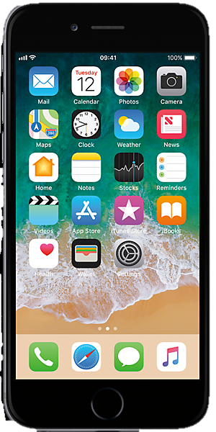
Introduction
Bible Talk

Slide 8

Introduction
Bible Talk

Slide 9

Introduction
Bible Talk

Slide 10

Introduction
Bible Talk

Slide 11
Introduction
You are worthy, our Lord and God, to receive glory and honour and power, for you created all things, and by your will they were created and have their being. – Revelation 4:11
Bible Talk

Slide 12
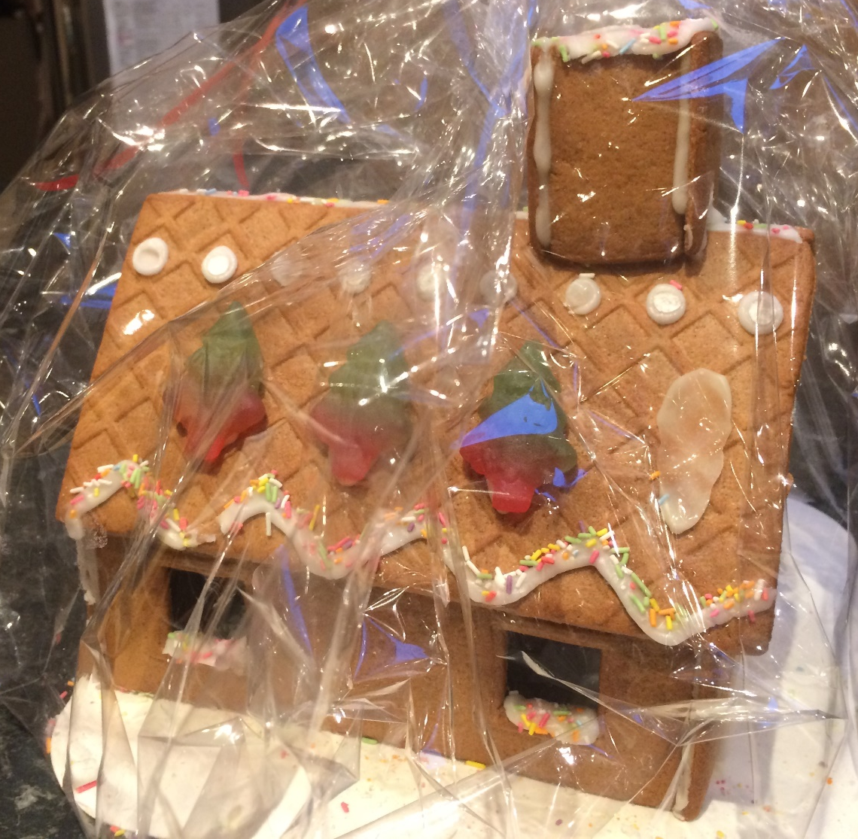
Introduction
You are worthy, our Lord and God, to receive glory and honour and power, for you created all things, and by your will they were created and have their being. – Revelation 4:11
Bible Talk

Slide 13
Introduction
You are worthy, our Lord and God, to receive glory and honour and power, for you created all things, and by your will they were created and have their being. – Revelation 4:11
Bible Talk

Slide 14
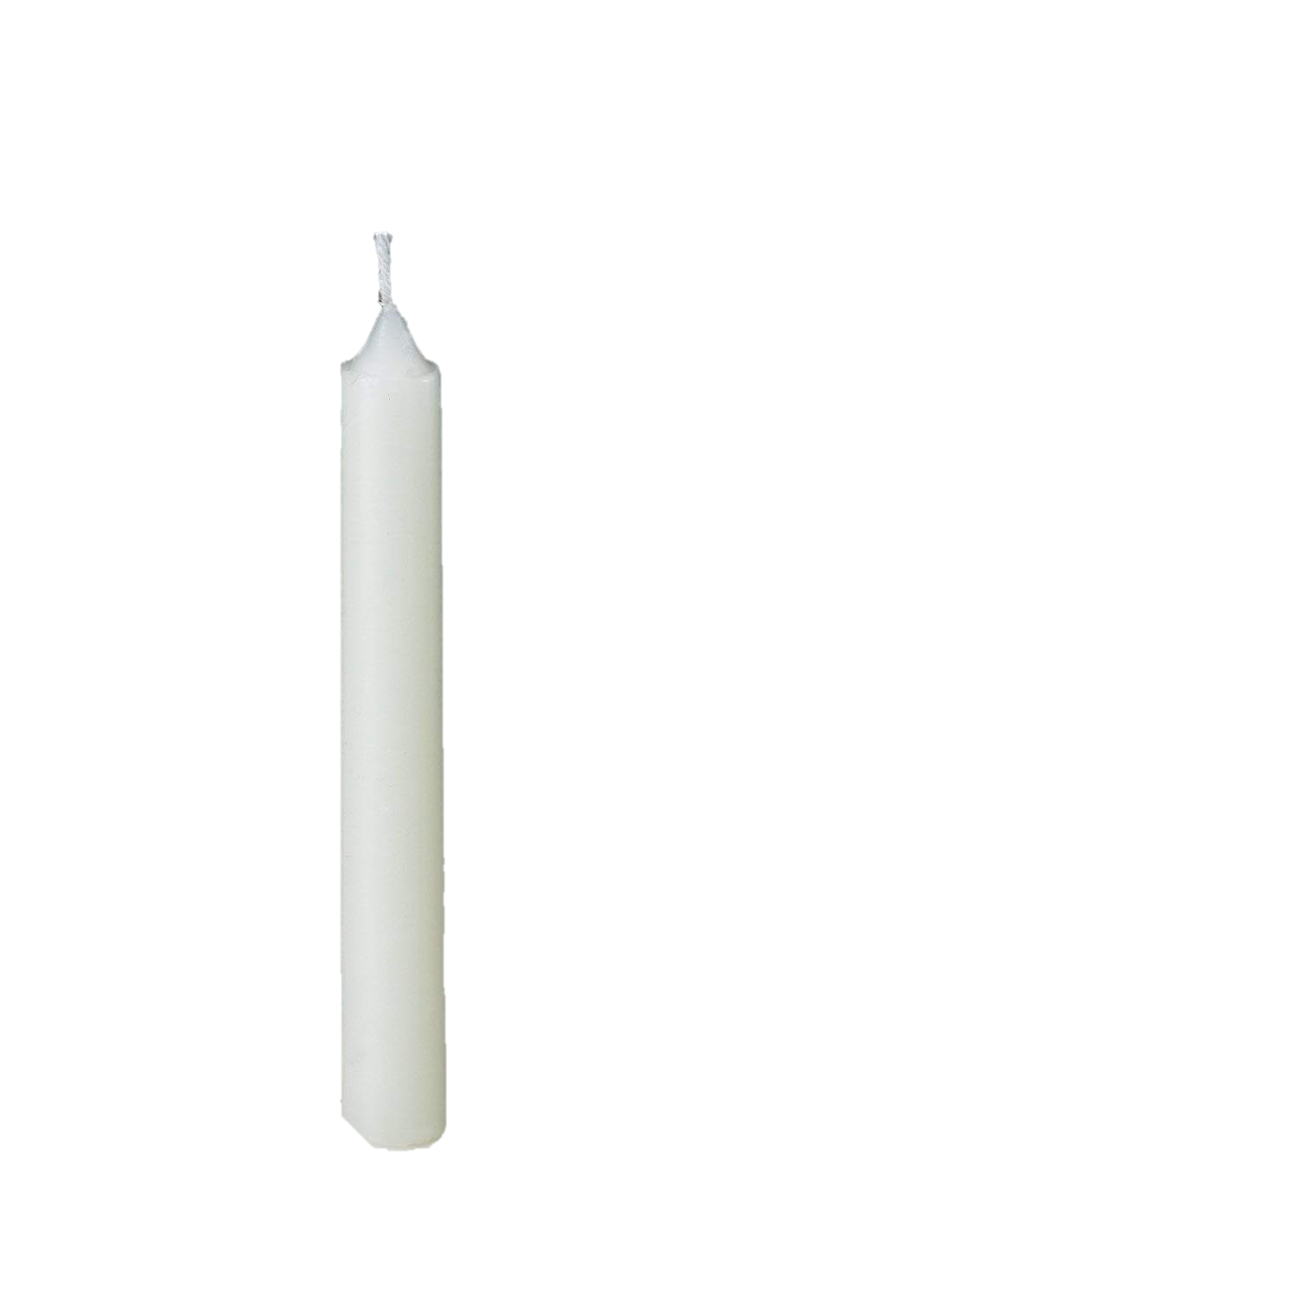
Introduction
Bible Talk

Slide 15
Introduction
When Jesus spoke again to the people, he said, “I am the light of the world. Whoever follows me will never walk in darkness but will have the light of life”. – John 8:12
Bible Talk

Slide 16

Introduction
Bible Talk

Slide 17
Introduction
For Christ died for sins once for all, the righteous for the unrighteous, to bring YOU to God. – 1 Peter 3:18
Bible Talk

Slide 18
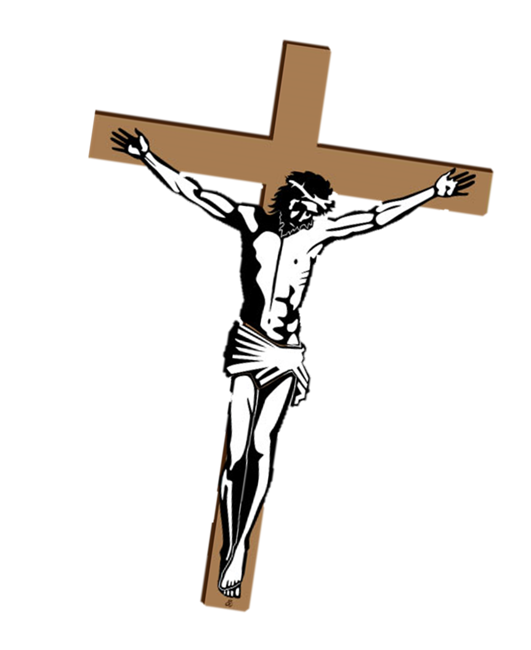
Introduction
For Christ died for sins once for all, the righteous for the unrighteous, to bring YOU to God. – 1 Peter 3:18
Bible Talk

Slide 19
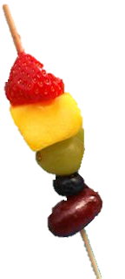
Introduction
Bible Talk

Slide 20
Introduction
Jesus said…I have come that they may have life, and have it to the full. – John 10:10
Bible Talk

Slide 21
A Mini Recap
Introduction
Bible Talk

Slide 22
A Mini Recap
Introduction
God made our world and everything in it.
Bible Talk

Slide 23
A Mini Recap
Introduction
God made our world and everything in it.
Jesus is the light of the world!
Bible Talk

Slide 24
A Mini Recap
Introduction
God made our world and everything in it.
Jesus is the light of the world!
Jesus shed his blood for us
on the cross.
Bible Talk

Slide 25
A Mini Recap
Introduction
God made our world and everything in it.
Jesus is the light of the world!
Jesus shed his blood for us
on the cross.
Bible Talk
God cares for each of us all year round!

Slide 26
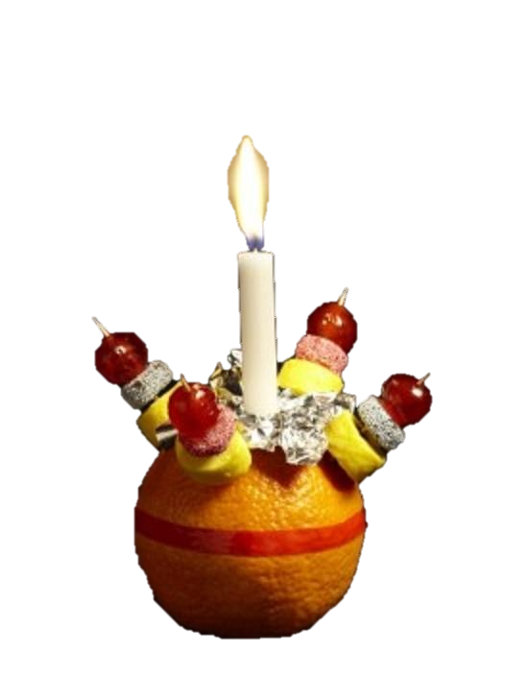

Christingle
Bible Talk

Slide 27
A Mini Recap
Introduction
God made our world and everything in it.
Jesus is the light of the world!
Jesus shed his blood for us
on the cross.
Bible Talk
God cares for each of us all year round!

Slide 28
Christingle
Bible Talk

Slide 29
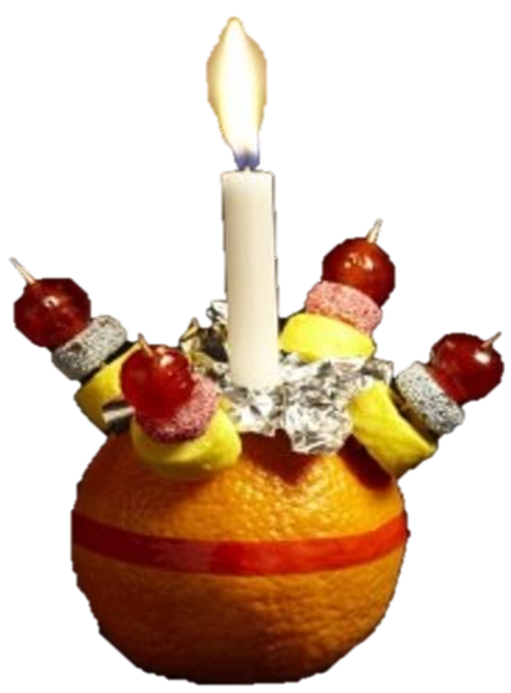
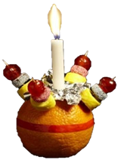
Dear God,
Thank you for creating the world and blessing us with so many good things and most especially at this time of year as we remember the birth of Jesus.
Thank you for sending Him to be the light of our world. Thank you that He shed his blood on the cross in my place. Thank you that you care for us in so many different ways throughout each and every
year! Please help me to daily be trusting you in
all things, for Jesus sake - Amen!
Prayer of Commitment

Slide 30



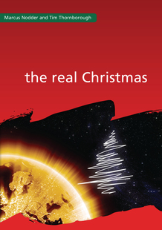

Taking Things
Further
Some Reading

Slide 31
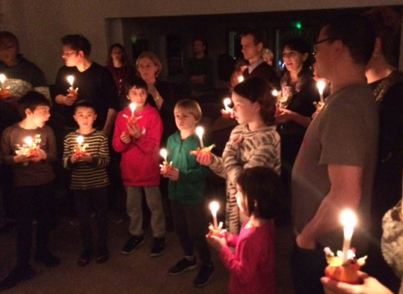
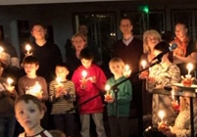
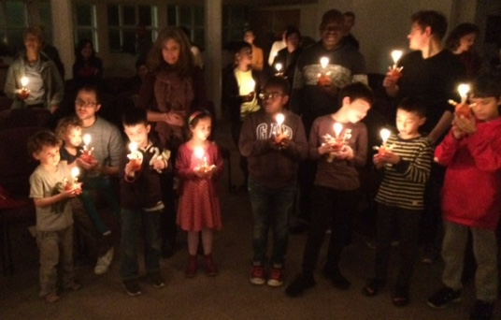
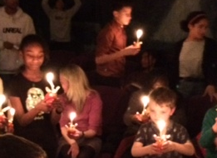
Christingles
Bible Talk

