Slide 1
Matthew 2:1-5
¹After Jesus was born in Bethlehem in Judea, during the time of King Herod, Magi from the east came Jerusalem ²and asked, "Where is the one who has been born king of the Jews? We saw his star when it rose and have come to worship him." ³When King Herod heard this he was disturbed, and all Jerusalem with him. ⁴ When he had called together all the people's chief priests and teachers of the law, he asked them where the Messiah was to be born. ⁵"In
Bethlehem in Judea," they replied, "for this is what
Reading God’s Word

Slide 2
Matthew 2:6-9
the prophet has written: ⁶"'But you, Bethlehem, in the land of Judah, are by no means least among the rulers of Judah; for out of you will come a ruler who will shepherd my people Israel.'" ⁷Then Herod called the Magi secretly and found out from them the exact time the star had appeared. ⁸He sent them to Bethlehem and said, "Go and search carefully for the child. As soon as you find him, report to me, so that I too may go and worship him." ⁹After they had heard
the king, they went on their way, and the star they
Reading God’s Word

Slide 3
Matthew 2:9-12
had seen when it rose went ahead of them until it stopped over the place where the child was. ¹⁰When they saw the star, they were overjoyed. ¹On coming to the house, they saw the child with his mother Mary, and they bowed down and worshiped him. Then they opened their treasures and presented him with gifts of gold, frankincense and myrrh. ¹²And having been warned in a dream not to go back to Herod, they returned to their country by another route.
Reading God’s Word

Slide 4
Responding to Jesus
(Matthew 2:1-12) talk by
Raymond Brown
Bible Talk

Slide 5
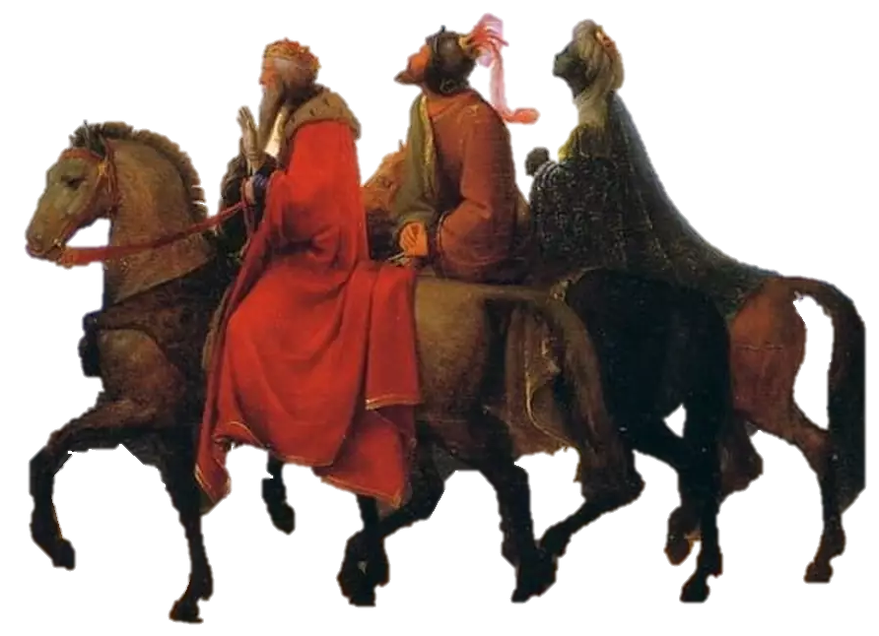
Responding to Jesus
Introduction
Bible Talk

Slide 6
Responding to Jesus
Introduction
Caspar
Balthasar
Melchior
Bible Talk

Slide 7
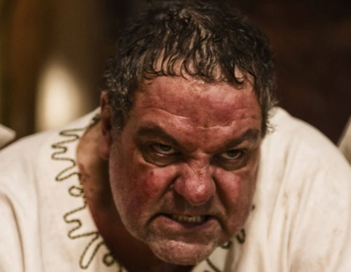
Responding to Jesus
Introduction
Anger and Rejection
Magi from the east came to Jerusalem 2 and asked, "Where is the one who has been born king of the Jews? 3 When King Herod heard this he was disturbed, and all Jerusalem with him…8 He sent them to Bethlehem and said, "Go and search carefully for the child. As soon as you find him, report to me, so that I too may go and worship him."
Bible Talk

Slide 8
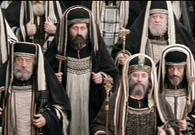
Responding to Jesus
Introduction
Anger and Rejection
Apathetic and non-committal
4 When he had called together all the people's chief priests and teachers of the law, he asked them where the Messiah was to be born. 5 "In Bethlehem in Judea," they replied, "for this is what the prophet has written: 6 "'But you, Bethlehem, in the land of Judah, are by no means least among the rulers of Judah; for out of you will come a ruler who will shepherd my people Israel.'"
Bible Talk

Slide 9
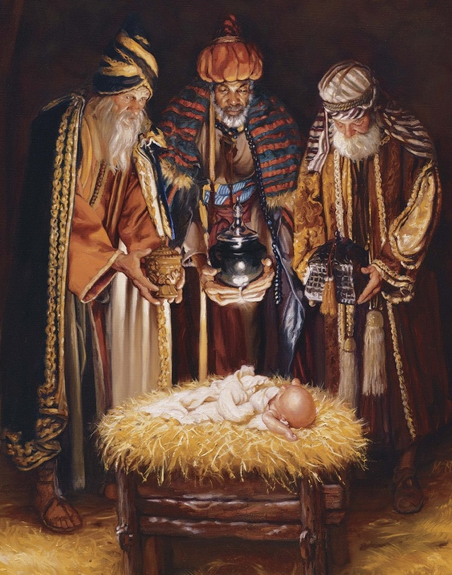
Responding to Jesus
Introduction
Anger and Rejection
Apathetic and non-committal
Acceptance and
worship
Bible Talk

Slide 10
Acceptance and worship
4 When he had called together all the people's chief priests and teachers of the law, he asked them where the Messiah was to be born. 5 "In Bethlehem in Judea," they replied, "for this is what the prophet has written: 6 "'But you, Bethlehem, in the land of Judah, are by no means least among the rulers of Judah; for out of you will come a ruler who will shepherd my people Israel.'" 7 Then Herod called the Magi secretly and found out from them the exact time the star had appeared. 8 He sent them to Bethlehem and said, "Go and search carefully for the child. As soon as you find him, report to me, so that I too may go and worship him." 9 After they had heard the king, they went on their way, and the star they had seen when it rose went ahead of them until it stopped over the place where the child was. 10 When they saw the star, they were overjoyed. 11 On coming to the house, they saw the child with his mother Mary, and they bowed down and worshiped him. Then they opened their treasures and presented him with gifts of gold, frankincense and myrrh. 12 And having been warned in a dream not to go back to Herod, they returned to their country by another route.
Bible Talk

Slide 11



Responding to Jesus
Introduction
Anger and Rejection
Apathetic and non-committal
Acceptance and
worship
Bible Talk

Slide 12





Taking Things
Further
Some Reading

