Slide 1
Listening to God
Ephesians
Chapter 1
Verses 1-10
Reading

Slide 2
Ephesians 1:1-10
¹ Paul, an apostle of Christ Jesus by the will of God. To God’s holy people in Ephesus, the faithful in Christ Jesus:
² Grace and peace to you from God our Father and the Lord Jesus Christ.
³ Praise be to the God and Father of our Lord Jesus Christ, who has blessed us in the heavenly realms with every spiritual blessing in Christ.
God’s Word

Slide 3
Ephesians 1:1-10
⁴ For he chose us in him before the creation of the world to be holy and blameless in his sight. In love ⁵ he predestined us for adoption to sonship through Jesus Christ, in accordance with his pleasure and will— ⁶ to the praise of his glorious grace, which he has freely given us in the One he loves. ⁷ In him we have redemption through his blood, the forgiveness of sins, in accordance with the riches of God’s grace ⁸ that he lavished on us.
God’s Word

Slide 4
Ephesians 1:1-10
With all wisdom and understanding, ⁹ he made known to us the mystery of his will according to his good pleasure, which he purposed in Christ, ¹⁰ to be put into effect when the times reach their fulfilment—to bring unity to all things in heaven and on earth under Christ.
Holy Bible, New International Version®, NIV® Copyright ©1973, 1978, 1984, 2011 by Biblica, Inc.® Used by permission. All rights reserved worldwide.
God’s Word

Slide 5
Sundays @GCB via Zoom The Christian’s Hope
17 Jan Hope In a Hopeless World Eph.1:1-10
24 Jan The Coming of Jesus Christ Tit.2:11-13
31 Jan My Future And Me 1 Thess.4:13-18
7 Feb My Hope in the Face of Covid Guest Speaker
14 Feb How This World Ends 2 Pet.3:1-10
21 Feb Guest Speaker - Jeremy Marshall

Slide 6
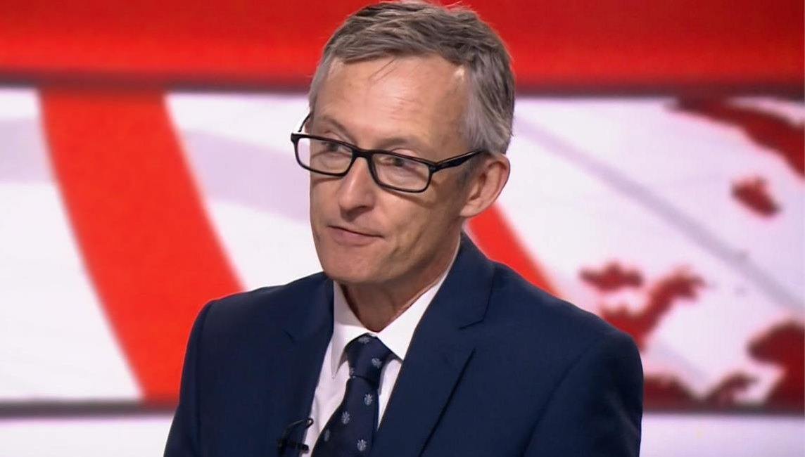
Hope in a hopeless world
Introduction
Sermon Outline

Slide 7
Hope in a hopeless world
Introduction
³…I envied the arrogant when I saw the prosperity of the wicked. ⁴ They have no struggles; their bodies are healthy and strong…⁶ Therefore pride is their necklace…⁸ They scoff, and speak with malice; with arrogance they threaten oppression…¹² This is what the wicked are like— always free of care, they go on amassing wealth. ¹³ Surely in vain I have kept my heart pure and have washed my hands in innocence. ¹⁴ All day long I have been afflicted, and every…
Psalm 73

Slide 8
Hope in a hopeless world
Introduction
…morning brings new punishments…¹⁶ When I tried to understand all this, it troubled me deeply ¹⁷ till I entered the sanctuary of God; then I understood their final destiny. ²⁰ They are like a dream when one awakes; when you arise, Lord, you will despise them as fantasies…²⁷ Those who are far from you will perish; you destroy all who are unfaithful to you. ²⁸ But as for me, it is good to be near God. I have made the Sovereign LORD my refuge.
– Psalm 73:3-4, 6, 8, 12-14, 16-17, 20, 27-28
Psalm 73

Slide 9
Hope in a hopeless world
Introduction
The focus of our hope as Christians
⁹…He [that is God] made known to us the mystery of his will according to his good pleasure, which he purposed in Christ, ¹⁰ to be put into effect when the times reach their fulfilment—[here it comes] to bring unity to all things in heaven and on earth under Christ. – Eph.1:9-10
Sermon

Slide 10
Hope in a hopeless world
Introduction
The focus of our hope as Christians
³ Praise be to the God and Father of our Lord Jesus Christ, who has blessed us in the heavenly realms with every spiritual blessing in Christ. ⁴ For he chose us in him before the creation of the world to be holy and blameless in his sight. In love ⁵ he predestined us for adoption to sonship through Jesus Christ, in accordance with his pleasure and will…⁷ In him we have redemption through his blood, the forgiveness of sins, in accordance with the riches of God's grace. – Eph.1:3-5, 7
Sermon

Slide 11
Hope in a hopeless world
Introduction
The focus of our hope as Christians
[Jesus Christ] is not just the instrument or the agent of that restoration; he is the focus, the centre point of it all. Everything points, and actually comes to, its fulfilment in Christ. – David Jackman
Sermon

Slide 12
Hope in a hopeless world
Introduction
The focus of our hope as Christians
Sermon

Slide 13
Hope in a hopeless world
Introduction
The focus of our hope as Christians
¹⁹…That power is the same as the mighty strength ²⁰he exerted when he raised Christ from the dead and seated him at his right hand in the heavenly realms, ²¹ far above all rule and authority, power and dominion, and every name that is invoked, not only in the present age but also in the one to come. ²² And God placed all things under his feet and appointed him to be head over everything for the church, ²³ which is his body, the fullness of him who fills everything in every way. – Eph.1:19-23
Sermon

Slide 14
Hope in a hopeless world
Key Summary: - Your hope as a Christian is that one day Jesus Christ will be seen by all to be exalted above everyone and everything, that He will reign as King of Kings and Lord or Lords, throughout the aeons of eternity and everyone and everything will ultimately be under His feet.
Sermon

Slide 15
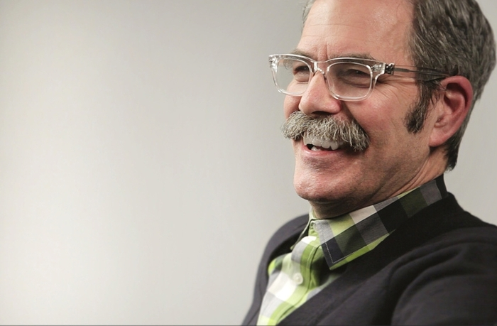
Hope in a hopeless world
Introduction
The focus of our hope as Christians
Practical implications of our hope as Christians
Sermon
Paul David Tripp

Slide 16
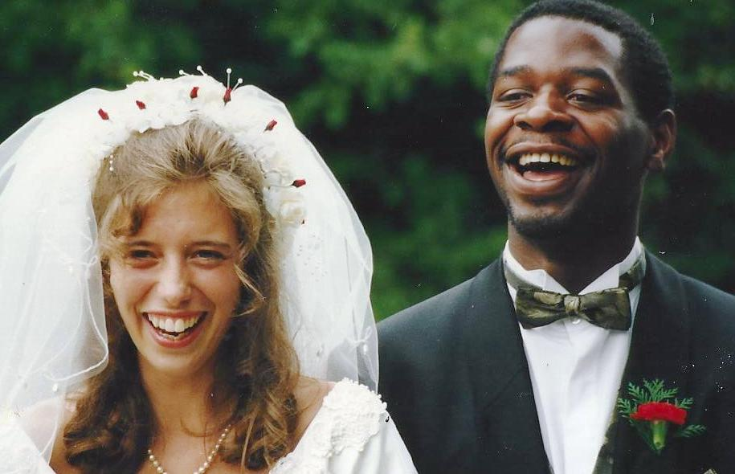
Hope in a hopeless world
Introduction
The focus of our hope as Christians
Practical implications of our hope as Christians
Sermon

Slide 17
Hope in a hopeless world
Introduction
The focus of our hope as Christians
Practical implications of our hope as Christians
Great Expectations,
Sermon

Slide 18
Hope in a hopeless world
Introduction
The focus of our hope as Christians
Practical implications of our hope as Christians
Great Expectations, Promises
Sermon

Slide 19
Hope in a hopeless world
Introduction
The focus of our hope as Christians
Practical implications of our hope as Christians
Great Expectations, Promises & Patience
Sermon

Slide 20
Hope in a hopeless world
Introduction
The focus of our hope as Christians
Practical implications of our hope as Christians
Great Expectations, Promises & Patience
Sermon

Slide 21
Reflect Time in breakout groups
Did you struggle to understand or accept anything that was said?
Was the speaker faithful to the Bible passage(s) being talked about?
What change should this sermon lead to, in your thinking, speaking and conduct?

