Slide 1
Listening to God
Colossians
Chapter 1
Verses 15 - 20
Reading
Holy Bible, New International Version®, NIV® Copyright ©1973, 1978, 1984, 2011 by Biblica, Inc.® Used by permission. All rights reserved worldwide.

Slide 2
Listening to God
¹⁵ The Son is the image of the invisible God, the firstborn over all creation. ¹⁶ For in him all things were created: things in heaven and on earth, visible and invisible, whether thrones or powers or rulers or authorities; all things have been created through him and for him. ¹⁷ He is before all things, and in him all things hold together. ¹⁸ And he is the head of the body, the church;
God’s Word Read

Slide 3
Listening to God
he is the beginning and the firstborn from among the dead, so that in everything he might have the supremacy. ¹⁹ For God was pleased to have all his fullness dwell in him, ²⁰ and through him to reconcile to himself all things, whether things on earth or things in heaven, by making peace through his blood, shed on the cross.
– Colossians 1:15-20
God’s Word Read

Slide 4
Hearing God Speak
Living in the light of hope
Colossians 1:15-20
Talk by
Raymond Brown
Sermon

Slide 5
Sundays @GCB via Zoom The Christian’s Hope
17 Jan Hope In a Hopeless World Eph.1:1-10
24 Jan The Coming of Jesus Christ Tit.2:11-13
31 Jan My Future And Me 1 Thess.4:13-18
7 Feb My Hope in the Face of Covid Eduard Tissen
14 Feb Hope when this world ends 2 Pet.3:1-10
21 Feb Hope in the face of death Jeremy Marshall
28 Feb The hope in heaven Rev.22:1-5, 22:1-5
7 Mar Living in the light of hope Col.1:15-20

Slide 6
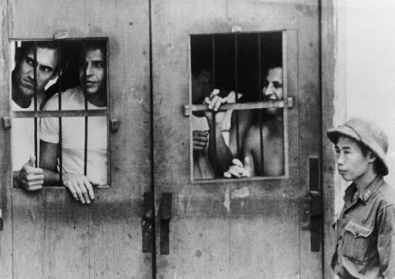
Living in the light of hope
Introduction
Talk outline

Slide 7
Living in the light of hope
Introduction
Hope, faith and a purpose in life, is medicinal. This is not merely a statement of belief but a conclusion proved by meticulously controlled scientific experiment.
- Harold G. Wolf
Talk outline

Slide 8
Living in the light of hope
Introduction
…the things that began to happen after that were so great and beautiful that I cannot write them. And for us this is the end of all the stories, and we can most truly say that they all lived happily ever after. But for them it was only the beginning of the real story.
Talk outline

Slide 9
Living in the light of hope
Introduction
All their life in this world and all their adventures in Narnia had only been the cover and the title page: now at last they were beginning Chapter One of the Great Story, which no one on earth has read: which goes on forever: in which every chapter is better than the one before. - C.S. Lewis
Talk outline

Slide 10
Living in the light of hope
Introduction
Jesus is our Creator and new Creator (Col.1:15-20)
Talk outline

Slide 11
Living in the light of hope
Introduction
Jesus is our Creator and new Creator (Col.1:15-20)
¹⁵ The Son is the image of the invisible God, the firstborn over all creation. ¹⁶ For in him all things were created: things in heaven and on earth, visible and invisible, whether thrones or powers or rulers or authorities; all things have been created through him and for him. ¹⁷ He is before all things, and in him all things hold together.
Talk outline

Slide 12
Living in the light of hope
Introduction
Jesus is our Creator and new Creator (Col.1:15-20)
¹⁸ And he is the head of the body, the church; he is the beginning and the firstborn from among the dead, so that in everything he might have the supremacy. ¹⁹ For God was pleased to have all his fullness dwell in him, ²⁰ and through him to reconcile to himself all things, whether things on earth or things in heaven, by making peace through his blood, shed on the cross.
Talk outline

Slide 13
Living in the light of hope
Introduction
Jesus is our Creator and new Creator (Col.1:15-20)
Be holy (2 Pe.3:11-13, 1Pe.1:13-16)
Talk outline

Slide 14
Living in the light of hope
Introduction
Jesus is our Creator and new Creator (Col.1:15-20)
Be holy (2 Pe.3:11-13, 1Pe.1:13-16)
'It was not any sermon that he preached; it was not anything that he ever said to me. It was the beautiful consistency and kindness of his daily life, in the house where he was staying, when I was a little girl. I said to myself, "If I ever have any religion, Mr Whitefield's God shall be my God"' – Anon
Talk outline

Slide 15
Living in the light of hope
Introduction
Jesus is our Creator and new Creator (Col.1:15-20)
Be holy
Be faithful (Matt.24:45-51)
Talk outline

Slide 16
Living in the light of hope
Introduction
Jesus is our Creator and new Creator (Col.1:15-20)
Be holy
Be faithful
Be diligent (1 Thes.5:12, 14; Thes.3:6-8)
Talk outline

Slide 17
Living in the light of hope
Introduction
Jesus is our Creator and new Creator (Col.1:15-20)
Be holy
Be faithful
Be diligent
Be joyful (Gal.5:22; Ja.1:2-3; 1 Pe.16)
Talk outline

Slide 18
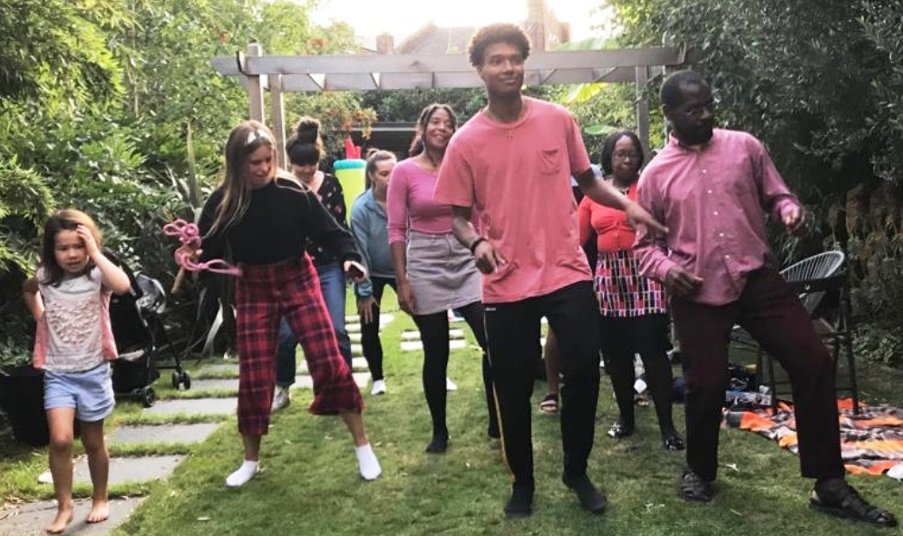
Living in the light of hope
Hope is listening to the music of the future, and faith is dancing to that music in the present. – Anon
Talk outline

Slide 19
Living in the light of hope
Talk outline

Slide 20
Living in the light of hope
Jesus is our Creator and new Creator (Col.1:15-20)
Be holy
Be faithful
Be diligent
Be joyful
Talk outline

Slide 21
Reflect Time in breakout groups
How has this series helped you to think about
YOUR hope as
a Christian?

Slide 22
Questions & Answers
Aim: For ALL to sit under the authority of God’s word
Was anything unclear?
Do you need further clarification?
Do you have a comment you would like to make that would benefit those present?
Further Edification

