Slide 1
Listening to God
1 Samuel 1
Chapter 1
Verses 21-28
Bible Reading
Holy Bible, New International Version®, NIV® Copyright ©1973, 1978, 1984, 2011 by Biblica, Inc.® Used by permission. All rights reserved worldwide.

Slide 2
Listening to God
21 When her husband Elkanah went up with all his family to offer the annual sacrifice to the LORD and to fulfil his vow, 22 Hannah did not go. She said to her husband, "After the boy is weaned, I will take him and present him before the LORD, and he will live there always." 23 "Do what seems best to you," her husband Elkanah told her. "Stay here until you have weaned him; only may the…
Bible Reading

Slide 3
Listening to God
…LORD make good his word." So the woman stayed at home and nursed her son until she had weaned him. 24 After he was weaned, she took the boy with her, young as he was, along with a three-year-old bull, an ephah of flour and a skin of wine, and brought him to the house of the LORD at Shiloh. 25 When the bull had been sacrificed, they brought the boy to Eli, 26 and she said to him, "Pardon me,
Bible Reading

Slide 4
Listening to God
…my lord. As surely as you live, I am the woman who stood here beside you praying to the LORD. 27 I prayed for this child, and the LORD has granted me what I asked of him. 28 So now I give him to the LORD. For his whole life he will be given over to the LORD." And he worshiped the LORD there.
Bible Reading

Slide 5
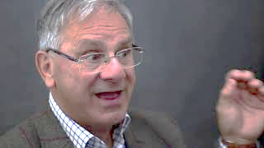
Hearing God Speak
The Speaker
Roger Carswell

Slide 6
Hearing God Speak
Prayers of the Bible
1 Samuel 1:21-28
by
Roger Carswell
Sermon

Slide 7
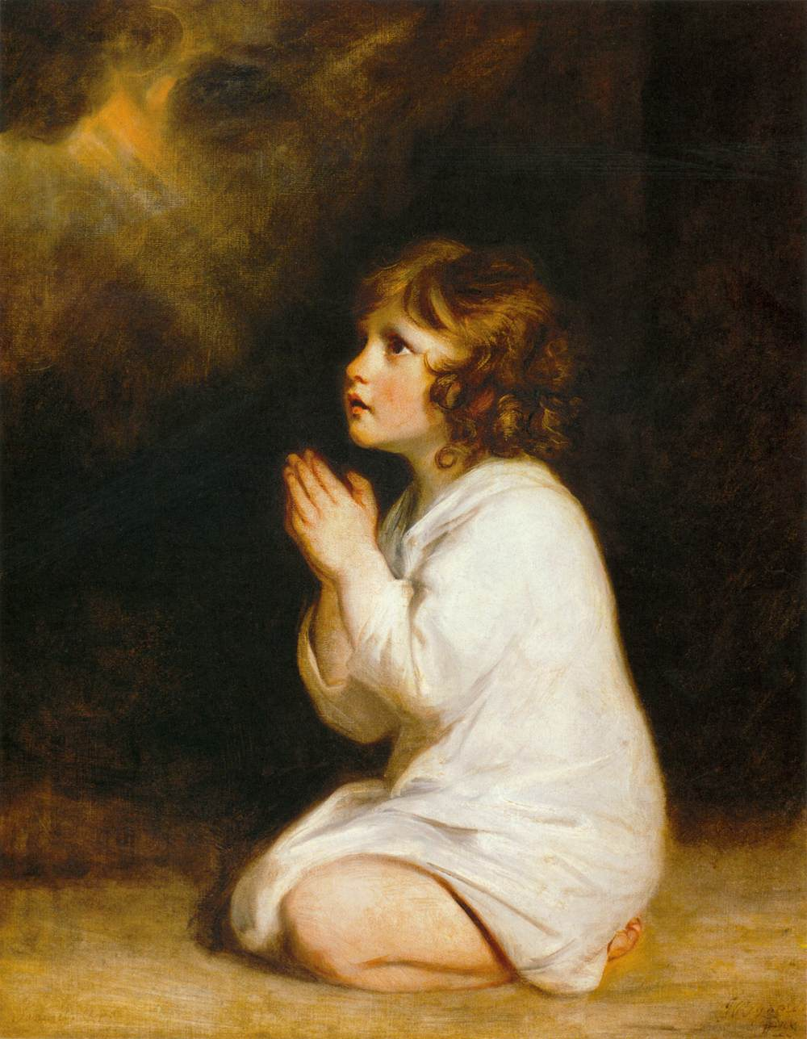
Hearing God Speak
Sermon

Slide 8
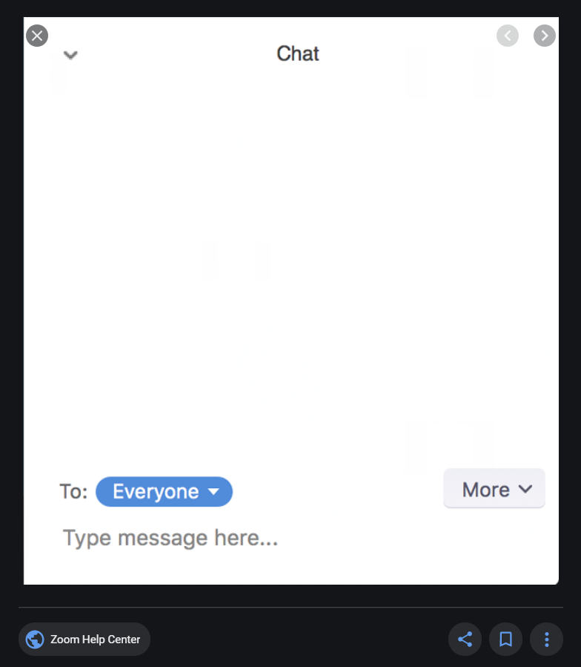
Questions & Answers
Further clarification

Slide 9
Books by Roger
Taking things Further

Slide 10
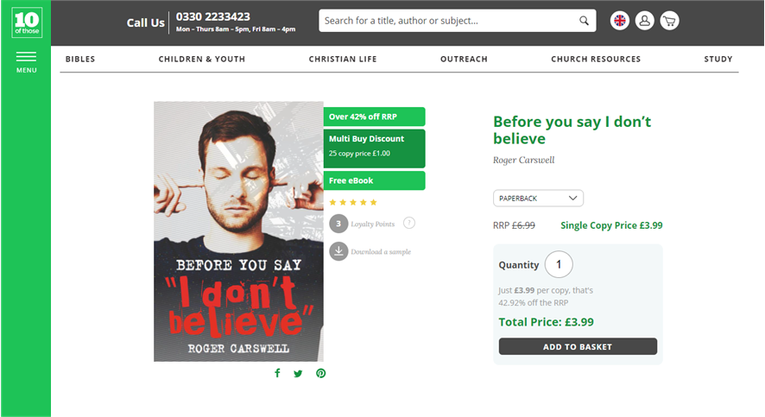
10ofThose.com - Books by Roger
Buying a good book

Slide 11
ZOOM ONLINE - SERIES OVERVIEW
Thurs 18th March | Who is Jesus?
Thurs 25th March | Why did Jesus come?
Thurs 1st April | What does it mean to follow Jesus?
www.gracechurchbrockley.org

