Slide 2
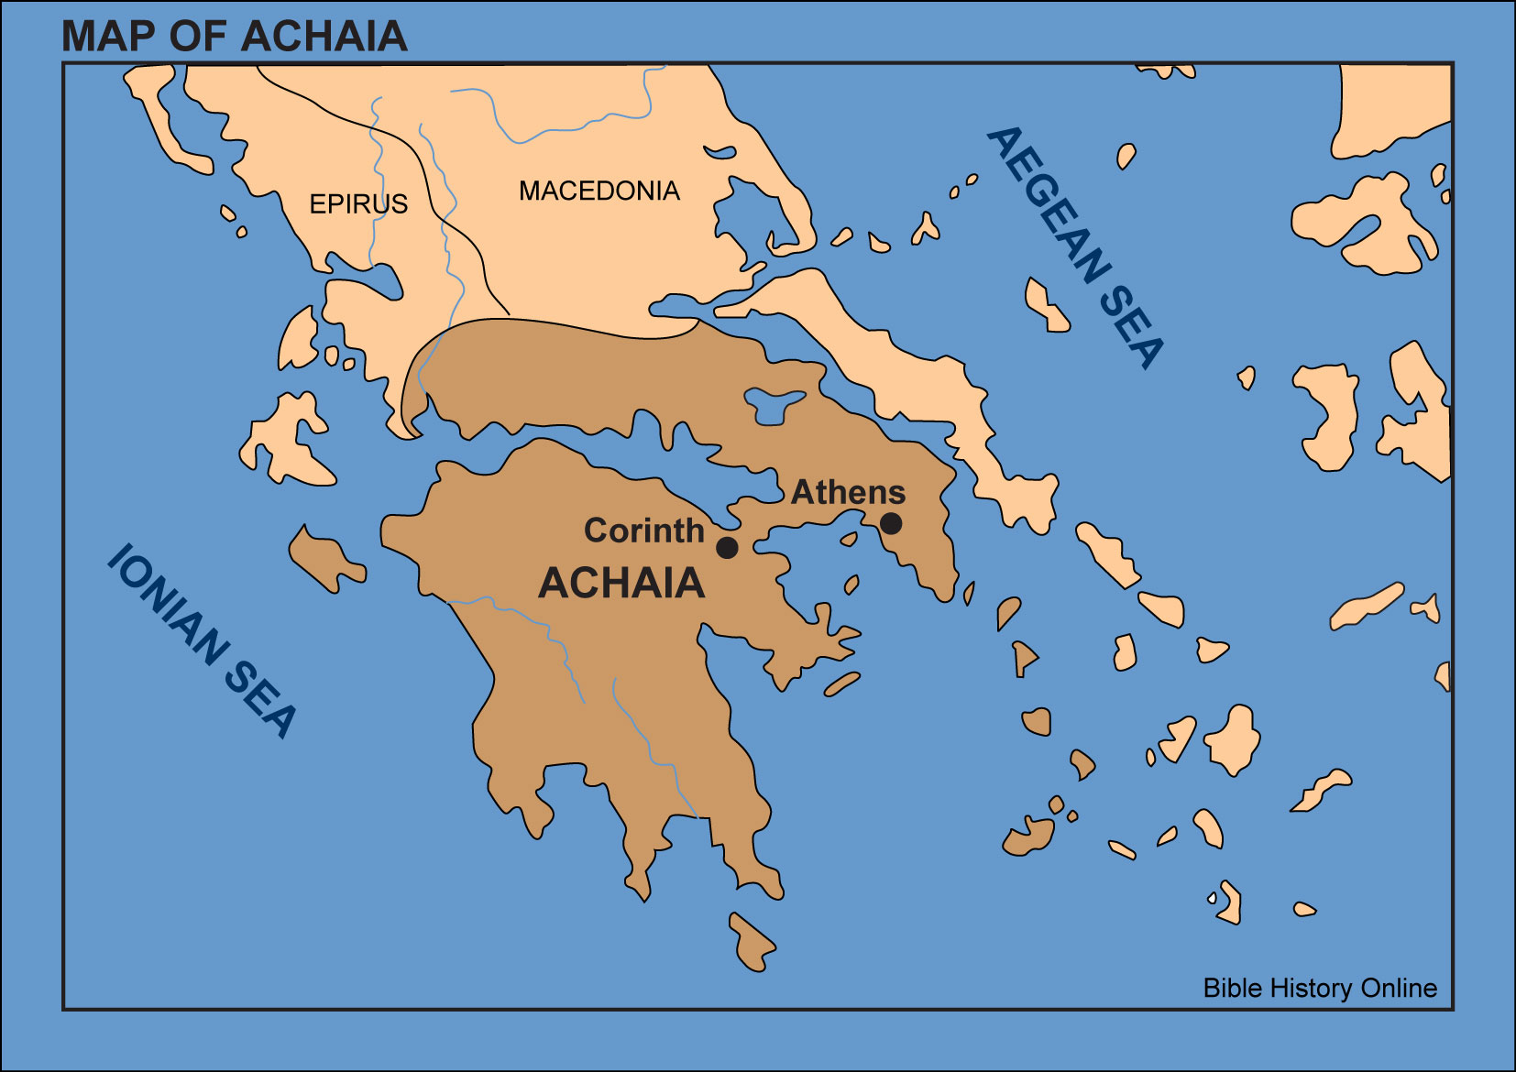

Slide 3
1 Corinthians 1:1-9 Meet the Corinthians
The church at Corinth was a church.....
...full of life.
...full of problems.
...full of itself.
They were arrogant - “puffed up”
(ch4:6,18,19; ch5:2; ch8:1; ch13:4)

Slide 4
1 Corinthians 1:1-9
The answer to pride is a right appreciation of God’s grace.
Grace in the past...
...which called you. (v1,2,9)
Grace in the present...
...which equips you. (v4-7)
Grace in the future...
...which will lead you home (v8)

