Slide 1
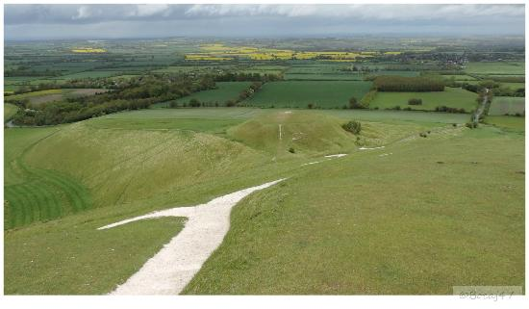

Slide 3
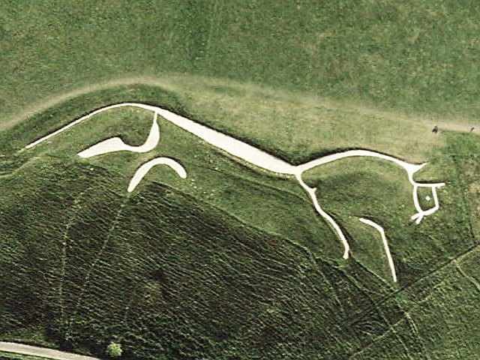

Slide 4
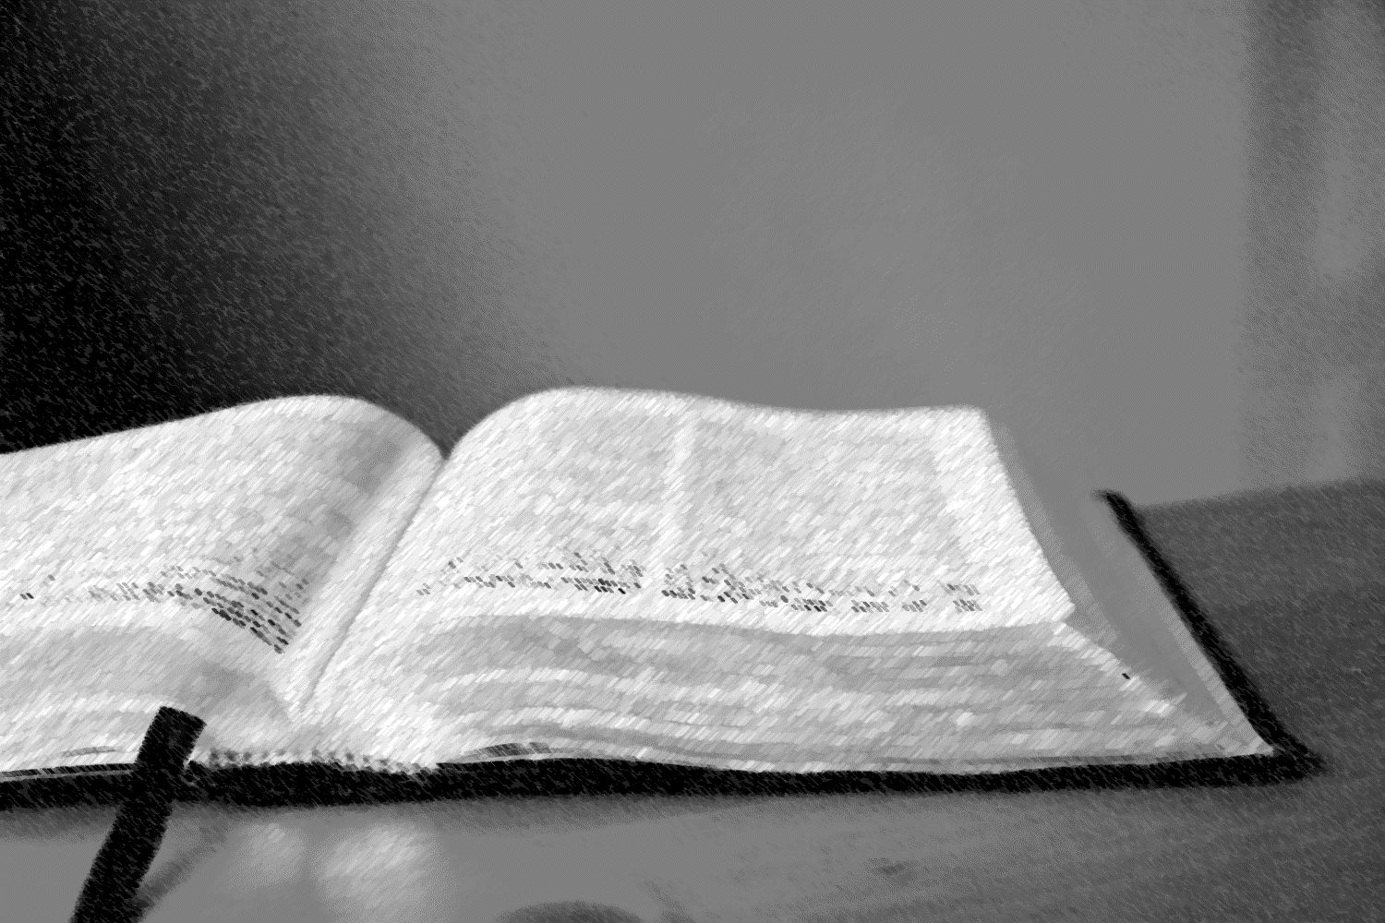
The Bible in two words…
three
Jesus
The hero of the whole thing
Restores
Life
The purpose of the whole thing

Slide 5
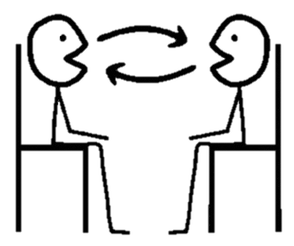
SCENE 1: God’s Creation = LIFE!
God’s Blessing
people enjoy a perfect world of life and joy
God’s rule
people submit to God’s loving rule of his world
God’s presence
God lives in a perfect face to face relationship with his people

Slide 6
SCENE 2: Our rebellion = DEATH!
God’s curse
We now experience hardship and pain. Death enters the world.
Rejecting God’s rule
God’s goodness is doubted and his commands broken. We set ourselves up as ‘king’.
Banished from God’s presence
Banished from the Garden- no longer enjoy relationship with God

Slide 7
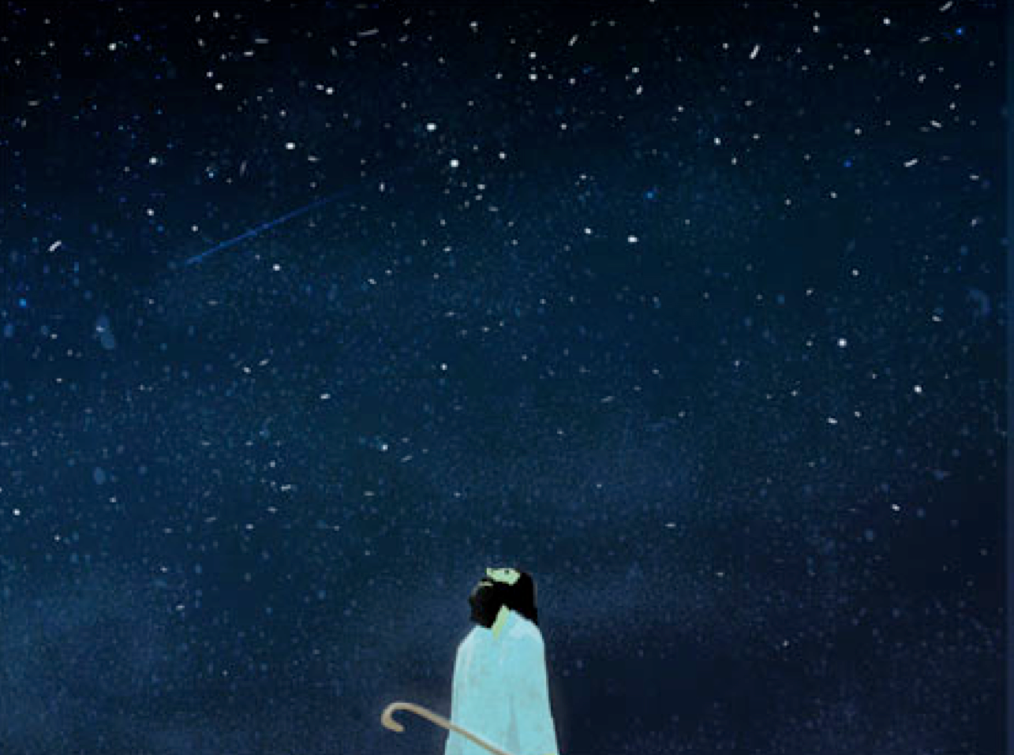
SCENE 3a: God promises to restore LIFE!
1. You will become a great nation
2. You will be given a great land
3. You will be blessed, and all peoples on earth through you and your family!

Slide 8
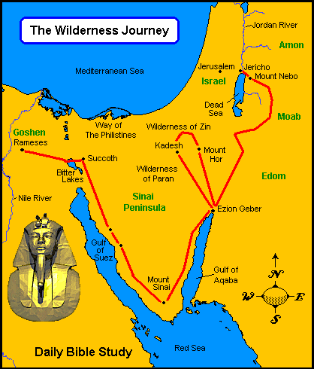

Slide 9
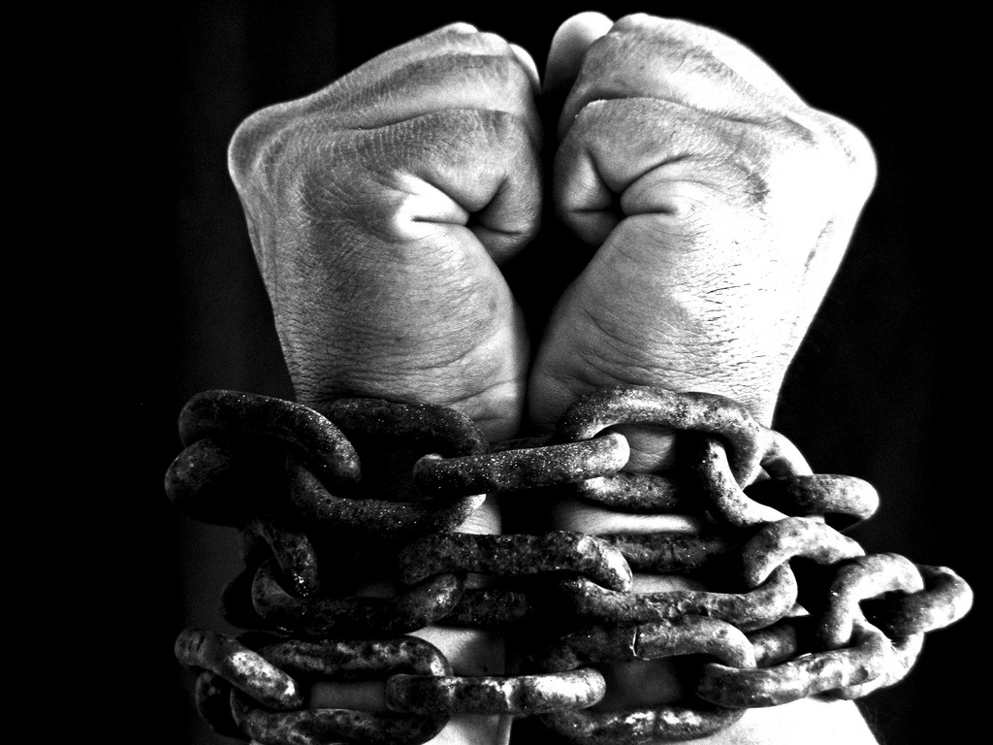
The Israelites in slavery in Egypt

Slide 10
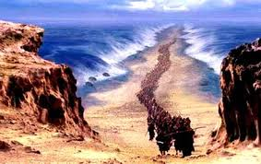
The Israelites escape through the parted sea

Slide 11
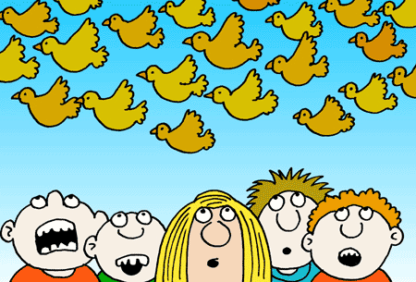
God provides manna and quail

Slide 12
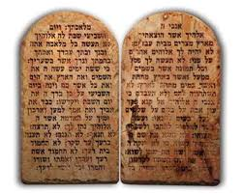
Moses receives the Law

Slide 13
The people wander in the desert for 40 years

Slide 14
Joshua leads the people into Canaan, the promised land

Slide 15
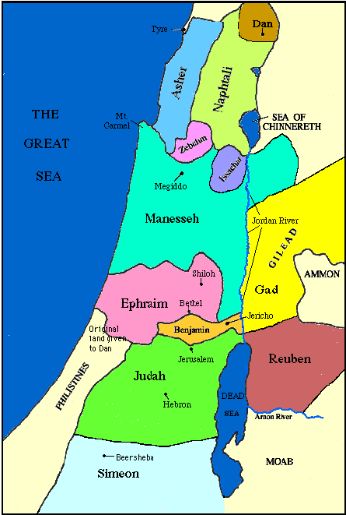
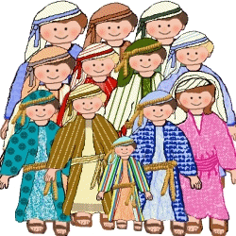
Jacob’s 12 sons

Slide 16
SCENE 3a: God promises to restore LIFE!
1. You will become a great nation
2. You will be given a great land
3. You will be blessed, and all peoples on earth through you and your family!

Slide 17
God grows a people
God provides a land

Slide 18
What is the Bible’s message in 2 words?
What are the three ‘ingredients’ to life in the Bible?
God’s promise to Abram included becoming a great nation. But what else was promised?
How many sons did Jacob have?
When did God give his people ‘the law’?
Why was the building of the temple such a high point?
Can you name the first 6 books of the Bible in order?

Slide 19
SCENE 3a: God promises to restore LIFE!
1. You will become a great nation
2. You will be given a great land
3. You will be blessed, and all peoples on earth through you and your family!

Slide 20
God grows a people
God provides a land
God establishes a great Kingdom

Slide 21
SCENE 1: God’s Creation = LIFE!
God’s Blessing
people enjoy a perfect world of life and joy
God’s rule
people submit to God’s loving rule of his world
God’s presence
God lives in a perfect face to face relationship with his people

Slide 22
SCENE 2: Our rebellion = DEATH!
God’s curse
We now experience hardship and pain. Death enters the world.
Rejecting God’s rule
God’s goodness is doubted and his commands broken. We set ourselves up as ‘king’.
Banished from God’s presence
Banished from the Garden- no longer enjoy relationship with God

Slide 23
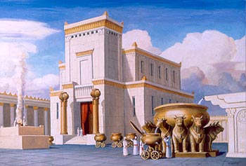
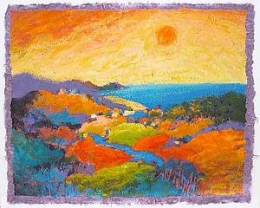
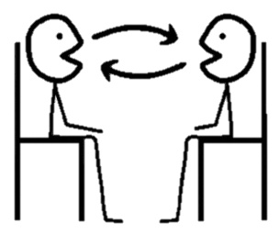
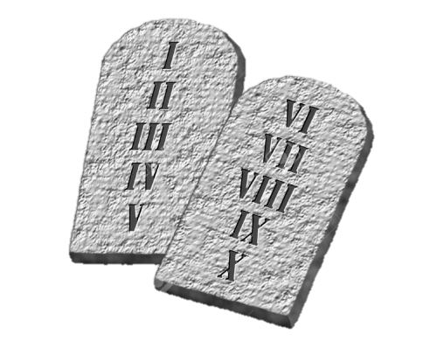
SCENE 3a: God promises to restore LIFE!
Partial fulfilment in OT
God’s presence
The temple provides a permanent place for God to dwell with his people
God’s Blessing
God brings his people into a land ‘flowing with milk and honey’
God’s rule
God provides his law for people to follow, and a King to lead them in it.
PARTIAL
PARTIAL
PARTIAL

Slide 24
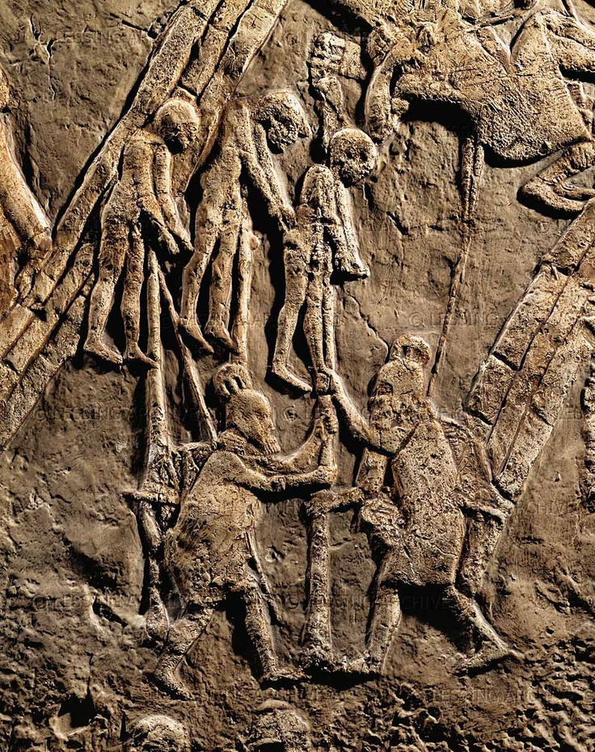
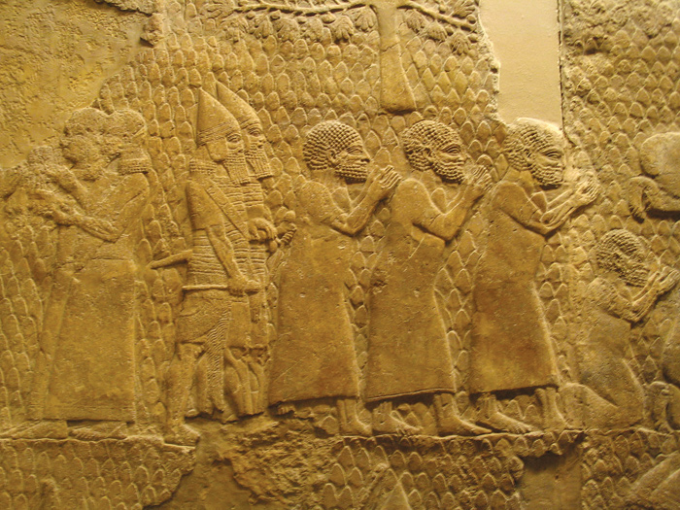

Slide 25
God grows a people
God provides a land
God establishes a great Kingdom
God’s people are unfaithful, the Kingdom collapses, the people are exiled

Slide 26
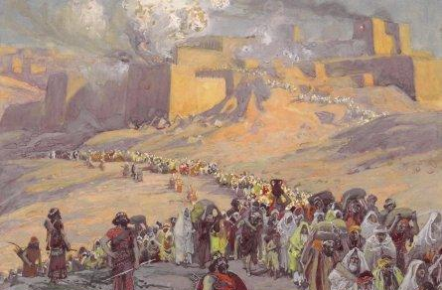
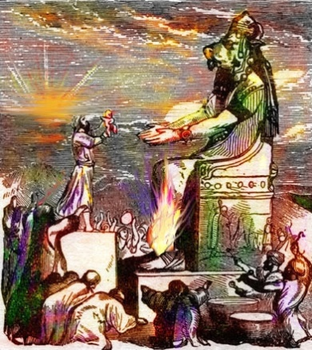
SCENE 3b: God promises to restore LIFE!
But God’s people still rebel
Rejecting God’s rule
Israel fail to obey God’s law, and instead worship other gods
Banished from God’s presence
The people are taken into exile. The temple is destroyed.
God’s curse
The exile is the justly deserved punishment for the people’s rejection of God

Slide 27
God grows a people
God provides a land
God establishes a great Kingdom
God’s people are unfaithful, the Kingdom collapses, the people are exiled
God’s people return to the land, but it’s a big disappointment

Slide 28
SCENE 3a: God promises to restore LIFE!
Has God’s plan to restore the world through Abraham’s family failed?
Has God given up on his promises to restore the world?
Has God forgotten his promise to David about an eternal kingdom?
Are people ‘unrescuable’?

Slide 29
Our sin leaves us powerless in the face of death
Adam and Eve- Death
Nation of Israel- Death
Each one of us- Death
God’s curse
We now experience hardship and pain. Death enters the world.
Rejecting God’s rule
God’s goodness is doubted and his commands broken. We set ourselves up as ‘king’.
Banished from God’s presence
Banished from the Garden- no longer enjoy relationship with God

Slide 30
On the cross Jesus faced God’s punishment for us
Jesus Christ- Death
God’s curse
We now experience hardship and pain. Death enters the world.
Rejecting God’s rule
God’s goodness is doubted and his commands broken. We set ourselves up as ‘king’.
Banished from God’s presence
Banished from the Garden- no longer enjoy relationship with God

Slide 31
On the cross Jesus faced God’s punishment for us
Jesus Christ- Death
God’s curse
We now experience hardship and pain. Death enters the world.
Rejecting God’s rule
God’s goodness is doubted and his commands broken. We set ourselves up as ‘king’.
Banished from God’s presence
Banished from the Garden- no longer enjoy relationship with God

Slide 32
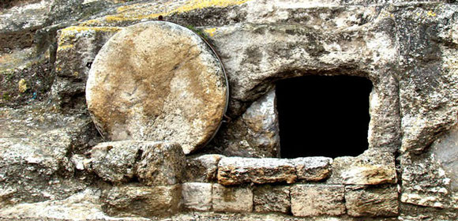
Jesus rises from the dead!

Slide 33
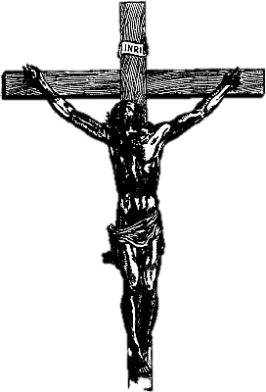
SCENE 4a: All God’s promises are fulfilled Jesus’ life death and resurrection
God’s Blessing
Jesus’ miracles restore blessing and life. His death and resurrection promise eternal life and blessing
God’s rule
Jesus came as God’s ‘Christ’ (King). He is currently ruling over his growing Kingdom
God’s presence
Through Jesus God comes to dwell with us. By his death he brings us back into relationship with God

Slide 34
The story of God’s restoration through Jesus

Slide 35
SCENE 3a: God promises to restore LIFE!
1. You will become a great nation
2. You will be given a great land
3. You will be blessed, and all peoples on earth through you and your family!

Slide 36
The story of God’s restoration through Jesus
The spread of God’s restoration though the world

Slide 37
SCENE 4b: All God’s promises are fulfilled The new creation!
God’s Blessing
The New Creation is a perfect place with no more tears of death
God’s rule
Jesus will return as judge of the whole world, and finally bring in his perfect Kingdom
God’s presence
We will enjoy a perfect eternal face to face relationship with God
PERFECTLY RESTORED
PERFECTLY RESTORED
PERFECTLY RESTORED

Slide 38
The story of God’s restoration through Jesus
The spread of God’s restoration though the world
The completion of God’s restoration in the new creation

Slide 39
The Bible in two words…
three
Jesus
The hero of the whole thing
Restores
Life
The purpose of the whole thing

