Slide 1
Deuteronomy

Slide 3
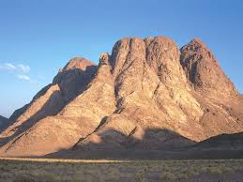

Slide 4
Deuteronomy
Reviewing the past
Revealing the present
Releasing the future

Slide 5
Reviewing the past
Promise fulfilled
LEADERS APPOINTED

Slide 6
WASTED OPPORTUNITY 1:19-46
JOINING HISTORY
1 CORINTHIANS 10:6
UNBELIEF
VICTORIOUS WARRIOR 1:29
CARING FATHER 1:31

Slide 7
GOD’S FAITHFULNESS

Slide 8
Revealing the present
God who creates also saves
Preaching
covenant

Slide 9
law
Character of God
God is basis of life

Slide 10
Releasing the future
The LORD your God will raise up for you a prophet like me from among you, from your fellow Israelites. You must listen to him
See, I set before you today life and prosperity, death and destruction
This day I call the heavens and the earth as witnesses against you that I have set before you life and death, blessings and curses. Now choose life, so that you and your children may live

Slide 11
Listen to jesus

