Slide 1
Judges 1:1-3:6

Slide 2
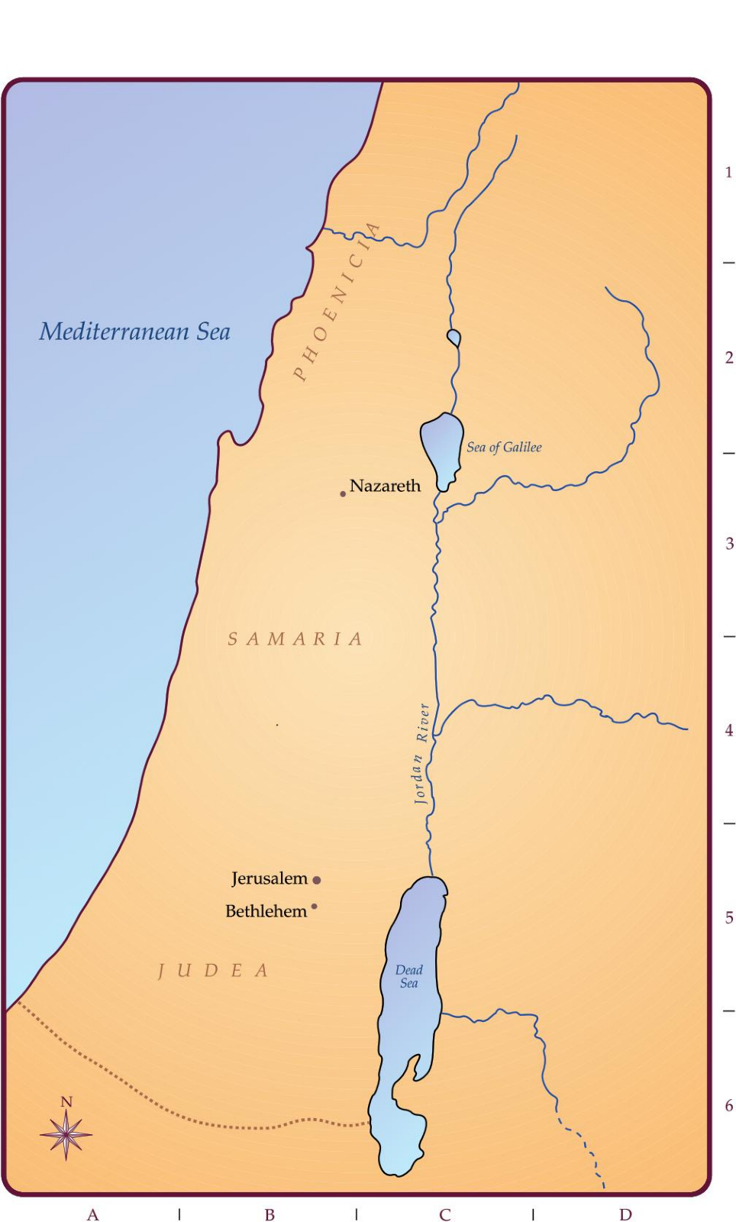

Slide 3
Now these things occurred as examples to keep us from setting our hearts on evil things as they did.

Slide 4
What is the problem?
The people of God did
EVIL

Slide 5
Two campaigns
Defeated Adoni-Bezek
Othniel
Angel of the Lord (2:1-5)
Gilgal

Slide 6
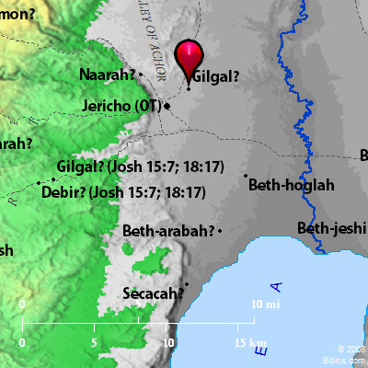

Slide 7
Canaanisation of Israel’s Society
Evil (2:11)
Other gods (2:12)
Provoked God to anger (2:12b)
God acts (2:16)
TESTING AND KNOWLEDGE

