Slide 1
Why what We Believe is
IMPORTANT
Psalm 119

Slide 2
Psalm 119:1
Blessed are those whose ways are blameless, who walk according to the law of the LORD.

Slide 3
The context
Choices
Keep me from deceitful ways; be gracious to me and teach me your law.
Turn my eyes away from worthless things; preserve my life according to your word.

Slide 4
Resident Aliens (exiles)
I am a stranger on earth; do not hide your commands from me.

Slide 5
A sceptical age
Indignation grips me because of the wicked, who have forsaken your law.
Though I am lowly and despised, I do not forget your precepts.
Streams of tears flow from my eyes, for your law is not obeyed.

Slide 6
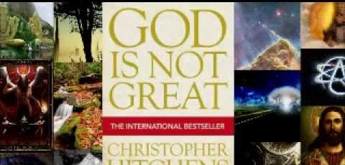

Slide 7
God’s law ignored
It is time for you to act, LORD; your law is being broken.

Slide 8
Double-minded
I hate double-minded people, but I love your law.

Slide 9
It is personal
Antagonism
Contempt
Slander
Intrigue
Pressure

Slide 10
reality
Temptation
Inconsistency
Opposition
Discipline

Slide 11
liberating
Guide my steps by your word, so I will not be overcome by evil.

Slide 12
spirituality
God acts
Fear of God
Witness
How long?
LIFE

Slide 13
Give me………..
Understanding
Teach me

Slide 14
The second half
I hate double-minded people, but I love your law.
Keep me from deceitful ways; be gracious to me and teach me your law.

Slide 15
Meditate on truth

