Slide 1
Jesus prepared the church for suffering
Then Jesus said to His disciples,
If anyone would come after me, he must deny himself and take up his cross daily and follow me. Luke 9:23 (also Matt 16:24, Mark 8:34)
As they persecuted me, so they will also persecute you John 15:20.
You are blessed when you are persecuted. Matt 5:10, Luke 6:22
Following me will involve suffering Matt 10:17-39
In this world you will have trouble but I have overcome the world. John 16:33

Slide 2
Paul - Early church expected suffering – Peter
In the book of Acts:
Interrogations/arrests
Imprisonments
Stoning/beatings
Martyred
2 Cor 1:8-9
2 Cor 11:24-28
2 Tim 3:12
Everyone who wants to live a godly life in Christ Jesus will be persecuted…
In the book of Acts:
Interrogation
Imprisonment
Martyred
In letter of 1 Peter suffering is mentioned 19 times!
“Do not be surprised at the painful trial that has come on you to test you, as though something strange were happening to you. But rejoice inasmuch as you participate in the sufferings of Christ..” 1 Peter 4:12-13

Slide 3



Christians suffering persecution in 2020
260 million Christians suffering high to severe levels of persecution
Every DAY….
Ten Christians are imprisoned unjustly.
25 churches or Christian buildings are attacked.
Eight Christians worldwide are killed because of their faith.
x 25
Source: Open Doors World Watch List 2020

Slide 4
Some helpful sites
https://www.opendoorsuk.org Open Doors
https://www.csw.org.uk/latest.htm Christian Solidarity Worldwide
https://barnabasfund.org/pray/praying-for-the-persecuted-church/ Barnabas
https://rtim.org/pray-persecuted-church/
https://www.operationworld.org/
https://www.europarl.europa.eu/RegData/etudes/BRIE/2015/572800/EPRS_BRI%282015%29572800_EN.pdf
https://christianpersecutionreview.org.uk/storage/2019/05/interim-report.pdf
At least 75% of all religiously-motivated violence and oppression in the world is suffered by Christians

Slide 5
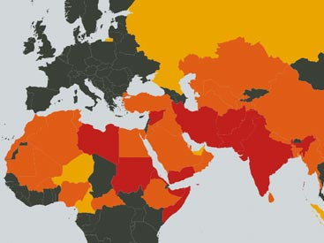
Most severe persecution
N Korea
Afghanistan
Somalia
Libya
Pakistan
Eritrea
Sudan
Yemen
Iran
India
Open Doors World watch List 2020

Slide 6
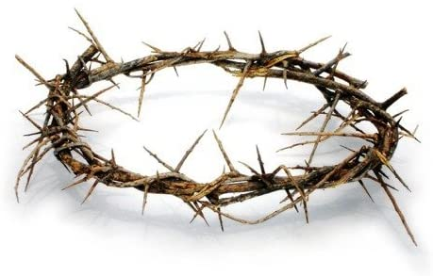
How would we view suffering for Christ’s sake?
If you are insulted because of the name of Christ, you are blessed, for the Spirit of glory and of God rests on you.
If you suffer as a Christian, do not be ashamed, but praise God that you bear that name.
Those who suffer according to God’s will should should commit themselves to their faithful Creator and continue to do good.
1 Peter 4 : 14, 16, 19
Continue to remember those in prison as if you were together with them in prison, and those who are mistreated as if you yourselves were suffering. Hebrews 13:3

Slide 7

We are the body of Christ, and each one of us is a part of it. If one part suffers, every part suffers with it
1 Cor 12:27 & 26
Continue to remember those in prison as if you were together with them in prison, and those who are mistreated as if you yourselves were suffering. Hebrews 13:3

Slide 8
Am I prepared for suffering for Christ’s sake?
We must not seek persecution
We should not seek to avoid persecution
We should trust our good loving Creator, Father God that:-
  He won’t put through more trial than we can manage in his strength 1 Cor 10:13
  His purposes may include for us to suffer :-
    As a witness to others. Matt 5:16
    To discipline us and to get our attention. Heb 12:7-11
    To strengthen and develop our faith 1 Peter 1:6-7
    To build his character in us Romans 5:3-5
  He will provide grace and strength when we need it 2 Cor 9:8,

