Slide 1

Christian Foundations:
The Truth About

Slide 2

John 18:37-38;
…the reason I was born and came into the world is to testify to the truth. Everyone on the side of truth listens to me.”
What is truth?

Slide 3
Why is Truth Important?
Jesus says of our enemy, Satan, …
John 8:44;
… there is no truth in him. When he lies, he speaks his native language, for he is a liar and the father of lies.

Slide 4
Why is Truth Important?
Jesus says our enemy, Satan, …
2 Corinthians 4:4;
  … has blinded the minds of unbelievers, so that they cannot see the light of the gospel that displays the glory of Christ, who is the image of God.

Slide 5
Why is Truth Important?
Jesus says…
John 8:32;
... the truth will set you free.

Slide 6
Recognising Truth
The battle of lies vs truth takes place in our minds…
Romans 12:2;
  Do not conform to the pattern of this world, but be transformed by the renewing of your mind.

Slide 7
Recognising Truth
So we must be rooted in truth…
Ephesians 6:14;
  Stand firm then, with the belt of truth buckled around your waist, with the breastplate of righteousness in place…

Slide 8
Recognising Truth
We must listen to truth…
John 18:37
  ...the reason I was born and came into the world is to testify to the truth. Everyone on the side of truth listens to me.”

Slide 9
Recognising Truth
We must allow truth to impact our lives…
John 8:31-32;
  Jesus said, ‘If you hold to my teaching, you are really my disciples. Then you will know the truth, and the truth will set you free.”

Slide 10
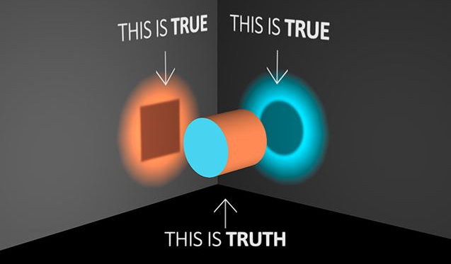
Worldviews of Truth
The truth is out there!…Or is it?

Slide 11
Worldviews of Truth
The truth is out there!…Or is it?
1 Corinthians 13:12; (KJV)
  For now we see through a glass, darkly... now I know in part; but then shall I know even as also I am known.

Slide 12
Sharing ‘True’ Truth in a World of ‘Truths’
1) Through Authentic Testimony
James 2:15-17;
  Suppose a brother or a sister is without clothes and daily food. If one of you says to them, “Go in peace; keep warm and well fed,” but does nothing about their physical needs, what good is it? In the same way, faith by itself, if it is not accompanied by action, is dead.

Slide 13
Sharing ‘True’ Truth in a World of ‘Truths’
2) Through Gospel Witness
1 Peter 3:15;
  Always be prepared to give an answer to everyone who asks you to give the reason for the hope that you have. But do this with gentleness and respect.

Slide 14
Sharing ‘True’ Truth in a World of ‘Truths’
3) Encourage people to ‘Try before they buy’
Psalm 34:4-10;
I sought the Lord, and he answered me; he delivered me from all my fears…
This poor man called, and the Lord heard him; he saved him out of all his troubles. The angel of the Lord … delivers them. Taste and see that the Lord is good; those who fear him lack nothing.

