Slide 1
Whose Mission Is It Anyway?
John 17 vs 1-26

Slide 2
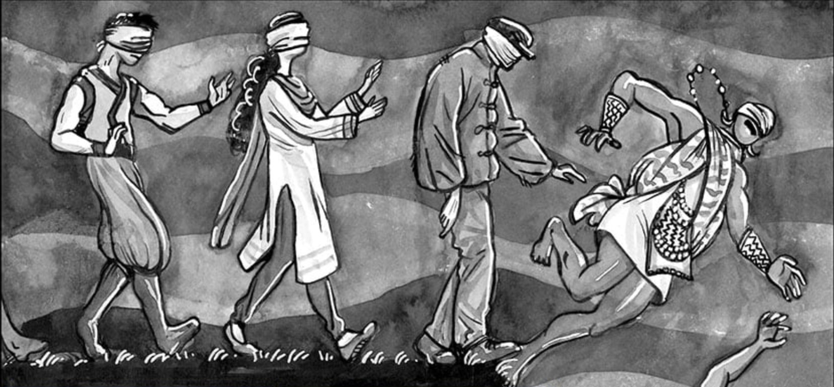
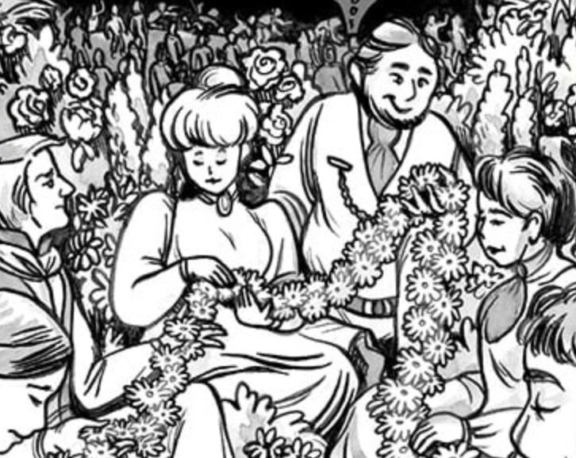

Slide 3
Whose Mission?
God’s Mission!
Jesus’ Mission
Disciples’ Mission
Our Mission (Church)
What’s My Part in it?
How?

Slide 4
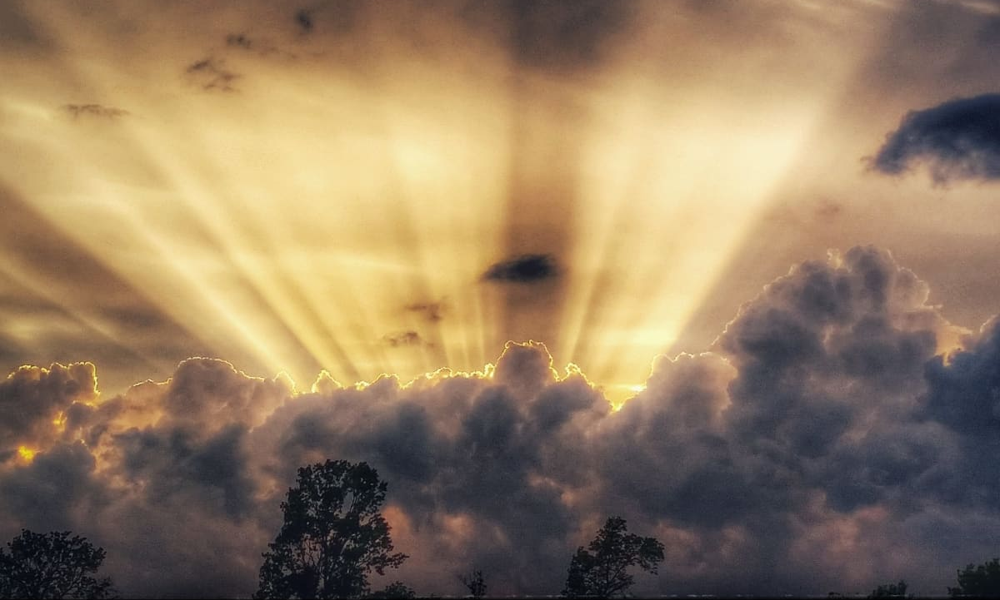
What is God’s Mission?
God’s Mission!
Jesus’ Mission
Disciples’ Mission
Our Mission (Church)
Glorifying God
God recognised as the One True God by all people; given the praise, worship & honour He is due.

Slide 5
What is God’s Mission for Jesus?
God’s Mission!
Jesus’ Mission
Disciples’ Mission
Our Mission (Church)
Glorifying God
John 17:1 & 4;
Glorify your Son, that your Son may glorify you…
… I have brought you glory on earth…

Slide 6
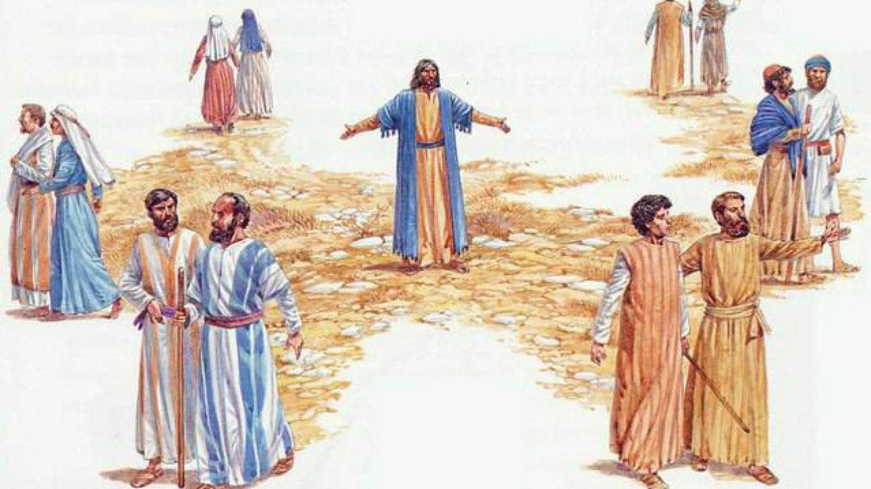
What is God’s Mission for Us?
God’s Mission!
Jesus’ Mission
Disciples’ Mission
Our Mission (Church)
Glorifying Jesus… & God
John 17:22;
I have given them the glory that you gave me…
John 17:10-11;
…glory has come to me through them. I will remain in the world no longer, but they are still in the world, and I am coming to you.

Slide 7
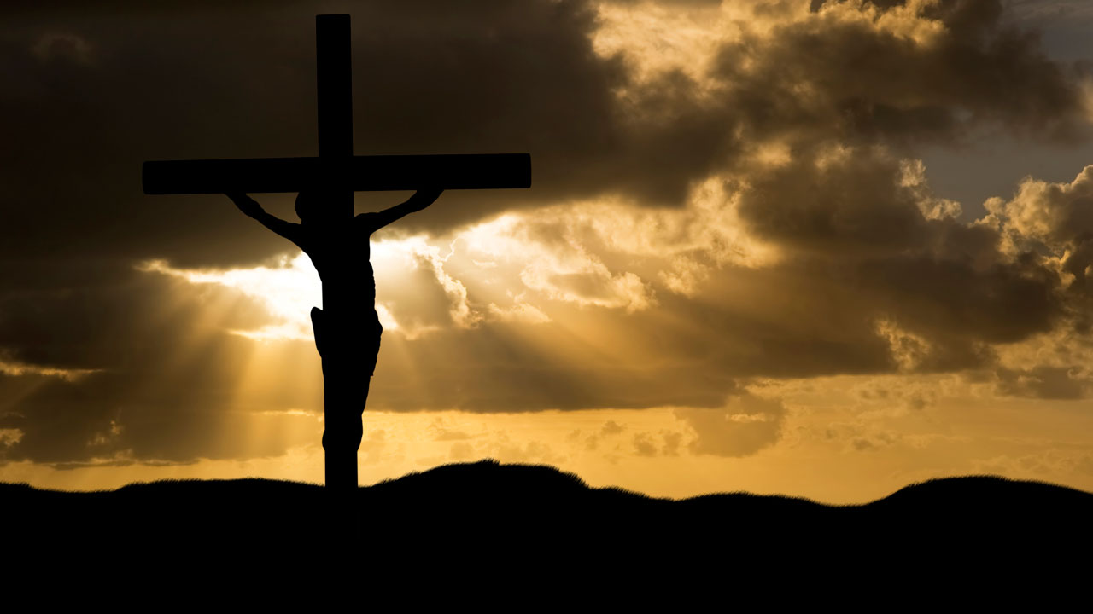
Glorifying God - How?
God’s Mission!
Jesus’ Mission
Disciples’ Mission
Our Mission (Church)
Through Jesus’ Crucifixion and Resurrection
John 17:1-2;
Father, the hour has come… For you granted him authority over all people that he might give eternal life to all those you have given him.

Slide 8
Glorifying God - How?
God’s Mission!
Jesus’ Mission
Disciples’ Mission
Our Mission (Church)
Through Knowing God & Jesus
John 17:3;
Now this is eternal life: that they know you, the only true God, and Jesus Christ, whom you have sent.

Slide 9
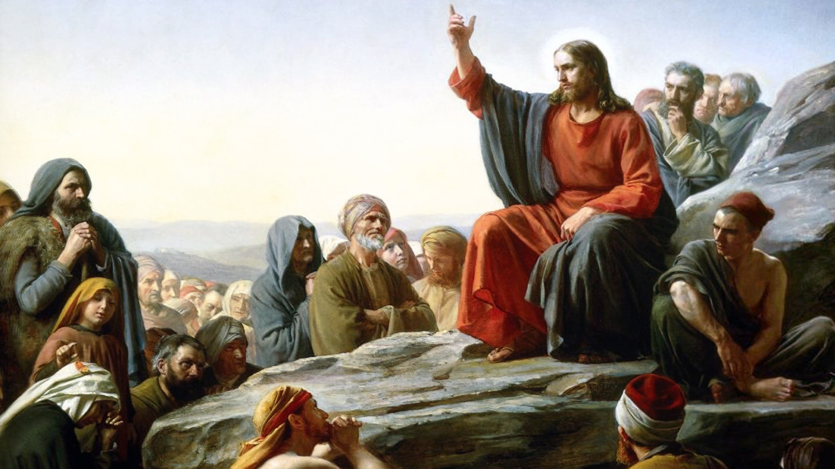
Glorifying God - How?
God’s Mission!
Jesus’ Mission
Disciples’ Mission
Our Mission (Church)
By Revealing God
John 17:6 & 8;
I have revealed you to those whom you gave me out of the world…. they have obeyed your word….
…For I gave them the words you gave me and they accepted them.

Slide 10
Glorifying God - How?
God’s Mission!
Jesus’ Mission
Disciples’ Mission
Our Mission (Church)
By Being in the World
John 17:15-16 & 17;
My prayer is not that you take them out of the world ... They are not of the world, even as I am not of it...
…As you sent me into the world, I have sent them into the world…

Slide 11
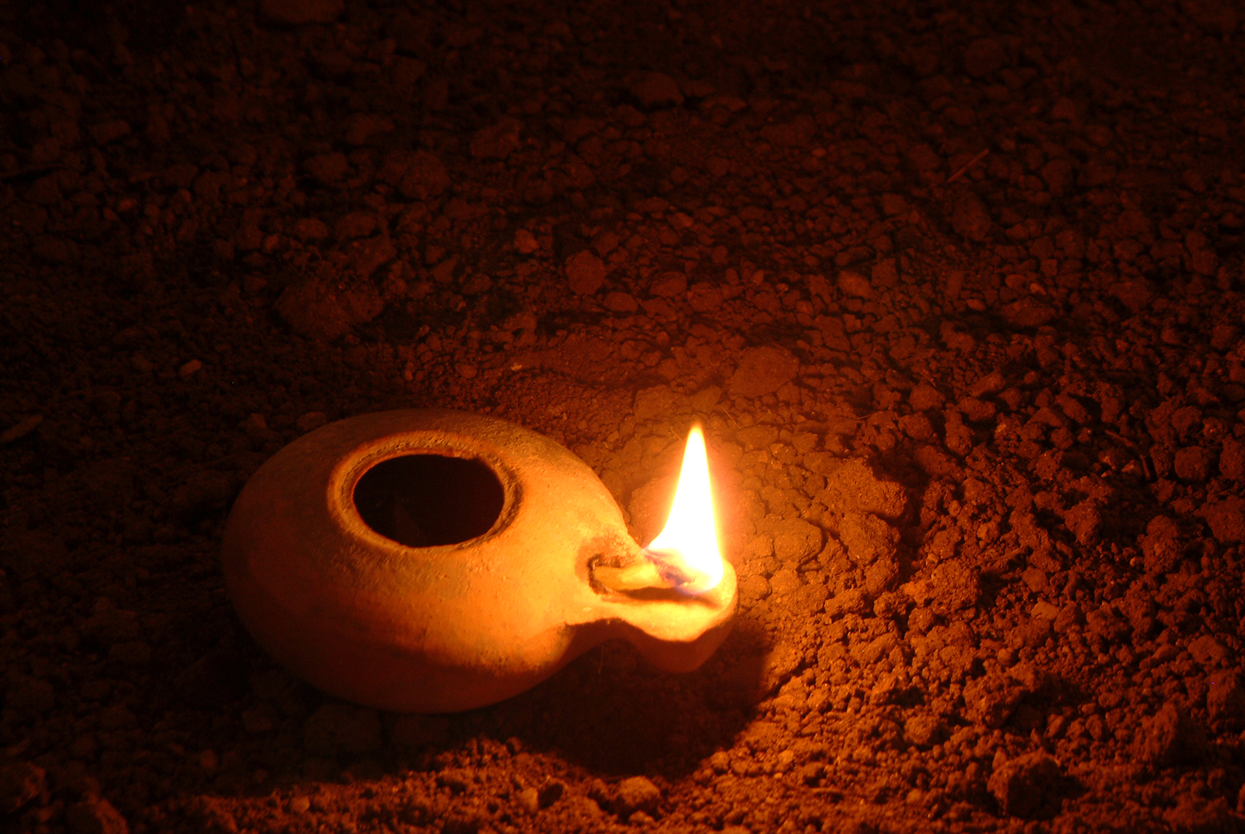
Glorifying God - How?
God’s Mission!
Jesus’ Mission
Disciples’ Mission
Our Mission (Church)
Through Holiness
John 17:17 & 18;
Sanctify them by the truth; your word is truth…
…For them I sanctify myself, that they too may be truly sanctified.

Slide 12
Glorifying God - How?
God’s Mission!
Jesus’ Mission
Disciples’ Mission
Our Mission (Church)
Under God’s Protection
John 17:10-11;
…Holy Father, protect them by the power of your name, the name you gave me, so that they may be one as we are one. While I was with them,
I protected them and kept them safe…

Slide 13
Glorifying God - How?
God’s Mission!
Jesus’ Mission
Disciples’ Mission
Our Mission (Church)
Under God’s Authority
John 17:2;
For you granted him authority over all people…

Slide 14
Glorifying God - How?
God’s Mission!
Jesus’ Mission
Disciples’ Mission
Our Mission (Church)
Through Loving Unity
John 17:22-23;
I have given them the glory that you gave me, that they may be one as we are one— I in them and you in me—so that they may be brought to complete unity….
John 17:26;
… the love you have for me may be in them and that I myself may be in them.

Slide 15
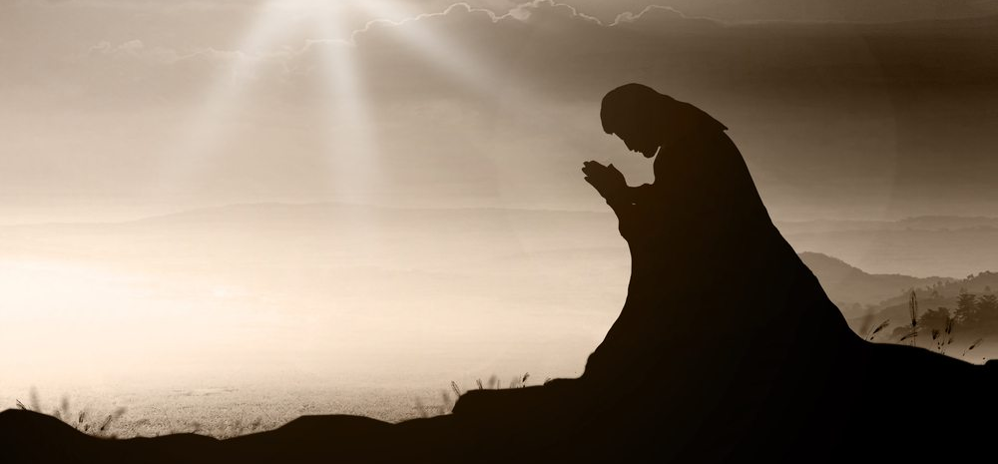
Glorifying God - How?
God’s Mission!
Jesus’ Mission
Disciples’ Mission
Our Mission (Church)
By Praying
John 17:2-3;
I pray for them. I am not praying for the world, but for those you have given me, for they are yours
John 17:20;
I pray also for those who will believe in me through their message…

Slide 16
Whose Mission?
God’s Mission!
Jesus’ Mission
Disciples’ Mission
Our Mission (Church)
God’s
What’s My Part in it?
Glorifying Jesus
How?
Knowing Jesus
Revealing Jesus
Being in the World
Holy/Righteous Living
By God’s Authority
Under God’s Protection
Loving Unity
Prayer

Slide 17
Am I Doing My Part?

