Slide 1
Romans 12:5
In Christ we, though many, form one body,
and each member belongs to all the others.
We have different gifts,
according to the grace
given to each of us.

Slide 2
If your gift is prophesying, then prophesy in accordance with your faith
if it is serving then serve;
if it is teaching then teach;
if it is to encourage then give encouragement;
if it is giving then give generously;
if it is to lead do it diligently;
if it is to show mercy do it cheerfully.
if your gift is giving, then give generously

Slide 3
If your gift is prophesying, then prophesy in accordance with your faith
if it is serving then serve;
if it is teaching then teach;
if it is to encourage then give encouragement;
if it is giving then give generously;
if it is to lead do it diligently;
if it is to show mercy do it cheerfully.
if your gift is giving, then give generously

Slide 5
‘Why does God want
us to give?’
‘Why does God want to
“gift” people
to give generously?’

Slide 7
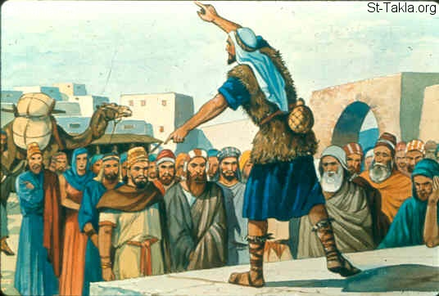
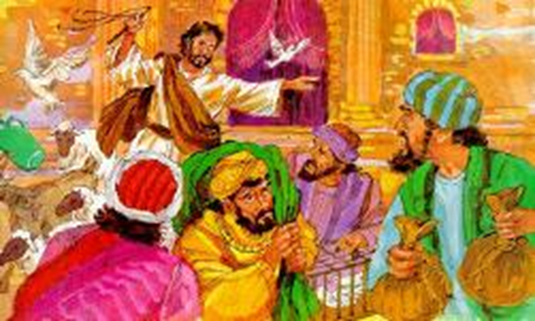
Amos
“You trample on
the heads of the poor!”
Jesus
…driving out those who
were buying & selling

Slide 8
2 stories
of foolish people

Slide 9
Mark’s Gospel 12:41-44

Slide 10
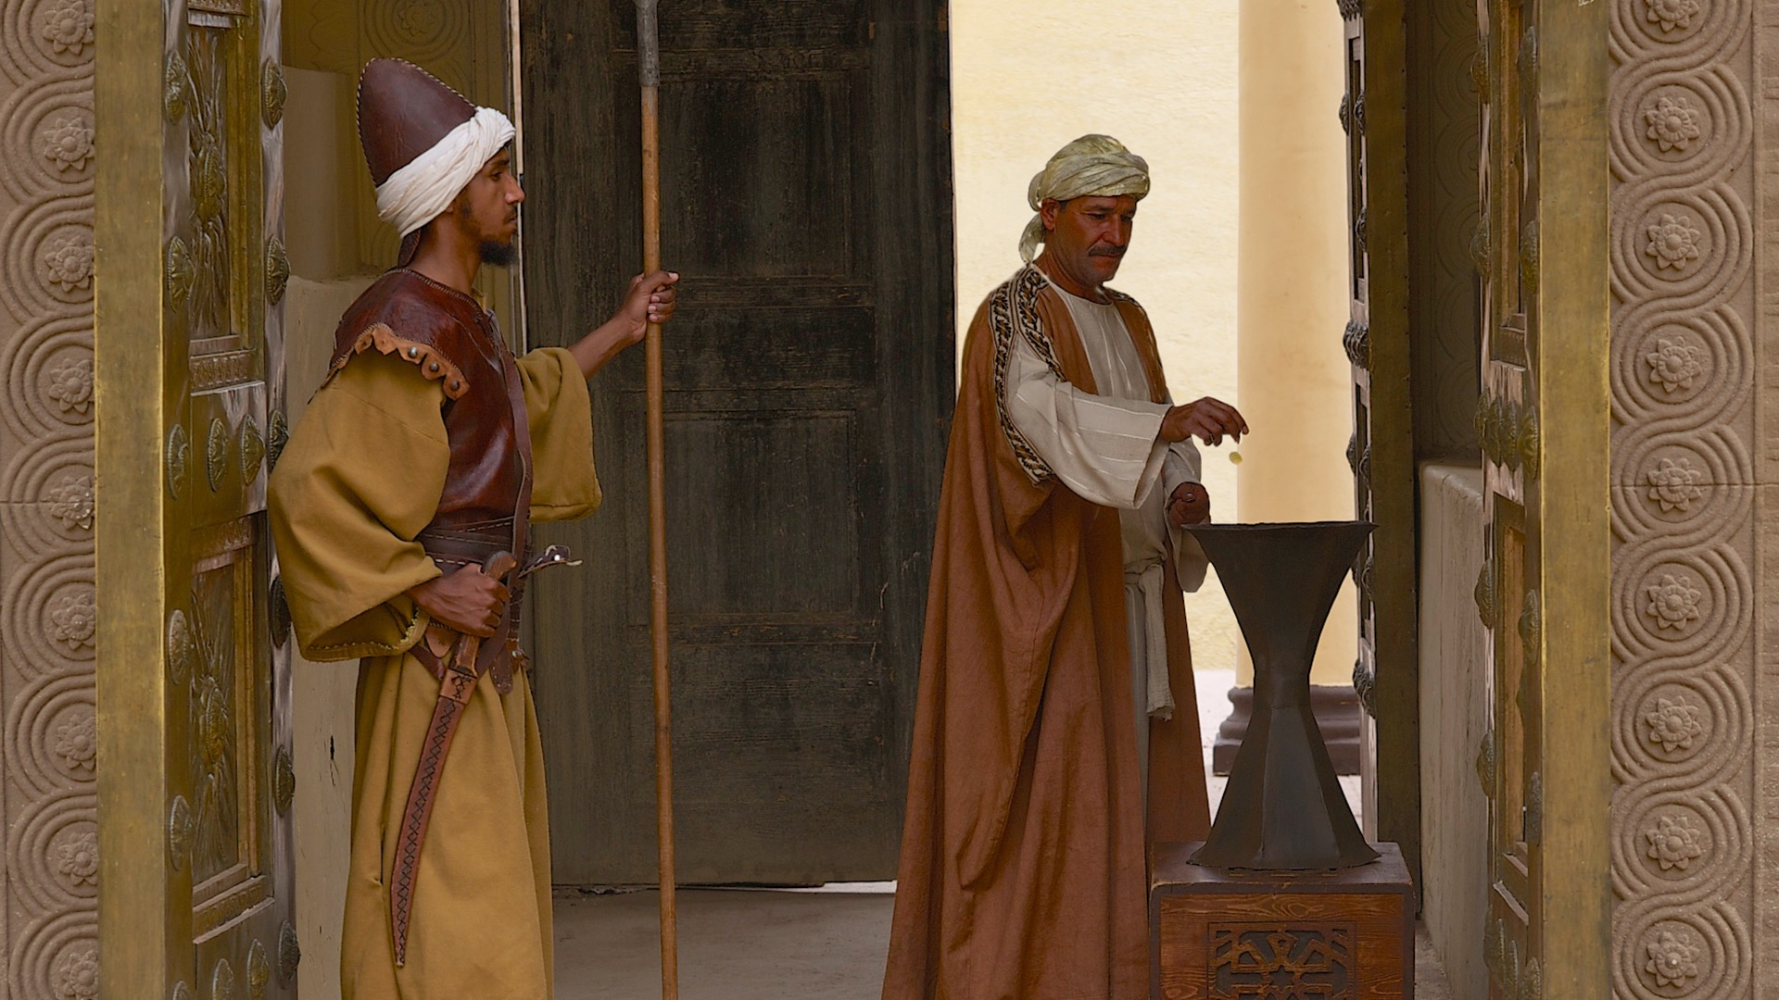

Slide 11
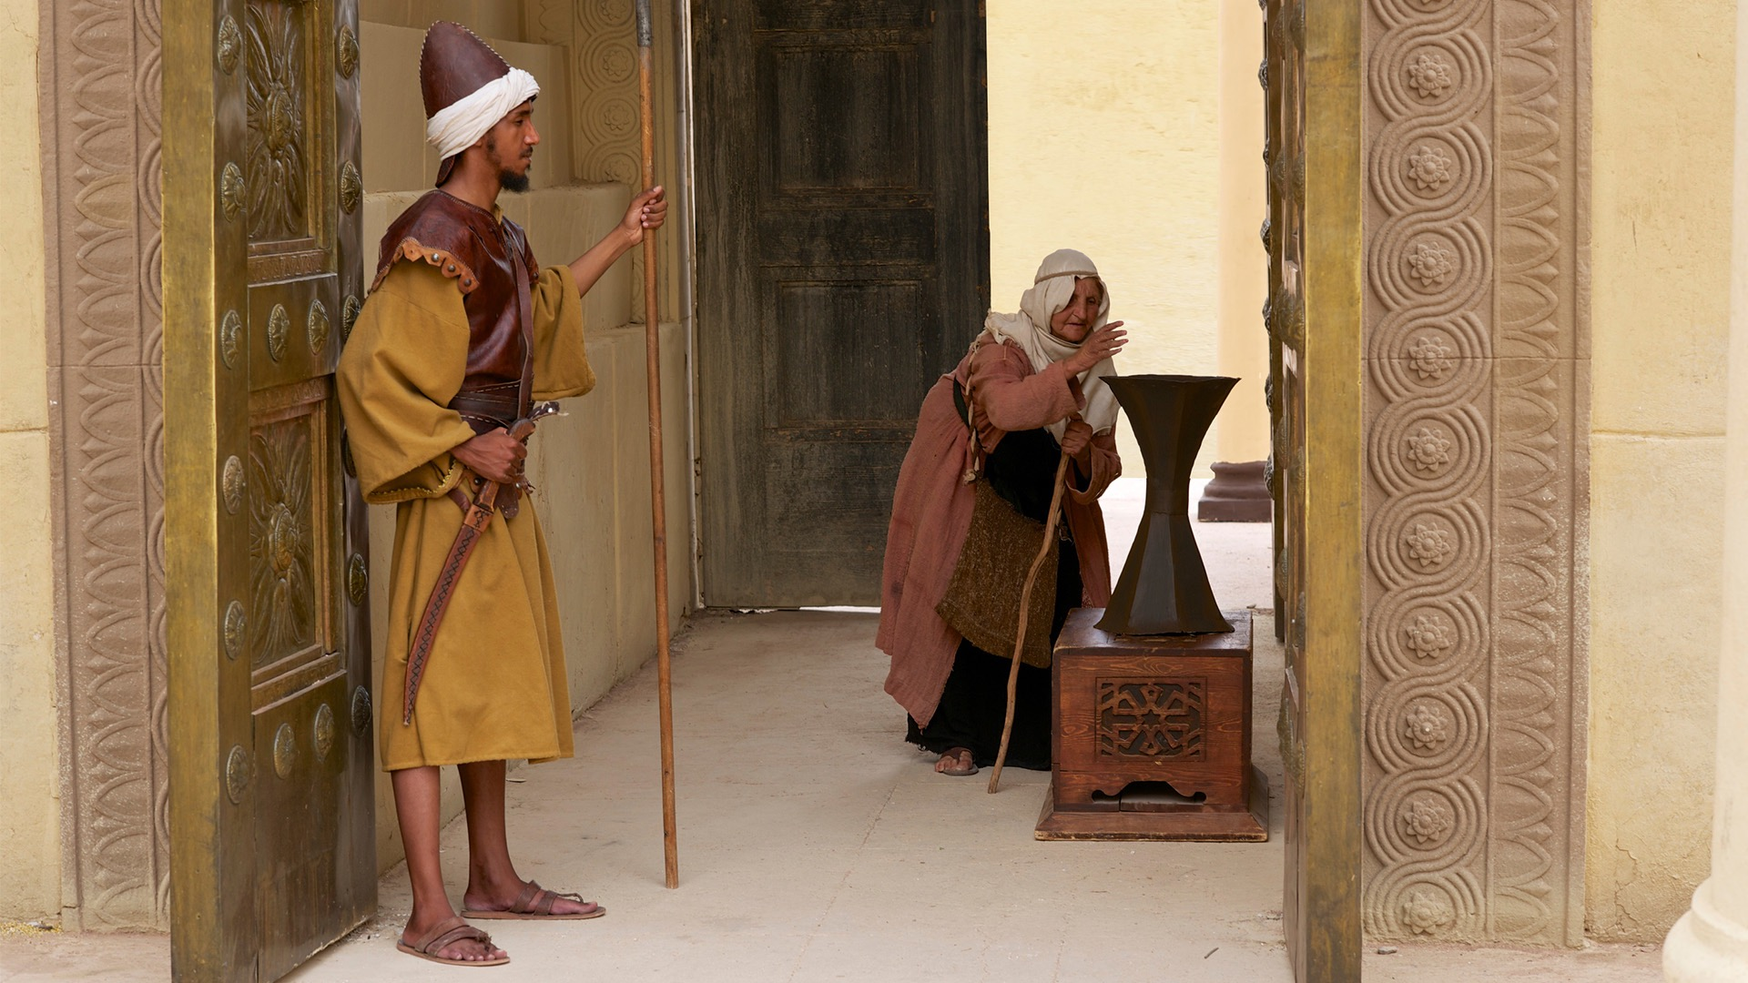

Slide 12
Mark’s Gospel 14:1-10

Slide 13
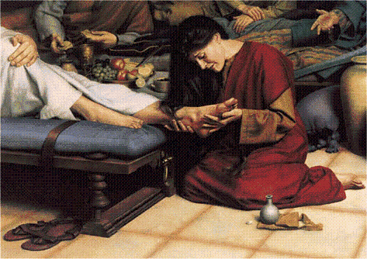

Slide 14
…they rebuked her harshly

Slide 15
She has done a beautiful thing…
Wherever the gospel is preached
throughout the world,
what she has done will also be told,
In memory of her.

Slide 16
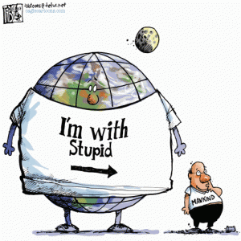

Slide 17
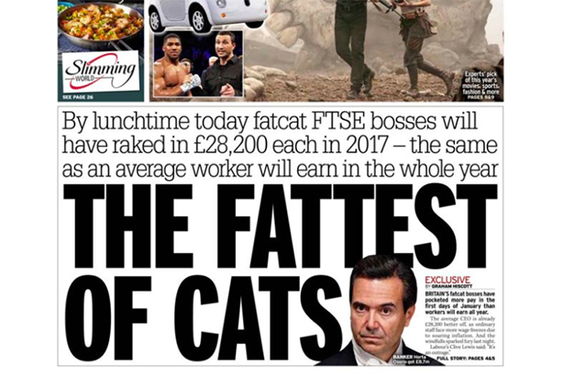
Wed 4th January

Slide 18
‘broken economics’

Slide 19
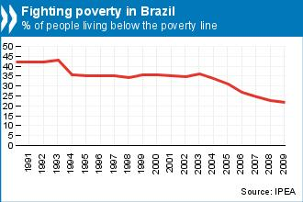
Attempts are being made,
with some success,
to reduce poverty…
but they are very limited in effectiveness

Slide 20
Theresa May
wants to shape
“The Shared Society”
but human nature will stand in her way
as it has confused every attempt to bring more equality across our society

Slide 21
There is great interest in
what people call the
“Universal Basic Income”

Slide 22
Pays everyone the equivalent of a basic safety net
Gets rid of the benefit system with all its complications,
its costly administration, & frequent injustice
Gives people the opportunity & means
to retrain for alternative employment
Eliminates the poverty trap

Slide 23
Finland has become the first country in Europe to pay its unemployed citizens
a basic monthly income,
in a radical pilot project aimed
at reducing poverty and joblessness,
while also cutting
national spending and bureaucracy.

Slide 24
0ne UK newspaper had a succession of articles
over recent months
Universal basic income
is not a magic solution,
but it could help millions
Universal basic income
is becoming an urgent necessity
Even in Finland,
Universal basic income
is too good to be true
Universal basic income
- an interesting idea
whose time has not yet come

Slide 25
The theme of the Davos
World Economic Forum
this month,
which costs a fortune to attend,
ironically had the theme of:
‘I n e q u a l i t y’

Slide 26
Christine Lagarde to Davos leaders:
“I warned about
the dangers of inequality
in 2013 and nobody listened”

Slide 27
Why do you teach Deuteronomy?

Slide 28
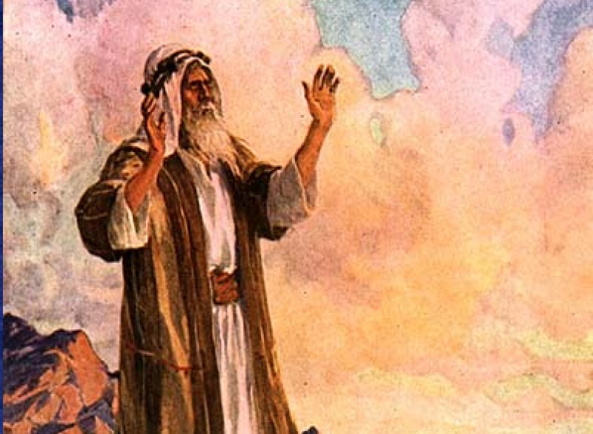
Deuteronomy 15
4 There need be no poor people among you…
At the end of every seven years you must cancel debts.
This is how it is to be done:
Every creditor shall cancel any loan
they have made to a fellow Israelite.
They shall not require payment
from anyone among their own people

Slide 29
7 If anyone is poor among you…
Do not be hard-hearted or tight-fisted toward them.
Rather, be openhanded and freely lend them
whatever they need.
Give generously to them
and do so without a grudging heart

Slide 30
11 There will always be poor people…
Therefore I command you to be openhanded
toward [those] who are poor and needy

Slide 31
Deut 4:5-6
Pay attention:
I’m teaching you the rules and regulations
that God commanded me, so that you may live by them …
How can we be those whose lives
illustrate God’s generosity?
Keep them! Practice them!
When other peoples hear & see what’s going on,
they’ll say, “What a great nation!
So wise, so understanding!
We’ve never seen anything like it.”

Slide 32
dovoljno
كافية
足够
genoeg
suffisamment
genug
पर्याप्त
elég
enough

Slide 33
Bishop Alf Stanway:
“What makes the difference
is the beer & the cigarettes!”
When people truly come to Christ
Their value system changes, their habits change,
their desires change…
and they have resources available for the Lord

Slide 34
Philippians 4:11
I am not saying this because I am in need,
for I have learned to be content whatever the circumstances.
1 Timothy 6:7-8
Since we entered the world penniless and will leave it penniless,
if we have bread on the table and shoes on our feet, that’s enough.
Hebrew 13:5
Make sure that your character is free from the love of money,
being content with what you have;
for He Himself has said,
“I will never desert you, nor will I ever forsake you”

Slide 35
Jesus
Luke 12:33-34
"Sell your possessions, and give to the needy.
Provide yourselves with moneybags that do not grow old,
with a treasure in the heavens that does not fail…
For where your treasure is, there will your heart be also."
Matthew 6:25-34
do not worry about your life … about clothes …
you of little faith… do not worry…
your heavenly Father knows that you need them …
seek first his kingdom and his righteousness …
do not worry about tomorrow

Slide 36
beyond logic

Slide 37
When does 2+2 not equal 4?
In school, we are taught that 2 plus 2 always equals 4. But
Science in general, points to a different, more dynamic result,
one that more accurately reflects reality.
The difference can help us better assess
economic statistics and the world as a whole.
A LINE ON LIFE
Two plus Two Equals Four,
but not always
Here's how your watch can prove
that 2 + 2 doesn't equal 4

Slide 38
2 Corinthians 8
We want you to know about the grace
that God has given the Macedonian churches.
In the midst of a very severe trial,
their overflowing joy and their extreme poverty
welled up in rich generosity.
For I testify that they gave as much as they were able,
and even beyond their ability…
And they exceeded our expectations:
They gave themselves first of all to the Lord,
and then by the will of God also to us.

Slide 39
God gives you his grace…
God gives you his love…
God gives you his Son…
For you know the grace of our Lord Jesus Christ,
that though he was rich
yet for your sake
he became poor
so that through his poverty
you might become rich.
2 Corinthians 8:9

Slide 40
Choice

Slide 41
God wants to gift those who will give generously…
to model for his people
a ‘gospel’ witness
which prompts people to say:
“We’ve never seen anything like it!”
&
who will turn to our generous Saviour
who, out of his poverty
makes us rich

