Slide 2
“Kingdom Building starts with Prayer”

Slide 3
Kingdom Building starts with Prayer
Background
Who - Nehemiah

Slide 4
Kingdom Building starts with Prayer
Background
Who – Nehemiah
Where – Middle East

Slide 5
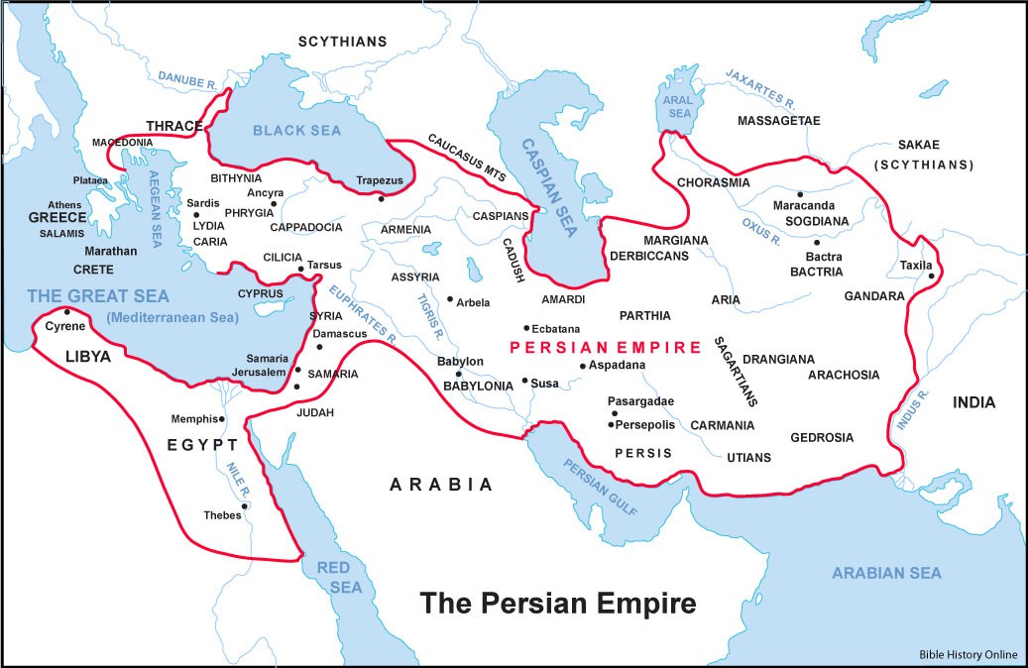
Susa

Slide 6
Susa
Jerusalem

Slide 7
Kingdom Building starts with Prayer
Background
Who – Nehemiah
Where – Middle East
When -

Slide 8
Kingdom Building starts with Prayer
Background
Who – Nehemiah
Where – Middle East
When – 445 BC

Slide 9
Kingdom Building starts with Prayer
Babylonian Empire
Jerusalem robbed
People Exiled
Babylonian Empire
Jerusalem destroyed
People Exiled
Persian Empire
Some people return
Temple work
Nehemiah
Chapter 1
597 BC
587 BC
539 BC
445 BC
142 years

Slide 10
Kingdom Building starts with Prayer
Background
Who – Nehemiah
Where – Middle East
When – 445 BC

Slide 11
Kingdom Building starts with Prayer
Nehemiah chapter 1
V4 - When I heard these things, I sat down and wept. For some days I mourned and fasted and prayed before the God of heaven.

Slide 12
Kingdom Building starts with Prayer
Nehemiah chapter 1
You never know what prayer is for,
until you know that life is war!

Slide 13
Kingdom Building starts with Prayer
Nehemiah chapter 1
Nehemiah prays
Nehemiah’s prayer:
rooted in the sovereignty of God

Slide 14
Kingdom Building starts with Prayer
God over all People over programs Faith over fear Giving over taking Together over alone Joy over despair Going over staying

Slide 15
Kingdom Building starts with Prayer
Faith over fear We will not insult God with small thinking and safe living. God is for us, so who can stand against us, and the power of God’s Spirit is given to equip us. Romans 8:31-32; 2 Corinthians 5:7; Acts 1:8; 2 Timothy 1:7

Slide 16
Kingdom Building starts with Prayer
Nehemiah chapter 1
Nehemiah prays
Nehemiah’s prayer:
rooted in the sovereignty of God
built on the promises of God

Slide 17
Kingdom Building starts with Prayer
Nehemiah chapter 1
Nehemiah prays
Nehemiah’s prayer:
rooted in the sovereignty of God
built on the promises of God
trusting in the grace of God

