Slide 1
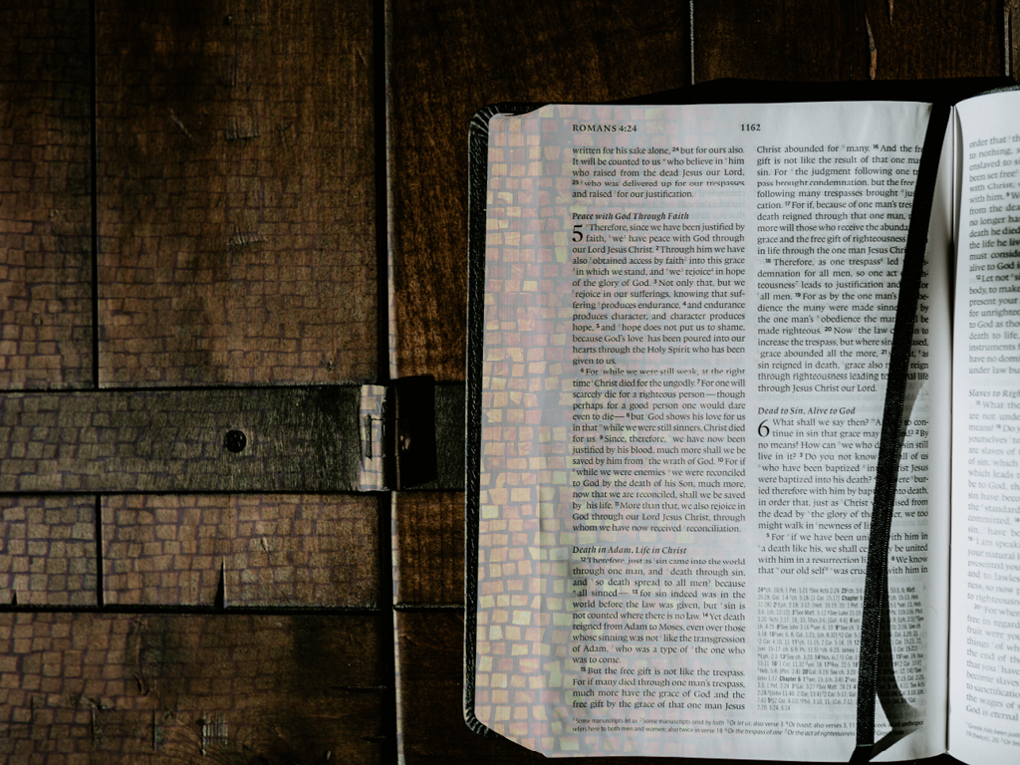
Faith for the Ages
Romans 4

Slide 2
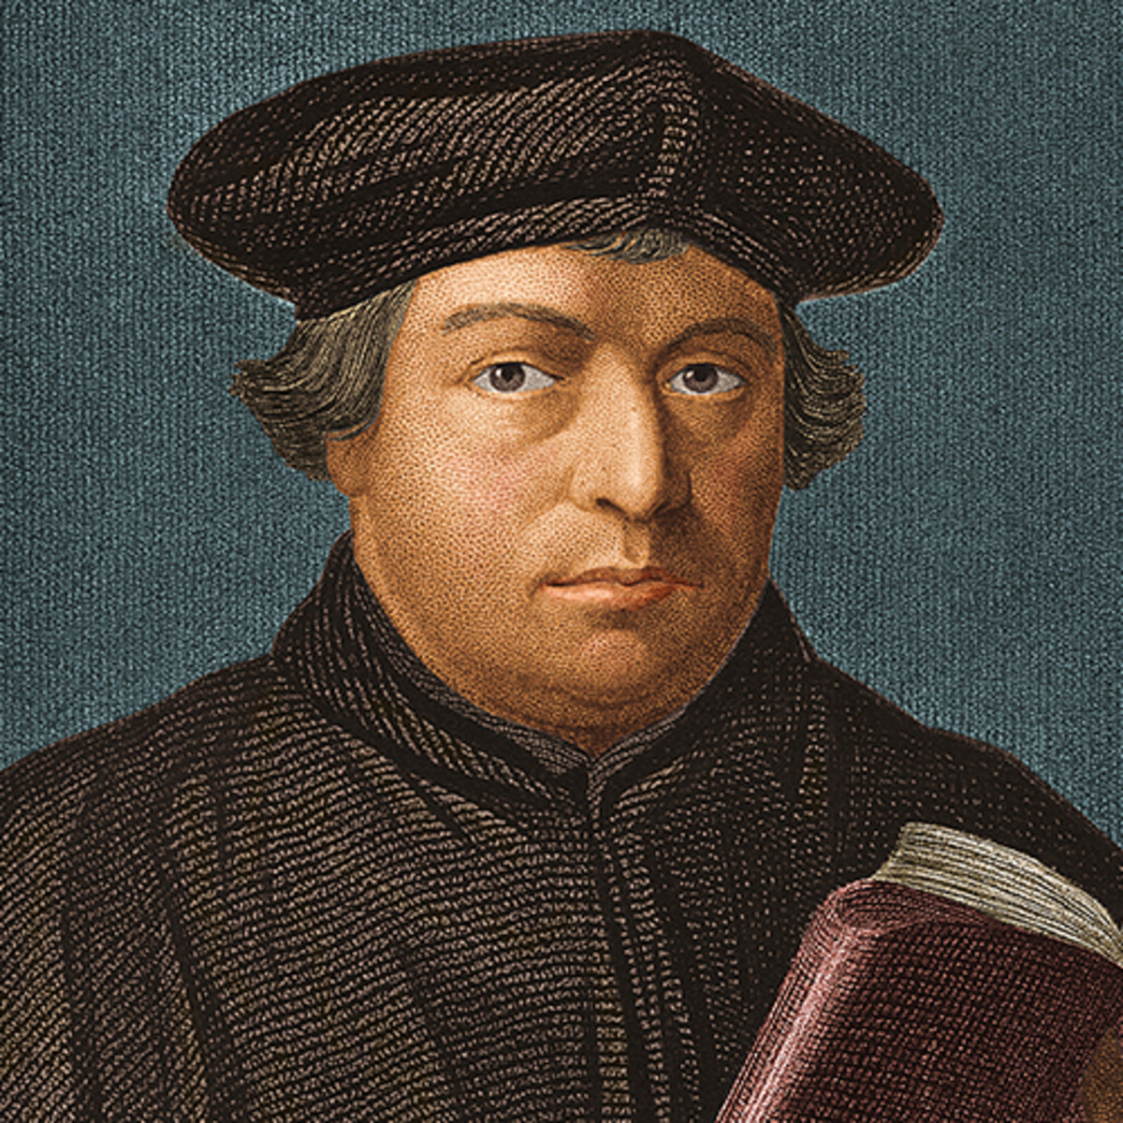
“The just shall live by faith”
Martin Luther

Slide 3
The big theme in Romans Chapter 4 is Justification by faith alone – ‘Sola Fide’
Justification means being declared righteous. It is a legal term used in the Bible to describe the act of God in which He declares that a person is not guilty.
A person who is justified is therefore in a state of acceptance with God.

Slide 4
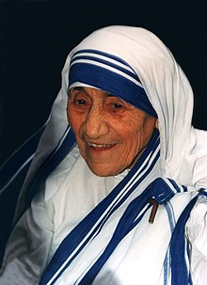
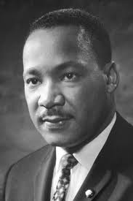
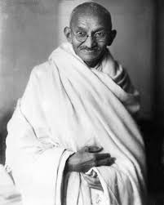
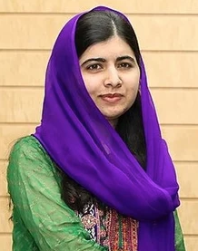
Who would you say has been the most revered, honoured, respected, influential man or woman who has ever lived?
?
?
?
?

Slide 5
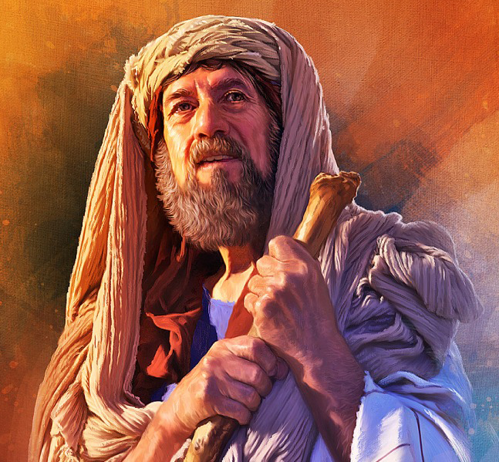
Abraham is considered to be the founding Father of three monotheistic religions: Judaism, Islam & Christianity.
Whether you are reading the writings of the Old Testament Hebrew prophets, the Epistles in the New Testament, or the Koran each refers to Abraham as the ‘Friend of God’.

Slide 6
Faith alone, not works – Romans: 4:1-8
So was Abraham saved by works or faith?
What does the scripture say?
Paul quotes Genesis 15:6 Abraham believed God, and it was credited it him as righteousness – Verse 3

Slide 7
Paul goes on to say if we work for something then it is not a free gift. Verse 4
He then brings King David into the argument. David is right up there with Abraham in significance to the Jews. He is the greatest King of Israel, a man after God’s own heart. Was David justified by faith as well? Absolutely. David had a sin debt he couldn’t pay back, yet he experienced God’s great mercy and forgiveness. Verses 6-8

Slide 8
What about us?
The first beatitude is: “Blessed are the poor in spirit for theirs is the Kingdom of Heaven.”
What does it mean to be poor in spirit?
To be poor in spirit means to recognize how far short we fall in relation to God’s standards, to understand that we are up to our eyes in debt and as a consequence throw ourselves on the mercy of God.
To be poor in spirit is to acknowledge that we are totally dependent on God’s grace and mercy, and to cry out to him for his help in all things.
So why are we so often reluctant to do this? To acknowledge our need to acknowledge our weakness?

Slide 9
Brennan Manning in his book the Ragamuffin Gospel reminds us of this truth.
“All of us are broken. All of us are in need. The greatest symptom of our brokenness is not acknowledging it. It’s only in pride that our need goes unmet. It’s only in pride that our brokenness is without healing. We serve a good loving Father who has always loved us. When we stop trying to prove to ourselves, God and others that we have our lives together, we actually begin to truly live. This is overwhelming freedom, joy and love in living with the reality that we are wholly accepted and loved just as we are.”

Slide 10
Paul believes that Jesus came to obliterate a works based relationship and to reveal Gods heart of unconditional, grace – filled, unchanging love.

Slide 11
Faith alone, not rituals – Romans: 4:9-12
If Abraham and his descendants, including David, were set apart by God by the Jewish ritual of circumcision, then how can Paul argue that justification by faith is available to both Jews (the circumcised) and gentiles (the un circumcised)?
Paul’s answer couldn’t be any clearer. God accepted (justified) Abraham first, and Abraham was circumcised later – Verse 10
What does that mean for us today?
Do we have rituals?

Slide 12
Faith alone, not the Law – Romans: 4:13-17
The Jews considered the Mosaic Law, which was a special revelation of God’s standards for human conduct, to be the basis for a right relationship with God.
If they kept the law, they reasoned, then they were good enough in god’s sight.
Paul reminds us that no one can keep the law in all its entirety.

Slide 13
How can I be justified
Sola Fide – By faith alone
How can I be made right with God
Sola Fide – By faith alone
So the big theme in Romans 4 is that we are saved by faith alone. We are declared not guilty not because of what we have done but because of what he has done for us in Jesus.

