Slide 1
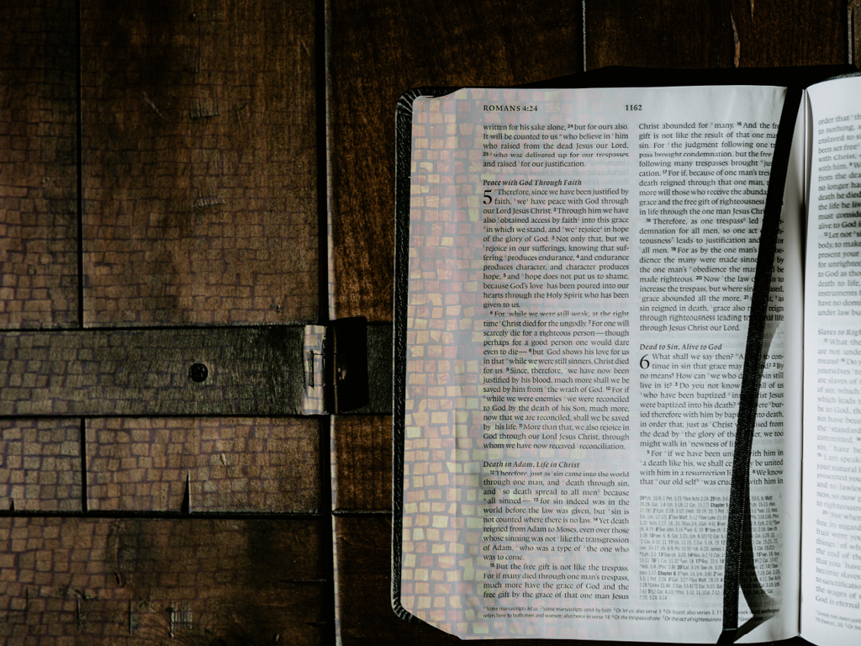
Truly Amazing
Romans 5

Slide 2
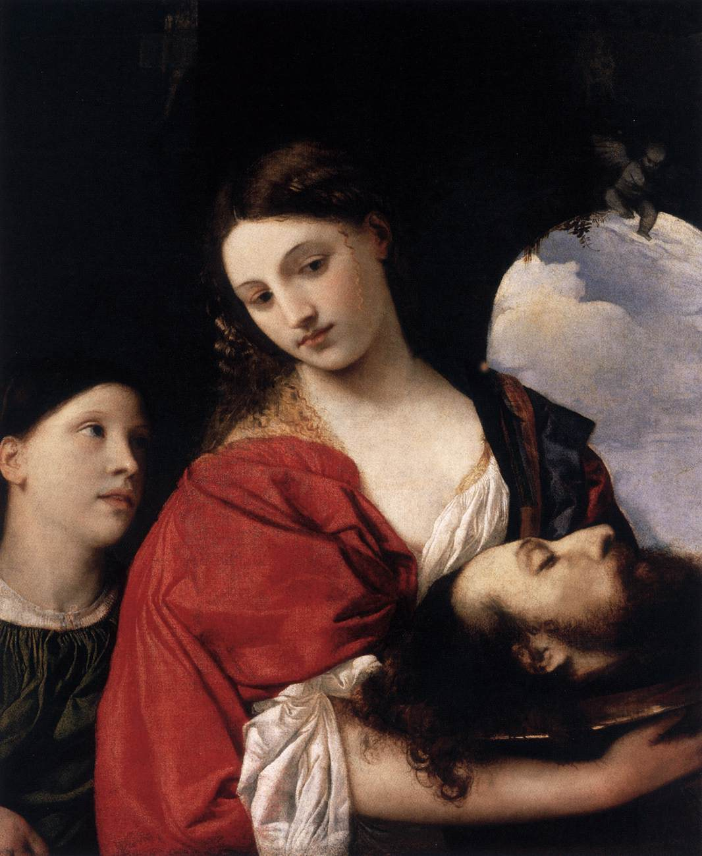
Painting of Salome with the head of John the Baptist by Titian.

Slide 3
Paul begins Romans 5:1 with the word ‘Therefore’
Consequently,
…Because of that
…on those grounds

Slide 4
Romans Chapter 4
• Faith alone, not works – 4:1-8
• Faith alone, not rituals – 4:9-12
• Faith alone, not the law – 4:13-17
How can I be made right with God – ‘Sola Fide’ – by faith alone
We are declared not guilty not because of what we have done but because of what God has done for us in Christ Jesus.

Slide 5
‘Therefore’ because of this – Romans: 5:1
Paul wants us to understand and know the consequence of justification by faith alone, the true value and benefit of what this brings for us. He does not want us to be like David Dickson and be in possession of something so precious but be unaware of it’s amazing significance to our lives both today and in the future.
Paul shares with us five benefits that are ours because we are justified by faith.

Slide 6
Romans 5:1
Firstly, Paul tells us we have:
PEACE

Slide 7
Genesis 3 – The consequence of sin
The Fall
3 Now the serpent was more crafty than any of the wild animals the Lord God had made. He said to the woman, “Did God really say, ‘You must not eat from any tree in the garden’?” 2 The woman said to the serpent, “We may eat fruit from the trees in the garden, 3 but God did say, ‘You must not eat fruit from the tree that is in the middle of the garden, and you must not touch it, or you will die.’”
4 “You will not certainly die,” the serpent said to the woman. 5 “For God knows that when you eat from it your eyes will be opened, and you will be like God, knowing good and evil.”
6 When the woman saw that the fruit of the tree was good for food and pleasing to the eye, and also desirable for gaining wisdom, she took some and ate it. She also gave some to her husband, who was with her, and he ate it. 7 Then the eyes of both of them were opened, and they realized they were naked; so they sewed fig leaves together and made coverings for themselves.
8 Then the man and his wife heard the sound of the Lord God as he was walking in the garden in the cool of the day, and they hid from the Lord God among the trees of the garden. 9 But the Lord God called to the man, “Where are you?”

Slide 8
10 He answered, “I heard you in the garden, and I was afraid because I was naked; so I hid.”
11 And he said, “Who told you that you were naked? Have you eaten from the tree that I commanded you not to eat from?”
12 The man said, “The woman you put here with me—she gave me some fruit from the tree, and I ate it.”
13 Then the Lord God said to the woman, “What is this you have done?”
The woman said, “The serpent deceived me, and I ate.”
17 To Adam he said, “Because you listened to your wife and ate fruit from the tree about which I commanded you, ‘You must not eat from it,’
“Cursed is the ground because of you;
through painful toil you will eat food from it
all the days of your life.
18 It will produce thorns and thistles for you,
and you will eat the plants of the field.
19 By the sweat of your brow
you will eat your food
until you return to the ground,
since from it you were taken;
for dust you are
and to dust you will return.”

Slide 9
20 Adam named his wife Eve, because she would become the mother of all the living.
21 The Lord God made garments of skin for Adam and his wife and clothed them. 22 And the Lord God said, “The man has now become like one of us, knowing good and evil. He must not be allowed to reach out his hand and take also from the tree of life and eat, and live forever.” 23 So the Lord God banished him from the Garden of Eden to work the ground from which he had been taken. 24 After he drove the man out, he placed on the east side of the Garden of Eden cherubim and a flaming sword flashing back and forth to guard the way to the tree of life.

Slide 10
What came from this?
Genesis 3:1-7 – Shame
Genesis 3:8-9 – Guilt
Genesis 3:10 – Fear
Genesis 3:11-13 – Blame
Genesis 3:14-19 – Death
Genesis 3:20-24 – Separation

Slide 11
Romans 5:2
Paul tells us we have:
Access
Because of our new life in Christ we have not only peace with God but also access to the very presence of God.

Slide 12
Union Soldier & Lincoln’s Son…

Slide 13
William Barclay in his commentary writes that this word ‘access’ carries two meanings.
First it gives a picture of our entry into the presence of royalty. Think of it, Christ ushers us into the presence of God himself. We who were once enemies of God can know stand before him without fear or shame.
Second the word for ‘access’ portrays a ship coming into a harbour, safe from the storm. Once we struggled in the open sea of sin, but know we can come and rest in Gods harbour of acceptance and forgiveness.
William Barclay

Slide 14
Romans 5:2
Paul tells us we have:
Hope
Not only have we gained access to God but we have also received hope in the glory of God.

Slide 15
What Paul means here is that because we have a new standing with God, we will one day share in God’s glory.
In a deeper way we share in the blessings, success and victories of God because we are part of his family, we are sons and daughters of the King.
Therefore, we have hope for today, tomorrow and for all eternity.

Slide 16
Romans 5:2-4
Paul tells us we have:
Joy
We have joy because of the peace and hope that are ours in Christ.

Slide 17
We can also experience joy in the midst of difficulties and suffering says Paul.
Notice that Paul does not say that we rejoice FOR our suffering, rather we rejoice IN our suffering.
There is no joy in the actual troubles themselves, rather, the understanding that we can amazingly benefit from them.
How? Paul says because we know…. Verse 3

Slide 18
Paul tells us there is a chain reaction
• Suffering leads to perseverance – verse 3
Perseverance is a word that means “single mindedness”
Suffering makes us focus, it helps us focus on what is really important.
• Perseverance leads to character – verse 4
Character is a word that means “testedness”. It’s quality of confidence that comes through tough experiences.
Paul says, all of this leads to growth in HOPE and hope does not disappoint us.

Slide 19
Romans 5:5-11
Paul tells us we have:
Assurance
Feeling unloved? Used? Rejected? Feeling as you never measure up?
Do you ever wonder if you will ever be truly loved by anyone?

Slide 20
The very moment you say yes to Jesus, the Holy Spirit enters your heart and begins to pour out the love of God.
He gives us his assurance that we are loved and that we belong to him. That our relationship with God which was once non-existence, broken down can be transformed by his unchanging and unconditional love.

Slide 21
Through faith alone in Christ…
…we are not only saved from something but we are saved to something.
We have:
Peace with God
Access to God
Hope in God
Joy in all things
Assurance of God’s love
That is truly amazing grace!

