Slide 1
Prayers
Persecuted Church

Slide 2
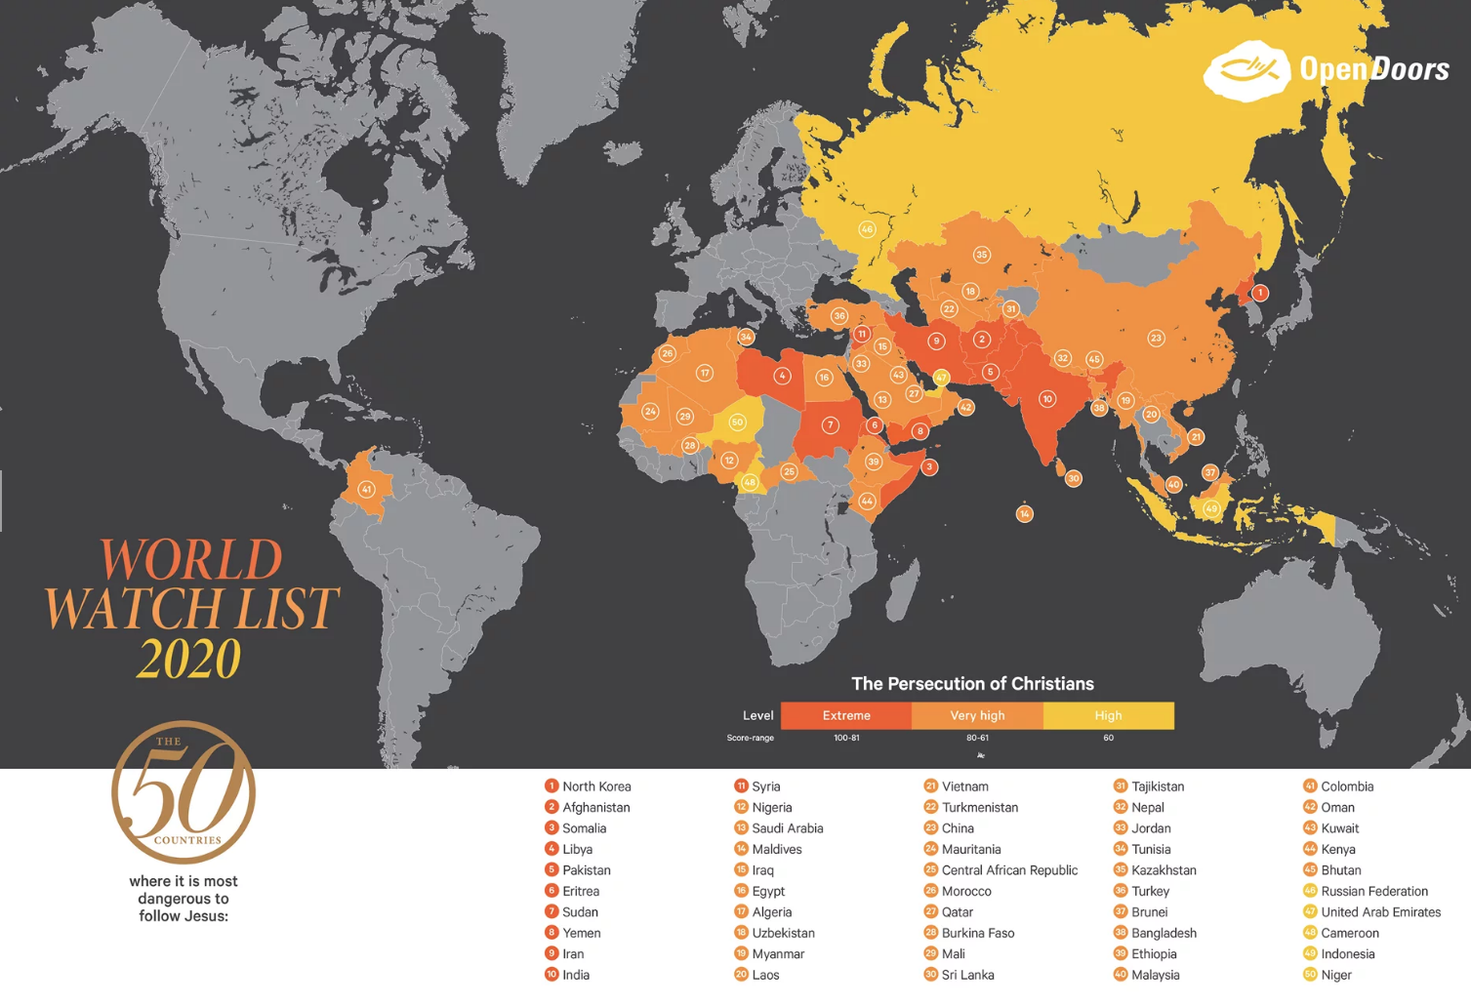
Nigeria

Slide 3
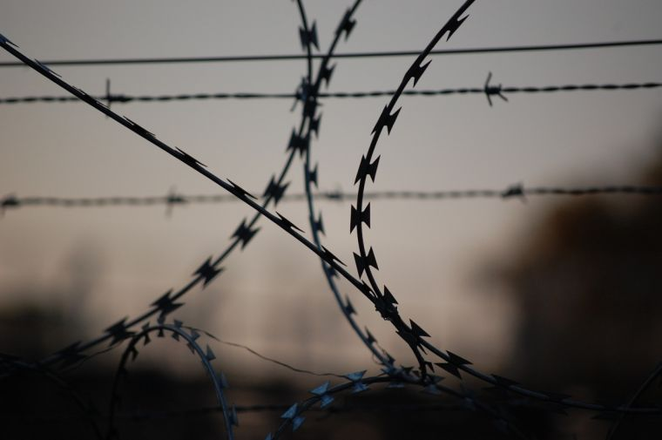
Lord, strengthen those you love suffering in your name
You prepare a table before me in the
presence of my enemies
Psalm 23.5

Slide 5
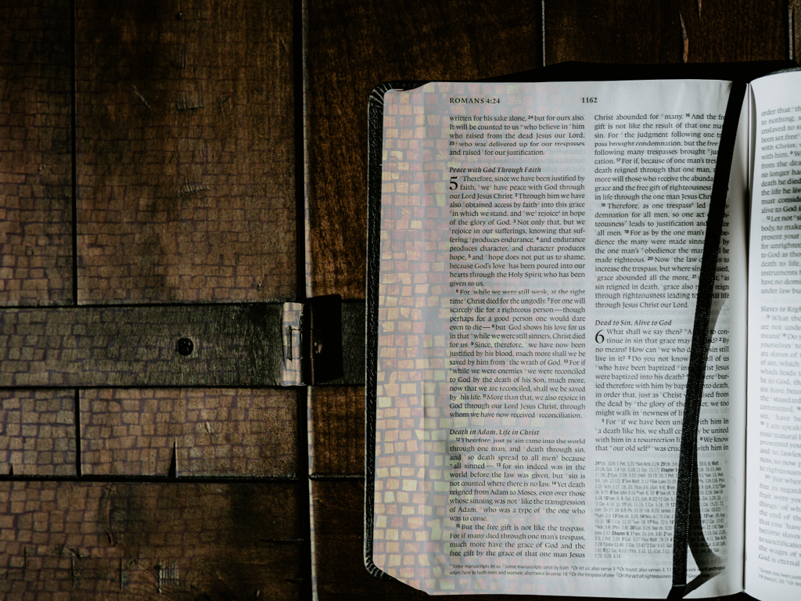
New Freedom
Romans 6

Slide 6
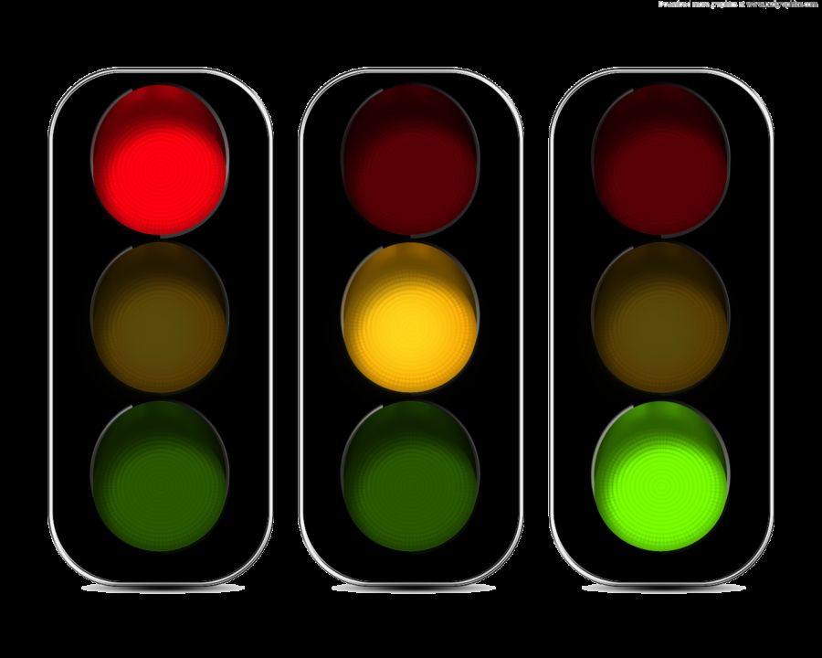

Slide 7
Red Light – STOP
v1:Shall we go on sinning so that grace may increase?
V15: Shall we sin because we are not under law but under grace? BY NO MEANS!!

Slide 8
Amber Light – THINK
..consider yourselves dead to sin (v11)
..you have been set free from sin (v17)

Slide 9
Amber Light – THINK

Slide 10
Green Light – GO
..consider yourselves dead to sin, but alive to God (v11)
..offer yourselves as slaves to righteousness (v19)

Slide 11
Free from the power of sin
and
Free for the purposes of God

