Slide 1
Matthew 5-7

Slide 2
Reflection on…
Matthew 6:16-18
“When you fast…”

Slide 3
Our Father God
We are linked together as those who
have heard the message of the Cross.
We trust in the death & rising of Jesus,
and we desire the fullness of your Spirit.
Help us we pray
to know Your Word speaking to us
to learn the way of Jesus for today
to take up our Cross….
May we see more clearly
what this means for our consciences
& our values, & our lifestyle this week.
Amen

Slide 4
Matthew 6:16-18
‘When you fast, do not look sombre as the hypocrites do, for they disfigure their faces to show others they are fasting. Truly I tell you, they have received their reward in full.
But when you fast, put oil on your head and wash your face, so that it will not be obvious to others that you are fasting,
but only to your Father, who is unseen;
and your Father, who sees what is done in secret,
will reward you.

Slide 5
6:1-18
Your giving 1-4
Your praying 5-15
“Our Father in Heaven…”
Your fasting 16-18

Slide 6
6:1-18
Your giving
Your praying
Your fasting
Don’t announce it … as the hypocrites do
Your Father sees what’s done in secret…
Don’t be seen by others… as the hypocrites do
Your Father sees what’s done in secret…
Don’t look sombre… as the hypocrites do…
Your Father who sees what’s done in secret…

Slide 7
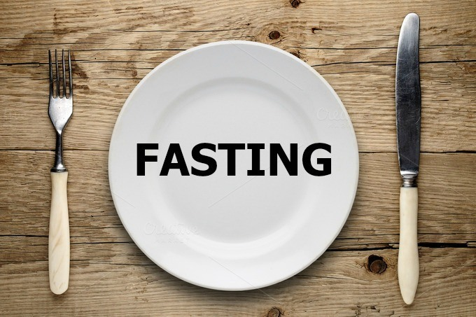
Let’s ask
some questions
about
fasting

Slide 10
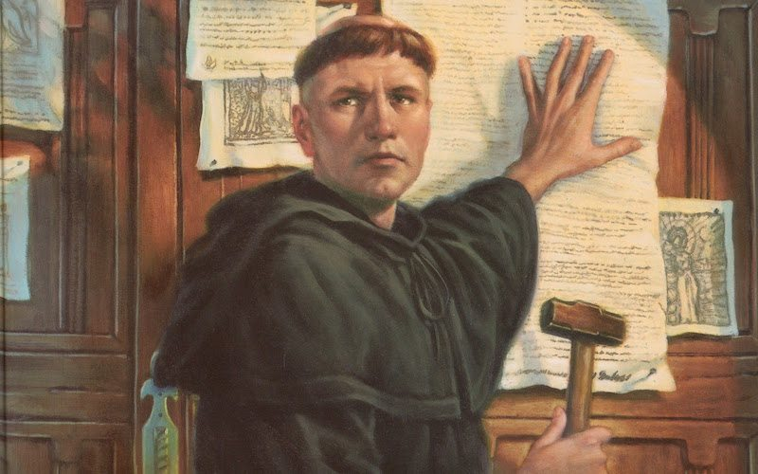
Luther was a very diligent monk…
prayer, fasting, ascetic practices -
going without sleep, enduring bone-chilling cold without a blanket, and flagellating himself.
"If anyone could have earned heaven
by the life of a monk, it was I."

Slide 11
The Day of Atonement
Leviticus 16:30-31
On this day atonement will be made for you,
to cleanse you...
It is a day of sabbath rest, and you must fast…
Yom Kippur, the Day of Atonement
is the holy of holies of Jewish time.
It is that rarest of phenomena,
a Jewish festival without food.
Instead it is a day of fasting & prayer,
introspection & self-judgement.

Slide 12
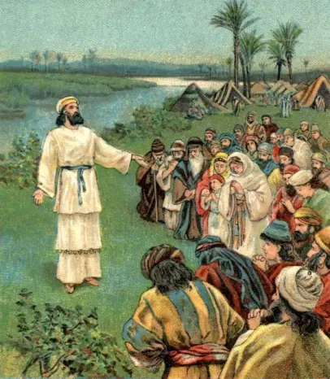
Ezra 8:21
There by the Ahava Canal,
I announced we would all fast
and deny ourselves before our God.
We would ask God for a safe trip
for ourselves, our children,
and all our possessions.
Ezra

Slide 13
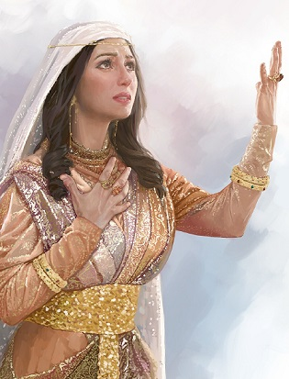
Esther
Esther 4:16
“Go, gather together all the Jews…
and fast for me.
Do not eat or drink for three days,
night or day.
I and my attendants will fast as you do.
When this is done, I will go to the king,
even though it is against the law.
And if I perish, I perish.”

Slide 14
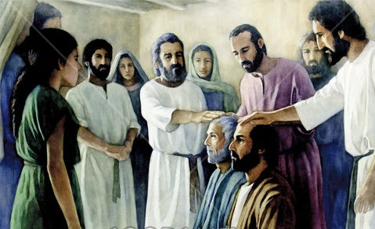
Church at Antioch
Acts 13:1-3
While they were worshipping the Lord & fasting,
the Holy Spirit said, ‘Set apart for me Barnabas & Saul
for the work to which I have called them.’
So after they had fasted and prayed,
they placed their hands on them and sent them off.

Slide 15
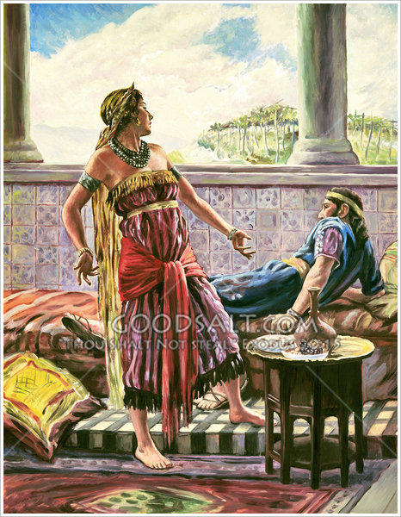
Queen Jezebel
1 Kings 21:7
Jezebel his wife said,
‘Is this how you act as king over Israel?
Get up and eat! Cheer up.
I’ll get you the vineyard of
Naboth the Jezreelite.’

Slide 16
Queen Jezebel
1 Kings 21:9
‘Proclaim a day of fasting
& give Naboth a prominent seat
among the people.
But put two scoundrels opposite him
and get them to bring charges
that he has cursed both God & the king. Then take him out & stone him to death.’

Slide 17
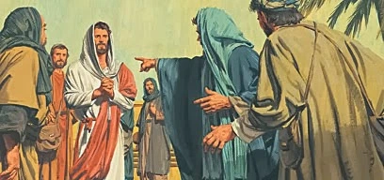
Now John’s disciples & the Pharisees
were fasting.
People asked Jesus,
‘How is it that John’s disciples
& the Pharisees’ disciples are fasting,
but yours are not?’
Mark 2:18-20

Slide 18
Jesus answered,
‘How can the guests of the bridegroom
fast while he is with them?
They can’t, so long as they have him with them.
But the time will come when
the bridegroom will be taken from them,
& on that day
they will fast.
Mark 2:18-20

Slide 19
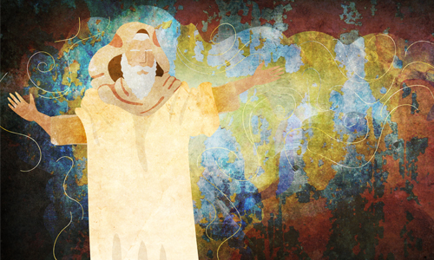
You cannot fast
as you do today
& expect your voice
to be heard on high!...
Is this what you call a fast?
Isaiah 58:4

Slide 20
Is this what you call
fasting?
Do you really think this
will please the Lord?
Isaiah 58:5

Slide 21
“No, this is the kind of fasting I want:
Free those who are wrongly imprisoned;
Lighten the burden of
those who work for you.
Let the oppressed go free
& remove the chains that bind people.
Share your food with the hungry
& give shelter to the homeless.
Give clothes to those who need them,
& do not hide from relatives
who need your help.

Slide 22
“Then
your salvation
will come like the dawn,
& your wounds will quickly heal.
Your godliness will lead you forward,
& the glory of the Lord
will protect you from behind.
Then when you call,
the Lord will answer.
‘Yes, I am here,’
he will quickly reply.”

Slide 23
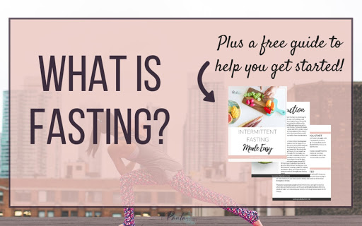

Slide 25
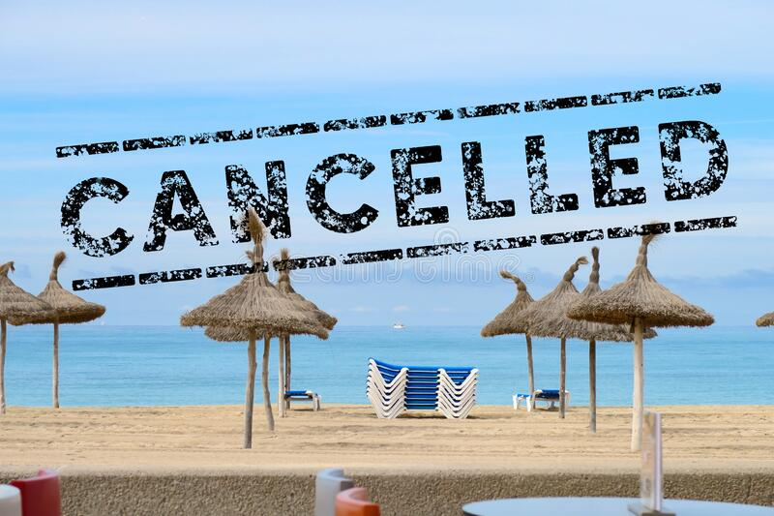

Slide 26
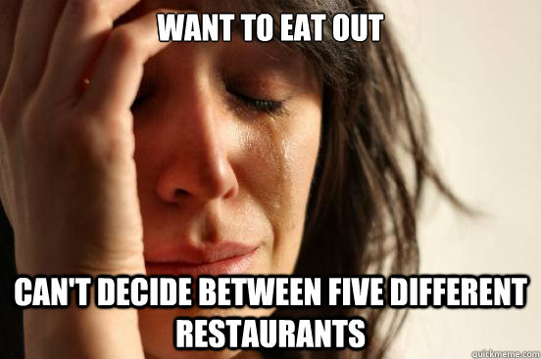

Slide 27
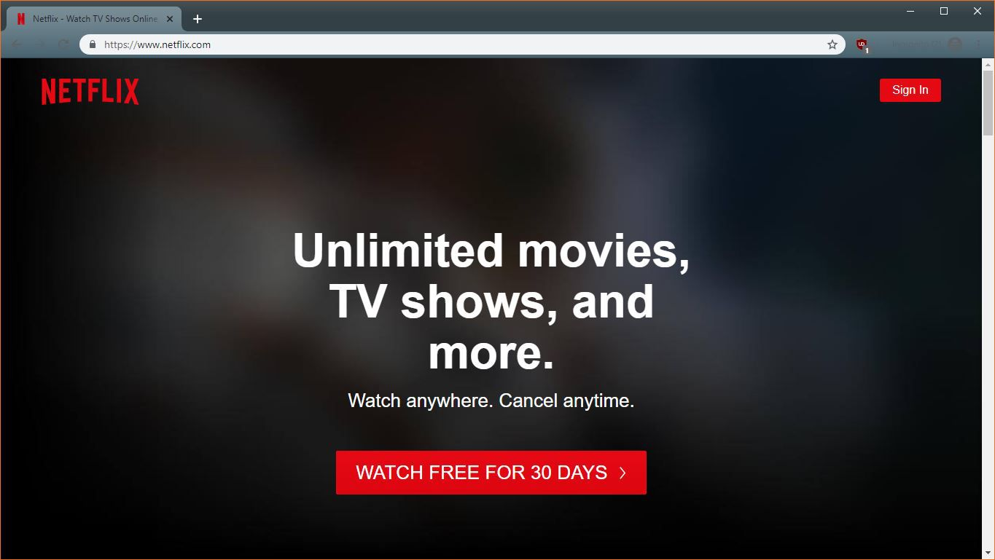

Slide 28
Then Jesus called the crowd
to him along with his disciples & said:
‘Whoever wants to be my disciple
must deny themselves…
What good is it for someone
to gain the whole world,
yet forfeit their soul?
Mark 8:34-36

Slide 29
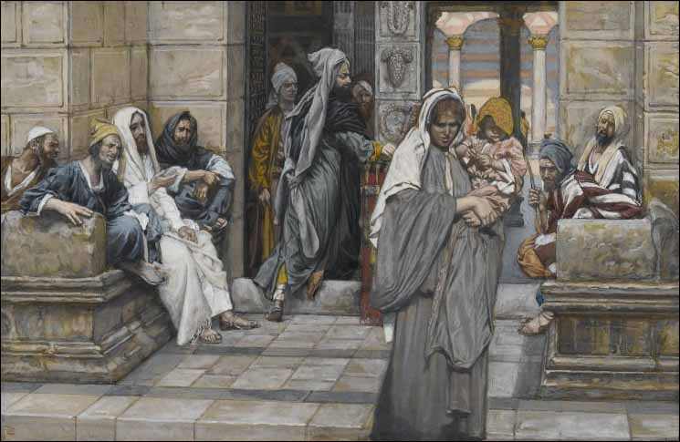
… but she, out of her poverty, put in everything – all she had to live on.

Slide 30
Jurgen Klopp
People also ask
How much is Jurgen Klopp worth?

Slide 31
Prayer
We are linked together as those who
have heard the message of the Cross.
We trust in the death & rising of Jesus,
and we desire the fullness of your Spirit.
Help us we pray
to know Your Word speaking to us
to learn the way of Jesus for today
to take up our Cross….
May we see more clearly
what this means for our consciences
& our values, & our lifestyle this week.
Amen

