Slide 2
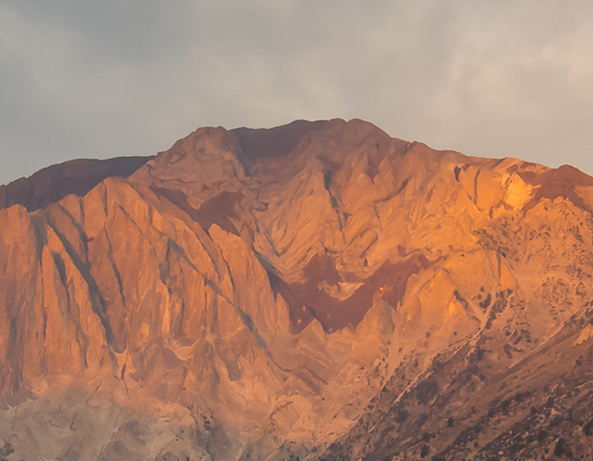
“You shall not make
for yourself an idol…”

Slide 3
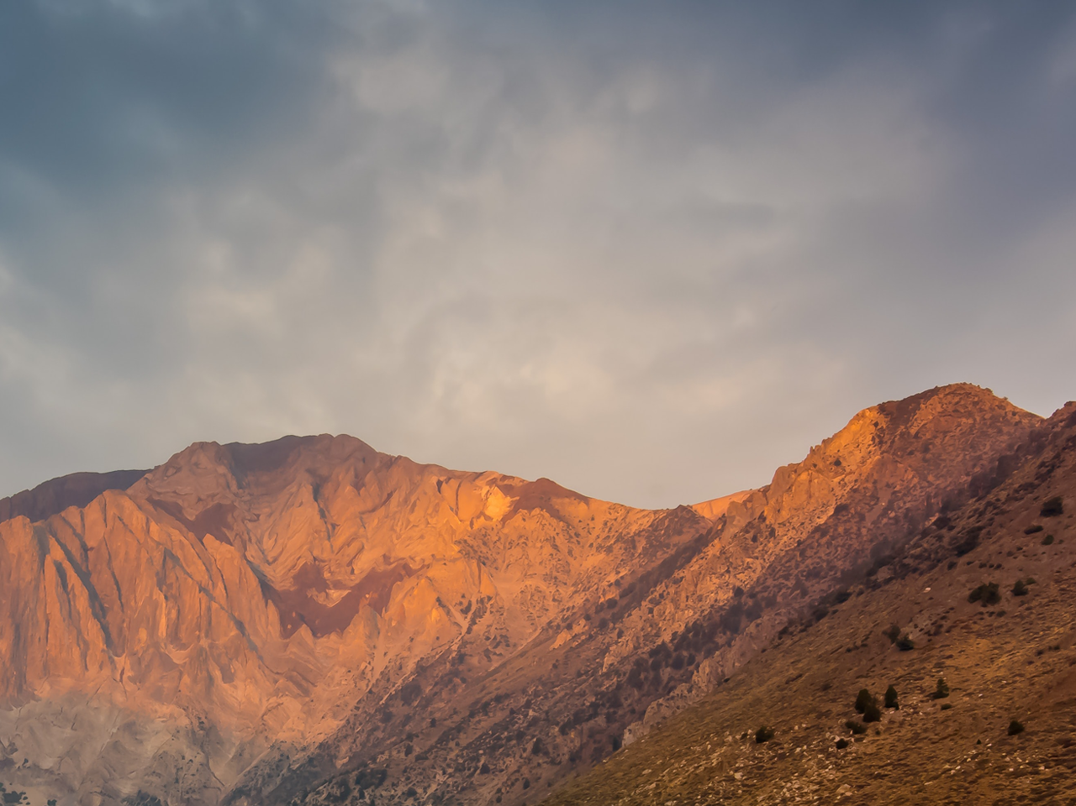
Psalm 115
Not to us, LORD, not to us
but to your name be the glory,
because of your love & faithfulness

Slide 4
Exodus 20
And God spoke all these words:
I am the Lord your God,
who brought you out of Egypt,
out of the land of slavery.
1 ‘You shall have no other gods before me.
2 ‘You shall not make for yourself an image
in the form of anything in heaven above
or on the earth beneath or in the waters below.
You shall not bow down to them or worship them;
for I, the Lord your God, am a jealous God, punishing the children for the sin of the parents to the third & fourth generation
of those who hate me,
but showing love to a thousand generations
of those who love me and keep my commandments.

Slide 5
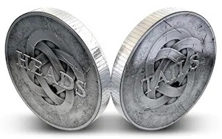
‘You shall have no other gods before me’
‘You shall not make for yourself an image’

Slide 7
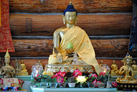
“You shall not murder.
“You shall not commit adultery.
“You shall not steal.
“You shall not give false testimony against your neighbor.
“You shall not covet your neighbour’s house. You shall not covet your neighbour’s wife, or his male or female servant, his ox or donkey, or anything that belongs to your neighbour.”
I’m not into idols!

Slide 8
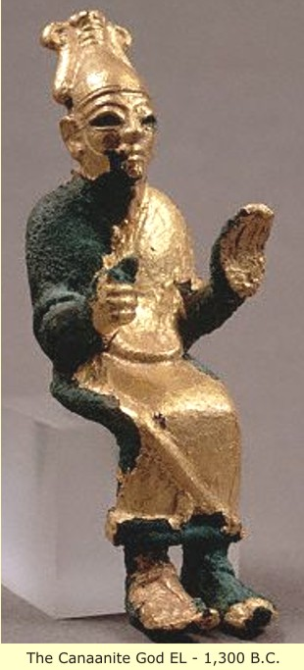
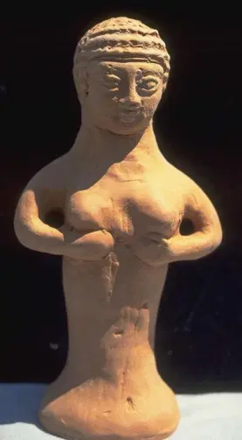
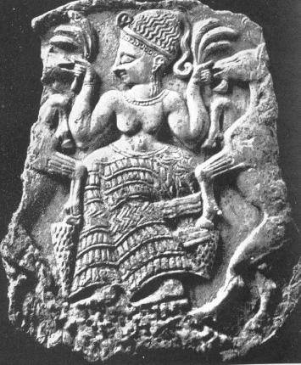
They are “nothings”!

Slide 9
Isaiah 44:12
The blacksmith takes a tool
and works with it in the coals;
he shapes an idol with hammers,
he forges it with the might of his arm.
He gets hungry and loses his strength;
he drinks no water and grows faint!

Slide 10
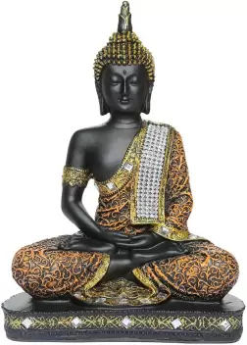
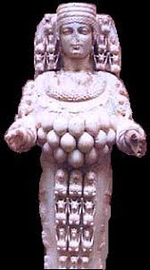
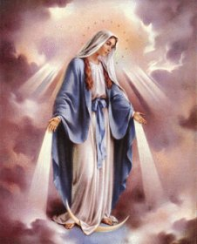

Slide 11
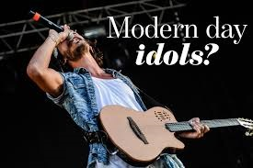
I’ve got those covered!
“You shall not murder.
“You shall not commit adultery.
“You shall not steal.
“You shall not give false testimony against your neighbor.
“You shall not covet your neighbour’s house. You shall not covet your neighbour’s wife, or his male or female servant, his ox or donkey, or anything that belongs to your neighbour.”

Slide 12
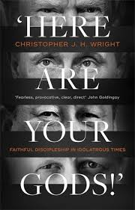
Christopher Wright

Slide 13
2 reflections
from the
Old Testament

Slide 14
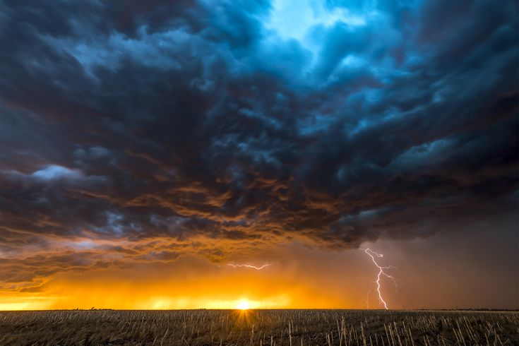
Here
are
your
gods!

Slide 15
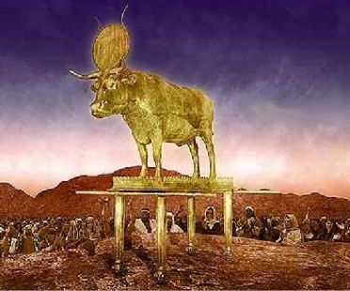
Exodus 32:4
Aaron took what they handed
him & made it into an idol cast
in the shape of a calf, fashioning it with a tool.
Then they said,
‘These are your gods’
Israel, who brought you up out of Egypt.’

Slide 16
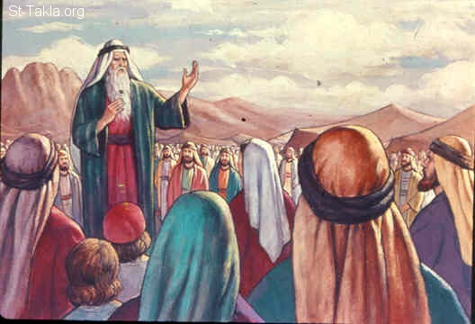
1240 BC

Slide 17
Moses – authority of God’s word
At the end of his life
Moses recalls God ‘meeting’
with his people at the Mountain
* Obnavljanje uticaja Reči

Slide 18
Deuteronomy 4:10
Remember the day
you stood before the Lord your God at Horeb… You …stood at the foot of the mountain
while it blazed with fire to the very heavens,
with black clouds and deep darkness.
Then the Lord spoke to you out of the fire.
You heard the sound of words
but saw no form; there was only a voice.

Slide 19
Deuteronomy 4:13
The LORD declared to you his covenant,
the Ten Commandments ...
You saw no form of any kind
the day the Lord spoke to you at Horeb out of the fire.
Therefore watch yourselves very carefully,
so that you do not become corrupt &
make for yourselves an idol,
an image of any shape…

Slide 20
Deuteronomy 4:13
The LORD declared to you his covenant,
the Ten Commandments...
You saw no form of any kind
Therefore watch yourselves very carefully, so that you
do not …
make for yourselves an idol,
an image of any shape…

Slide 21
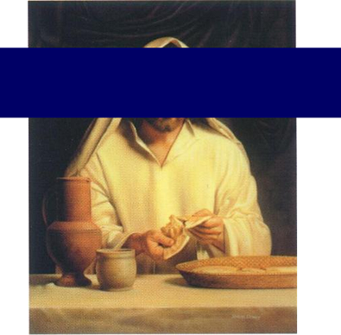
Jesus took bread, & when he had given thanks,
he broke it & gave it to his disciples…

Slide 22
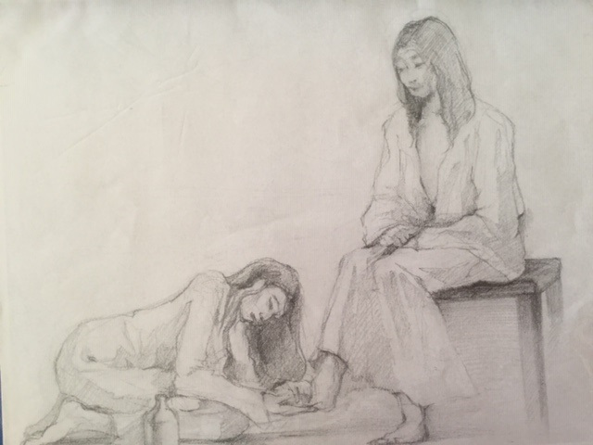

Slide 23
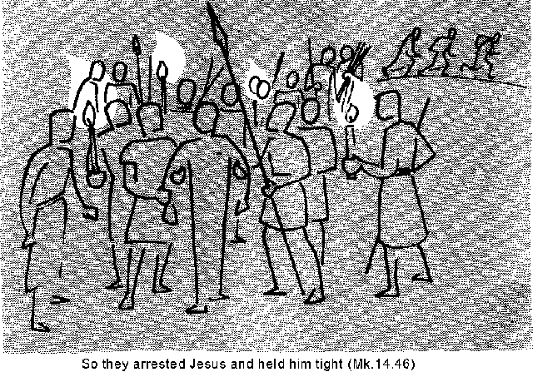
Mark 14:50
Then everyone deserted him & fled everyone deserted & fled

Slide 24
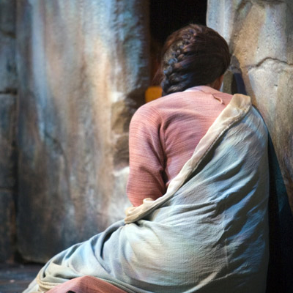
Jesus said,
“Do not hold on to me,
for I have not yet ascended to the Father.
Go instead to my
brothers & tell them,
‘I am ascending
to my Father
and your Father,
to my God
and your God.’”

Slide 25
Deuteronomy 4
“You were shown these things
so that you might know that the Lord is God;
besides him there is no other.
Acknowledge and take to heart this day
that the Lord is God
in heaven above
& on the earth below.”

Slide 26
Here
are
your
gods!

Slide 27
Kingdom of Israel - Solomon
Mediterranean
Galilee
931 BC
Solomon
left a divided kingdom
Jerusalem
Dead Sea

Slide 28
Kingdom of Israel - Solomon
Mediterranean
Galilee
Jeroboam
& 10 tribes rebelled
Jerusalem
His son Rehoboam ignored advice
Dead Sea

Slide 29
1 Kings 12:28
After seeking advice, the king made two golden calves. He said to the people, ‘It is too much for you to go up to Jerusalem.
‘Here are your gods’
Israel, who brought you up out of Egypt.’

Slide 30
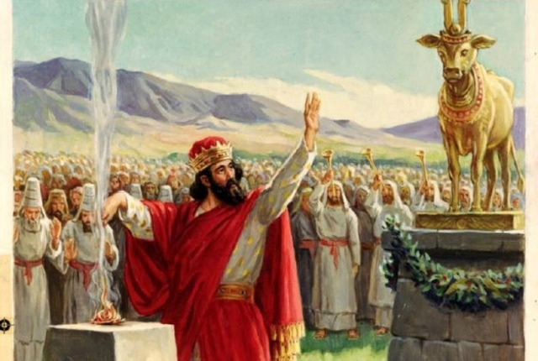
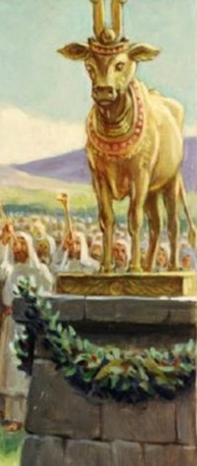
Jeroboam, rebel king, making the
north of Israel a separate nation
“Here are your gods!”

Slide 31
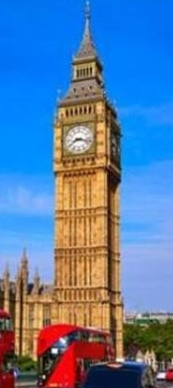
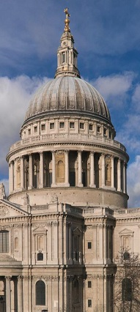
The creation of ‘gods’
to become a national cultural religion which ‘glorifies’ the state
& which gives us
our security,
our sense of identity,
something which is
‘our possession’

Slide 32
Isaiah 2:12-18
The Lord Almighty has a day in store
for all the proud & lofty,
for all that is exalted
(& they will be humbled)…
The arrogance of man will be brought low
and human pride humbled;
the Lord alone will be exalted in that day,
and the idols will totally disappear.

Slide 33
2 reflections
from the
New Testament

Slide 34
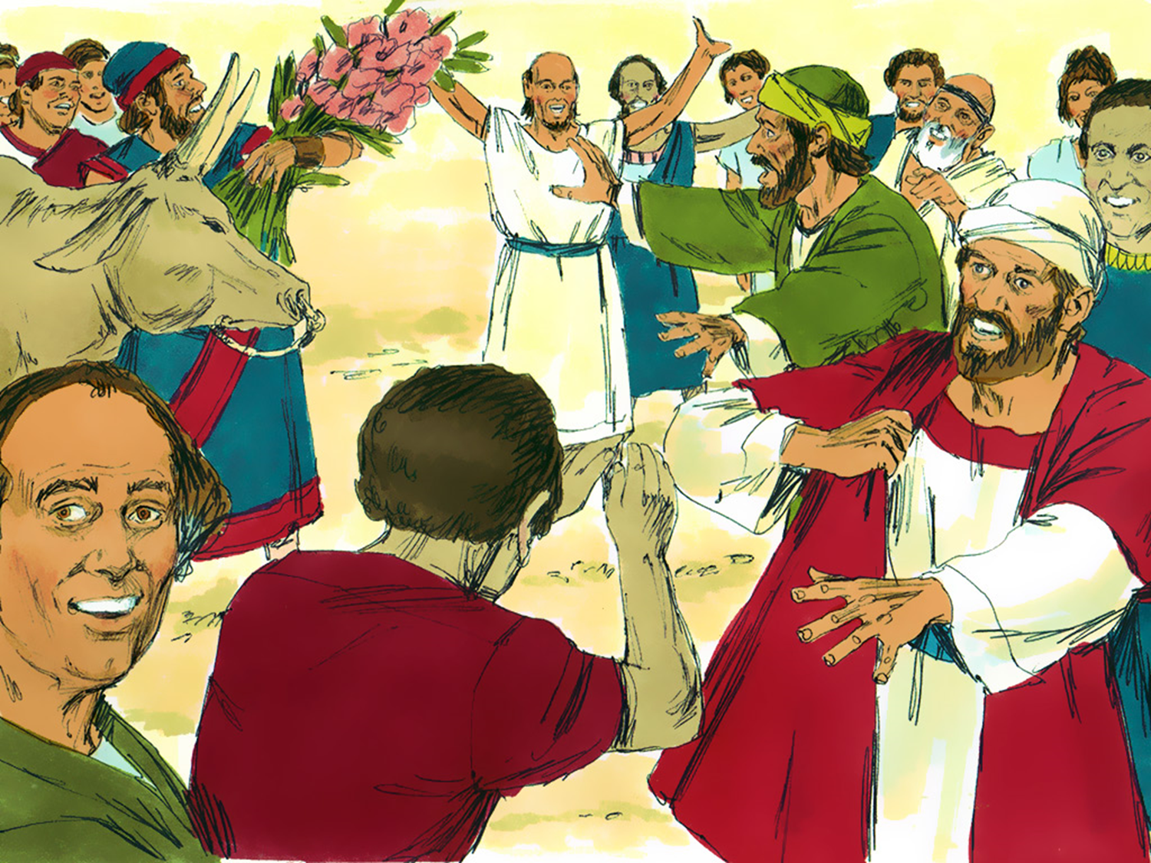
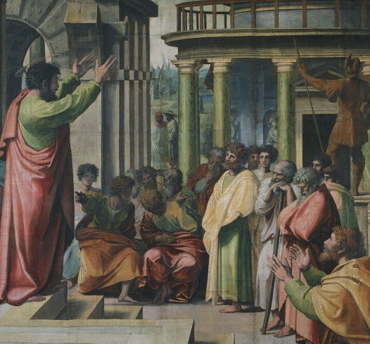
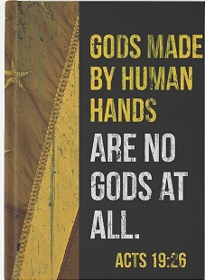
At Lystra
Turn from these worthless things to the living God!
At ATHENS
God who made the world does not live in temples made by human hands
At EPHESUS
“Paul says that gods by human hands are no gods at all!”

Slide 35
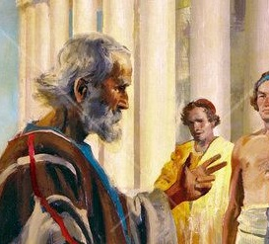
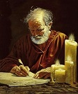
Paul to non Christians
Uncompromising, but not offensive
the result of ignorance
the emptiness of idolatry
highlighting God’s kindness & patience
Paul to Christians
Uncompromising, plus intense warnings
Idolatry leads to God’s righteous judgment 1:18
God gives people over to shameful lusts 1:26
God gives people over to corrupted minds 1:28

Slide 37
Letter to the Romans
For although they knew God,
they neither glorified him as God
nor gave thanks to him,
but their thinking became futile
and their foolish hearts were darkened.
Although they claimed to be wise,
they became fools and exchanged
the glory of the immortal God for images…
Romans 1:21

Slide 38
inequality
active termination of life
hostility to migrants
consumerism & ‘rights’
morality
truth

Slide 39
Jeremiah 29:7
Seek the peace & prosperity of the city
to which I have carried you into exile.
Pray to the Lord for it,
because if it prospers, you too will prosper.’

Slide 40
1 John 5:21
“Dear children,
Keep yourself from idols”

