Slide 1
Exodus 15: 1-21
Then Moses and the Israelites sang this song to the Lord:
‘I will sing to the Lord, for he is highly exalted. Both horse and driver he has hurled into the sea.
² ‘The Lord is my strength and my defence; he has become my salvation. He is my God, and I will praise him, my father’s God, and I will exalt him. ³ The Lord is a warrior; the Lord is his name.

Slide 2
⁴ Pharaoh’s chariots and his army he has hurled into the sea. The best of Pharaoh’s officers are drowned in the Red Sea. ⁵ The deep waters have covered them; they sank to the depths like a stone. ⁶ Your right hand, Lord, was majestic in power. Your right hand, Lord, shattered the enemy.

Slide 3
⁷ ‘In the greatness of your majesty you threw down those who opposed you. You unleashed your burning anger; it consumed them like stubble. ⁸ By the blast of your nostrils the waters piled up. The surging waters stood up like a wall; the deep waters congealed in the heart of the sea.

Slide 4
⁹ The enemy boasted, “I will pursue, I will overtake them. I will divide the spoils; I will gorge myself on them. I will draw my sword and my hand will destroy them.” ¹⁰ But you blew with your breath, and the sea covered them. They sank like lead in the mighty waters.

Slide 5
¹¹ Who among the gods is like you, Lord? Who is like you – majestic in holiness, awesome in glory, working wonders?
¹² ‘You stretch out your right hand, and the earth swallows your enemies. ¹³ In your unfailing love you will lead the people you have redeemed. In your strength you will guide them to your holy dwelling.

Slide 6
¹⁴ The nations will hear and tremble; anguish will grip the people of Philistia. ¹⁵ The chiefs of Edom will be terrified, the leaders of Moab will be seized with trembling, the people of Canaan will melt away; ¹⁶ terror and dread will fall on them. By the power of your arm they will be as still as a stone – until your people pass by, Lord, until the people you bought pass by.

Slide 7
¹⁷ You will bring them in and plant them on the mountain of your inheritance – the place, Lord, you made for your dwelling, the sanctuary, Lord, your hands established.
¹⁸ ‘The Lord reigns for ever and ever.’
¹⁹ When Pharaoh’s horses, chariots and horsemen went into the sea, the Lord brought the waters of the sea back over them, but the Israelites walked through the sea on dry ground.

Slide 8
²⁰ Then Miriam the prophet, Aaron’s sister, took a tambourine in her hand, and all the women followed her, with tambourines and dancing. ²¹ Miriam sang to them:
‘Sing to the Lord, for he is highly exalted. Both horse and driver he has hurled into the sea.’

Slide 9
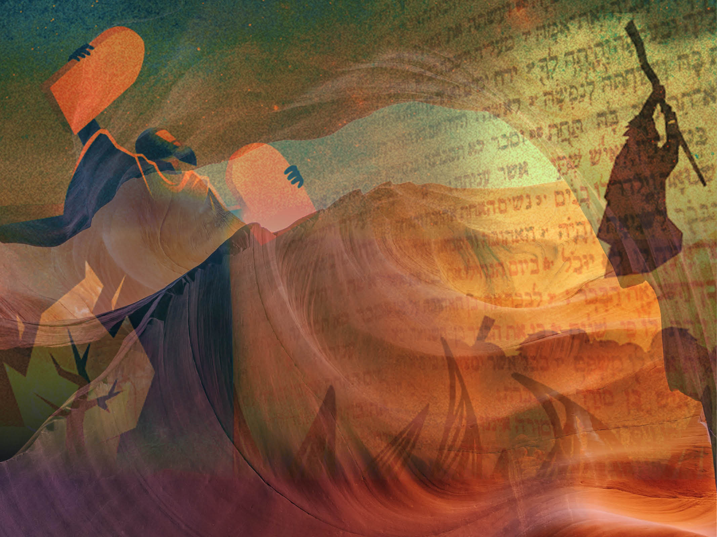
God’s Salvation Song…
Exodus 15:1-21

Slide 11
Exodus 14 – Crossing the Red Sea…
… The pursuing Egyptian army is drowned.

Slide 12
Exodus 15 – God’s people rescued and free…
… free from slavery, free to move on towards The Promised Land…
…singing of their salvation…

Slide 13
God’s Salvation Song: Exodus 15
God as the subject and the object…
A song to God…
A song about God…

Slide 14
God’s Salvation Song: Exodus 15
Praising God for:
what he has done (vv1-10)…
what he will do (vv13-18)…
who he is…

Slide 15
Praising God in song (interactive)…
Type into the “Chat” function any lyrics of hymns/worship songs that come to mind, as a result of these verses in Exodus 15…

Slide 16
Praising God in song (interactive)…
Type into the “Chat” function any lyrics of hymns/worship songs that come to mind, as a result of these verses in Exodus 15…
“I will sing to the Lord, for he is highly exalted” (v1) …
“He is exalted, the King is exalted”?

Slide 17
Praising God in song (interactive)…
Type into the “Chat” function any lyrics of hymns/worship songs that come to mind, as a result of these verses in Exodus 15…
“The Lord is my strength and my defence, he has become my salvation”(v2) …

Slide 18
Praising God in song (interactive)…
Type into the “Chat” function any lyrics of hymns/worship songs that come to mind, as a result of these verses in Exodus 15…
“Your right hand Lord was majestic in power” (v6) …

Slide 19
Praising God in song (interactive)…
Type into the “Chat” function any lyrics of hymns/worship songs that come to mind, as a result of these verses in Exodus 15…
“Who among the gods is like you Lord?” (v11) …

Slide 20
Praising God in song (interactive)…
Type into the “Chat” function any lyrics of hymns/worship songs that come to mind, as a result of these verses in Exodus 15…
“Who is like you – majestic in holiness, awesome in glory, working wonders?” (v11) …

Slide 21
Praising God in song (interactive)…
Type into the “Chat” function any lyrics of hymns/worship songs that come to mind, as a result of these verses in Exodus 15…
“In your unfailing love you will lead the people you have redeemed.”(v13)…

Slide 22
Praising God in song (interactive)…
Type into the “Chat” function any lyrics of hymns/worship songs that come to mind, as a result of these verses in Exodus 15…
“The Lord reigns for ever and ever” (v18)…

Slide 23
God’s Salvation Song: Exodus 15
The Lord himself as the sole focus…
Nothing of them in it…
All of God in it…

Slide 24
God’s Salvation Song: Exodus 15
The Lord himself as the sole focus…
Nothing of them in it…
All of God in it…
A great model for praise!

Slide 25
God’s Salvation Song: Exodus 15
A congregational song…

Slide 26
God’s Salvation Song: Exodus 15
A congregational song…
…but we can’t currently sing together as a congregation…

Slide 27
God’s Salvation Song: Exodus 15
A song at a moment of supreme triumph… singing when they’re “winning”!

Slide 28
God’s Salvation Song: Exodus 15
A song at a moment of supreme triumph…singing when they’re “winning”!
…Is this our current experience?…

Slide 29
God’s Salvation Song: Exodus 15
These are strange times…
This feels like a “strange land”…

Slide 30
God’s Salvation Song: Exodus 15
These are strange times…
This feels like a “strange land”…
…so…
“How can we sing the Lord’s song in a strange land?” (Psalm 137:4)

Slide 31
God’s Salvation Song: Exodus 15
“How can we sing the Lord’s song in a strange land?” (Psalm 137:4)
Lament…

Slide 32
God’s Salvation Song: Exodus 15
“How can we sing the Lord’s song in a strange land?” (Psalm 137:4)
Lament…
Whole life worship…“living differently”, as a people of hope…

Slide 33
God’s Salvation Song: Exodus 15
“How can we sing the Lord’s song in a strange land?” (Psalm 137:4)
Praise be to the God and Father of our Lord Jesus Christ! In his great mercy he has given us new birth into a living hope through the resurrection of Jesus Christ from the dead, and into an inheritance that can never perish, spoil or fade. This inheritance is kept in heaven for you, who through faith are shielded by God’s power until the coming of the salvation that is ready to be revealed in the last time. (1 Peter 1:3-5).

Slide 34
God’s Salvation Song: Exodus 15
“How can we sing the Lord’s song in a strange land?” (Psalm 137:4)
Keeping the focus on God: who he is, what he’s done, what he will do…

Slide 35
God’s Salvation Song: Exodus 15
“How can we sing the Lord’s song in a strange land?” (Psalm 137:4)
Keeping the focus on God: who he is, what he’s done, what he will do…
Lament…

Slide 36
God’s Salvation Song: Exodus 15
“How can we sing the Lord’s song in a strange land?” (Psalm 137:4)
Keeping the focus on God: who he is, what he’s done, what he will do…
Lament…
“Living differently”, as a people of hope…

Slide 37
Prayer…

