Slide 2
Hebrews 10
¹⁹ Therefore, brothers and sisters, since we have confidence to enter the Most Holy Place by the blood of Jesus, ²⁰ by a new and living way opened for us through the curtain, that is, his body, ²¹ and since we have a great priest over the house of God, ²² let us draw near to God with a sincere heart and with the full assurance that faith brings, having our hearts sprinkled to cleanse us from a guilty conscience and having our bodies washed with pure water. ²³ Let us hold unswervingly to the hope we profess, for he who promised is faithful. ²⁴ And let us consider how we may spur one another on towards love and good deeds, ²⁵ not giving up meeting together, as some are in the habit of doing, but encouraging one another – and all the more as you see the Day approaching…

Slide 3
Hebrews 10
³⁶ You need to persevere so that when you have done the will of God, you will receive what he has promised. ³⁷ For,
‘In just a little while, he who is coming will come and will not delay.’
³⁸ And,
‘But my righteous one will live by faith. And I take no pleasure in the one who shrinks back.’
³⁹ But we do not belong to those who shrink back and are destroyed, but to those who have faith and are saved.

Slide 6
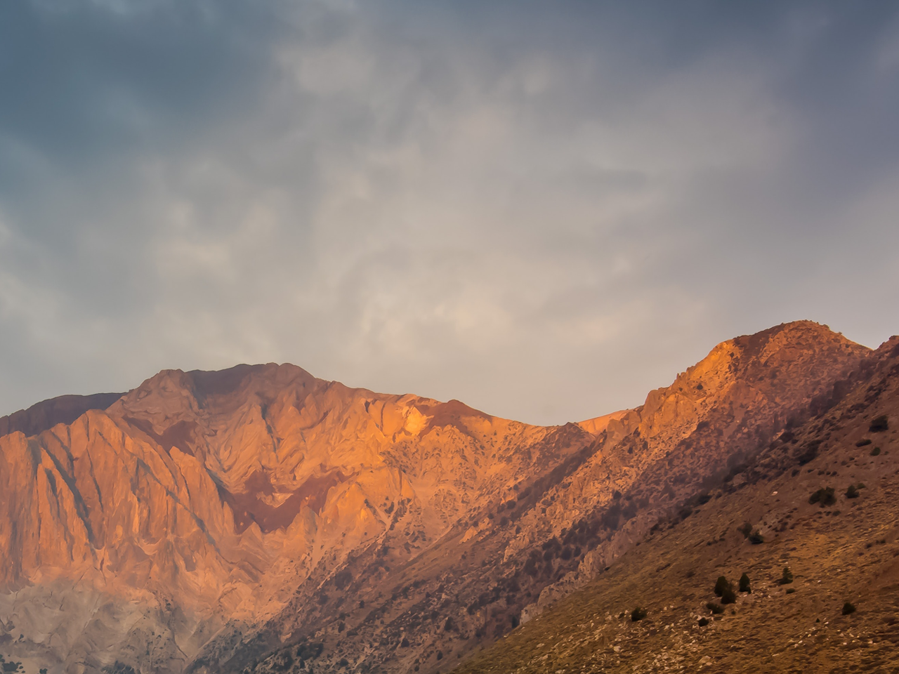
Prayers

Slide 8
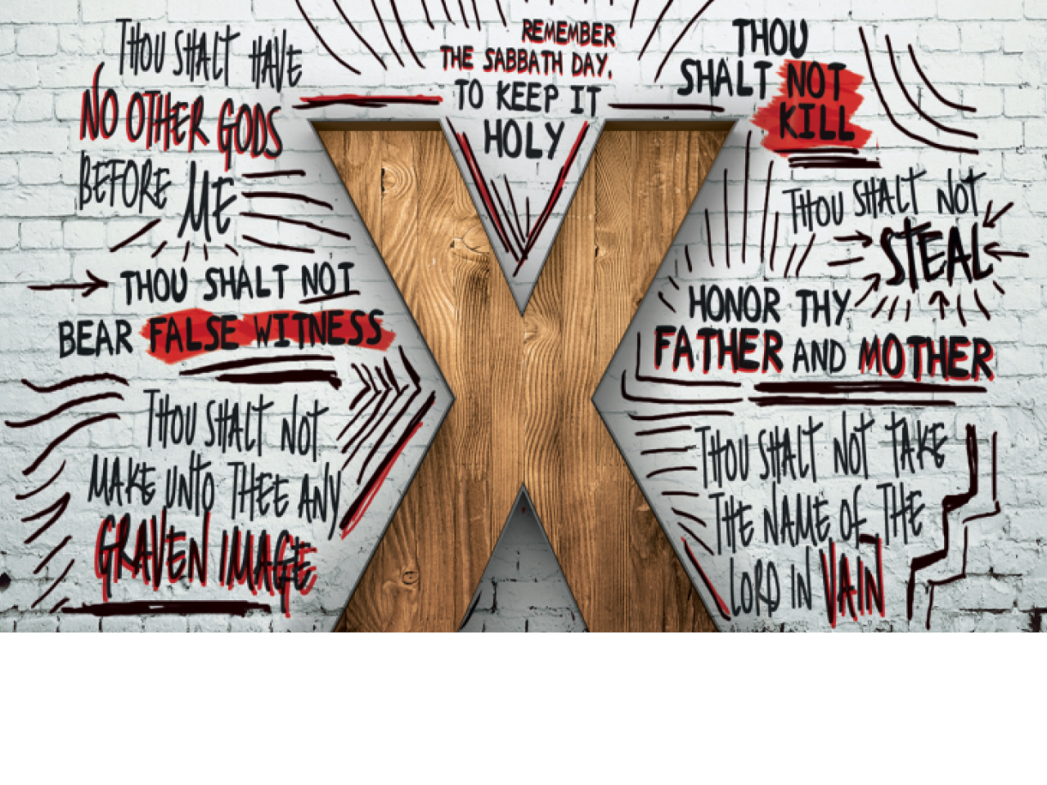
Week 7

Slide 9
1. You shall have no other God – verse 3
2. You shall not make for yourself an idol – verse 4
3. You shall not misuse the name of God – verse 7
4. Remember the Sabbath – verse 8
5. Honour your father & mother – verse 12
6. You shall not murder – verse 13
7. You shall not commit adultery – verse 14
8. You shall not steal – verse 15
9. You shall not give false testimony – verse 16
10 You shall not covet – verse 17

Slide 11
“You shall respect life”

Slide 12
God created life (Genesis 1)…
Jesus came that we may have life in all its fulness (John 10:10)…
Whoever believes in Jesus will not perish, but will have eternal life (John 3:16)…

Slide 13
God created life (Genesis 1)…
So God created mankind in his own image, in the image of God he created them; male and female he created them.
(Genesis 1:27)

Slide 14
God created life (Genesis 1)…
The way we treat other people is an indication of our attitude towards them and towards God, but also an example of the way in which we, ourselves, represent God…

Slide 15
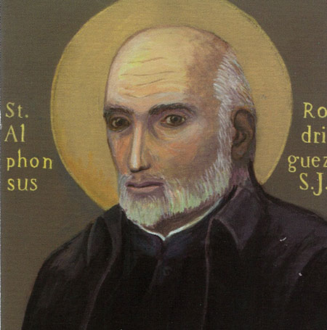
God created life (Genesis 1)…
The way we treat other people is an indication of our attitude towards them and towards God, but also an example of the way in which we, ourselves, represent God…

Slide 16
Moment of reflection and repentance

Slide 18
You have heard that it was said to the people long ago, “You shall not murder, and anyone who murders will be subject to judgment.” But I tell you that anyone who is angry with a brother or sister will be subject to judgment.
^{(Matthew 5:21-22)}

Slide 20
You have heard that it was said to the people long ago, “You shall not murder, and anyone who murders will be subject to judgment.” But I tell you that anyone who is angry with a brother or sister will be subject to judgment.
^{(Matthew 5:21-22)}

Slide 21
Therefore, since we have been justified through faith, we have peace with God through our Lord Jesus Christ, 2 through whom we have gained access by faith into this grace in which we now stand. And we boast in the hope of the glory of God. 3 Not only so, but we also glory in our sufferings, because we know that suffering produces perseverance; 4 perseverance, character; and character, hope. 5 And hope does not put us to shame, because God’s love has been poured out into our hearts through the Holy Spirit, who has been given to us. 6 You see, at just the right time, when we were still powerless, Christ died for the ungodly. 7 Very rarely will anyone die for a righteous person, though for a good person someone might possibly dare to die. 8 But God demonstrates his own love for us in this: while we were still sinners, Christ died for us.
^{(Romans 5:1-8)}

Slide 22
Prayer
Gracious, loving and forgiving God,
Help us, by the power of your Spirit to ourselves be people of grace of love and of forgiveness.
Guard our hearts from anger and bitterness.
Keep us from resentment and insults.
Plant in us, your seeds of relationship, restoration and reconciliation,
That we might grow in your Kingdom-likeness,
Reaching out to others and firmly rooted in you.
Through Jesus Christ our Lord,
Amen

Slide 24
Thank you for coming!
Every blessing for the coming time.

