Slide 1


Slide 2

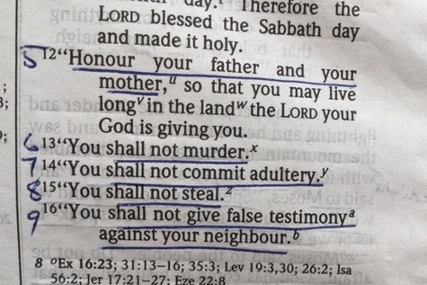

Slide 3
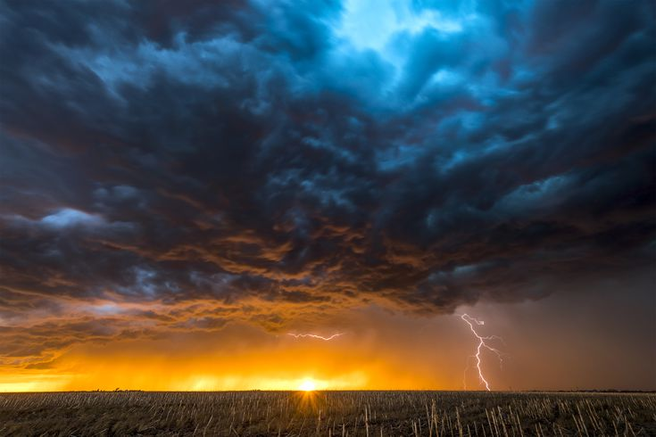
“You shall not
commit adultery”

Slide 4
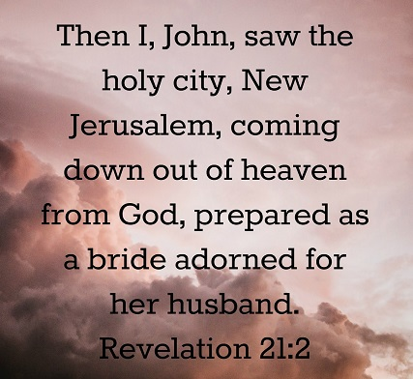

Slide 5


Slide 6
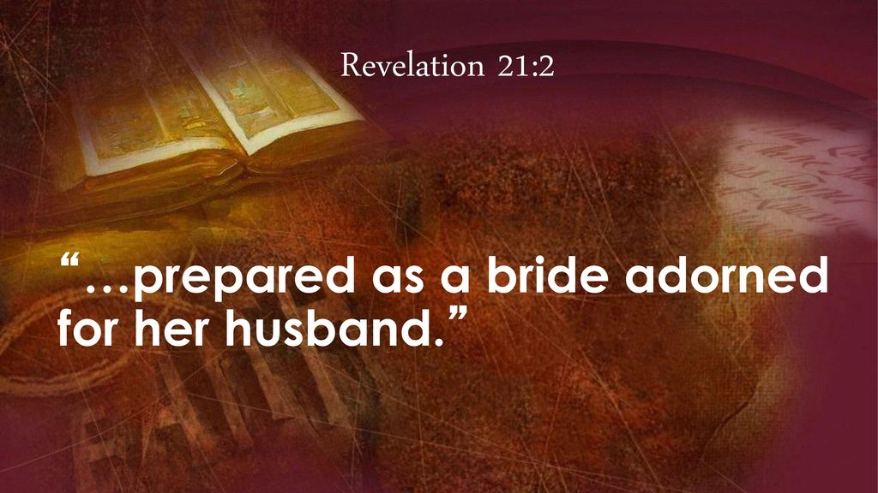

Slide 7
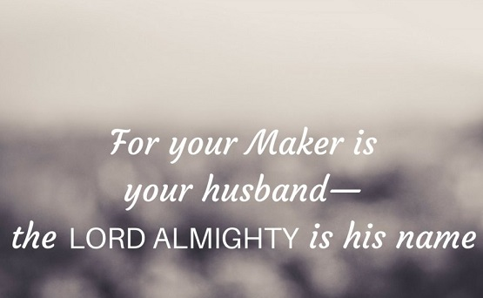
Isaiah 54:5
Isaiah 54:5
Your Maker is your husband –
the Lord Almighty is his name

Slide 8
Our Father we praise you for revealing to us
this glorious prospect for the future.
A glimpse of that day, in your perfect will,
when you will fulfil all your promises
and take to yourself your ‘bride’,
drawing your people
to yourself in a wonderful unity.

Slide 9
A marriage when all will be made complete…
to end our deep unworthiness,
all the failings of your people,
& we will know the wholeness of the healing
of the sacrifice of Christ, your Son
& we will see more fully than we have ever understood,
His love for the church,
by which He gave himself up for her to make her holy.

Slide 10
And we praise you for
this understanding of the gift…
& wonder…
& privilege of marriage.

Slide 11
But we know that this ‘marriage’ has been costly
for our Lord Jesus Christ.
We know that all through the history of your grace
You have had to be patient
and merciful towards an ungrateful people.
As we thought on Sunday
about the grumbling & ingratitude of your people,
liberated from captivity & slavery,
so we come with regret & recall our carelessness
about the riches of this relationship
by which our lives are brought into union with Christ.
We seek your forgiveness,
&, moment by moment,
the renewal of love in our hearts & attitudes.

Slide 12
And Lord, we come in repentance that ‘marriage’
in which a man & a woman come together
- this special relationship of interdependence -
is being lost in our society…
that the partnership which fulfils your pattern for life
- for parenthood, for nurturing young lives,
for sharing example, & love -
is being trashed,
not just by selfishness, & lust,
but often mockery, & even by legislation.

Slide 13
So Lord, we worship you for your faithful,
sacrificial love and grace for your ‘bride’
Help us to reflect on the glorious pattern of your purpose
in a way that blesses our consciences,
all in our fellowship, all families…
and finds its way out into our stricken society
where so many live as single parents, confused children, teenagers without fathers
families coping with divorce, divided loyalties…

Slide 14
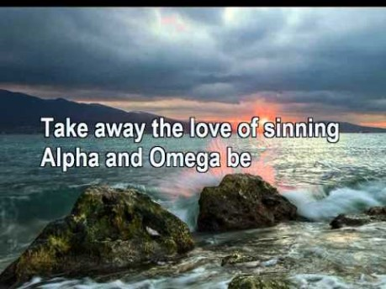
https://www.youtube.com/watch?v=_hmfqe_8SEI

Slide 15
Israel and Assyria
Mediterranean
Sea
Israel
Samaria
•
Judah

Slide 16
Hosea 1
When the Lord first spoke to Israel
through Hosea, he said…
Hosea & Gomer
“Go and get married;
your wife will be unfaithful…
In the same way…
God & His people
my people have left me
and become unfaithful.”

Slide 17
609 BC
c 730 BC
Nineveh
•
Assyria
Mediterranean
Sea
Israel
Judah
Babylon
Egypt
Persian
Gulf
Red
Sea

Slide 18
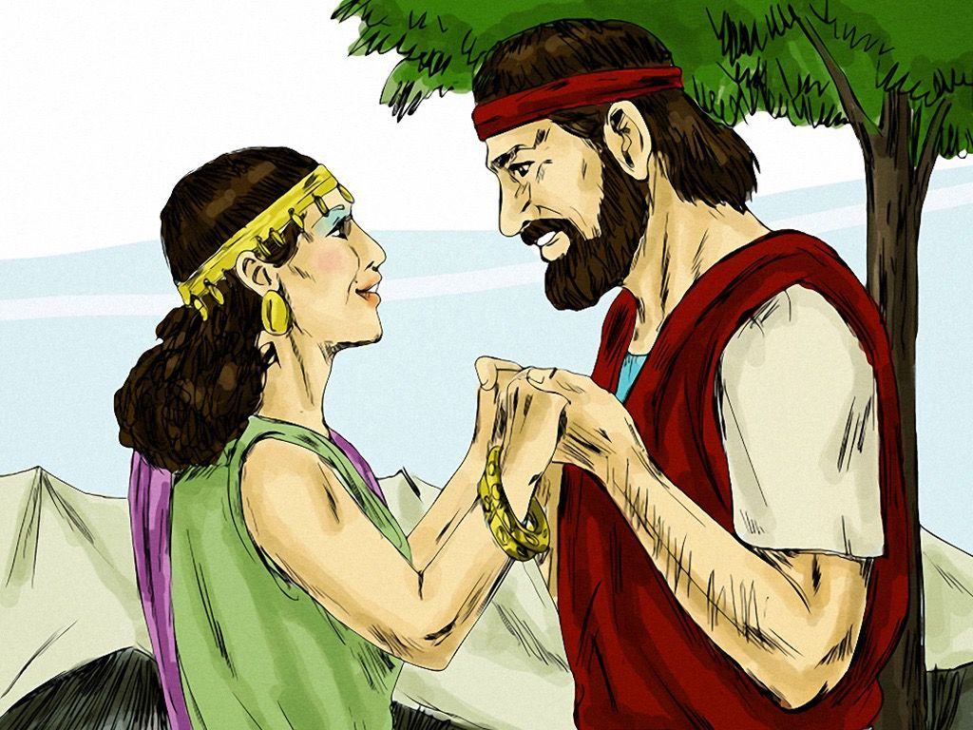
Hosea 1:2
So Hosea married Gomer

Slide 19
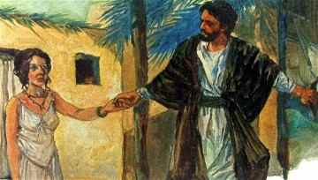
Hosea 2:5
Their mother has been unfaithful

Slide 20
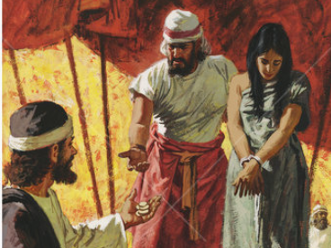
Hosea 3:2
So I bought her back…
though she is an adulteress

Slide 21
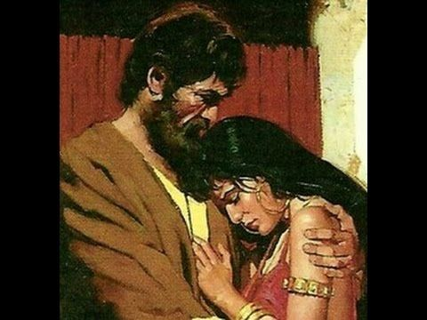
Hosea 3:3
“You must not
be a prostitute
or be intimate
with any man,
& I will behave
the same way
toward you”

Slide 22

Israel and Assyria
Samaria
was destroyed
& the people of ISRAEL
were taken
into exile
Invasion
by
ASSYRIA
Israel
Samaria
•
722

Slide 23
Israel and Assyria
Mediterranean
Sea
Meanwhile…
what was happening in the southern kingdom of
JUDAH?
•
Jerusalem
Judah

Slide 24
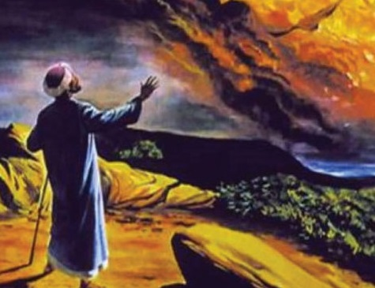
605 BC
593 BC
Assyria
Mediterranean
Sea
Babylon
Judah
•
Ezekiel
in exile
Egypt
Persian
Gulf
Red
Sea

Slide 25
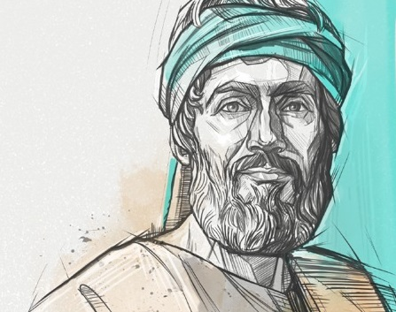
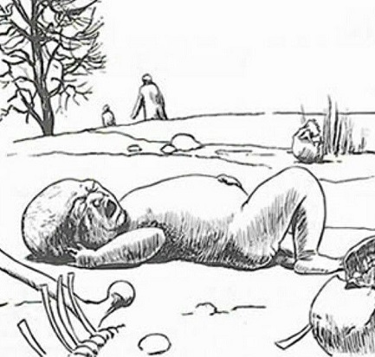
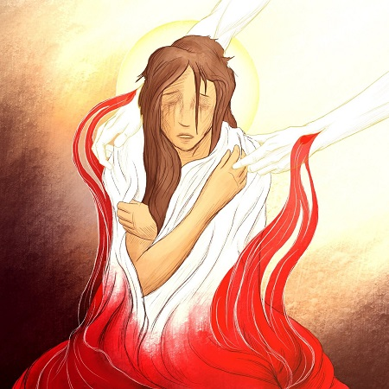
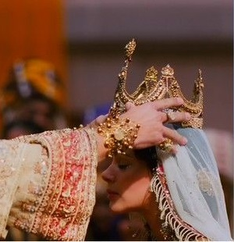
Ezekiel 16
You were thrown out
into the open field
I made you grow like a plant of the field
I saw that you were
old enough for love
I gave you my solemn oath …
& you became mine.
I bathed you … I clothed you …
I dressed you … I adorned you
the splendour I had given you
made your beauty perfect

Slide 26
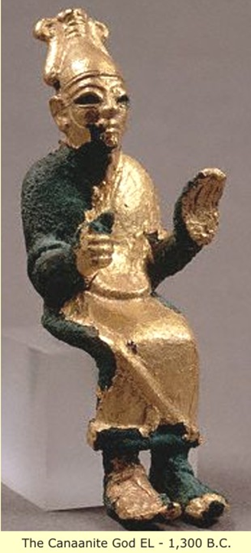
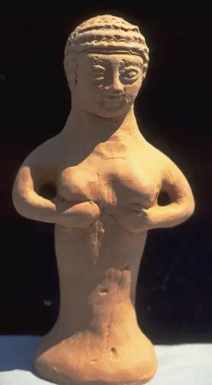
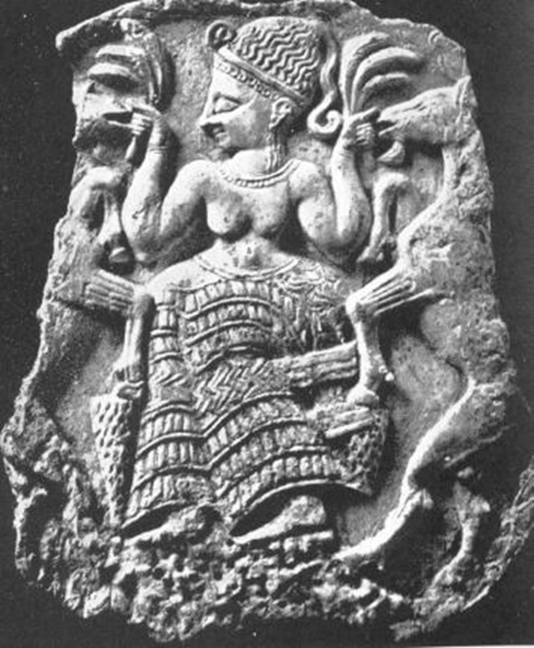
Ezekiel 16
“But you trusted in your beauty
& used your fame to become a prostitute”
“You adulterous wife!
You prefer strangers to your own husband!”

Slide 27
Ezekiel 16
“I will deal with you as you deserve,
because you have despised my oath
by breaking the covenant.”
“Yet I will remember the covenant
I made with you in the days of your youth…”
“I will establish
an everlasting covenant with you.”
“Then you will remember your ways
and be ashamed.”

Slide 28
605 BC
586 BC
Assyria
Mediterranean
Sea
Babylon
Judah
Egypt
Persian
Gulf
Red
Sea

Slide 29
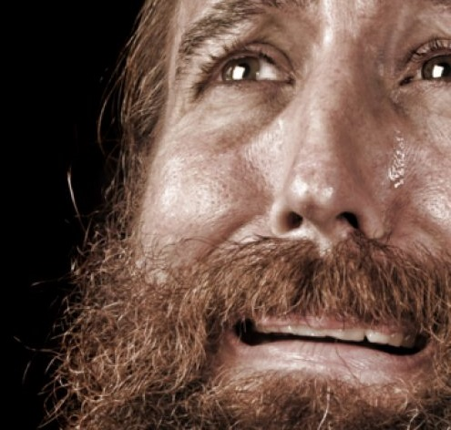
Jeremiah 3
The Lord said to me,
‘Have you seen what faithless Israel has done?
She has gone up on every high hill & under every
spreading tree & has committed adultery there.
I gave faithless Israel her certificate of divorce
and sent her away because of all her adulteries.
Yet I saw that her unfaithful sister Judah
had no fear;
she also went out & committed adultery.

Slide 30
Jeremiah 3
The Lord said to me,
‘Have you seen what faithless Israel has done?
She has gone up on every high hill & under every
spreading tree & has committed adultery there.
I gave faithless Israel her certificate of divorce
and sent her away because of all her adulteries.
Yet I saw that her unfaithful sister Judah
had no fear;
she also went out & committed adultery.

Slide 31
Israel and Assyria
Mediterranean
Sea
Jerusalem & the Temple were destroyed
& the people taken into exile
Invasion
by
BABYLON
•
Jerusalem
Judah
586 BC

Slide 32
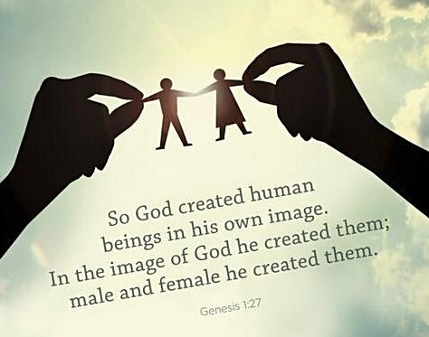

Slide 33


What's your gender?
For some people it's a simple question -- nothing more than checking one of two boxes. But it can get more complicated than simply indicating that you're male or female…
Starting today Google includes support for
an infinite number of gender identities.

Slide 34
“Human sexuality
is a dimension of the
image of God
in human life,
& is therefore
infinitely precious.”

Slide 35
Matthew 5:27
Jesus said:
“You have heard that it was said,
‘Do not commit adultery.’
But now I tell you:
anyone who looks at a woman
& wants to possess her is
guilty of committing adultery
with her in his heart.
So if your right eye causes you to sin,
take it out & throw it away!

Slide 36
Matthew 5:27
Jesus said:
“It is much better for you to lose a part of your body than to have your whole body thrown into hell.
If your right hand causes you to sin,
cut it off & throw it away!
It is much better for you to lose one of your limbs than to have your whole body go off into hell.”

Slide 37
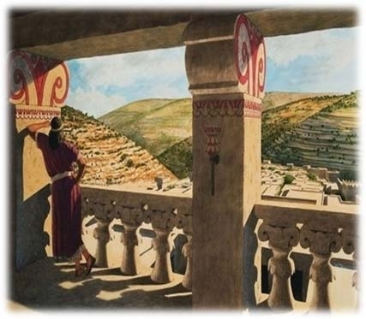

Slide 38
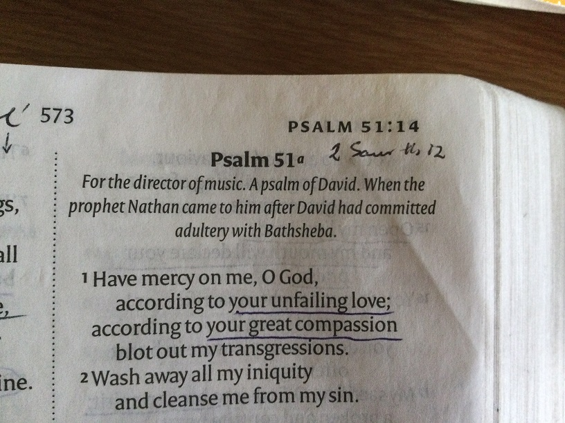

Slide 39
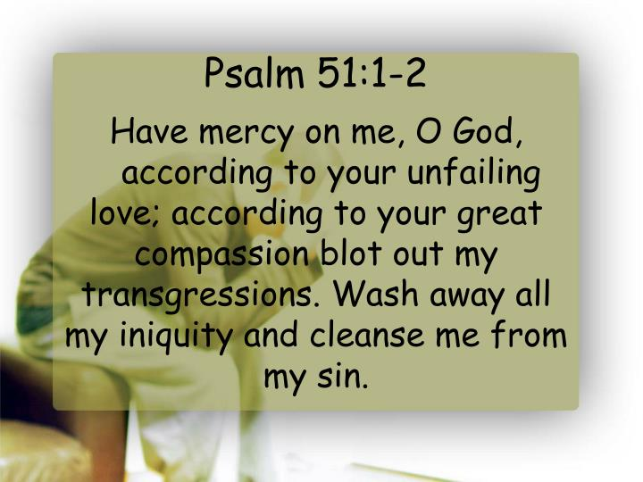

Slide 40
