Slide 1
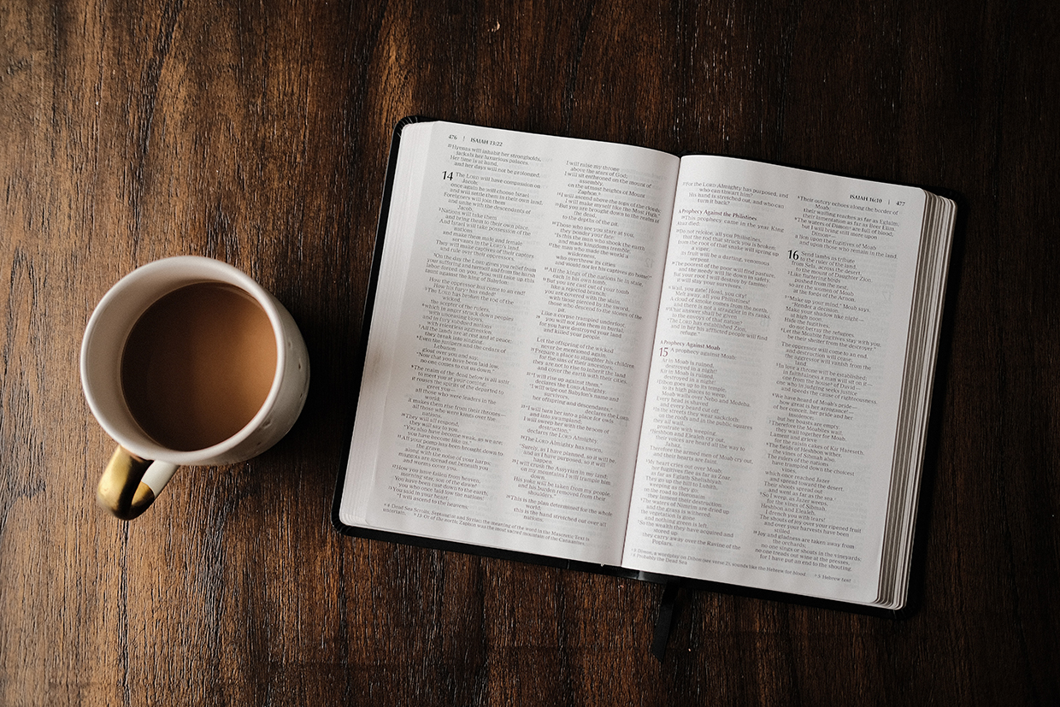
Exodus 17:8-16 | The Amalekites Defeated
The Amalekites came and attacked the Israelites at Rephidim. Moses said to Joshua, “Choose some of our men and go out to fight the Amalekites. Tomorrow I will stand on top of the hill with the staff of God in my hands.”
So Joshua fought the Amalekites as Moses had ordered, and Moses, Aaron and Hur went to the top of the hill.

Slide 2
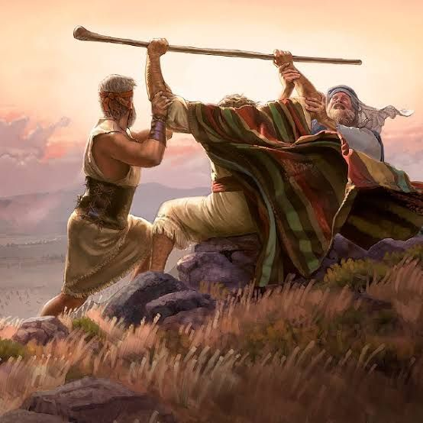
As long as Moses held up his hands, the Israelites were winning, but whenever he lowered his hands, the Amalekites were winning. When Moses’ hands grew tired, they took a stone and put it under him and he sat on it. Aaron and Hur held his hands up — one on one side, one on the other — so that his hands remained steady till sunset. So Joshua overcame the Amalekite army with the sword.
Then the Lord said to Moses,

Slide 3
“Write this on a scroll as something to be remembered and make sure that Joshua hears it, because I will completely blot out the name of Amalek from under heaven.”
Moses built an altar and called it The Lord is my Banner. He said, “Because hands were lifted up against the throne of the Lord, the Lord will be at war against the Amalekites from generation to generation.”

Slide 4
Exodus 17:8-16
‘Hands lifted high’

Slide 5
In this passage in Exodus we see that the Amalekites launch an unprovoked surprise attack against God’s people.
There is no record that the Jews had to fight any battles when they were slaves in Egypt. Even on the night of their deliverance they didn’t have to fight the Egyptian army, because the Lord fought for them.
“Stand firm and you will see the Salvation of the Lord which he will show to you today” Exodus - 14:13

Slide 6
God’s people have been set free from bondage and are now pilgrims on a journey to the promised land.
They face opposition and conflict. This is going to be a reoccurring theme for God’s people.
Before their rescue and salvation there is no conflict.
After their rescue and salvation there is Conflict.
It is almost as if they have been freed to fight!

Slide 7
In the first half of Exodus we see God accomplishing his work of delivering and saving his people from captivity.
From this point on in the story we will see God securing the future of his people as he leads them towards the promised land.
It is going to be a journey which includes both internal conflicts and external conflicts that threaten this worshipping community.

Slide 8
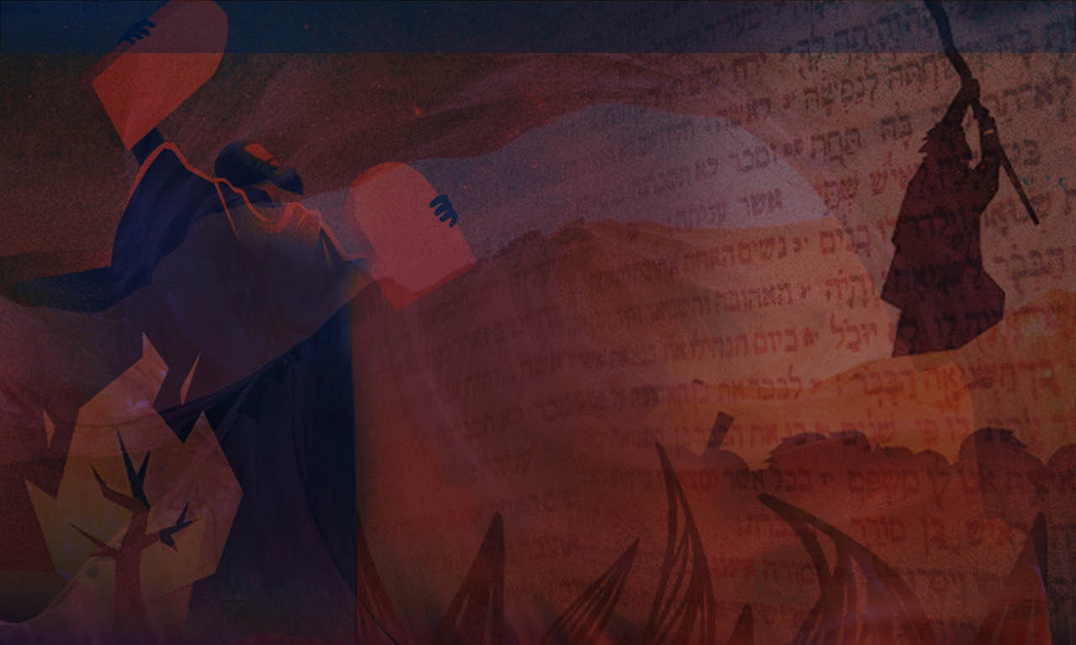
Internal moaning and complaining can kill worship
External conflicts from enemies that can kill worshippers.

Slide 9
God’s people had seen and experienced a miraculous deliverance from the hands of the Egyptians.
We like the Hebrews have seen a decisive victory. The Hebrews were set free from slavery in Egypt. We have been set free from the power of sin and death through Jesus Christ. His death upon the cross and his resurrection from the dead has bought us freedom.
Like the Hebrews, we too are on a journey to the promised land. This place is not our home we are passing through this world. And like the Hebrews, we have and will continue to encounter foes along the way.

Slide 10
It seems to me that we have been called not to a life of comfort but a life of conflict.
1 John 2 – reminds us that we will have conflict with the world, the flesh (the sinful nature) and the devil.

Slide 11
PRAYER displays that God is the Saviour of his people
Although Joshua led the Israelite army into battle, the spotlight of the story shines on Moses at the top of the hill.
‘As long as Moses held up his hands, the Israelites were winning, but whenever he lowered his hands the Amalekites were winning’ Verse 11

Slide 12
Phil Moore in his commentary states:
‘What mattered most was not the strength of Israel’s army but the strength of Israel’s God, as Moses laid hold of his throne in prayer.
Most of us know this deep down but we never make it quite so visible as when we give ourselves by faith to preserving prayer’.
Persevering in prayer was key to winning the battle.

Slide 13
The victory did not come through the sword alone but the sword and the staff.
The sword alone represents our own abilities, power, strength, wisdom. If we are honest so many of us trust in these things on a daily basis. When we find ourselves in a fight that is beyond us we realise the importance of the staff.

Slide 14
When victory was achieved God told Moses to write down on a scroll what had happened and what he promised. God promised that he would completely blot out the name of Amalek from under heaven.
Moses then builds an altar and calls it ‘The Lord is my banner’
It was a constant reminder to the people that is was a victory that came about by God’s gracious and mighty hand through prayer. Joshua and his men could not claim to have won this battle through the sword alone.

Slide 15
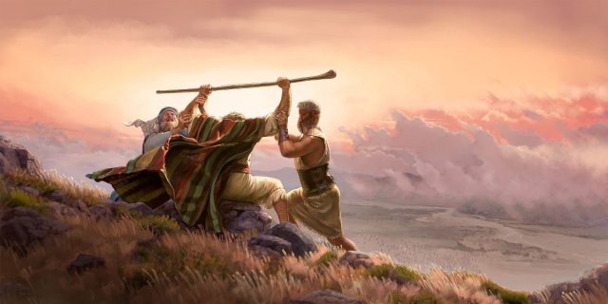
What transpired that day on the top of the hill at Rephidim was crucial for the success of the people of God in the valley.

Slide 16
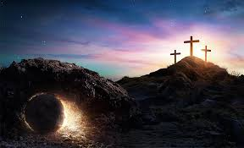
What transpired on the top of a hill two thousand years ago in Jerusalem is crucial to our living a victorious life in Christ as we make our way home.
The stone was physical reminder to the people and the empty tomb is a physical reminder for us too that we have the victory in Christ over the world, the flesh and the devil.

Slide 17
Prayer displays that God is the sustainer of his people
Prayer is hard work. It is difficult at times. We need God’s help even to pray. Paul reminds us that it is the Holy Spirit who helps us in our weakness (Romans 8:26-27)
“The spirit helps us in our weakness. We do not know what we ought to pray for, but the Spirit himself intercedes for us with groans that words cannot express. And he who searches our hearts knows the mind of the Spirit, because the Spirit intercedes for the saints in accordance with Gods will.”

Slide 18
Joshua couldn’t have succeeded without Moses, but Moses couldn’t have prevailed without the support of Aaron & Hur.
We can be those who help others to succeed by sharing the load in prayer. And likewise others can lift our hands up when we get tired and weary from the fight.

Slide 19
Martin Luther confessed:
‘At home in my own house there is no warmth or vigour in me, but in the Church, when the people are gathered together a fire is kindled in my heart and it breaks its way through’.
If Martin Luther needed earthly Aarons and Hurs to help him to pray, then we need them too! So let’s take the opportunities to pray together regularly with others.

Slide 20
As we journey through this life like the Hebrews we will face opposition and we will experience conflict.
We overcome the world, the works of the flesh & the works of the enemy by daily putting on the armour of God and praying. Prayer works and prayer is the work. (Ephesians 6)
As you stand firm and lift holy hands to the lord in prayer my hope is that your prayer life will display God as your Lord and Saviour and Faithful Sustainer.

