Slide 1
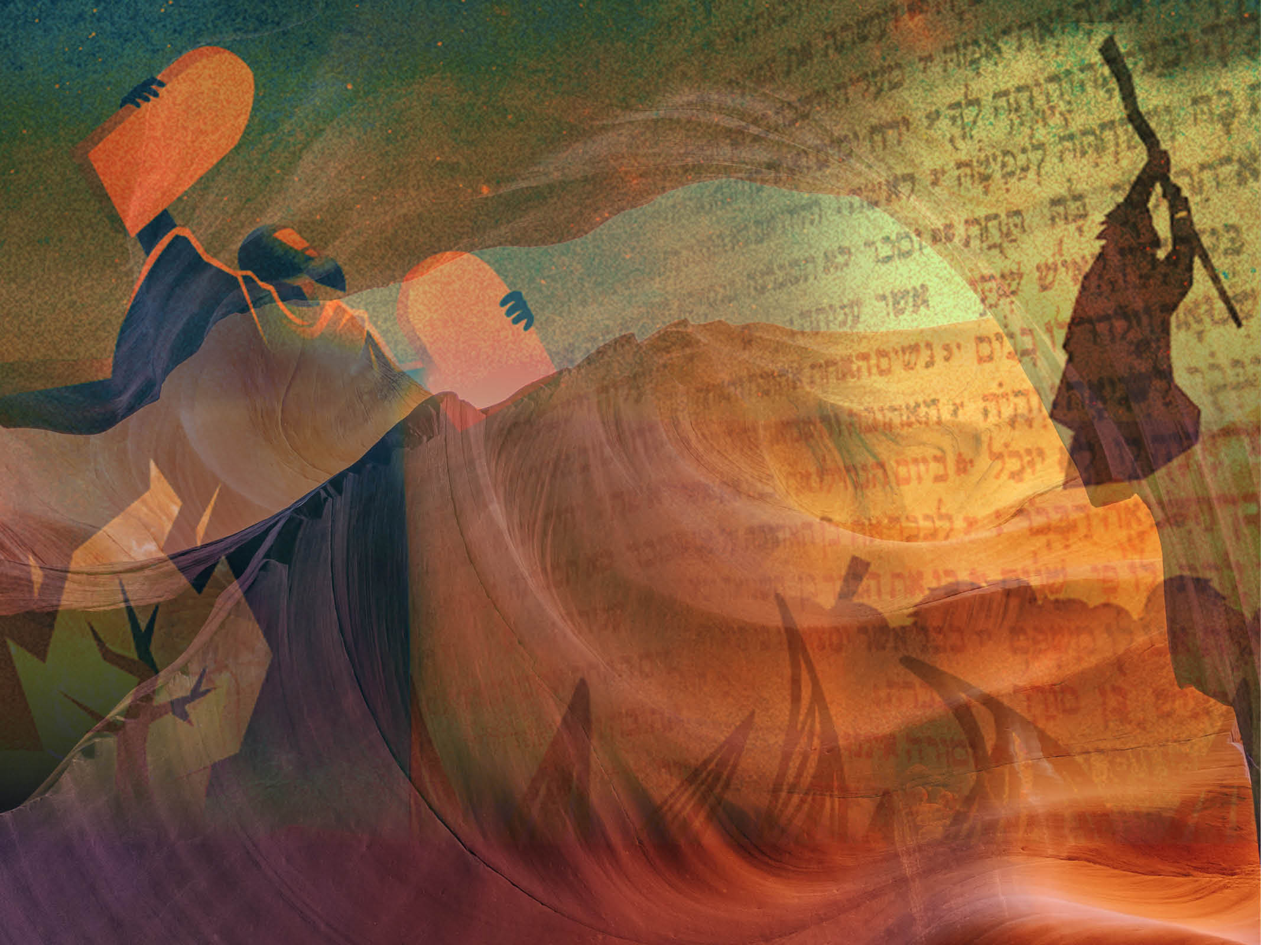
The Importance of Wise Counsel and Shared Leadership
Exodus 18

Slide 2
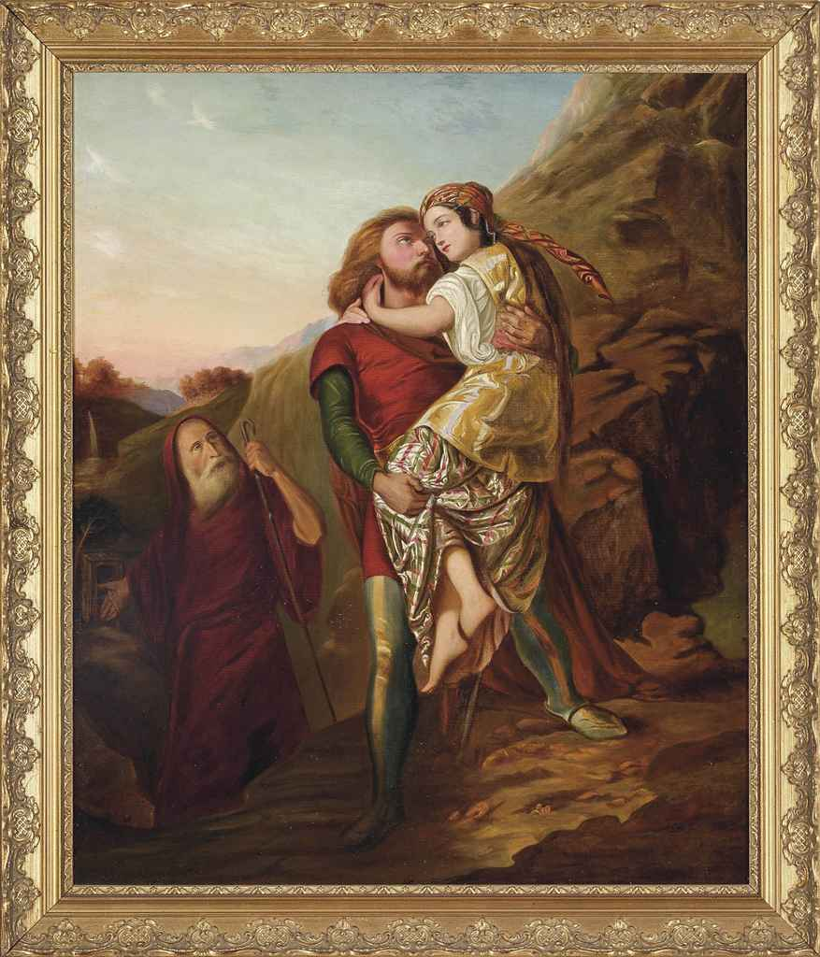
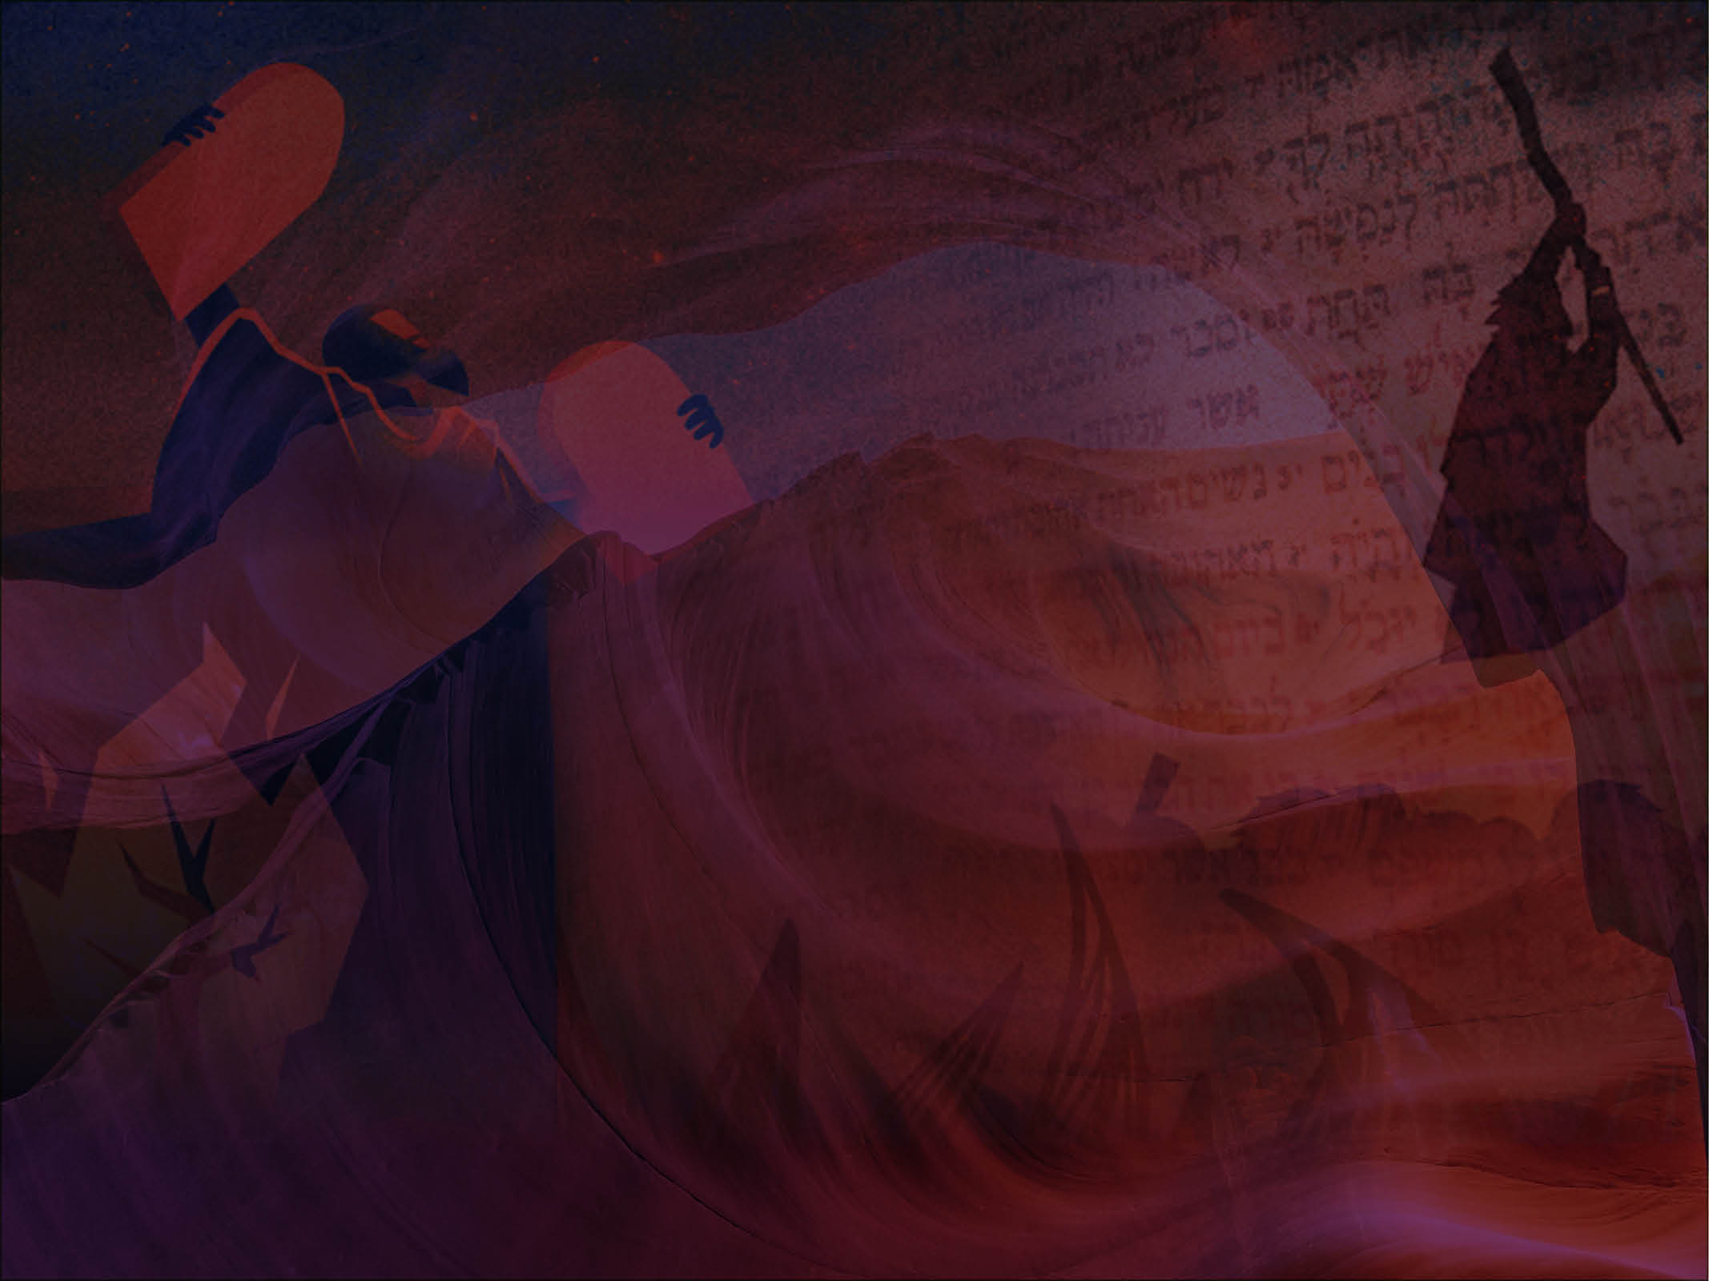

Slide 3
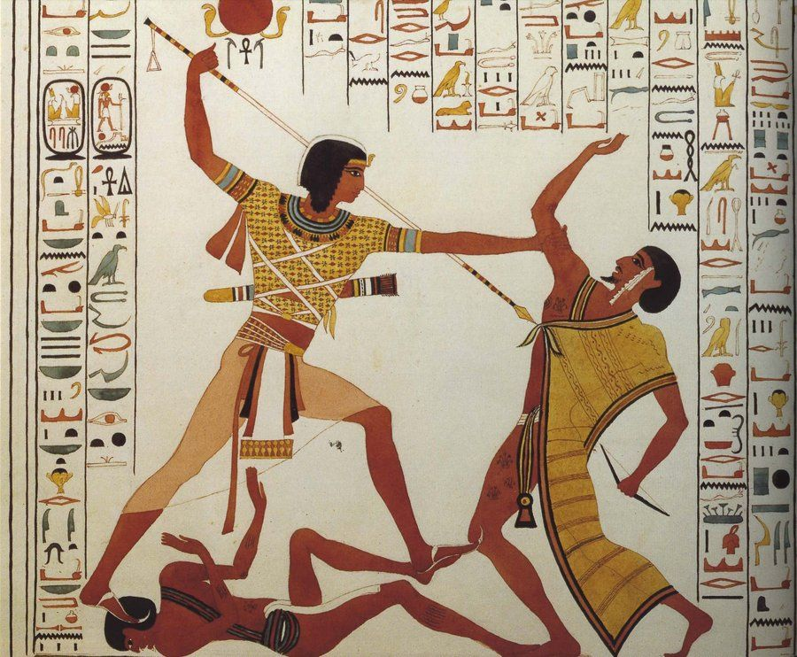

Slide 4
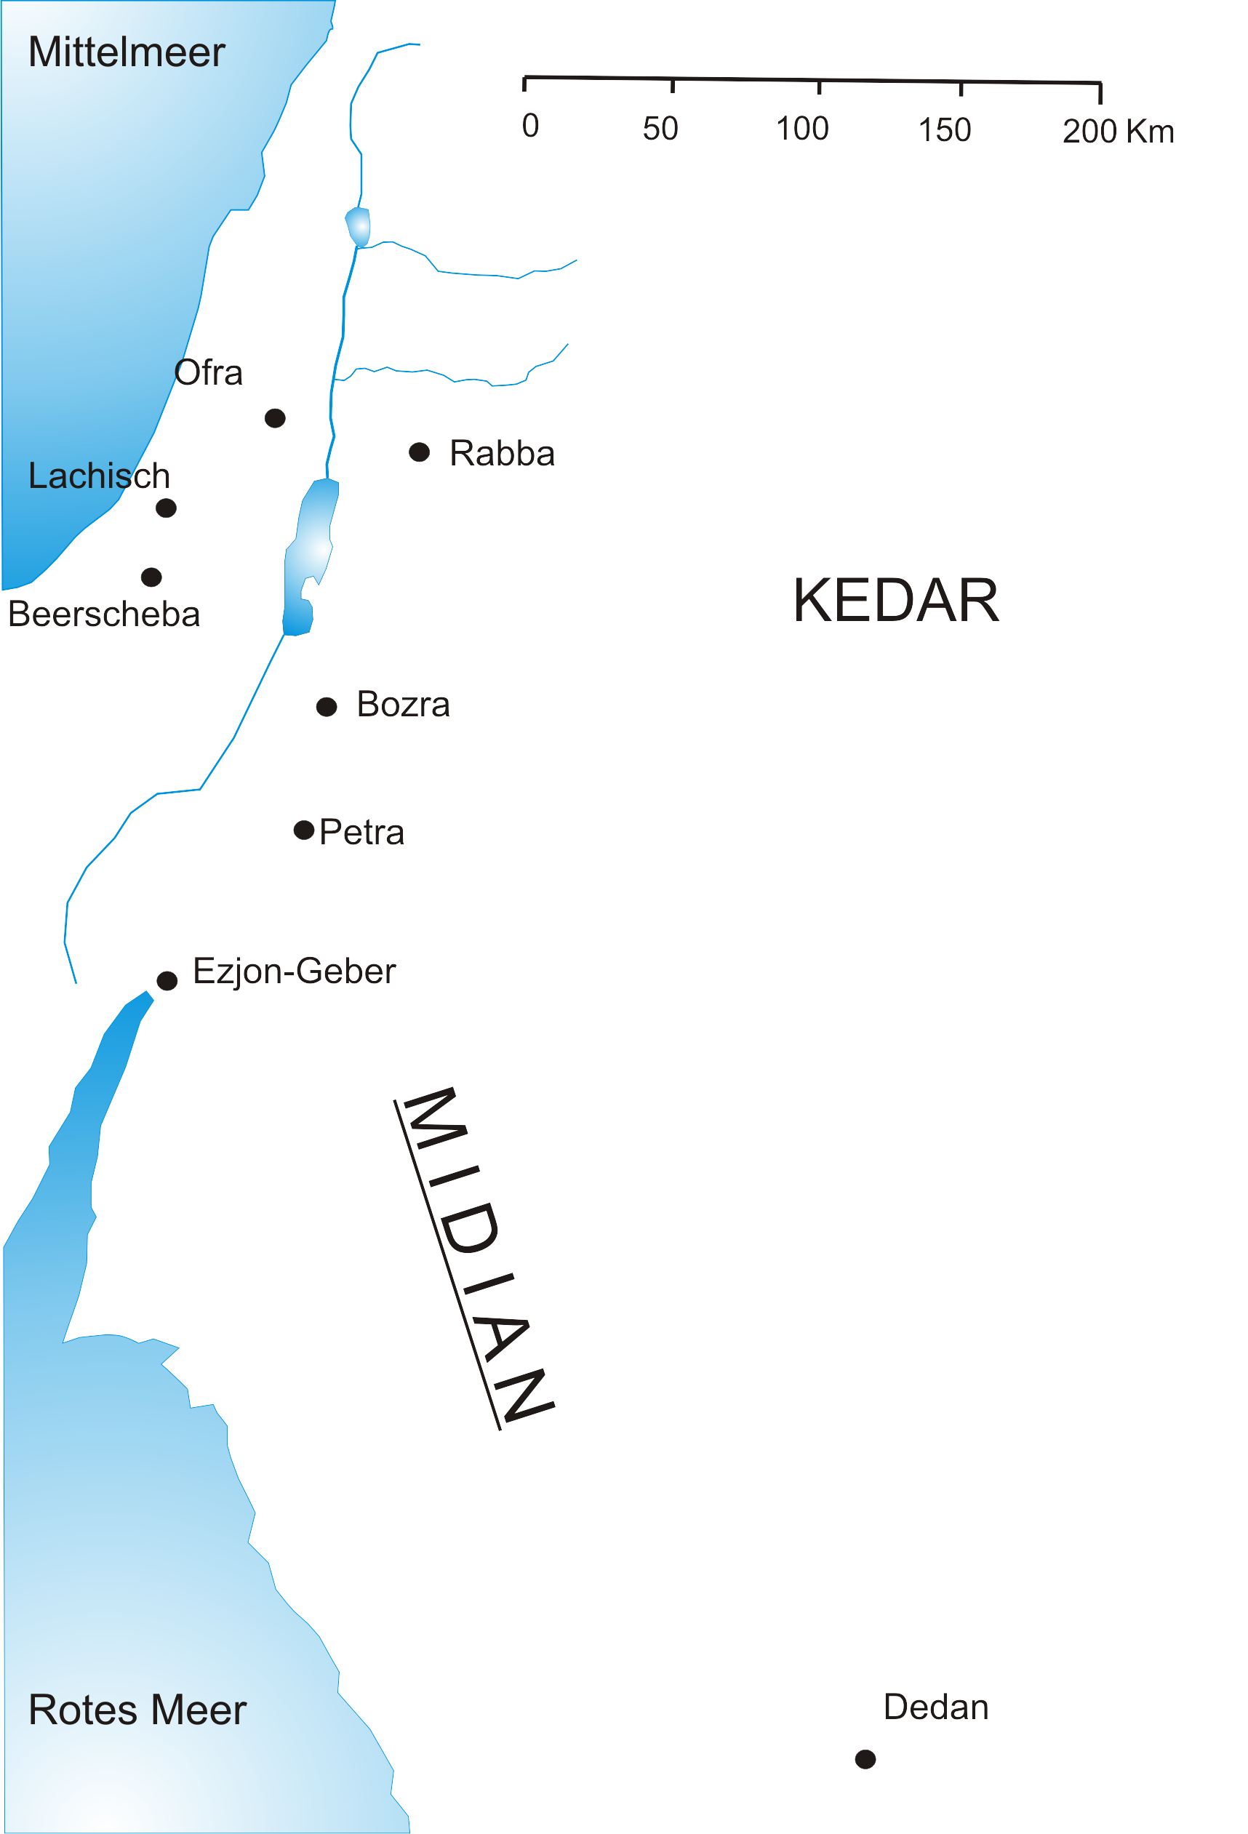
Text in slide…..

Slide 5
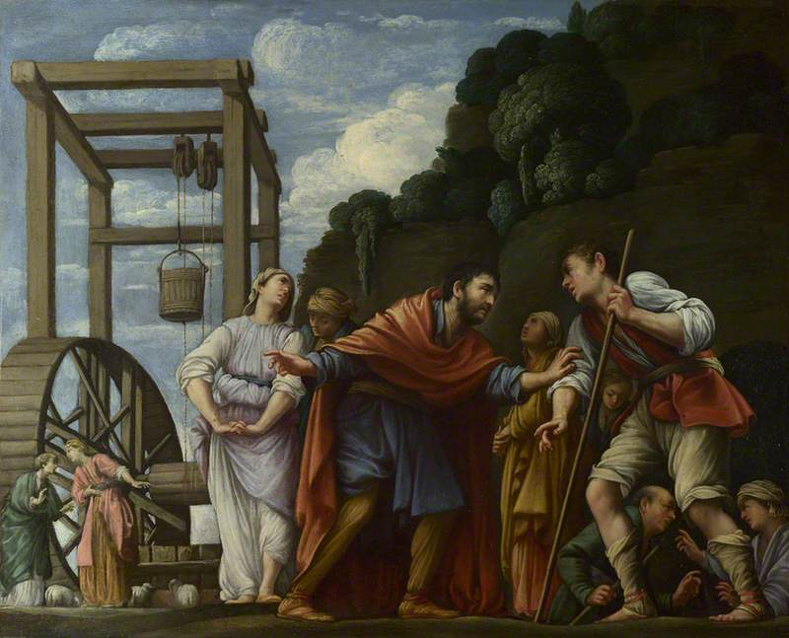
Text in slide…..

Slide 6
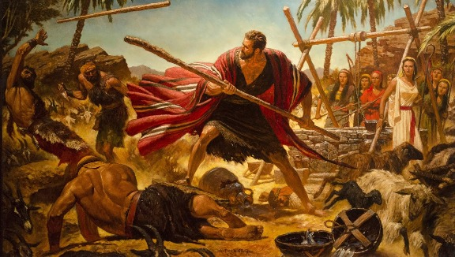

Slide 7
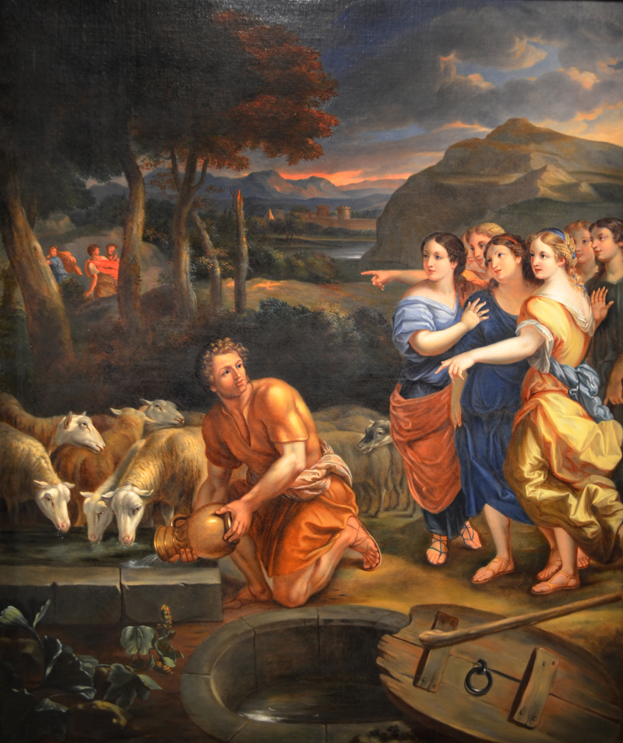
Text in slide…..

Slide 8
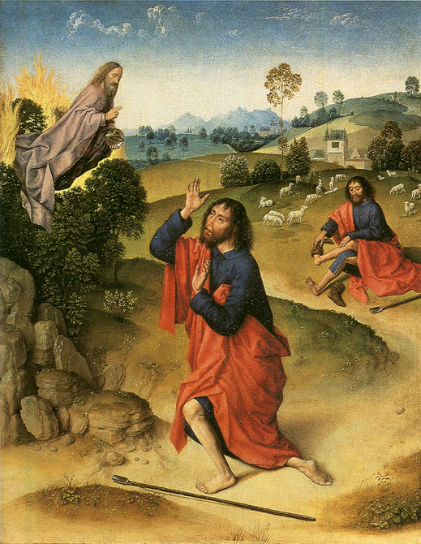

Slide 9
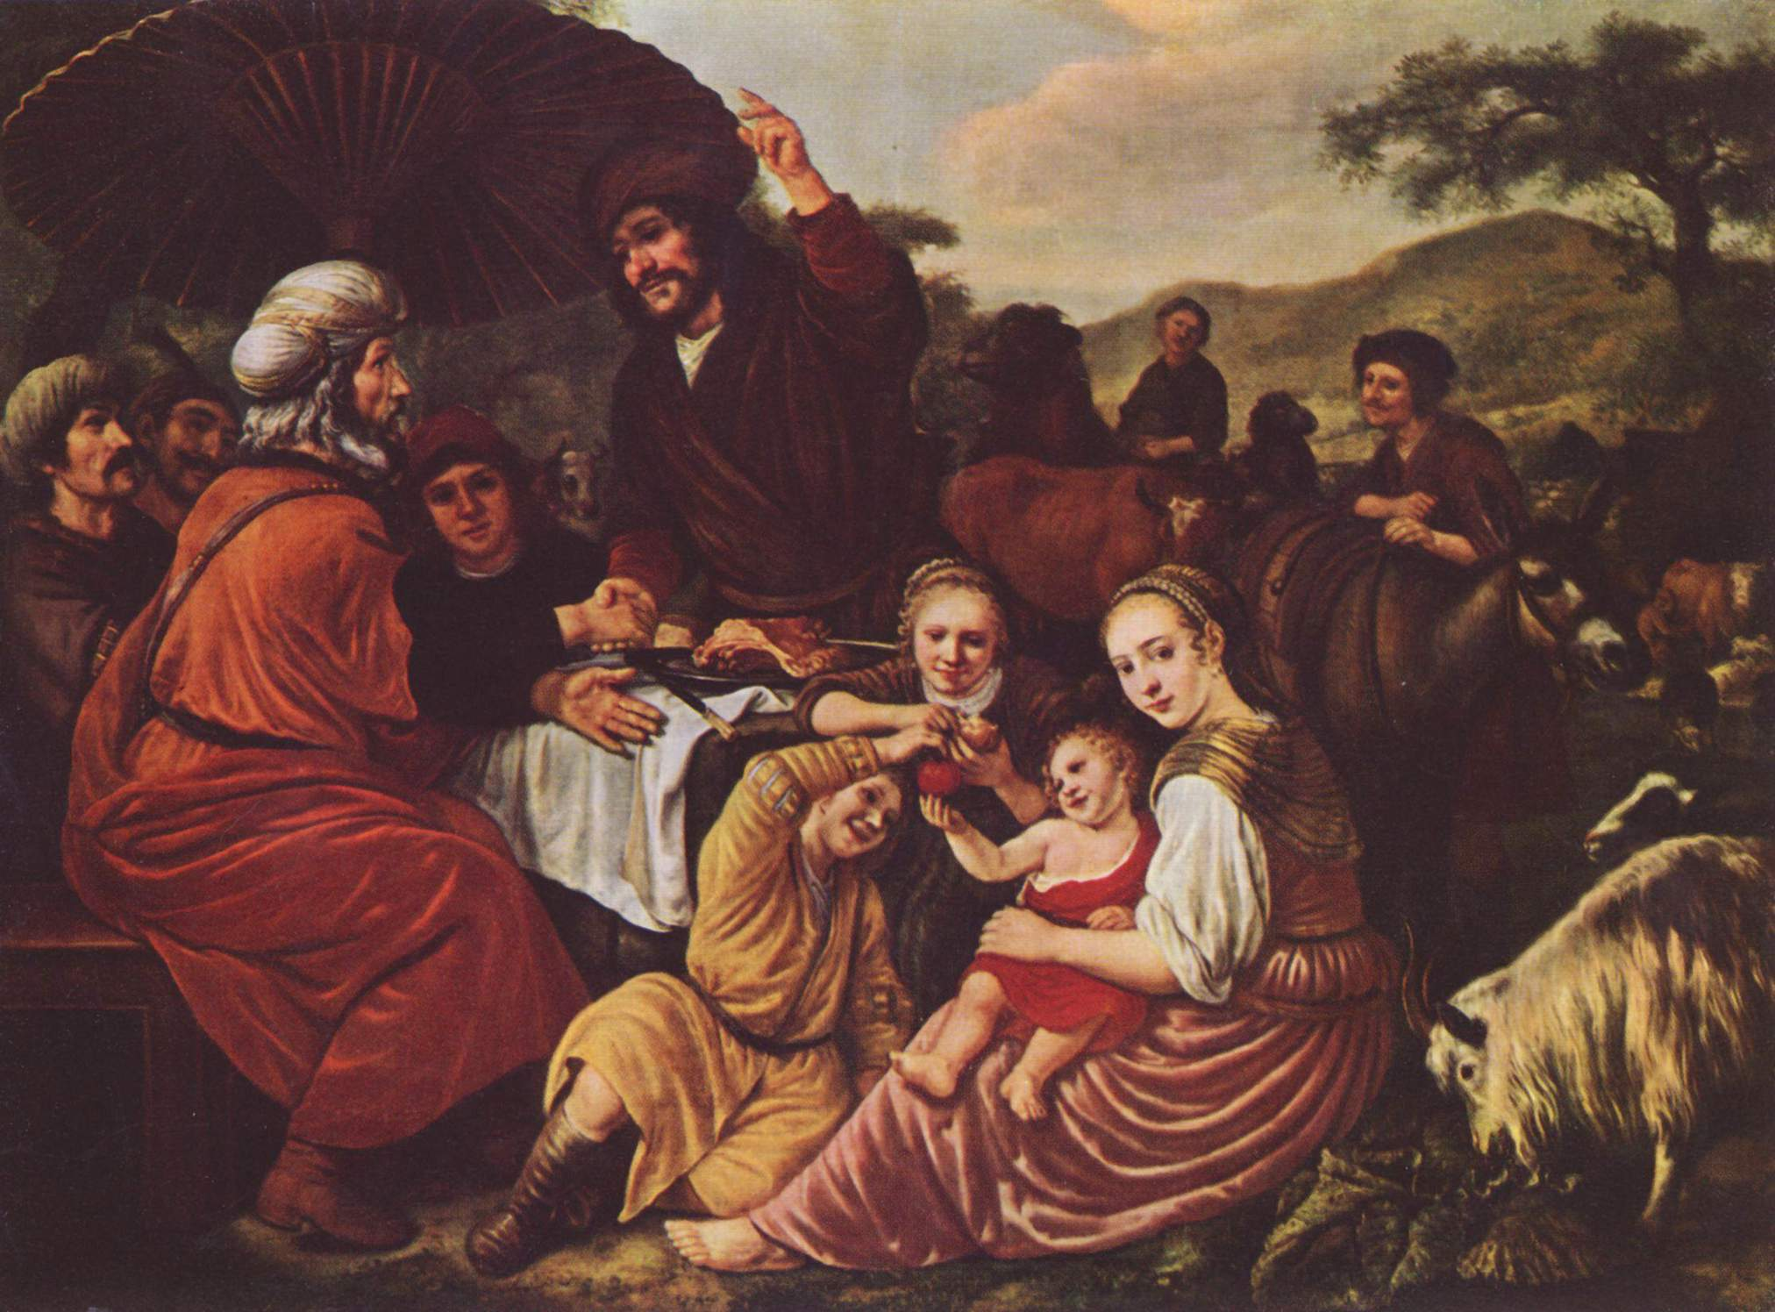

Slide 10
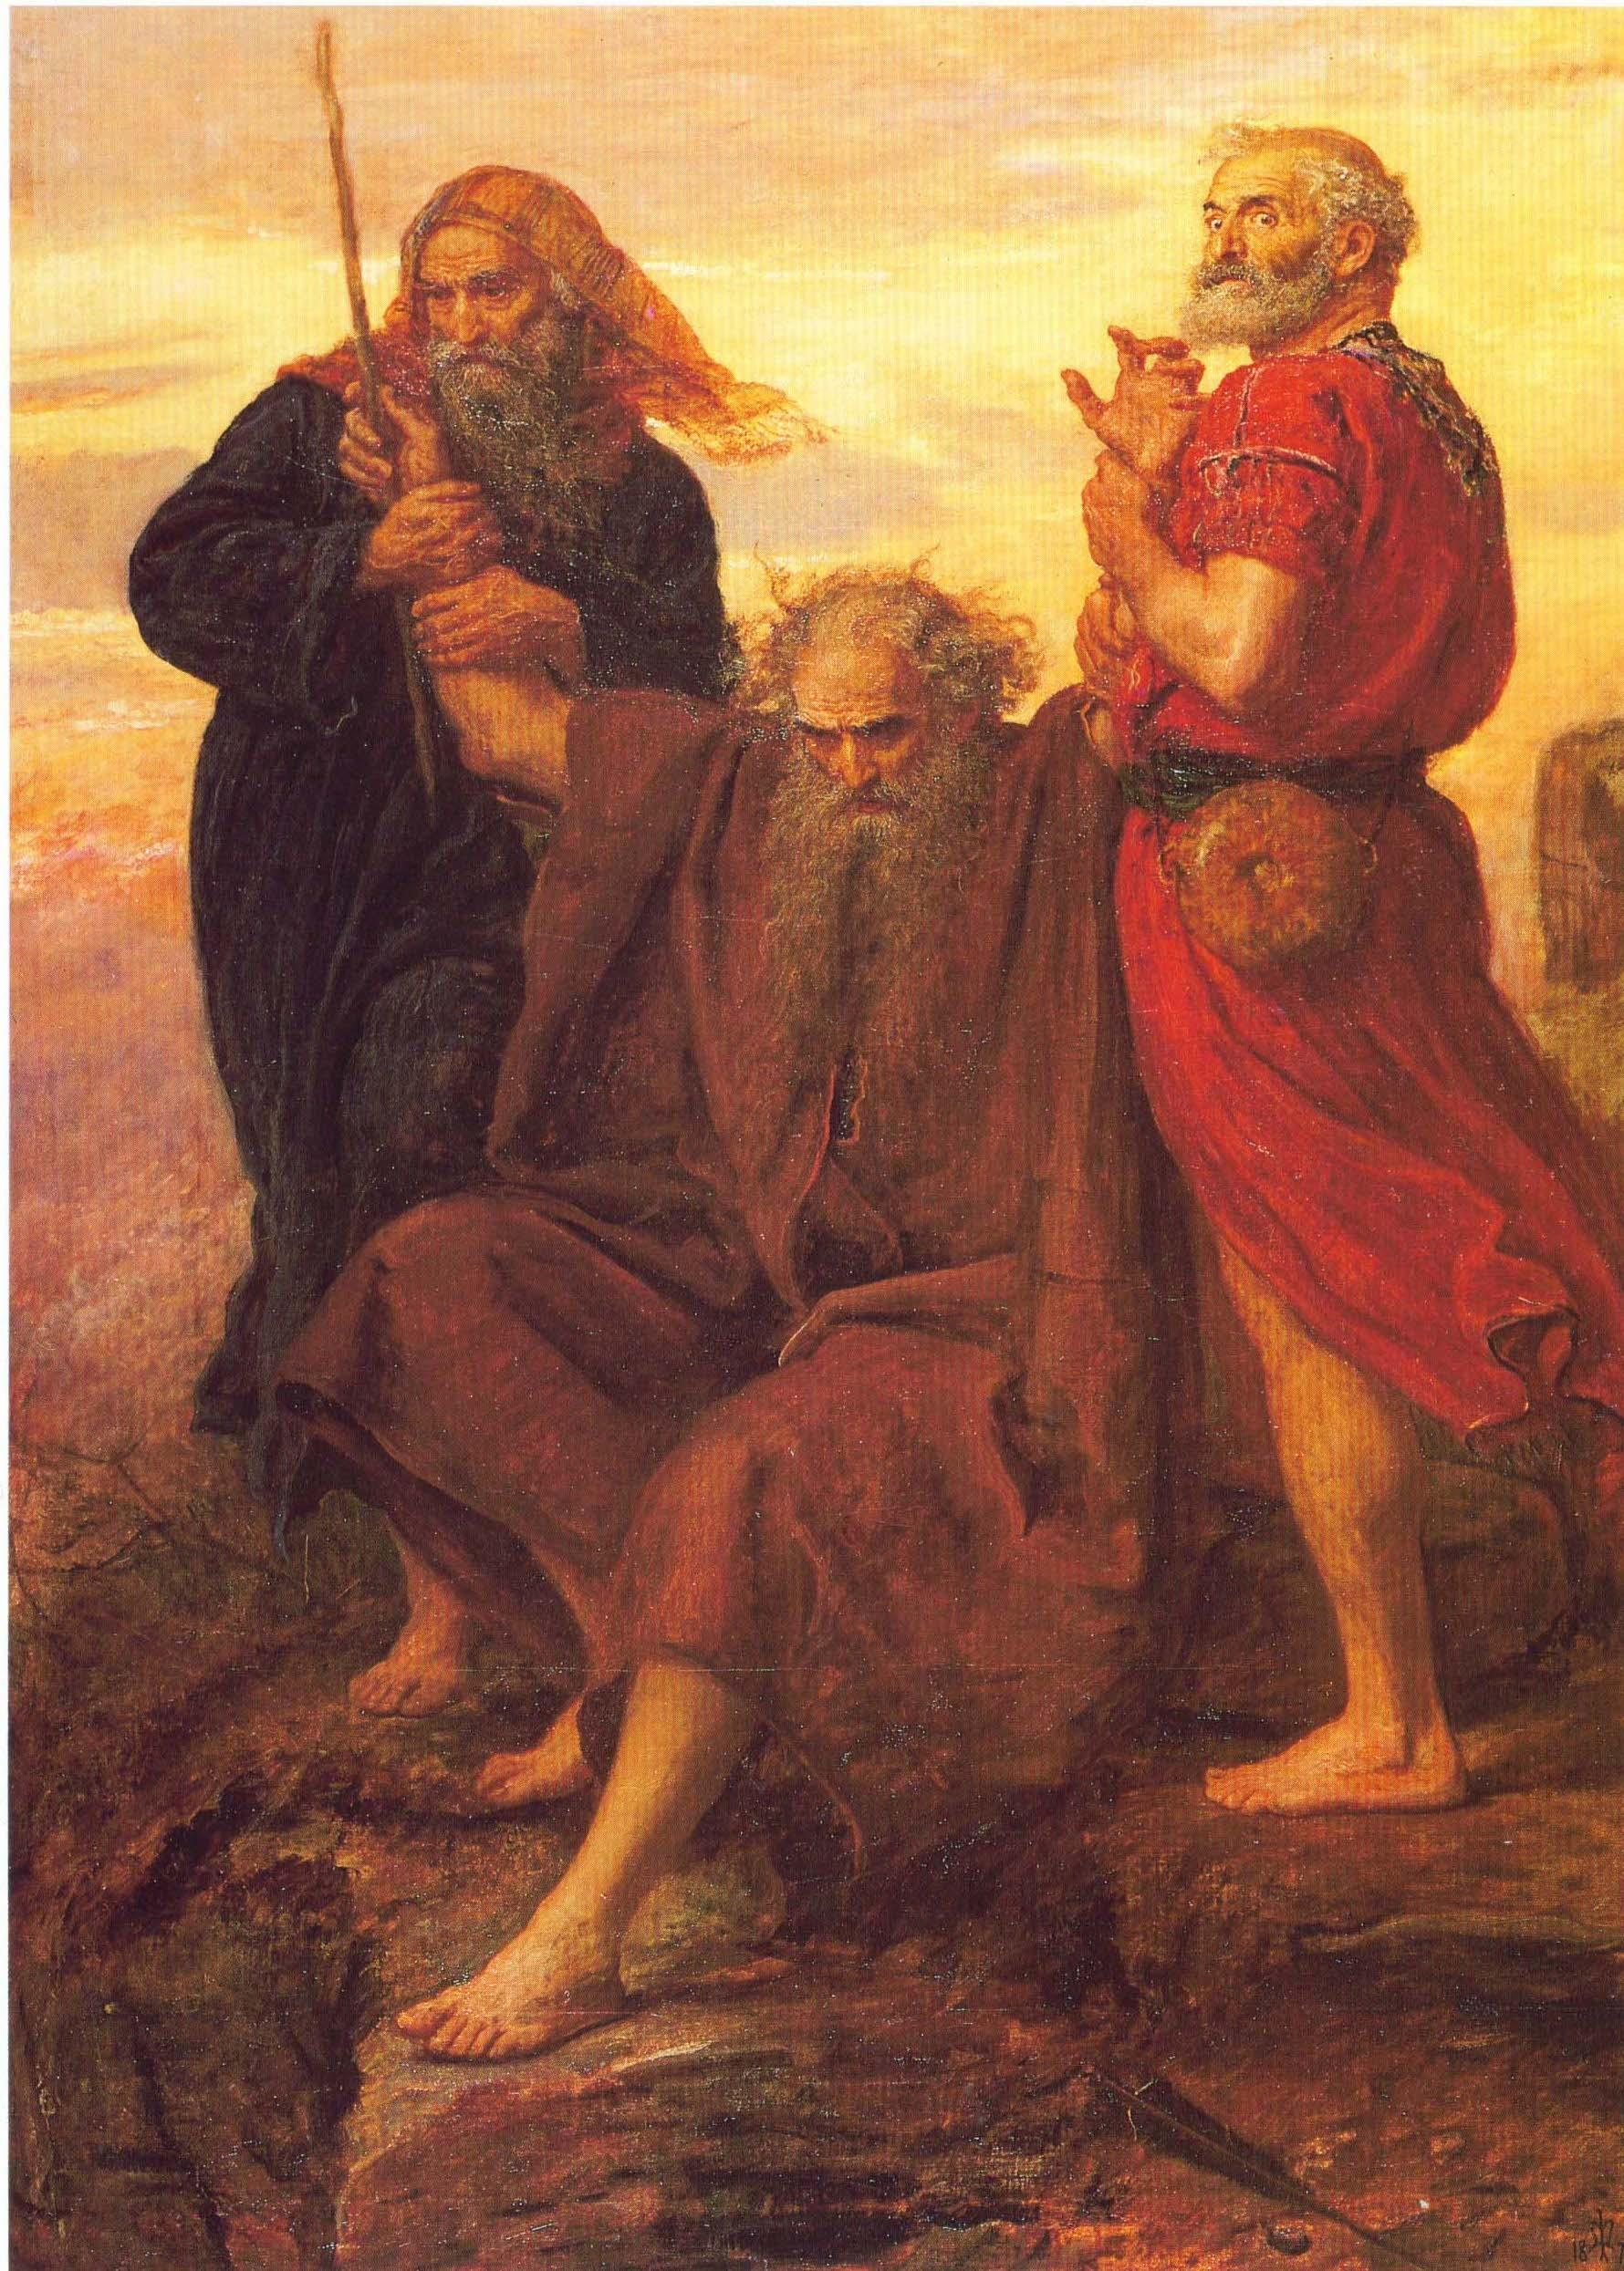

Slide 11
Now Jethro, the priest of Midian and father in law of Moses, heard of everything God had done for Moses and for his people Israel, and how the Lord had brought Israel out of Egypt.
(Exodus 18:1, NIV)

Slide 12
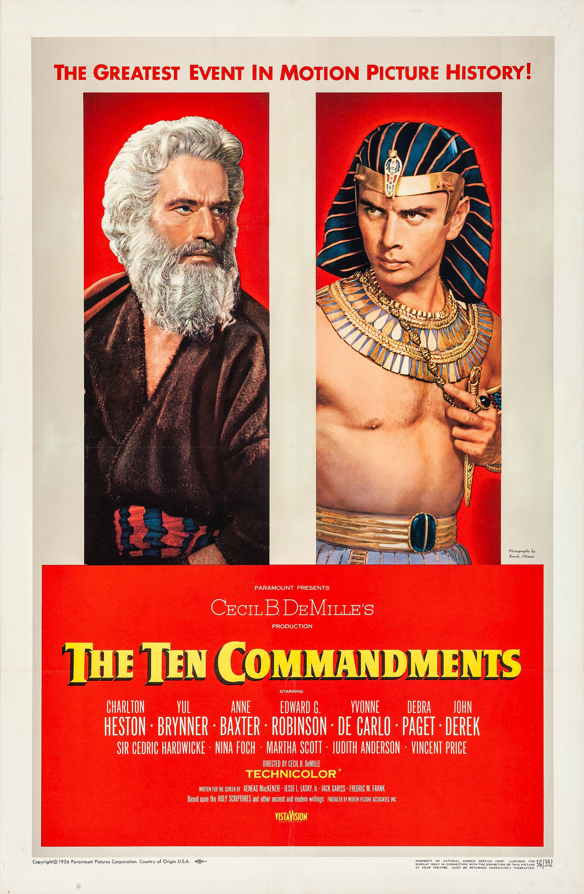

Slide 13
Moses told his father in law about everything the Lord had done to Pharaoh and the Egyptians for Israel’s sake and about all the hardships they had met along the way and how the Lord had saved them.
(Exodus 18: 8, NIV)

Slide 14
Jethro was delighted to hear about all the good things the Lord had done for Israel in rescuing them from the hand of the Egyptians. He said, “Praise be to the Lord, who rescued you from the hand of the Egyptians. Now I know that the Lord is greater than all other gods, for he did this to those who had treated Israel arrogantly.”
(Exodus 18:9-11, NIV)

Slide 15
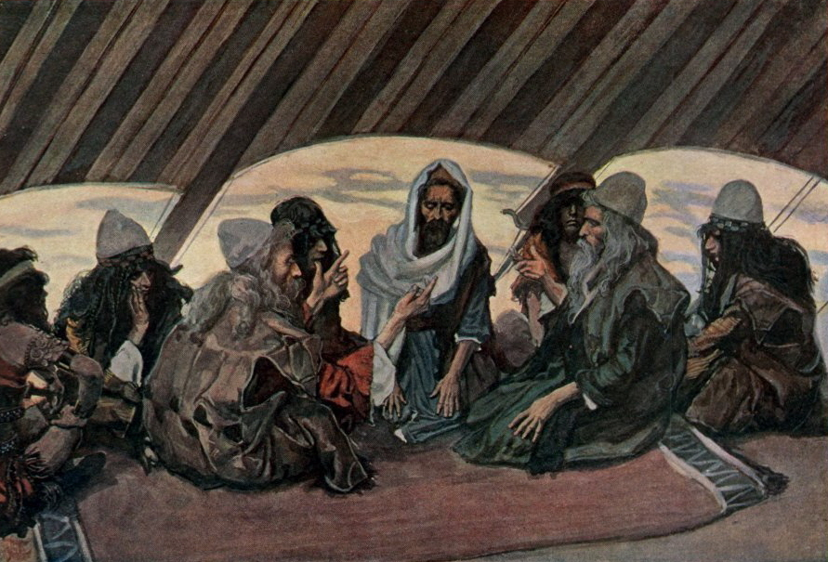

Slide 16
Then Jethro, Moses’ father in law, brought a burnt offering and other sacrifices to God, and Aaron came with all the elders of Israel to eat bread with Moses’ father in law in the presence of God.
(Exodus 8:12, NIV)

Slide 17
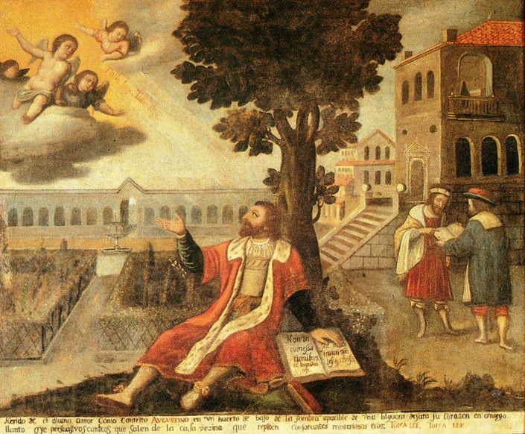

Slide 18
“Return to your home, and declare how much God has done for you.”
(Luke 8:39, NIV)

Slide 19
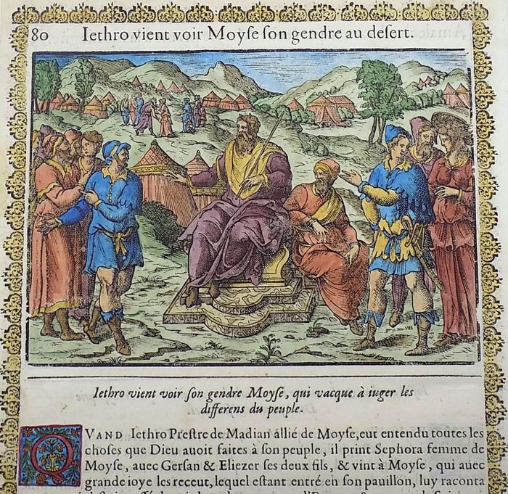

Slide 20
“What you are doing is not good. You and these people who come to you will only wear yourselves out. The work is too heavy for you; you cannot handle it alone.”
(Exodus 18:18, NIV)

Slide 21
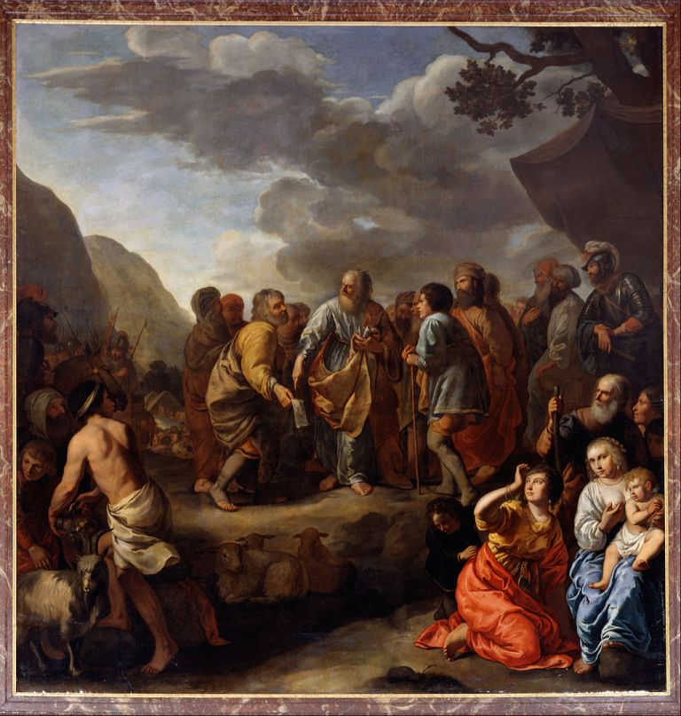

Slide 22
“You must be the people’s representative before God and bring their disputes to him. Teach them the way to live and the duties they are to perform.”
(Exodus 18:19-20, NIV)

Slide 23
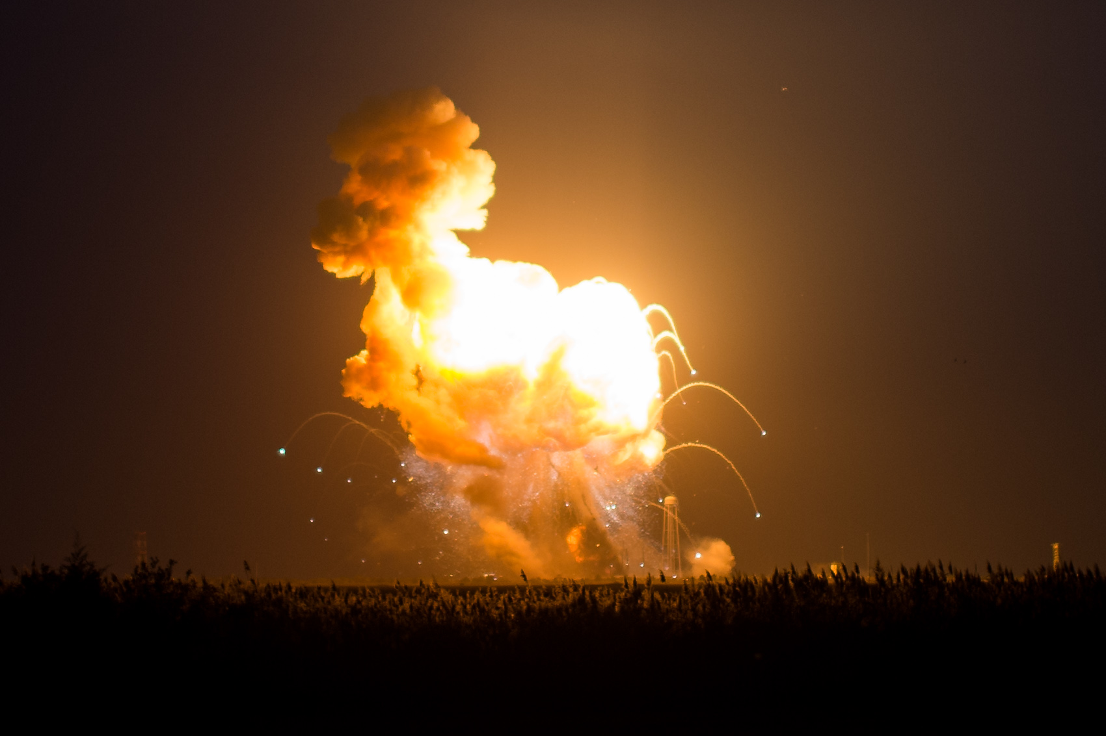

Slide 24
Live as children of light (for the fruit of the light consists in all goodness, righteousness and truth) and find out what pleases the Lord.
(Ephesians 5:8-10, NIV)

Slide 25
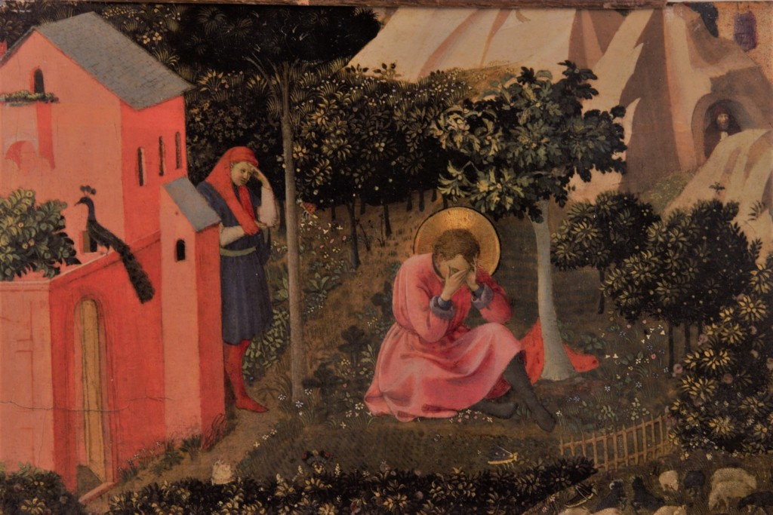

Slide 26
I urge, then, first of all, that petitions, prayers, intercession and thanksgiving be made for all people – for kings and all those in authority, that we may live peaceful and quiet lives in all godliness and holiness. This is good, and pleases God our Saviour, who wants all people to be saved and to come to a knowledge of the truth.
(1 Timothy 2:1-4, NIV)

Slide 27
[Select] capable men from all the people – men who fear God, trustworthy men who hate dishonest gain…
(Exodus 18:21, NIV)

Slide 28
The midwives, however, feared God and did not do what the king of Egypt had told them to do; they let the boys live.
(Exodus 1:17, NIV)

Slide 29
Now the overseer is to be above reproach, faithful to his wife, temperate, self-controlled, respectable, hospitable, able to teach, not given to drunkenness, not violent but gentle, not quarrelsome, not a lover of money. He must manage his own family well and see that his children obey him, and he must do so in a manner worthy of full respect… He must not be a recent convert, or he may become conceited and fall under the same judgment as the devil.
He must also have a good reputation with outsiders, so that he will not fall into disgrace and into the devil’s trap.

Slide 30
In the same way, deacons are to be worthy of respect, sincere, not indulging in much wine, and not pursuing dishonest gain. They must keep hold of the deep truths of the faith with a clear conscience. They must first be tested; and then if there is nothing against them, let them serve as deacons.
(1 Timothy 3:2-10, NIV)

Slide 31
Here is a trustworthy saying: whoever aspires to be an overseer desires a noble task.
(1 Timothy 3:1, NIV)

Slide 32
To the elders among you, I appeal as a fellow elder and a witness of Christ’s sufferings who also will share in the glory to be revealed: be shepherds of God’s flock that is under your care, watching over them – not because you must, but because you are willing, as God wants you to be; not pursuing dishonest gain, but eager to serve; not lording it over those entrusted to you, but being examples to the flock. And when the Chief Shepherd appears, you will receive the crown of glory that will never fade away.
(1 Peter 5:1-4, NIV)

Slide 33
