Slide 1
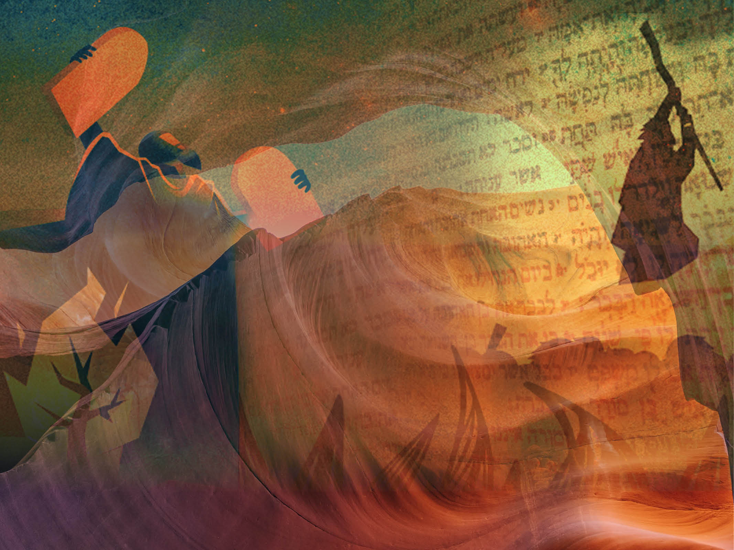
Meeting God on Mount Sinai
Exodus 19

Slide 2
God’s promise
And God said, ‘I will be with you. And this will be the sign to you that it is I who have sent you: when you have brought the people out of Egypt, you will worship God on this mountain.’ Exodus 3:12
God is sovereign,
He will do what He has promised

Slide 3
God’s presence
“You yourselves have seen what I did to Egypt, and how I carried you on eagles’ wings and brought you to myself.” Exodus 19:4.
“I will dwell among the Israelites and be their God – They will know that I am the Lord their God who brought them out of Egypt so that I might dwell among them.” Exodus 29:46

Slide 4
God’s presence
“The Word became flesh and made his dwelling among us” John 1:14
“Anyone who loves me will obey my teaching. My Father will love them, and we will come to them and make our home with them”.
John 14:23

Slide 5
God’s purity
“Once you were alienated from God and were enemies in your minds because of your evil behaviour. But now he has reconciled you by Christ’s physical body through death to present you holy in his sight, without blemish and free from accusation.” Colossians 1:21-22
“

Slide 6
God’s purpose
Then Moses went up to God, and the Lord called to him from the mountain and said,… “You yourselves have seen what I did to Egypt, and how I carried you on eagles’ wings and brought you to myself. Now if you obey me fully and keep my covenant, then out of all nations you will be my treasured possession. Although the whole earth is mine, you will be for me a kingdom of priests and a holy nation.” These are the words you are to speak to the Israelites.’ Exodus 19: 3-6
“

Slide 7
God’s purpose
“already being within the covenant, the children of Israel were called to obey so that they might enjoy the benefits and privileges of Gods people…. Obedience is not our part in a two-sided bargain but our grateful response to what the Lord has unilaterally decided and done”. Alex Motyer
“

Slide 8
God’s purpose
“But you are a chosen people, a royal priesthood, a holy nation, God’s special possession, that you may declare the praises of him who called you out of darkness into his wonderful light. Once you were not a people, but now you are the people of God; once you had not received mercy, but now you have received mercy.” 1 Peter 2:9-10
“

Slide 9
God’s word to us:
God’s promises
God’s presence
God’s purity
God’s purpose

