Slide 2
Numbers 13 and 14 ‘A collapse of courage’

Slide 3
The Land of Promise
Numbers 13:1-3
The Lord said to Moses,“Send some men to explore the land of Canaan, which I am giving to the Israelites. From each ancestral tribe send one of its leaders.” So at the Lord’s command Moses sent them out from the Desert of Paran. All of them were leaders of the Israelites.

Slide 4
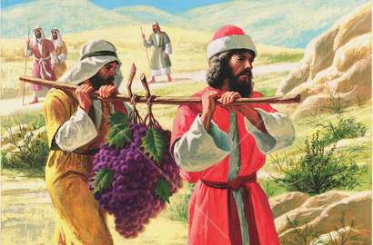
When they returned they all agreed it was just as God had told them, a land flowing with milk and honey.
There was no doubt that God was giving them the land.
It could not fail to belong to them because God had promised it. But, the people of God had to take possession of it. God had done his part, and now it was up to them to have courage and do their part.

Slide 5
^{Opportunity or obstacle?}
^{Numbers 13:27-29}
They gave Moses this account: “We went into the land to which you sent us, and it does flow with milk and honey! Here is its fruit. But the people who live there are powerful, and the cities are fortified and very large. We even saw descendants of Anak there. The Amalekites live in the Negev; the Hittites, Jebusites and Amorites live in the hill country; and the Canaanites live near the sea and along the Jordan.”

Slide 6
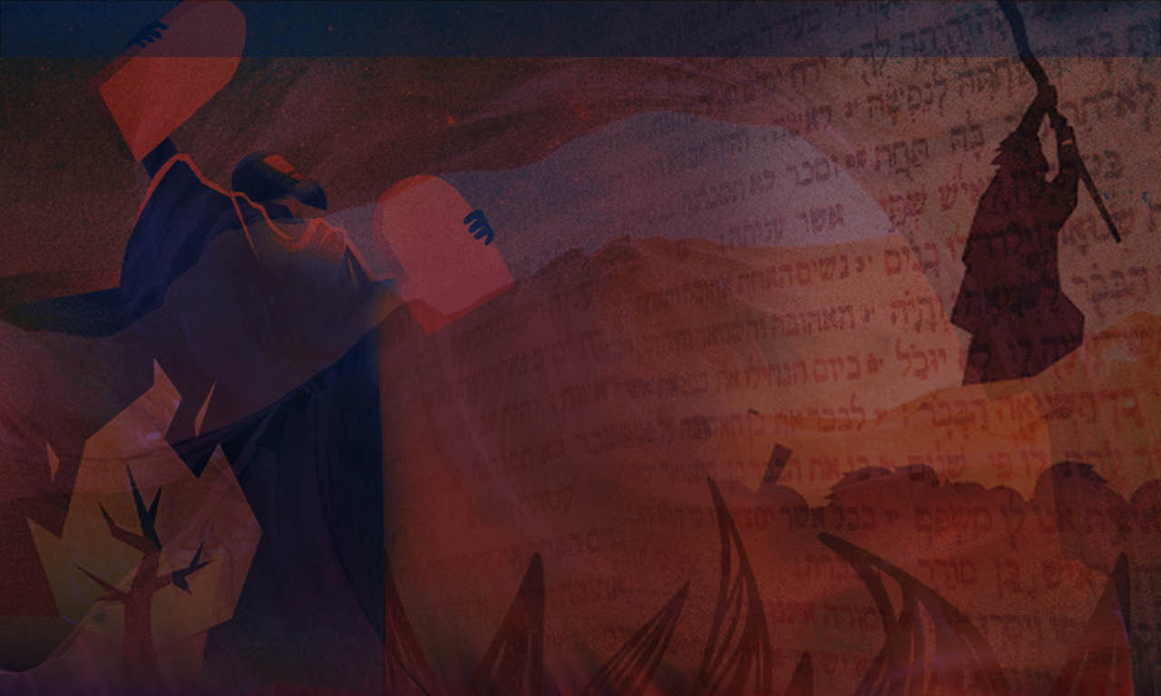
‘But’ is the third most used conjunction in the English language.
It is a small word and needs to be careful used because it is often used to nullify whatever has preceded it.
The Ten Spies were saying; “everything that God told us about the land is true, but he lied when he said it will be ours to take because there is no way we can conquer it!”
Interestingly the Hebrew word that is used here for but is ‘efes’ which means ‘zero’. They believe they have zero chance of taking possession of the land. As far as they are concerned it’s over before it has even started!

Slide 7
What was Caleb and Joshua’s response?
^{Numbers 13:30}
Then Caleb silenced the people before Moses and said, “We should go up and take possession of the land, ^{for we can certainly do it.”}
But Caleb and Joshua are quietened and the Ten Spies continue with their bad report and spread fear amongst ^{the whole community.}

Slide 8
^{Faith or fear?}
^{Numbers 13:31-14:4}
But the men who had gone up with him said, “We can’t attack those people; they are stronger than we are.” And they spread among the Israelites a bad report about the land they had explored. They said, “The land we explored devours those living in it. All the people we saw there are of great size. We saw the Nephilim there (the descendants of Anak come from the Nephilim). We seemed like grasshoppers in our own eyes, and we looked the same to them.”

Slide 9
It’s all about perspective.
The Ten Spies see giants, fortresses and failure. They viewed themselves as grasshoppers in the midst of these giants.
Caleb and Joshua had a different spirit and a different perspective. They were not worried about the size of the problem because they trusted God and his promises; they remembered when God had delivered them in the past.

Slide 10
How about us?
In life when we face challenges that come our way do we see challenges or opportunities for God to work.
The important question in life is not; How big is the problem? Or how big am I? But, how big is my God?
How do we respond to challenging circumstances that we face, with faith or fear?

Slide 11
^{Numbers 14:1-4.}
That night all the members of the community raised their voices and wept aloud. All the Israelites grumbled against Moses and Aaron, and the whole assembly said to them, “If only we had died in Egypt! Or in this wilderness! Why is the Lord bringing us to this land only to let us fall by the sword? Our wives and children will be taken as plunder. Wouldn’t it be better for us to go back to Egypt?” And they said to each other, “We should choose a leader ^{and go back to Egypt.”}

Slide 12
Fear is the enemy of faith
Fear can grip the heart of an individual person and it can grip the heart of a whole nation.
Fear can be created by what we know and what we don’t know.
It can either drive us or paralyse us.
The fearful Ten Spies spread the bad report and the people believe it and panic!

Slide 13
The people begin to moan and complain, they talked about going back to Egypt, they rebelled against Moses and even considered stoning Moses, Joshua and Caleb and getting new leaders!
This is what fear can do…
Fear causes us to panic, it can cause us to stampede.

Slide 15
Tragedy or triumph? Numbers 14:10-19
But the whole assembly talked about stoning them. Then the glory of the Lord appeared at the tent of meeting to all the Israelites. The Lord said to Moses, “How long will these people treat me with contempt? How long will they refuse to believe in me, in spite of all the signs I have performed among them? I will strike them down with a plague and destroy them, but I will make you into a nation greater and stronger than they.”
Moses said to the Lord, “Then the Egyptians will hear about it! By your power you brought these people up from among them. And they will tell the inhabitants of this land about it. They have already heard that you, Lord, are with these people and that you, Lord, have been seen face to face, that your cloud stays over them, and that you go before them in a pillar of cloud by day and

Slide 16
a pillar of fire by night. If you put all these people to death, leaving none alive, the nations who have heard this report about you will say, 16 ‘The Lord was not able to bring these people into the land he promised them on oath, so he slaughtered them in the wilderness.’
“Now may the Lord’s strength be displayed, just as you have declared: ‘The Lord is slow to anger, abounding in love and forgiving sin and rebellion. Yet he does not leave the guilty unpunished; he punishes the children for the sin of the parents to the third and fourth generation.’ In accordance with your great love, forgive the sin of these people, just as you have pardoned them from the time they left Egypt until now.”

Slide 17
God Forgives his people but he gives them what they want. A life in the wilderness.
They are judged for their unbelief and only Joshua and Caleb enter the promised land from amongst their generation some 40 years later.
It is a tragic story. A journey to the Promised Land that should have taken a matter of days takes 40 years!

Slide 18
Today, I believe that we need courage more than ever
What is courage?
Chambers dictionary: “Courage is the quality that enables people to meet danger without giving way to fear”

Slide 19
Mark Twain:“Courage is resistance to fear, mastery of fear, not the absence of fear”
Fear is the enemy of faith
Fear stops us moving on with God. Courage enables us to face our fears and go beyond our limitations.

Slide 20
How do we develop confidence and courage in the Lord?
By daily meditating on God’s Word.
Joshua 1:7-8
“Be strong and very courageous. Be careful to obey all the law my servant Moses gave you; do not turn from it to the right or to the left, that you may be successful wherever you go. Keep this Book of the Law always on your lips; meditate on it day and night, so that you may be careful to do everything written in it. Then you will be prosperous and successful”.

Slide 21
By obeying God’s Word
Joshua 1:7-8
“Be strong and very courageous. Be careful to obey all the law my servant Moses gave you; do not turn from it to the right or to the left, that you may be successful wherever you go. 8 Keep this Book of the Law always on your lips; meditate on it day and night, so that you may be careful to do everything written in it. Then you will be prosperous and successful”.

Slide 22
By reminding God of his Promises
Joshua 1:9
“Have I not commanded you? Be strong and courageous. Do not be afraid; do not be discouraged, for the Lord your God will be with you wherever you go.”

Slide 23
By recalling the faithfulness of God in past circumstances
Joshua 21:45
Not one of all the Lord’s good promises to Israel failed; everyone was fulfilled.

Slide 24
What is the Canaan land of opportunity before you today?
What is the Canaanite opposition that is causing you to be afraid and hesitate?
Will you embrace and exercise a spirit of courage like Caleb – having confidence and courage in the face of this challenge?
Fear not for the future – God is in control.
He is in control of your life and your death. His plans and purposes for you and your family will be fulfilled.

Slide 25
…Let’s take a moment to wait on the Lord in silence

