Slide 1
The mystery of suffering and the sovereignty of God

Slide 2
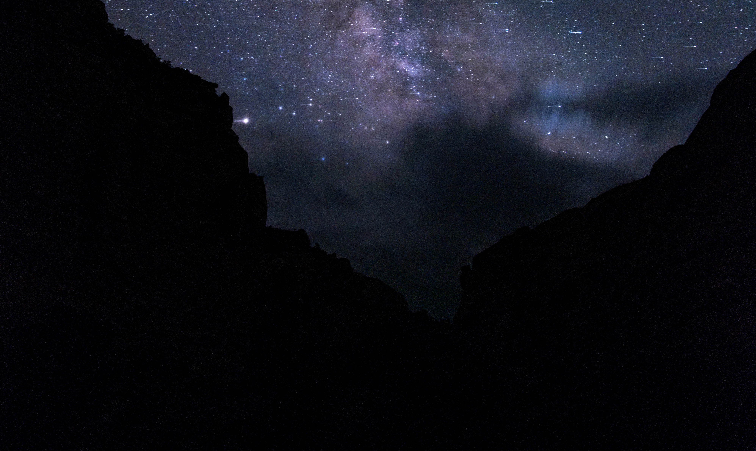
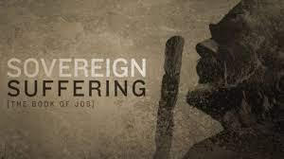
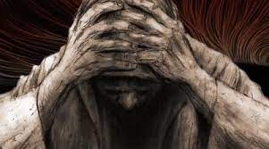
The rebuke in suffering – Job Chapter 38-41
What Job wanted more than anything is answers from God and not people about his situation. He is judged and condemned by friends and his good standing in the community is over because of everything that has happened to him.

Slide 3
Job is going to hear an answer from God. However, the reply is not an explanation about why he is going through what he is going through.
There is no mention about the conversation between God and Satan. No apologies of any kind, instead a rebuke and a fresh revelation of who it is that Job has been professing to worship and trust.

Slide 4
38 ¹Then the Lord spoke to Job out of the storm. He said:
² “Who is this that obscures my plans with words without knowledge? ³ Brace yourself like a man; I will question you, and you shall answer me

Slide 5
Job has several questions for God.
God has some questions of his own for Job. …To be more specific more than seventy questions!
We can summarise God’s questions to Job in three points:
Job can you explain my creation? – 38: 4-38
Job can you oversee my creation? – 38:39 - 39:30
Job can you subdue my creation? – 40:6-41

Slide 6
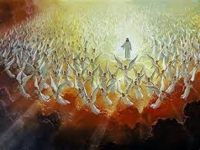
Job can you explain my creation? – 38:4-38
⁴ “Where were you when I laid the earth’s foundation? Tell me, if you understand. ⁵ Who marked off its dimensions? Surely you know! Who stretched a measuring line across it? ⁶ On what were its footings set, or who laid its cornerstone— ⁷ while the morning stars sang together and all the angels shouted for joy?
⁸ “Who shut up the sea behind doors when it burst forth from the womb, ⁹ when I made the clouds its garment and wrapped it in thick darkness, ¹⁰ when I fixed limits for it and set its doors and bars in place, ¹¹ when I said, ‘This far you may come and no farther; here is where your proud waves halt’?
¹² “Have you ever given orders to the morning, or shown the dawn its place, ¹³ that it might take the earth by the edges
and shake the wicked out of it?

Slide 7
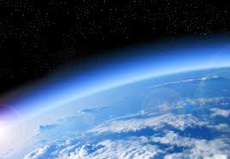
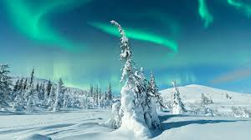
Job can you explain my creation? – 38:4-38
¹⁴ The earth takes shape like clay under a seal; its features stand out like those of a garment. ¹⁵ The wicked are denied their light, and their upraised arm is broken.
¹⁶ “Have you journeyed to the springs of the sea or walked in the recesses of the deep? ¹⁷ Have the gates of death been shown to you? Have you seen the gates of the deepest darkness? ¹⁸ Have you comprehended the vast expanses of the earth? Tell me, if you know all this.
¹⁹ “What is the way to the abode of light? And where does darkness reside? ²⁰ Can you take them to their places? Do you know the paths to their dwellings? ²¹ Surely you know, for you were already born! You have lived so many years!
²² “Have you entered the storehouses of the snow or seen the storehouses of the hail, ²³ which I reserve for times of trouble, for days of war and battle?

Slide 8
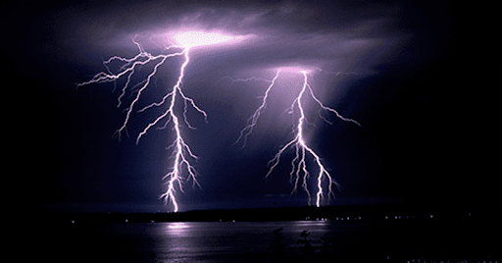
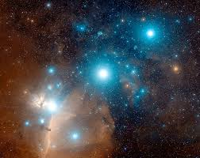
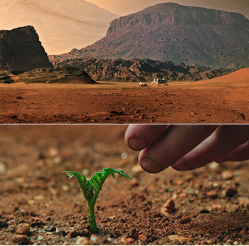
Job can you explain my creation? – 38:4-38
²⁴ What is the way to the place where the lightning is dispersed, or the place where the east winds are scattered over the earth? ²⁵ Who cuts a channel for the torrents of rain, and a path for the thunderstorm, ²⁶ to water a land where no one lives, an uninhabited desert, ²⁷ to satisfy a desolate wasteland and make it sprout with grass? ²⁸ Does the rain have a father? Who fathers the drops of dew? ²⁹ From whose womb comes the ice? Who gives birth to the frost from the heavens ³⁰ when the waters become hard as stone, when the surface of the deep is frozen?
³¹ “Can you bind the chains of the Pleiades? Can you loosen Orion’s belt?

Slide 9
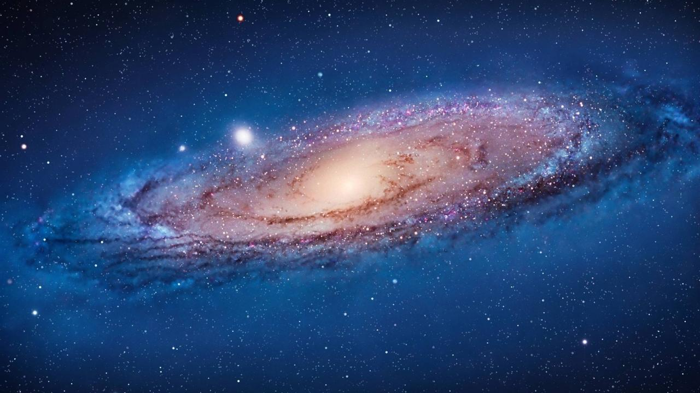
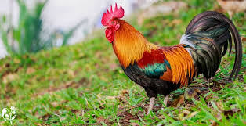
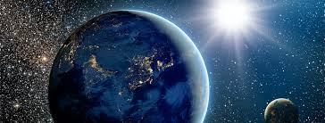
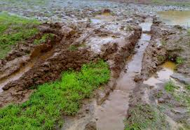
Job can you explain my creation? – 38:4-38
³² Can you bring forth the constellations in their seasons or lead out the Bear with its cubs? ³³ Do you know the laws of the heavens? Can you set up God’s dominion over the earth?
³⁴ “Can you raise your voice to the clouds and cover yourself with a flood of water? ³⁵ Do you send the lightning bolts on their way? Do they report to you, ‘Here we are’? ³⁶ Who gives the ibis wisdom or gives the rooster understanding?
³⁷ Who has the wisdom to count the clouds? Who can tip over the water jars of the heavens ³⁸ when the dust becomes hard and the clods of earth stick together?

Slide 10
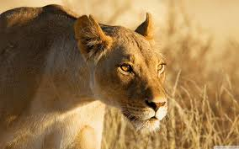
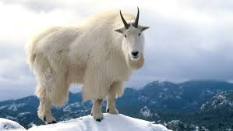
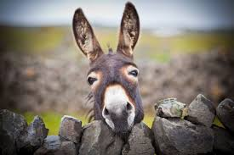
Job can you oversee the care of my creation – 38:39-39:30
³⁹ “Do you hunt the prey for the lioness and satisfy the hunger of the lions ⁴⁰ when they crouch in their dens or lie in wait in a thicket? ⁴¹ Who provides food for the raven when its young cry out to God and wander about for lack of food?
39 “Do you know when the mountain goats give birth? Do you watch when the doe bears her fawn? ² Do you count the months till they bear? Do you know the time they give birth? ³ They crouch down and bring forth their young; their labor pains are ended.
⁴ Their young thrive and grow strong in the wilds; they leave and do not return.
⁵ “Who let the wild donkey go free? Who untied its ropes?

Slide 11
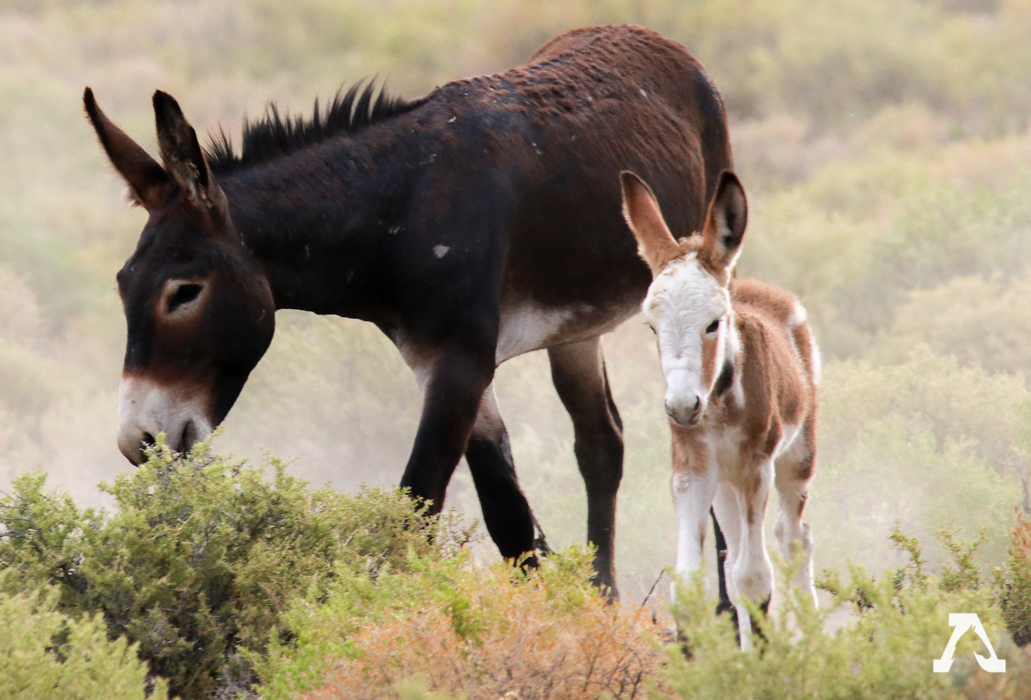
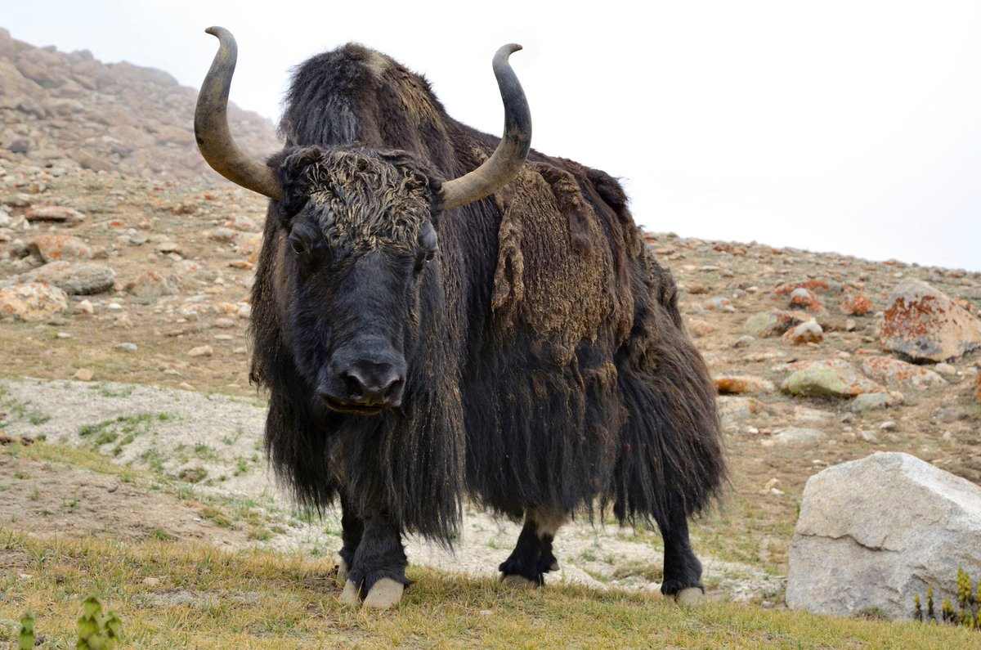
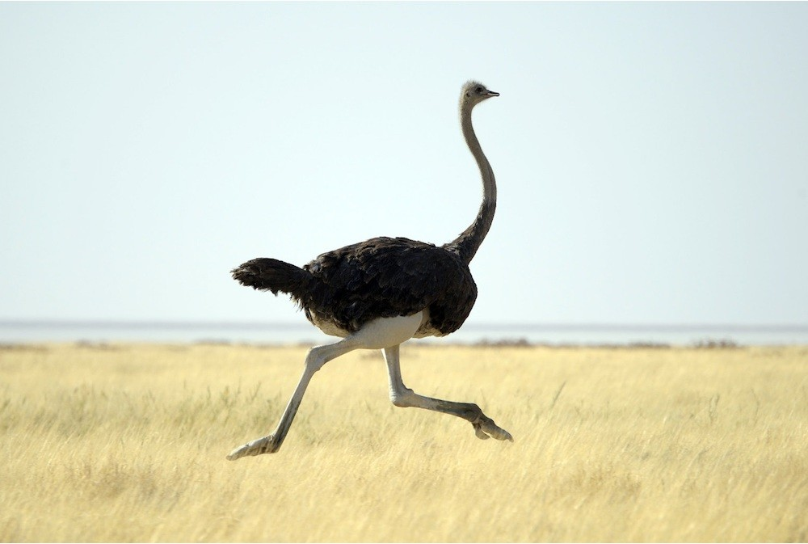
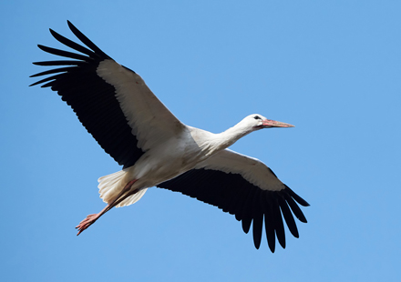
Job can you oversee the care of my creation – 38:39-39:30
⁶ I gave it the wasteland as its home, the salt flats as its habitat. ⁷ It laughs at the commotion in the town; it does not hear a driver’s shout. ⁸ It ranges the hills for its pasture and searches for any green thing.
⁹ “Will the wild ox consent to serve you? Will it stay by your manger at night? ¹⁰ Can you hold it to the furrow with a harness? Will it till the valleys behind you? ¹¹ Will you rely on it for its great strength? Will you leave your heavy work to it? ¹² Can you trust it to haul in your grain and bring it to your threshing floor?
¹³ “The wings of the ostrich flap joyfully, though they cannot compare with the wings and feathers of the stork.

Slide 12
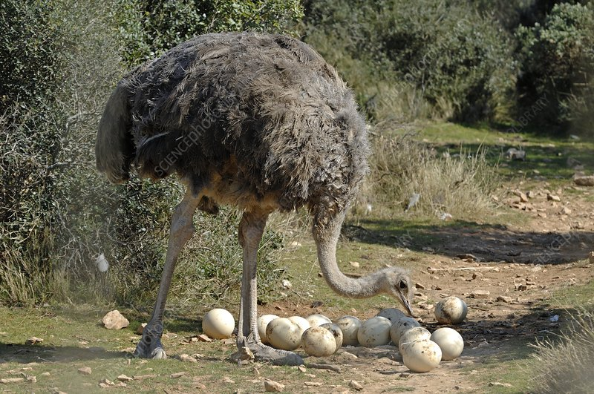
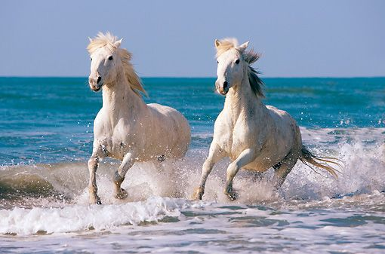
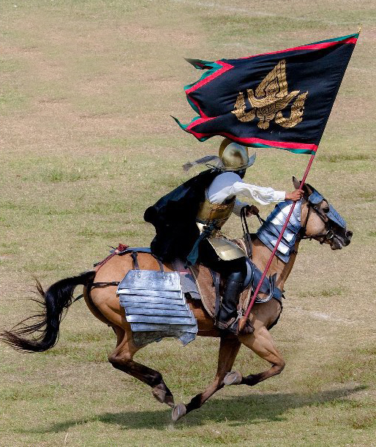
Job can you oversee the care of my creation – 38:39-39:30
¹⁴ She lays her eggs on the ground and lets them warm in the sand, ¹⁵ unmindful that a foot may crush them, that some wild animal may trample them. ¹⁶ She treats her young harshly, as if they were not hers; she cares not that her labor was in vain, ¹⁷ for God did not endow her with wisdom or give her a share of good sense. ¹⁸ Yet when she spreads her feathers to run, she laughs at horse and rider.
¹⁹ “Do you give the horse its strength or clothe its neck with a flowing mane? ²⁰ Do you make it leap like a locust, striking terror with its proud snorting? ²¹ It paws fiercely, rejoicing in its strength, and charges into the fray.
²² It laughs at fear, afraid of nothing; it does not shy away from the sword.

Slide 13
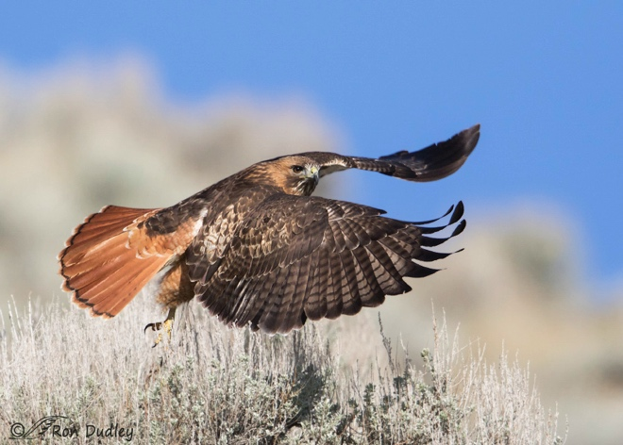
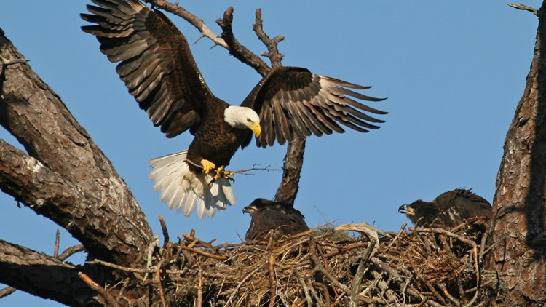
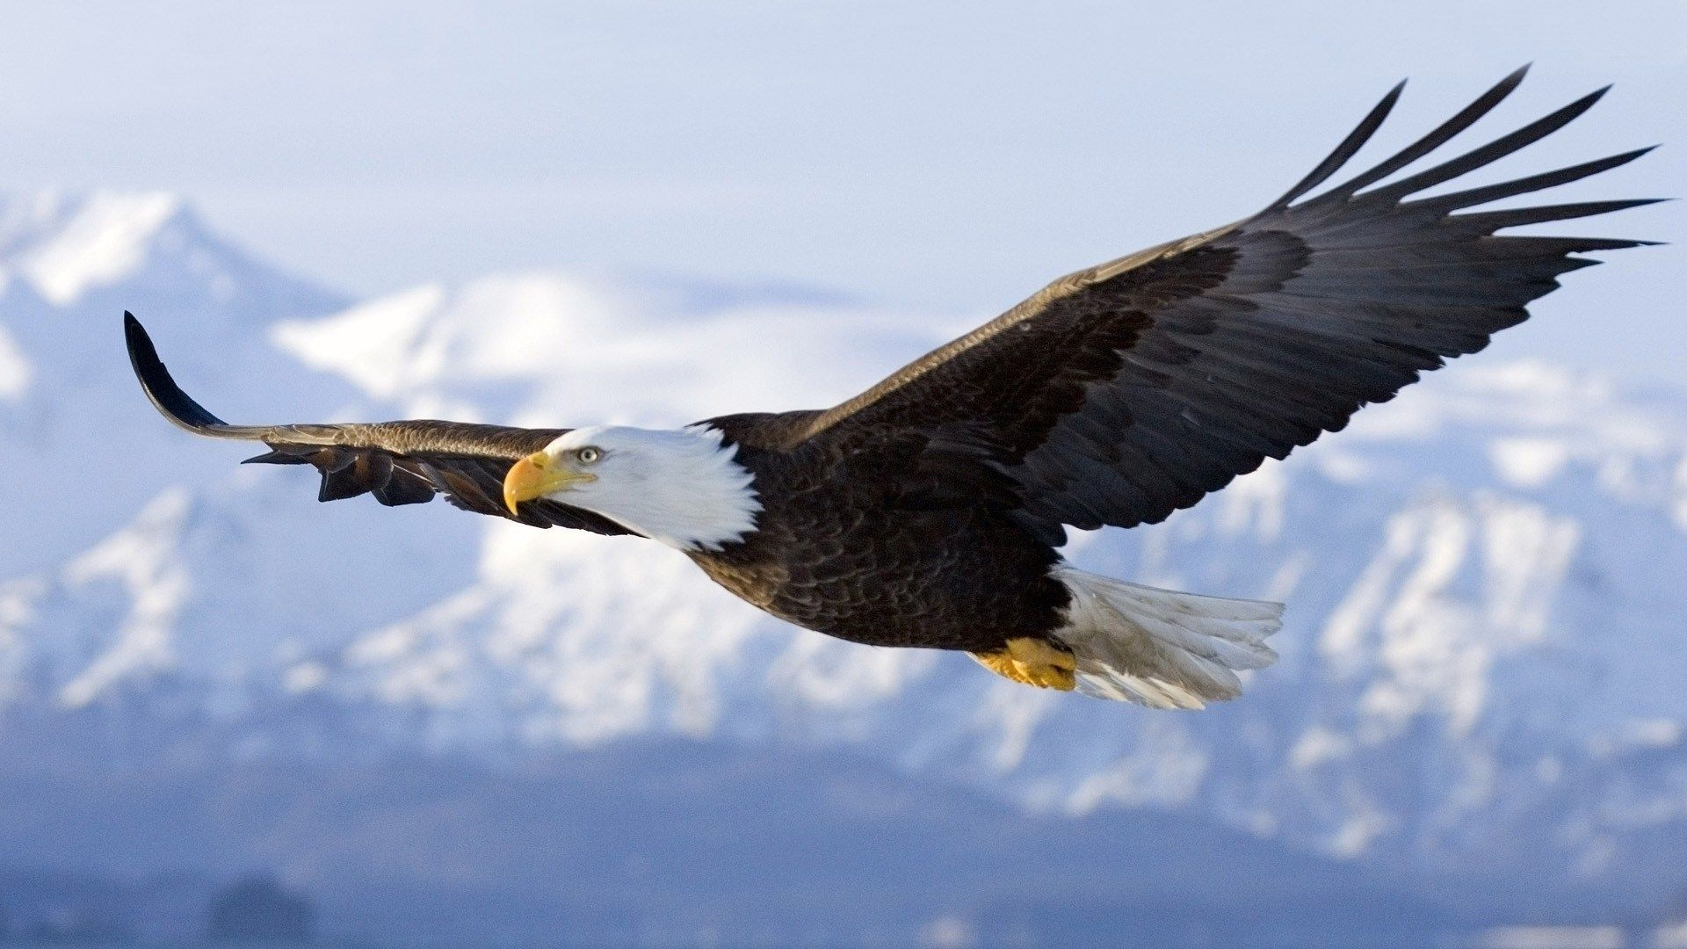
Job can you oversee the care of my creation – 38:39-39:30
²³ The quiver rattles against its side, along with the flashing spear and lance. ²⁴ In frenzied excitement it eats up the ground; it cannot stand still when the trumpet sounds. ²⁵ At the blast of the trumpet it snorts, ‘Aha!’ It catches the scent of battle from afar, the shout of commanders and the battle cry.
²⁶ “Does the hawk take flight by your wisdom and spread its wings toward the south? ²⁷ Does the eagle soar at your command and build its nest on high? ²⁸ It dwells on a cliff and stays there at night; a rocky crag is its stronghold. ²⁹ From there it looks for food; its eyes detect it from afar. ³⁰ Its young ones feast on blood, and where the slain are, there it is.”

Slide 14
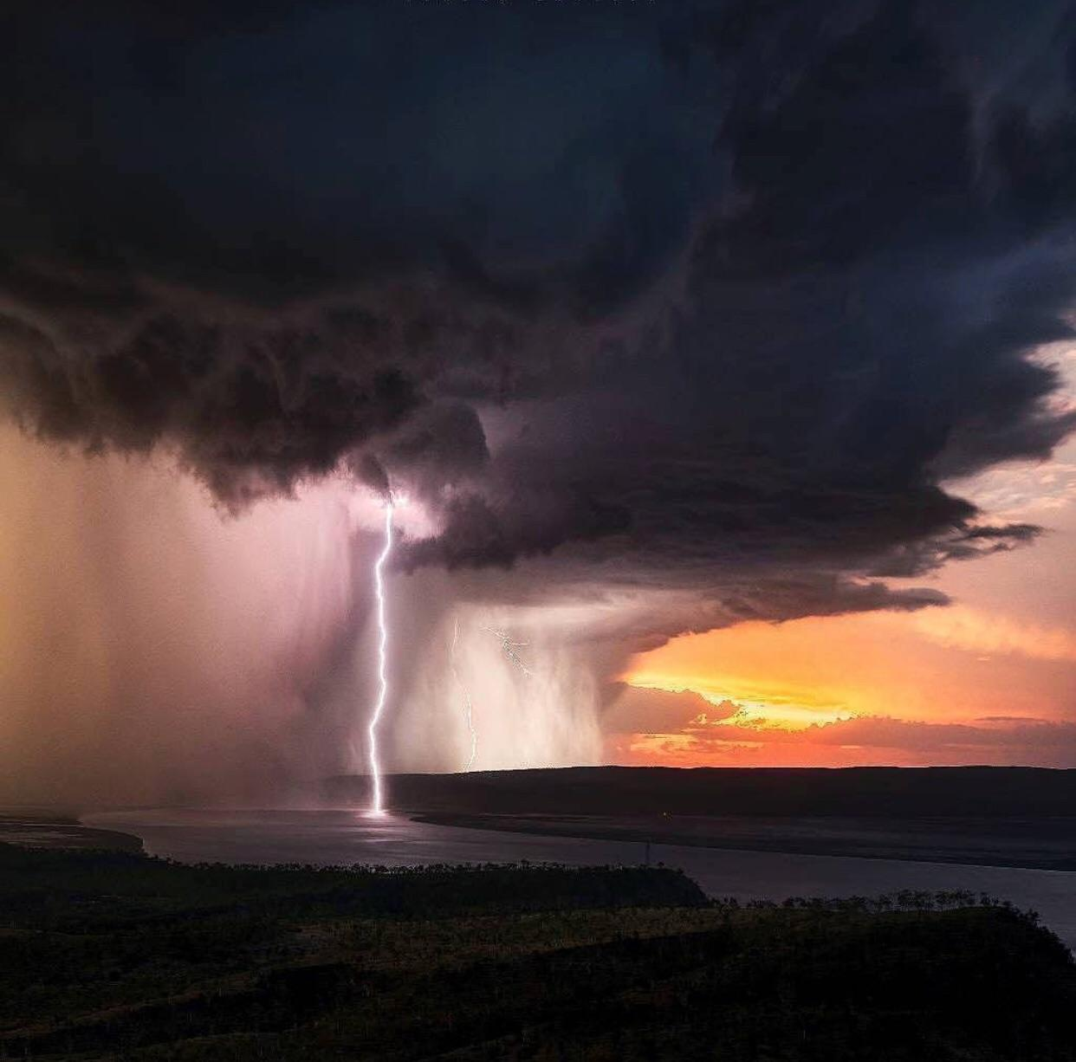
Job can you subdue my creation? – 40:6-41
⁶ Then the Lord spoke to Job out of the storm:
⁷ “Brace yourself like a man; I will question you, and you shall answer me.
⁸ “Would you discredit my justice? Would you condemn me to justify yourself? ⁹ Do you have an arm like God’s, and can your voice thunder like his? ¹⁰ Then adorn yourself with glory and splendor, and clothe yourself in honor and majesty. ¹¹ Unleash the fury of your wrath, look at all who are proud and bring them low, ¹² look at all who are proud and humble them, crush the wicked where they stand. ¹³ Bury them all in the dust together; shroud their faces in the grave. ¹⁴ Then I myself will admit to you that your own right hand can save you.

Slide 15
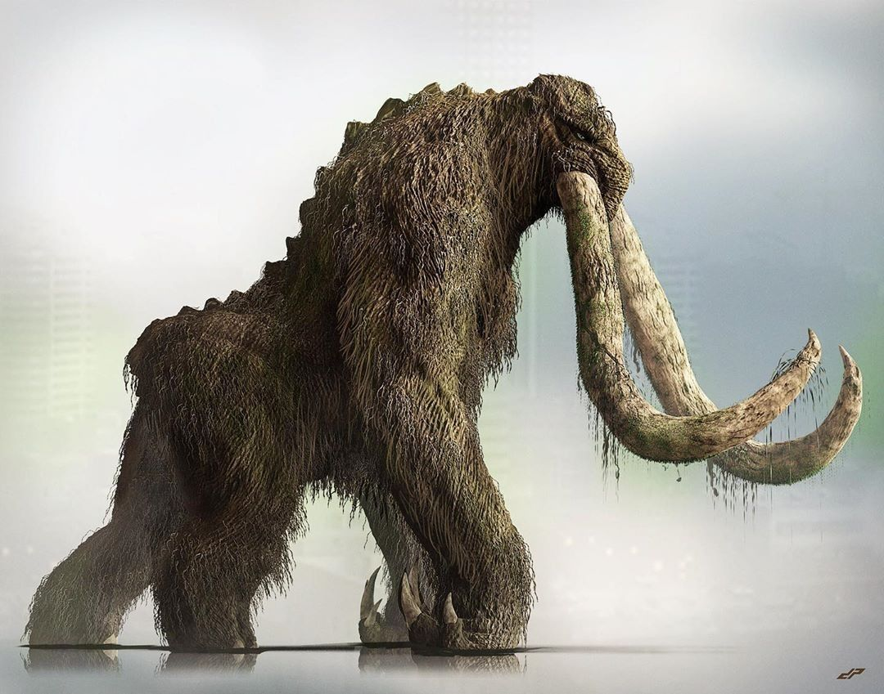
Job can you subdue my creation? – 40:6-41
¹⁵ “Look at Behemoth, which I made along with you and which feeds on grass like an ox. ¹⁶ What strength it has in its loins, what power in the muscles of its belly! ¹⁷ Its tail sways like a cedar; the sinews of its thighs are close-knit. ¹⁸ Its bones are tubes of bronze, its limbs like rods of iron. ¹⁹ It ranks first among the works of God, yet its Maker can approach it with his sword.

Slide 16
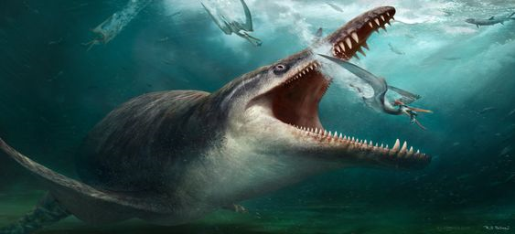
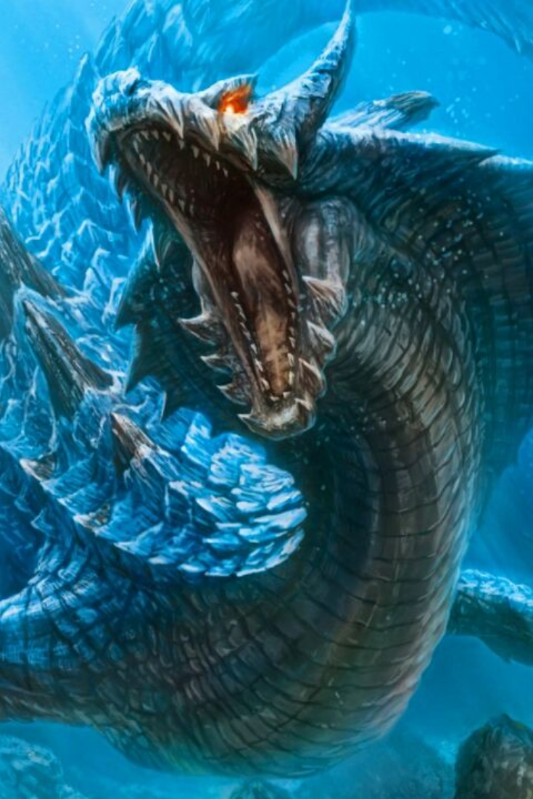
Job can you subdue my creation? – 40:6-41
41 “Can you pull in Leviathan with a fishhook or tie down its tongue with a rope? ² Can you put a cord through its nose or pierce its jaw with a hook? ³ Will it keep begging you for mercy? Will it speak to you with gentle words? ⁴ Will it make an agreement with you for you to take it as your slave for life? ⁵ Can you make a pet of it like a bird or put it on a leash for the young women in your house? ⁶ Will traders barter for it? Will they divide it up among the merchants?

Slide 17
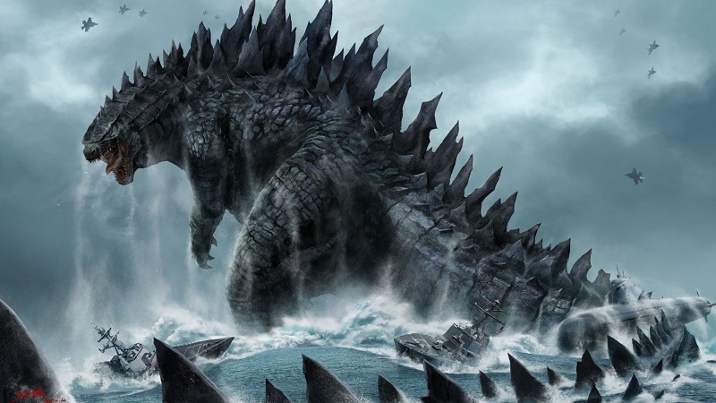
Job can you subdue my creation? – 40:6-41
⁷ Can you fill its hide with harpoons or its head with fishing spears? ⁸ If you lay a hand on it, you will remember the struggle and never do it again! ⁹ Any hope of subduing it is false; the mere sight of it is overpowering. ¹⁰ No one is fierce enough to rouse it. Who then is able to stand against me? ¹¹ Who has a claim against me that I must pay? Everything under heaven belongs to me.

Slide 18
Job finally got an audience with God. He is given his day in court to defend his case.
The big question God has for Job is; “Are you my equal?”
“If you can explain my creation, take care of my creation and rule over my creation – then and only then are you my equal”.
Job cannot do any of these things.

Slide 19
I believe God asks these questions to get Job to see beyond his narrow view of his world.
“God’s rebuke is not meant to destroy Job but to teach him a valuable lesson concerning the relationship of his own life to God’s government of the world. Although Job’s suffering is important to God, evidenced in the fact that God answers Job, there is a mystery concerning the way God governs the world, which means there is a mystery from a human standpoint concerning the whole subject of suffering”.
Richard Belcher

Slide 20
40 The Lord said to Job:
² “Will the one who contends with the Almighty correct him? Let him who accuses God answer him!”
³ Then Job answered the Lord:

Slide 21
⁴ “I am unworthy—how can I reply to you? I put my hand over my mouth.
⁵ I spoke once, but I have no answer— twice, but I will say no more.”

Slide 22
Job humbles himself and acknowledges that he was foolish to speak out against God. He was foolish to think that God is not in control and that he is blameless and God is guilty.
We will look further at what Job learnt through these challenging times next week when we consider the theme “Revelation in Suffering”.
How about you?
Do you have questions for God?
Would you like your day in court to challenge God about how he has or has not managed this world, mankind?
What would you really say to him?

Slide 23
God made each living thing, including man, suited to its environment and task. But man is not content to be the creature, he wants to be creator, and that is Satan’s promise to man if he will disobey God. The next time you are tempted to listen to Satan’s lies, that you could do a better job at running planet earth, look at God’s creation and remember that you are not God and you are certainly not his equal.
Warren Wiersbe.

Slide 24
That sense of “I am God and I am with you;
it’s going to be okay”.
In those times I am strengthened to implement my whatever, whenever & however response to life’s dramas.

Slide 25
If God’s ways are higher than mine, then WHATEVER he allows I will seek to trust him.
If God has answers I lack, then WHENEVER he speaks I will seek to listen and learn from him.
If God is in full control, then HOWEVER he directs my steps I will seek to follow him.

