Slide 1
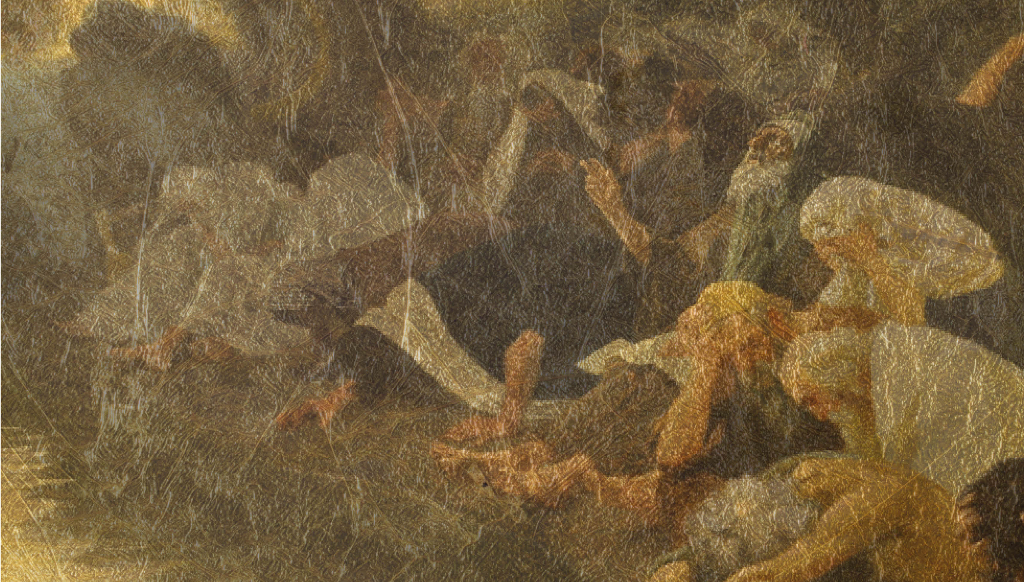
Singing in Babylon
finding purpose in life’s second choices
Blessing Babylon

Slide 3
I will make you into a great nation, and I will bless you; I will make your name great, and you will be a blessing. I will bless those who bless you, and whoever curses you I will curse; and all peoples on earth will be blessed through you.
Genesis chapter 12 v 2-3
‘Blessed…to be a blessing’

Slide 4
Daniel chapter 1: Israel defeated and in exile
1. Withdraw – have nothing to do with the enemy 2. Attack – use force to destroy the enemy 3. Compromise – become just like the enemy
4. Bless – join in with God’s mission to the enemy

Slide 5
Daniel chapter 1:
¹⁷ To these four young men God gave knowledge and understanding of all kinds of literature and learning. And Daniel could understand visions and dreams of all kinds.
¹⁸ At the end of the time set by the king to bring them into his service, the chief official presented them to Nebuchadnezzar. ¹⁹ The king talked with them, and he found none equal to Daniel, Hananiah, Mishael and Azariah; so they entered the king’s service.

Slide 6
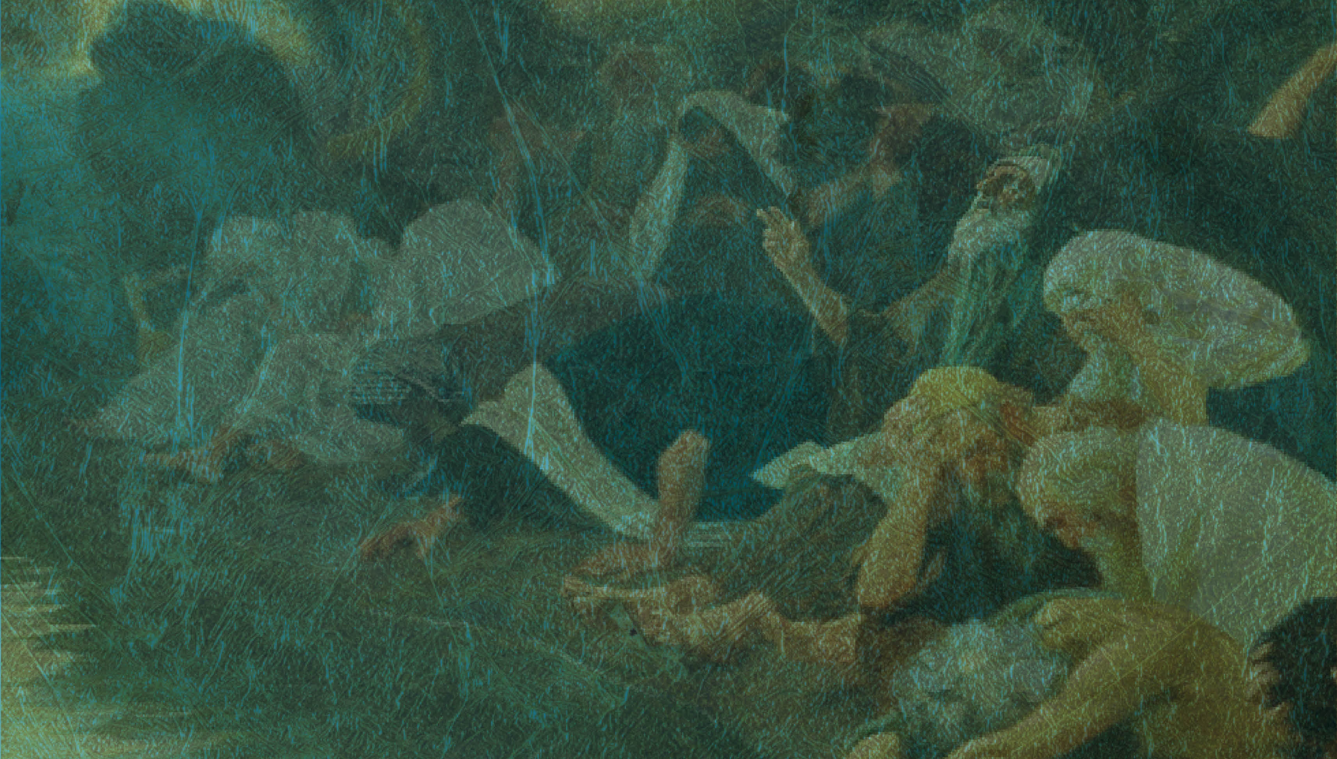
Jesus:
Love your neighbour as yourself Mark 12 v 31
Love your enemies, and pray for those who persecute you Matthew 5 v 44

Slide 7
Daniel chapter 1: Blessing Babylon
God’s blessing to authority

Slide 8
Daniel chapter 1: Blessing Babylon
Bringing God’s blessing to authority
The blessing of godly young people

Slide 9
Daniel chapter 1: Blessing Babylon
Bringing God’s blessing to authority
The blessing of godly young people

Slide 10
Daniel chapter 1: Blessing Babylon
Bringing God’s blessing to authority
The blessing of godly young people
We are blessed…to be a blessing

