Slide 1
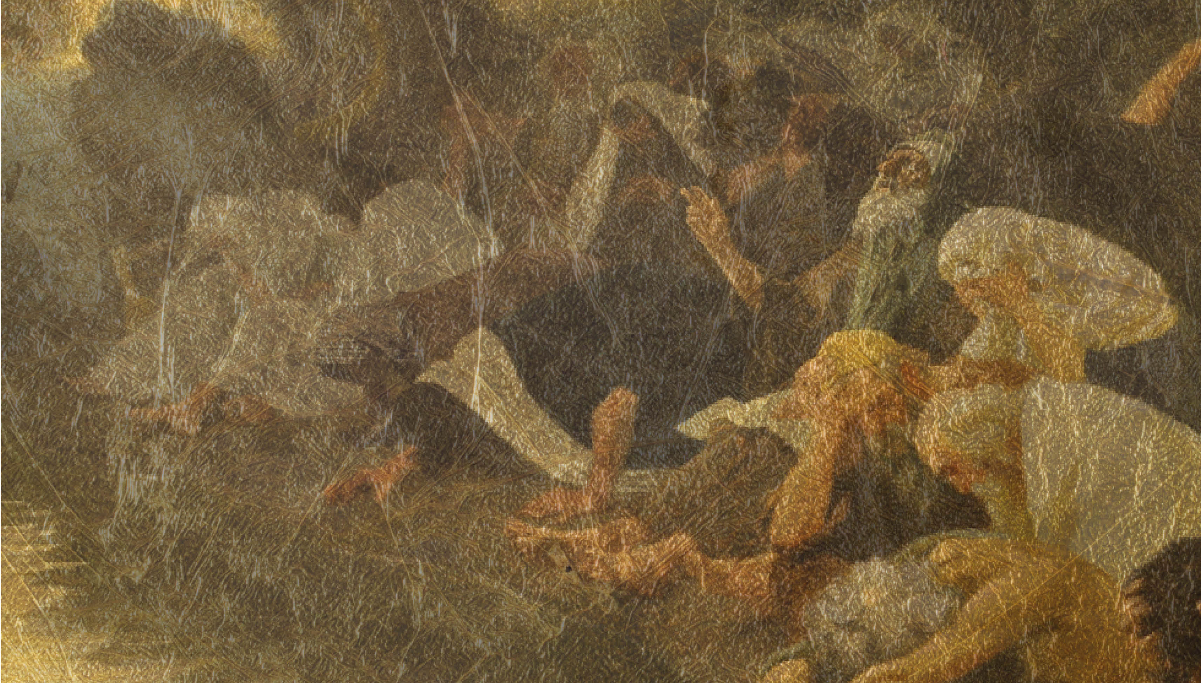
Singing in Babylon
Over & Out
Daniel 9:1-19 & 10 & 12:13

Slide 2
Daniel’s Prayer
Daniel has been reading the prophecies of Jeremiah the Prophet Jeremiah 25:1-14 & Jeremiah 29:1-11
Daniel falls to his knees and turns to God in prayer, rather than simply waiting for the prophecy to come to pass.

Slide 3
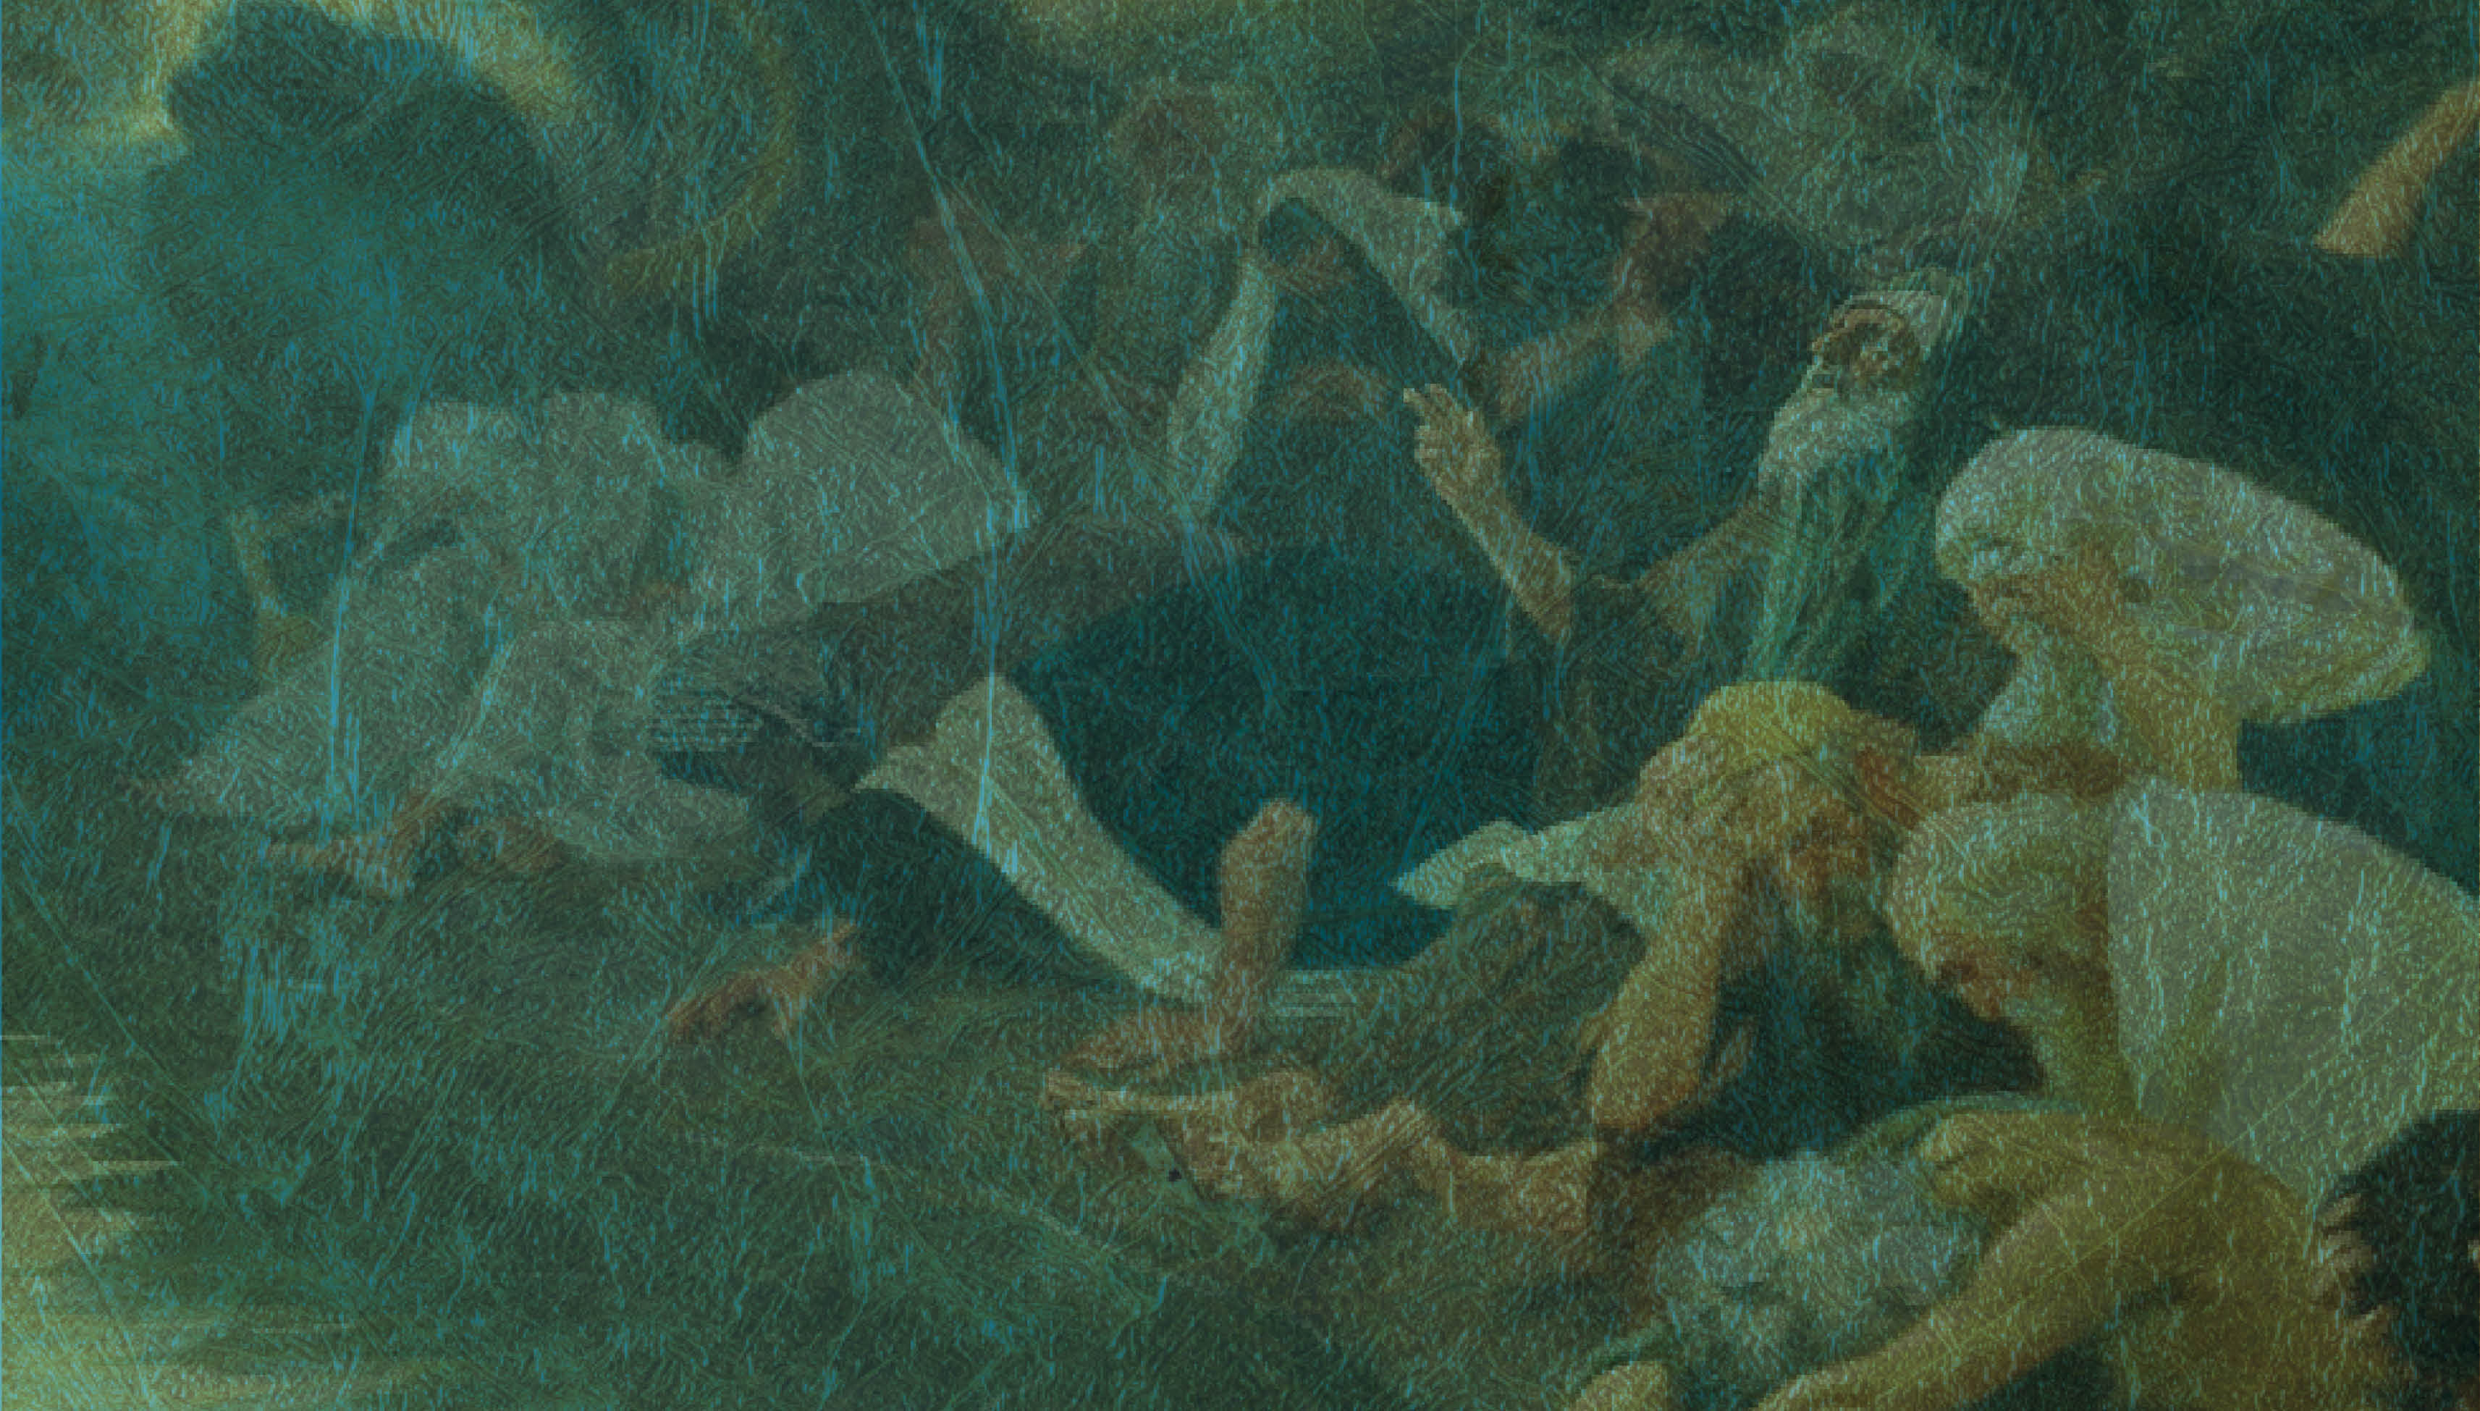
The importance of our prayers being guided by scripture.
How often do you use scripture to shape your prayer?

Slide 4
Daniels prayer has three elements to it.
Adoration • Confession Petition

Slide 5
Adoration & Declaration
Daniel begins the prayer with worship and throughout the prayer declares certain truths about God’s character.
He is great and awesome God – verse 4 He is a covenant keeping God – verse 4 He is merciful – verse 4 He is righteous – verse 7 He is forgiving – verse 9 He is the God who delivered his people out of Egypt – verse 15

Slide 6
Confession
The second element is confession. Daniel confesses his own sin and failure and the sins and failure of his people. He looks back over Israel’s history and grieves the disobedience, neglect of covenant responsibilities, and failure to respond to the the warnings of the prophets.
We have sinned – verses 5,8,11, 15 We have acted wickedly – verses 5,15 We have rebelled – verses 5,9 We have departed from your commands – verse 5 We have not listened to your prophets – verse 6

Slide 7
Petition
The third element in Daniel’s prayer is petition. It is interesting that Daniel does not even begin to petition God until a full confession of sin had been made. He does not blame God for the calamities that have befallen Israel or suggest that Israel deserves to be rescued or restored because of who they are.
However, he begins to express hope and confidence that God will act for good on behalf of Israel because of who God is. God is merciful and forgiving. Also God’s name and reputation is at stake, Israel have become a disgrace, bringing Israel back to their home, Jerusalem will hopefully change this.

Slide 8
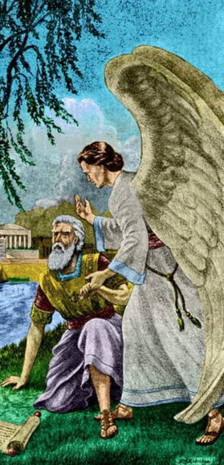
After three weeks of fasting and prayer (Daniel 10:2) Daniel receives a remarkable answer through the arrival of the Angel Gabriel, who assures him that he is loved and highly esteemed and that his prayers were heard from the moment he began to plead with God for his people.
The rest of the book of Daniel speaks in detail about what will happen in the future, how empires will rise and fall, the spiritual battle that is raging and how God will bring not just Israel’s exile to an end but all of history.

Slide 9
Daniel intercedes for his people and his prayers are answered.
It reminds us that prayer is the most important activity we can engage in.
Prayer is not passive it’s active. It is really doing something.
Prayer isn’t the least we can do; it is the most important thing we can do. Prayer is the central work, which causes all other work to bear fruit.

Slide 10
Daniel’s account reminds us that prayer is supernatural. It is reaching out of the visible world into the unseen world. Prayer can be difficult at times because we are engaging in spiritual warfare.
Paul reminded us in Ephesians 6:12
“our struggle is not against flesh and blood, but against the rulers, against the authorities, against the powers of this dark world and against the spiritual forces of evil in the heavenly realms”.

Slide 11
God answered Daniel’s prayers and Israel did go back to Jerusalem. It was not an easy journey back; there were plenty of challenges and plenty of stops and starts to the rebuilding of Jerusalem by God’s people under the guidance of Ezra & Nehemiah and others.

Slide 12
Daniel himself never made it back. He lived out his years in Babylon.
“As for you, go your way till the end. You will rest, and then at the end of the days you will rise to receive your allotted inheritance.”
Daniel 12:13

Slide 13
The book of Daniel ends with Daniel remaining in Babylon but receiving the promise that one day he will receive resurrection life and will be with his God in his kingdom forever.
As we remain in exile, may we be a people who regularly pray for God’s kingdom to come and his will to be done in our world, nation, community and homes.

Slide 14
As we wait for the promises of God to be fulfilled may we be encouraged to keep on keeping on.
As we go about our daily business may we have the sure and certain hope and knowledge like Daniel that our future is certain and secure.
One day we will be with our God forever.
As we wait may, may each of us daily keep a right perspective. May we keep our focus on the prize ahead and not get entangled or distracted by the things of this world.

Slide 15
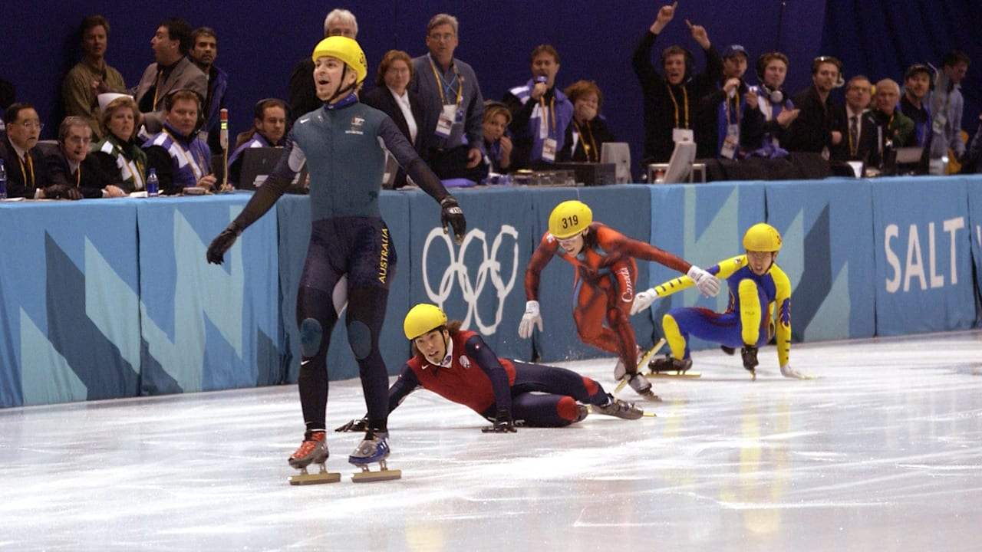

Slide 16
The challenge for us is how are we going to finish?
In life an important aspect is not how you start but how you finish.

Slide 17
Paul was able to say - 2 Timothy 4:7-8
“I have fought the good fight, I have finished the race, I have kept the faith. Now there is in store for me the crown of righteousness, which the Lord, the righteous judge, will award me on that day, and not only to me, but also to all who have longed for his return.”

Slide 18
We have a prize that awaits us, may God give us grace and strength to finish well like Daniel.
Amen

