Slide 2
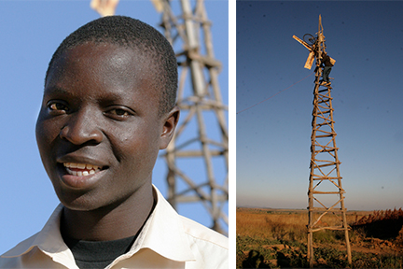

Slide 3
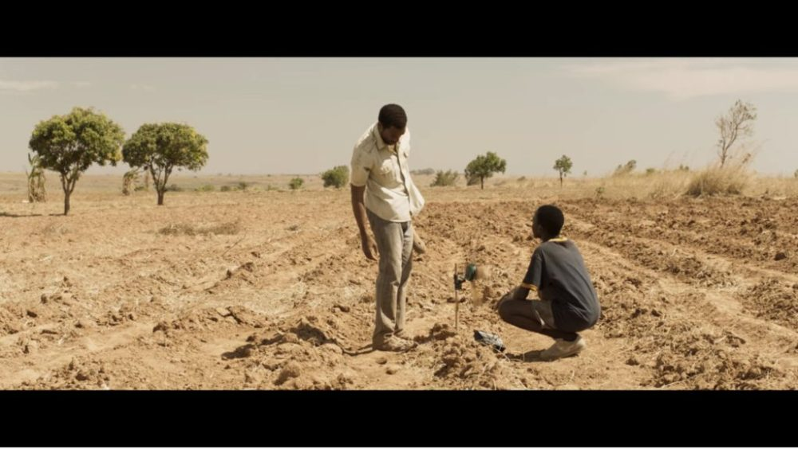

Slide 5
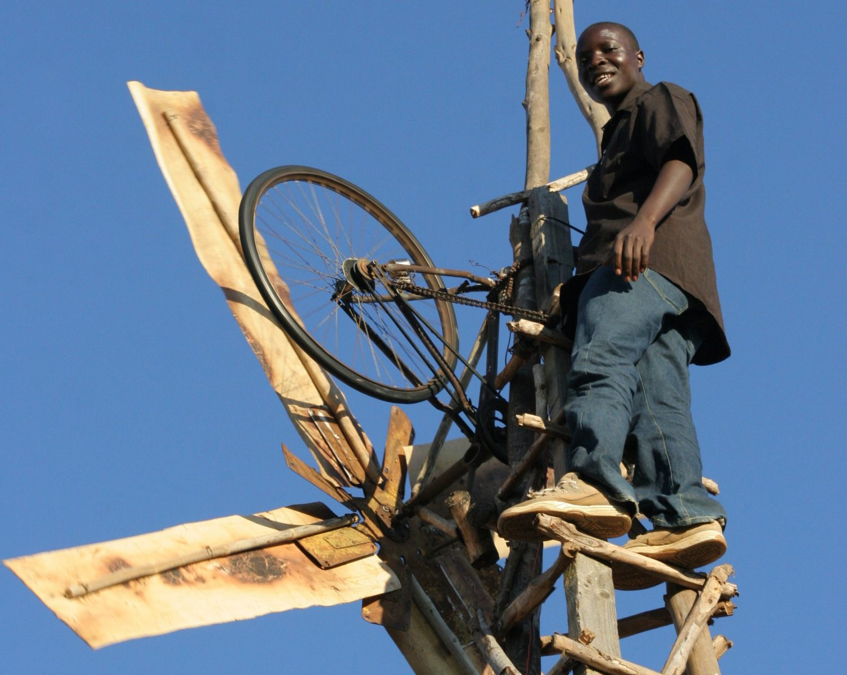

Slide 7
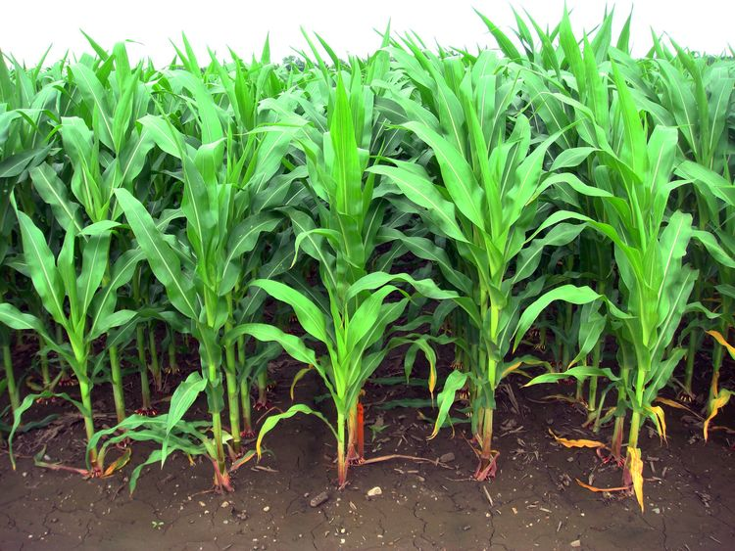

Slide 8
Importance of “church” to God
Eph 1:22 God placed all things under Jesus and appointed him to be head over everything for the church
Eph 2:19 – you are no longer foreigners and aliens but fellow citizens with God’s people and members of God’s household.

Slide 9
Importance of “church” to God
Eph 3: 10 God’s intent was that now through the church the manifold wisdom of God should be made known
Eph 3: 21 To him be glory in the church
Eph: 4:12. God’s gifts.. to prepare God's people for works of service so that the body of Christ may be built up.

Slide 10
Ephesians 5:18-21
Do not get drunk on wine, which leads to debauchery. Instead, be filled with the Spirit, speaking to one another with psalms, hymns, and songs from the Spirit. Sing and make music from your heart to the Lord, always giving thanks to God the Father for everything, in the name of our Lord Jesus Christ. Submit to one another out of reverence for Christ.

Slide 11
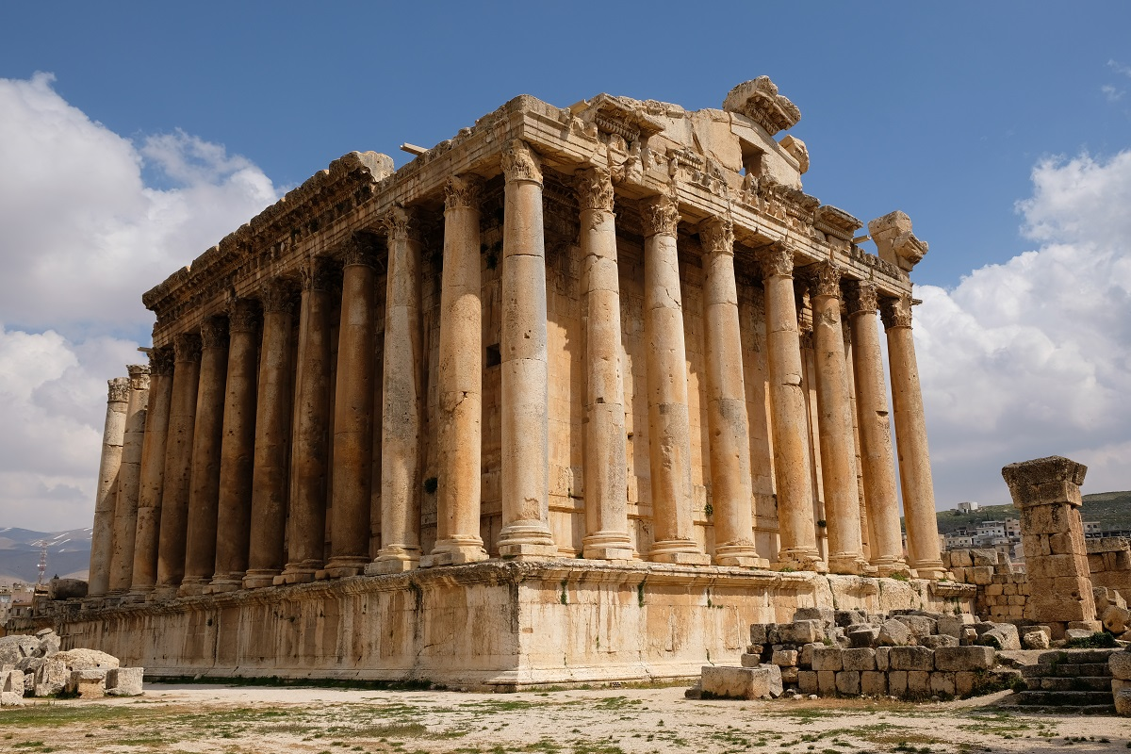
The negative- do not get drunk on wine

Slide 12
Ephesians 1: 3-8
Praise be to the God and Father of our Lord Jesus Christ, who has blessed us in the heavenly realms with every spiritual blessing in Christ. For he chose us in him before the creation of the world to be holy and blameless in his sight. In love he predestined us for adoption to sonship through Jesus Christ, in accordance with his pleasure and will— to the praise of his glorious grace, which he has freely given us in the One he loves. In him we have redemption through his blood, the forgiveness of sins, in accordance with the riches of God’s grace that he lavished on us.

Slide 13
The positive – Be filled by the Spirit
A command
Present and continuous action
Also passive

Slide 14
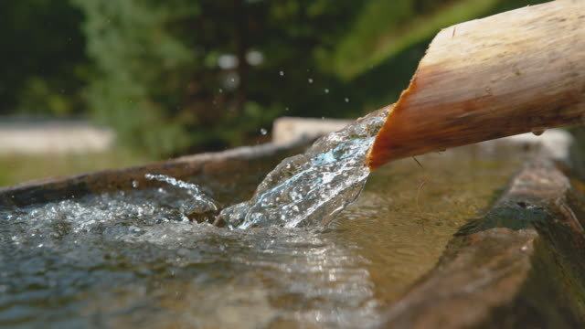
The positive – be filled by the Spirit

Slide 15
“That is being filled with the Spirit of God. The Spirit of God is already there. It hasn’t gone anywhere. You can’t empty yourself of Him. He is already there. However, you can clog it up. You can shut it down. You can stop the flow. So therefore, constantly in my life, I have to stay unhindered so the Holy Spirit of God can flow and minister His life through me. I can’t minister to anybody. I can’t do anything. It is Christ doing it through me.” Wayne Barber

Slide 16
Ephesians 5:18-21
Do not get drunk on wine, which leads to debauchery. Instead, be filled with the Spirit, speaking to one another with psalms, hymns, and songs from the Spirit. Sing and make music from your heart to the Lord, always giving thanks to God the Father for everything, in the name of our Lord Jesus Christ. Submit to one another out of reverence for Christ.

Slide 17
Impact of being filled by Spirit:
Speaking psalms, hymns and spiritual songs to each other
Singing and making music to the Lord
Giving thanks for everything
Submitting to one another

Slide 18
What does be filled with the Spirit mean?
A command
Present and continuous action
Also passive
Plural in application

Slide 19
“We are right to nurture the expectation of a particular encounter with the dynamic presence of the Spirit … when we gather together in the corporate worship of the church.”
John Risbridger BST series on Worship

Slide 20
Worship
Thanksgiving
Service

Slide 21
Worship
Thanksgiving
Service

Slide 22
Challenge: are we there for the church?
Encouragement: the church is God’s gift to us

