Slide 1
The Armour of God
Ephesians 6 V 10-20

Slide 2
Finally, be strong in the Lord and in his mighty power. Put on the full armour of God, so that you can take your stand against the devil’s schemes. For our struggle is not against flesh and blood, but against the rulers, against the authorities, against the powers of this dark world and against the spiritual forces of evil in the heavenly realms. Therefore put on the full armour of God, so that when the day of evil comes, you may be able to stand your ground, and after you have done everything, to stand.

Slide 3
Stand firm then, with the belt of truth buckled around your waist, with the breastplate of righteousness in place, and with your feet fitted with the readiness that comes from the gospel of peace. In addition to all this, take up the shield of faith, with which you can extinguish all the flaming arrows of the evil one. Take the helmet of salvation and the sword of the Spirit, which is the word of God.

Slide 4
And pray in the Spirit on all occasions with all kinds of prayers and requests. With this in mind, be alert and always keep on praying for all the Lord’s people. Pray also for me, that whenever I speak, words may be given me so that I will fearlessly make known the mystery of the gospel, for which I am an ambassador in chains. Pray that I may declare it fearlessly, as I should.

Slide 5
Ephesians 6 v 10-20 – The Armour of God
Battle Engaged
Battle Equipped
Battle Empowered

Slide 6
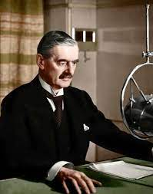
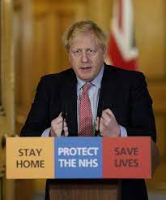
Battle Engaged

Slide 7
Battle Engaged
Our struggle is not against flesh and blood but against the rulers, powers and evil forces in the heavenly realms 6 v 12

Slide 8
Battle Engaged
Our struggle is not against flesh and blood but against the rulers, powers and evil forces in the heavenly realms 6 v 12
“A caution against lashing out against human opponents as though they were the real enemy and against assuming that the battle can be fought using merely human resources.”

Slide 9
Battle Engaged : the Battle for Truth
What is Truth?
My Truth
The
Truth

Slide 10
Battle Engaged : Examples of My Truth
“Be true to yourself”
“If whatever you choose to believe works for you, then its fine”

Slide 11
Battle Engaged : Examples of My Truth
Hi. I'm Zen.Your Personal Alignment Coach
You are the creator of your life, and life is supposed to feel good.
All of your power, all of your creative ability is dependent on your alignment with who you really are, your greatest and authentic self,
Begin by taking stock of what you feel is your truth.

Slide 12
Battle Engaged : the Battle for Truth
What is Truth?
My Truth
The
Truth

Slide 13
My Truth – if its alright for me, its alright
BUT
I can be sincere and equally wrong
My understanding will always be limited
I am weak

Slide 14
The Truth - A person not a philosophy
In Jesus was life, and that life was the light of men John 1 v 4
The true light that gives light to every man was coming into the world John 1 v 9
I am the way, the truth and the life – John 14 v 6

Slide 15
Battle Engaged : the Battle for Truth
For the time will come when men will not put up with sound doctrine– they will turn their ears away from the truth and turn aside to myths. 2 Tim 4 v 3
Although they claimed to be wise, they became fools….they exchanged the truth of God for a lie Romans 1 v 22- 25
I am the way, the truth and the life
John 14 v 6

Slide 16
Battle Equipped – Armour provided by God
A helmet to protect against doubt – the helmet of salvation – our God has given us a mighty saviour Luke 1 v 69
A breastplate to give courage for our hearts,
- a breastplate of righteousness - although naturally rebellious towards God are declared purified by him Acts 15 v9
The belt of truth

Slide 17
The Belt of Truth
The typical Roman soldier wore a tunic that was cinched around the waist by a wide leather belt. It served as the foundational piece of his entire outfit, holding his sword in place, supporting him in battle, and binding the rest of his armour together. No soldier would ever willingly press the battle without this piece of armour. To enter into conflict without a belt was to be unarmed, and therefore vulnerable.

Slide 18
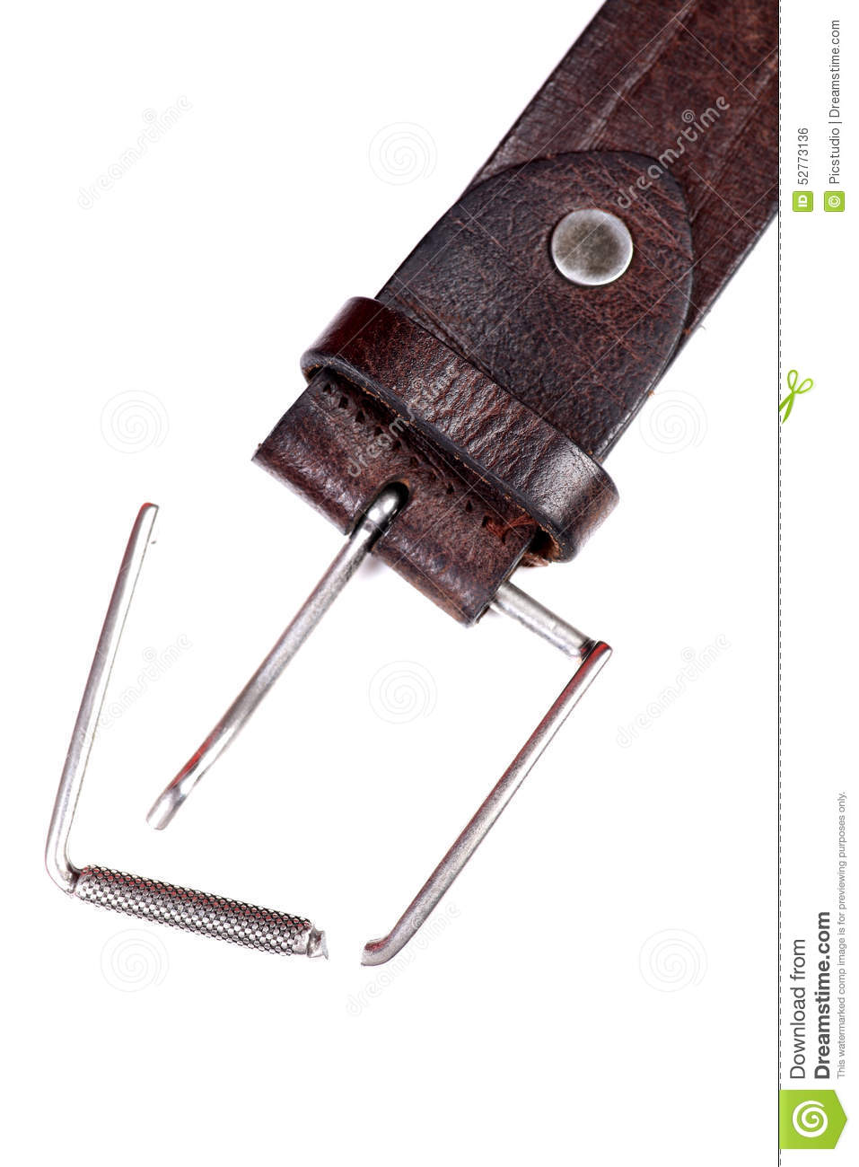
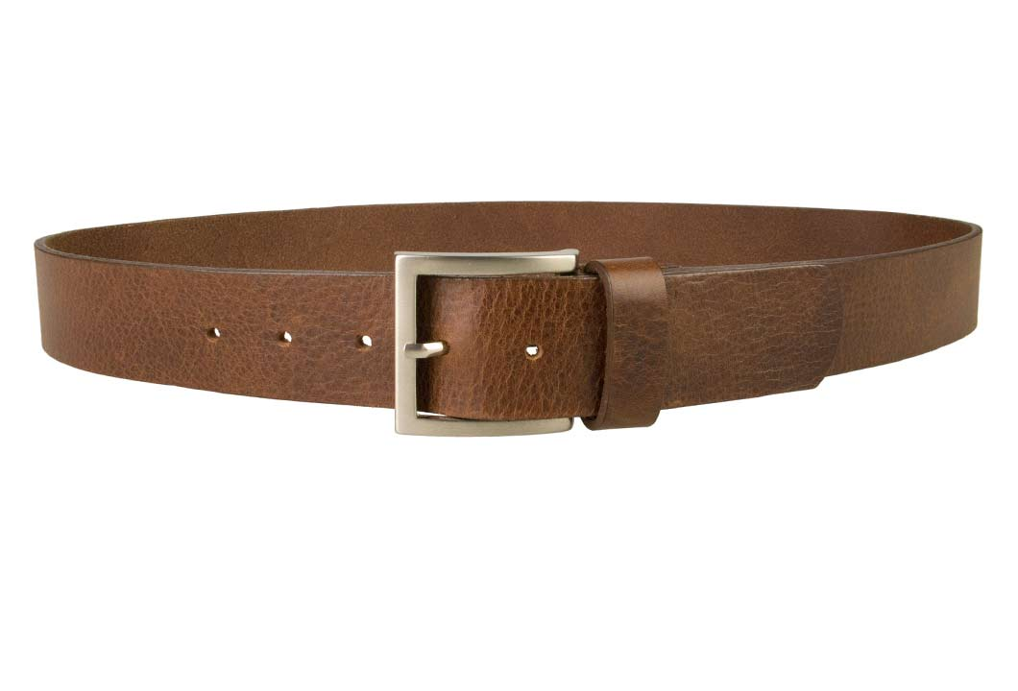
Battle Equipped –What belt do I wear?
My Truth
What is Truth?
The Truth
No Belt

Slide 19
Get belted in with a reliable belt
Not a new philosophy but a person!
You also were included in Christ when you heard the word of truth, the gospel of your salvation. Having believed you were marked in him with a seal the promised Holy Spirit. Ephesians 1 v 13
A belt that holds onto us – not the other way around!

Slide 20
Battle Empowered – the application
Be strong in the Lord Eph 6 v 10
Stand firm Eph 6 v 14
Pray, and keep praying Eph 6 v 18
Declare the gospel Eph 6 v 19

Slide 21
Pray and Keep Praying….Paul’s prayer
I keep asking that God…
may give you the Spirit of wisdom and revelation so that you may know him better.
I pray that the eyes of your heart may be enlightened, to know the hope to which he has called you…
and his incomparably great power for us who believe
Eph 1 v 17-19.

Slide 22
Ephesians 6 v 10-20 – The Armour of God
Battle Engaged – we are in a cosmic struggle
Battle Equipped – let’s each wear the belt of truth
Battle Empowered – to tell the gospel

Slide 23
The Gospel
Praise be to the God and Father of our Lord Jesus Christ, who has blessed us in the heavenly realms with every spiritual blessing in Christ. For he chose us in him before the creation of the world to be holy and blameless in his sight. In love he predestined us to be adopted as his sons, through Jesus Christ, in accordance with his pleasure and will - to the praise of his glorious grace which he has freely given us in the One he loves. In him we have redemption through his blood, the forgiveness of sins, in accordance with the riches of God’s grace
Eph 1 v 3-7

