Slide 1
Psalm 129 They’ve kicked me around ever since I was young” —this is how Israel tells it— “They’ve kicked me around ever since I was young, - but they never could keep me down. Their ploughmen ploughed long furrows up and down my back;
But God wouldn’t put up with it, he sticks with us. Then God ripped the harnesses of the evil ploughmen to shreds.”
Oh, let all those who hate Zion grovel in humiliation; Let them be like grass in shallow ground that withers before the harvest, Before the farmhands can gather it in, the harvesters get in the crop, Before the neighbours have a chance to call out, “Congratulations on your wonderful crop! We bless you in God’s name!”

Slide 2
Patience
20 February 2022

Slide 3
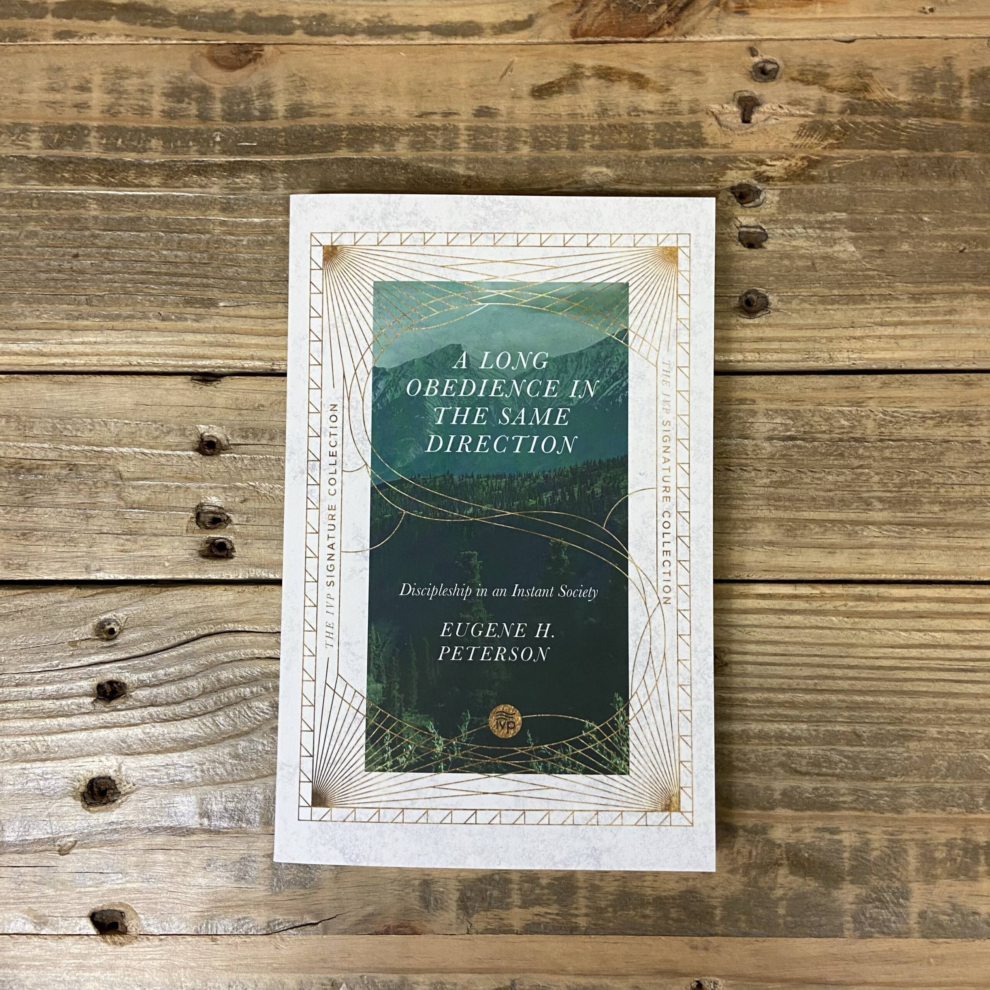
“A Long Obedience in the Same Direction”
Patience or Perseverence

Slide 4
Patience i) It is rooted in love
ii) It is modelled by Jesus
iii) It is part of our journey
iv) It is God sticking with us

Slide 5
Patience is rooted in love Love is patient, love is kind… It keeps no record of wrongs. It always protects, always trusts, always hopes, always perseveres
1 Cor 13 v 4-7
.

Slide 6
Patience is modelled by Jesus The Garden of Gethsamene Luke 22 v 39-44.
Calvary Luke 23 v 34
Paul’s testimony .. ‘unlimited patience’ 1 Tim 1 v 16
Available for everyone ..2 Peter 3 v 9

Slide 7
Patience is modelled by Jesus
He was tempted but was without sin Hebs 4 v 15
For the joy set before him…he endured the cross.. Hebs 12 v 2

Slide 8
Patience is modelled by Jesus
May the Lord direct your hearts into God’s love and Christ’s perseverance 2 Thess 3 v 5

Slide 9
Patience i) It is rooted in love
ii) It is modelled by Jesus
iii) It is part of our journey
iv) It is God sticking with us

Slide 10
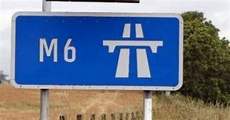
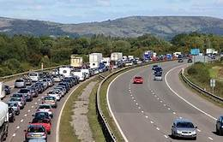
Perseverence is part of our journey

Slide 11
Perseverance is part of our journey
We are hard pressed on every side, but not crushed, perplexed but not in despair, persecuted but not abandoned… struck down but not destroyed…
Therefore we do not lose heart – though outwardly we are wasting away, inwardly we are being renewed day by day…. So we fix our eyes not on what is seen by what is unseen. What is seen is temporary what is unseen is eternal.
2 Cor 5 v 8

Slide 12
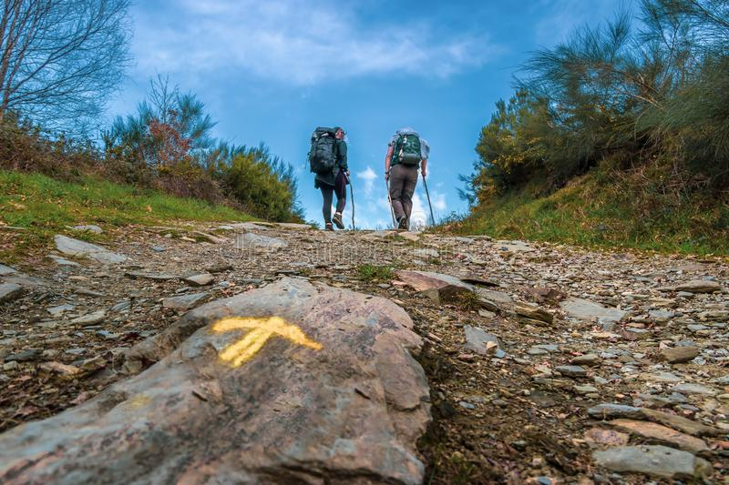
Perseverance is part of our journey

Slide 13
Perseverance is part of our journey
Consider it pure joy my brothers when you face trials of many kind because you know that the testing of your faith produces perseverance – perseverance must finish its work so that you may be mature and complete, not lacking anything. James 1 v 2 – 4
We know that suffering produces perseverance, perseverance character and character hope Romans 5 v 3

Slide 14
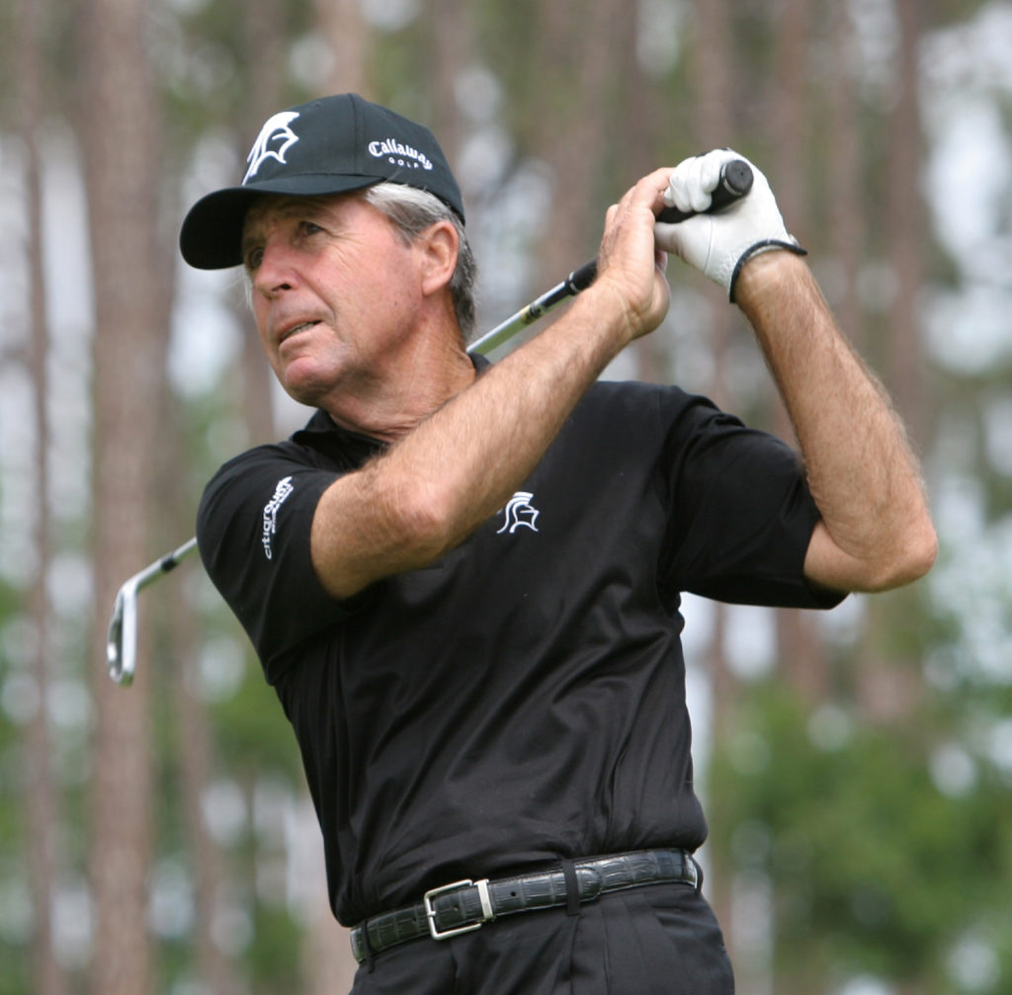
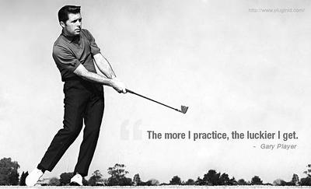
Perseverance is part of our journey

Slide 15
Perseverance is part of our journey
“Obedience is not a stodgy plodding in in the ruts of religion - it is a hopeful race towards God’s promises.
Perseverance is not resignation, putting up with things they way they are, staying in the same rut year after year or being a doormat for people to wipe their feet on. It is a travelling from strength to strength. Perseverance is triumphant and alive” Eugene Peterson

Slide 16
Patience i) It is rooted in love
ii) It is modelled by Jesus
iii) It is part of our journey
iv) It is God sticking with us

Slide 17
Patience is God sticking with us
“The central reality for Christians is the personal, unalterable, persevering commitment God makes to us.
Perseverance is not the result of our determination – it is the result of God’s faithfulness. We survive in the faith not because we have extraordinary stamina but because God is righteous, God sticks with us “ Eugene Peterson

Slide 18
Patience is God sticking with us
Christian discipleship is a process of paying more and more attention to God’s righteousness and less and less attention to our own – finding the meaning in our lives not by probing our own moods and motives and morals but by believing in God’s will and purposes, making a map of the faithfulness of God, not charting the rise and fall of our enthusiasms. It is out of such a reality that we acquire perseverance
Eugene Peterson

Slide 19
Patience is God sticking with us – Ps 129 They’ve kicked me around ever since I was young” —this is how Israel tells it— “They’ve kicked me around ever since I was young, - but they never could keep me down. Their ploughmen ploughed long furrows up and down my back;
But God wouldn’t put up with it, he sticks with us. Then God ripped the harnesses of the evil ploughmen to shreds.”
Oh, let all those who hate Zion grovel in humiliation; Let them be like grass in shallow ground that withers before the harvest, Before the farmhands can gather it in, the harvesters get in the crop, Before the neighbours have a chance to call out, “Congratulations on your wonderful crop! We bless you in God’s name!”

Slide 20
Patience is God sticking with us
I get knocked down, but I get up again You are never gonna keep me down I get knocked down, but I get up again You are never gonna keep me down I get knocked down, but I get up again You are never gonna keep me down I get knocked down, but I get up again You are never gonna keep me down

Slide 21
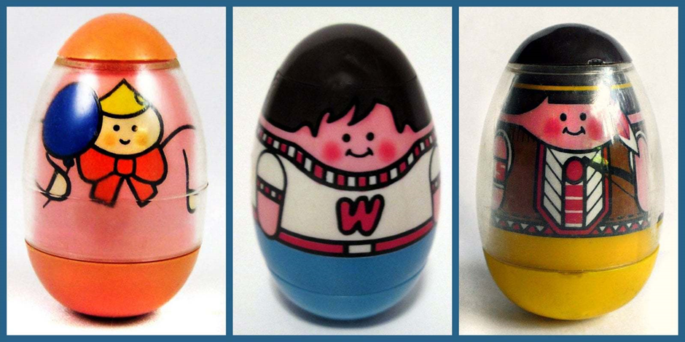
Patience is God sticking with us

Slide 22
Patience is God sticking with us
Weebles wobble
but they won’t
fall down!

Slide 23
Patience is God sticking with us
I will never leave you or forsake you Deut 31 v 6
We will come to him and make our home with him John 14 v 23
Surely I am with you always – to the very end of the age – Mthw 28 v 20.
“If we died with him, we will also live with him. If we endure, we will also reign with him, if we disown him, he will disown us, if we are faithless, he will remain faithful for he cannot disown himself. Tim 2 v 11-13

Slide 24
Patience /Perseverance
Since we are surrounded by such a great cloud of witnesses, let us throw off everything that hinders and the sin that so easily entangles and let us run with perseverance the race marked out for us. Let us fix our eyes on Jesus.
Hebrews 12 v 1

Slide 25
Patience i) It is rooted in love
ii) It is modelled by Jesus
iii) It is part of our journey
iv) It is God sticking with us

Slide 26
Patience
“ The central reality for Christians is the personal, unalterable, persevering commitment God makes to us.

