Slide 1
A long Obedience In The Same Direction
Hope 6 March 2022

Slide 2
Psalm 130 song video: Sons of Korah - PSALM 130 (More Than The Watchmen Wait) - YouTube
(MP4 download available in Dropbox folder)

Slide 3
Psalm 130
¹ Out of the depths I cry to you, Lord; ² Lord, hear my voice. Let your ears be attentive to my cry for mercy.
³ If you, Lord, kept a record of sins, Lord, who could stand? ⁴ But with you there is forgiveness, so that we can, with reverence, serve you.

Slide 4
⁵ I wait for the Lord, my whole being waits, and in his word I put my hope. ⁶ I wait for the Lord more than watchmen wait for the morning, more than watchmen wait for the morning.
⁷ Israel, put your hope in the Lord, for with the Lord is unfailing love and with him is full redemption. ⁸ He himself will redeem Israel from all their sins.

Slide 5
A long Obedience In The Same Direction
Hope 6 March 2022

Slide 6
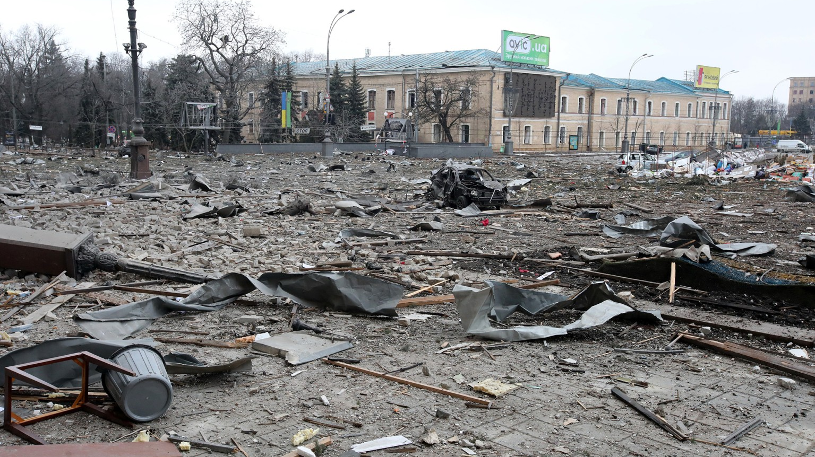

Slide 7
Psalm 130…
The certainty of hope in the Lord, in a world of uncertainty
The redemptive heart of God, in response to the sin and suffering of the human condition

Slide 8
Romans 15:4
For everything that was written in the past was written to teach us, so that through the endurance taught in the Scriptures and the encouragement they provide we might have hope.

Slide 9
Psalm 130
¹ Out of the depths I cry to you, Lord; ² Lord, hear my voice. Let your ears be attentive to my cry for mercy.
³ If you, Lord, kept a record of sins, Lord, who could stand? ⁴ But with you there is forgiveness, so that we can, with reverence, serve you.

Slide 10
“To be human is to be in trouble.”
(Peterson, A Long Obedience…, p.137)

Slide 11
Psalm 130
¹ Out of the depths I cry to you, Lord; ² Lord, hear my voice. Let your ears be attentive to my cry for mercy.
³ If you, Lord, kept a record of sins, Lord, who could stand? ⁴ But with you there is forgiveness, so that we can, with reverence, serve you.

Slide 12
“sufferings can only be dealt with creatively when they are understood as wounds integral to our human condition… with the recognition of this condition, liberation starts.”
(Nouwen, The Wounded Healer…, p.95)

Slide 13
“There is no place too dark that we cannot pray to God and no sin too sinful that God cannot reach us with his forgiveness.”
(Stackhouse, Praying Psalms)

Slide 14
The God of Psalm 130
The Lord (v1)
Mercy (v2)
Does not allow our sin to keep us from standing in his presence (v3)
Forgiveness (v4)
To be revered (v4)
Speaks through his Word which brings hope (v5)
Unfailing love (v7)
Full redemption (v7)
Redeemer of Israel from all their sins (v8)

Slide 15
⁵ I wait for the Lord, my whole being waits, and in his word I put my hope. ⁶ I wait for the Lord more than watchmen wait for the morning, more than watchmen wait for the morning.
⁷ Israel, put your hope in the Lord, for with the Lord is unfailing love and with him is full redemption. ⁸ He himself will redeem Israel from all their sins.

Slide 16
Waiting on God…
Is not a passive pursuit…
Is living a life of prayer…
Is avoiding the temptation to try to force the issue…

Slide 17
Waiting on God…
“The Christian’s waiting and watching -that is, hoping, -is…a willingness to let God do it his way and in his time. It is the opposite of making plans that we demand God put into effect, telling him both how and when to do it.”
(Peterson, A Long Obedience…, p.144)

Slide 18
⁵ I wait for the Lord, my whole being waits, and in his word I put my hope. ⁶ I wait for the Lord more than watchmen wait for the morning, more than watchmen wait for the morning.
⁷ Israel, put your hope in the Lord, for with the Lord is unfailing love and with him is full redemption. ⁸ He himself will redeem Israel from all their sins.

Slide 19
The movement and focus of Psalm 130
From the individual (“I”) to the collective (“Israel”)
Up to God
Inside at self
Out into the community

Slide 20
Redemption in Psalm 130
Redemption is God’s plan for all of creation
Redemption is God’s plan in the present – “with him is full redemption” (v7)
Redemption is God’s plan for the future – “He himself will redeem Israel” (v8)

Slide 21
Psalm 130
¹ Out of the depths I cry to you, Lord; ² Lord, hear my voice. Let your ears be attentive to my cry for mercy.
³ If you, Lord, kept a record of sins, Lord, who could stand? ⁴ But with you there is forgiveness, so that we can, with reverence, serve you.

Slide 22
⁵ I wait for the Lord, my whole being waits, and in his word I put my hope. ⁶ I wait for the Lord more than watchmen wait for the morning, more than watchmen wait for the morning.
⁷ Israel, put your hope in the Lord, for with the Lord is unfailing love and with him is full redemption. ⁸ He himself will redeem Israel from all their sins.

