Slide 1
1 Timothy

Slide 2
1 Timothy - Purpose
That God’s people know the truth and live accordingly…
Right belief leads to right behaviour

Slide 3
1 Timothy
Have confidence in your calling, whatever it may be…
Invest in relationships, with Kingdom intentionality but no strings attached…
The resources for ministry come from God, not from ourselves…

Slide 4
1 Timothy 1:12-20
12 I thank Christ Jesus our Lord, who has given me strength, that he considered me trustworthy, appointing me to his service.
13 Even though I was once a blasphemer and a persecutor and a violent man, I was shown mercy because I acted in ignorance and unbelief.

Slide 5
1 Timothy 1:12-20
14 The grace of our Lord was poured out on me abundantly, along with the faith and love that are in Christ Jesus.
15 Here is a trustworthy saying that deserves full acceptance: Christ Jesus came into the world to save sinners--of whom I am the worst.

Slide 6
1 Timothy 1:12-20
16 But for that very reason I was shown mercy so that in me, the worst of sinners, Christ Jesus might display his immense patience as an example for those who would believe in him and receive eternal life.
17 Now to the King eternal, immortal, invisible, the only God, be honour and glory for ever and ever. Amen.

Slide 7
1 Timothy 1:12-20
18 Timothy, my son, I am giving you this command in keeping with the prophecies once made about you, so that by recalling them you may fight the battle well,
19 holding on to faith and a good conscience, which some have rejected and so have suffered shipwreck with regard to the faith.

Slide 8
1 Timothy 1:12-20
20 Among them are Hymenaeus and Alexander, whom I have handed over to Satan to be taught not to blaspheme.

Slide 9
1 Timothy 1:12-20 – Main message...
God loves you and, in his mercy, wants you to serve him not despite who you are but BECAUSE OF WHO YOU ARE…

Slide 10
1 Timothy 1:12-20 – Main message...
God loves you and, in his mercy, wants you to serve him not despite who you are but BECAUSE OF WHO YOU ARE…
“…for that very reason”…

Slide 11
Paul
12 I thank Christ Jesus our Lord, who has given me strength, that he considered me trustworthy, appointing me to his service.
13 Even though I was once a blasphemer and a persecutor and a violent man, I was shown mercy because I acted in ignorance and unbelief.

Slide 12
Paul
15 Here is a trustworthy saying that deserves full acceptance: Christ Jesus came into the world to save sinners--of whom I am the worst.
16 But for that very reason I was shown mercy so that in me, the worst of sinners, Christ Jesus might display his immense patience as an example for those who would believe in him and receive eternal life.

Slide 13
Paul
16 But for that very reason I was shown mercy so that in me, the worst of sinners, Christ Jesus might display his immense patience as an example for those who would believe in him and receive eternal life.
In his mercy, Christ chose Paul to serve him not despite who he was, but BECAUSE OF WHO HE WAS.

Slide 14
Timothy

Slide 15
Timothy
PLAY YOUTUBE VIDEO FROM THIS LINK:
Timothy Cho on North Korea at the 2022 Geneva Summit for Human Rights and Democracy - YouTube

Slide 16
Timothy
God has used Timothy’s past circumstances and experiences to enable him to be a witness for Christ today…
…in local politics
…in campaigning for human rights, freedom and faith
…in working as a university research assistant
…as a husband and a father

Slide 17
Timothy
God has used Timothy’s past circumstances and experiences to enable him to be a witness for Christ today…
In his mercy, Christ chose Timothy to serve him not despite who he was, but BECAUSE OF WHO HE IS.

Slide 18
Paul and Timothy…
…lives transformed by Jesus Christ…

Slide 19
Paul and Timothy…
…lives transformed by Jesus Christ…
Able to accept self
Able to accept circumstances

Slide 20
Paul and Timothy…
…lives transformed by Jesus Christ…
If anyone is in Christ, the new creation has come.
2 Corinthians 5:17

Slide 21
Us?…

Slide 22
Us?…
…sinners

Slide 23
Us?…
…sinners, but…
There is now no condemnation for those who are in Christ Jesus…
In his mercy, Christ choses us to serve him not despite who we are, but BECAUSE OF WHO WE ARE

Slide 24
Us?…
…scarred by circumstances?...

Slide 25
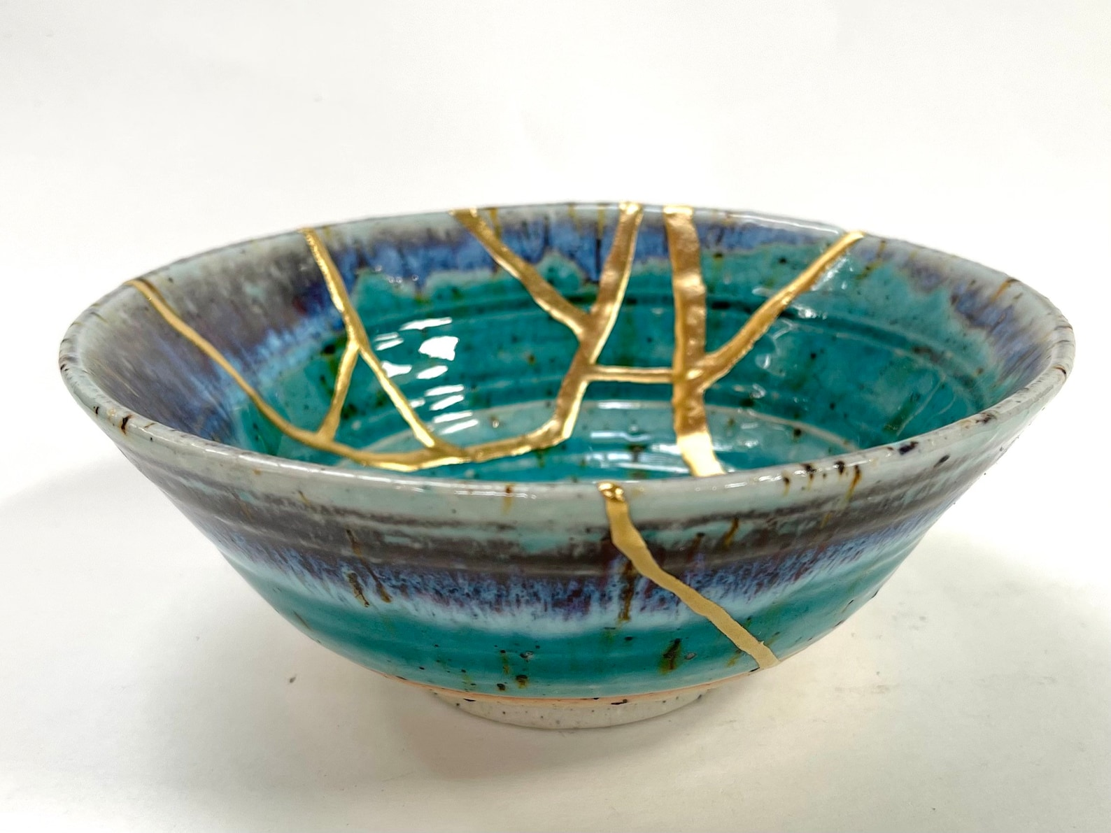
Us?…
…scarred by circumstances…
Kintsugi

Slide 26
Us?…
…scarred by circumstances, but...
The grace of our Lord was poured out on me abundantly, along with the faith and love that are in Christ Jesus

Slide 27
Us?…
…scarred by circumstances, but...
In his mercy, Christ choses us to serve him not despite who we are, but BECAUSE OF WHO WE ARE

Slide 28
Us…
…God loves us and, in his mercy, wants us to serve him, not despite who we are, but BECAUSE OF WHO WE ARE…
…for that very reason…

