Slide 2
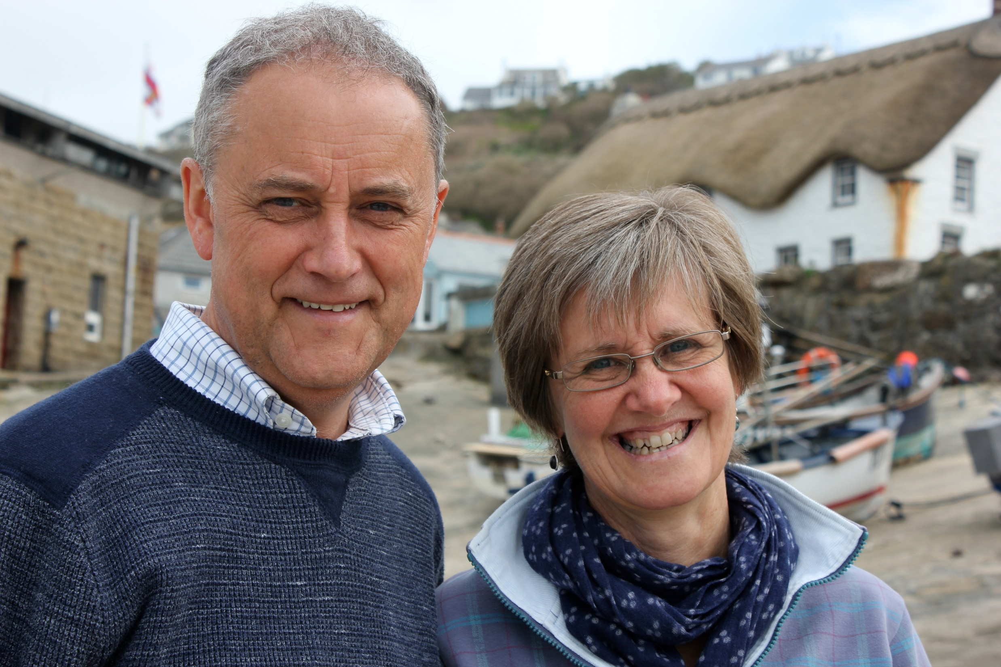

Slide 3
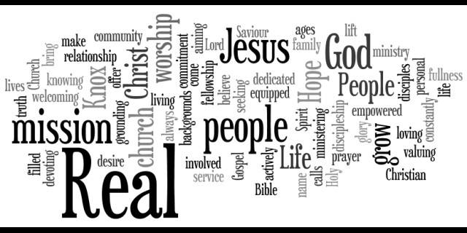
Mission@NMBC

Slide 4
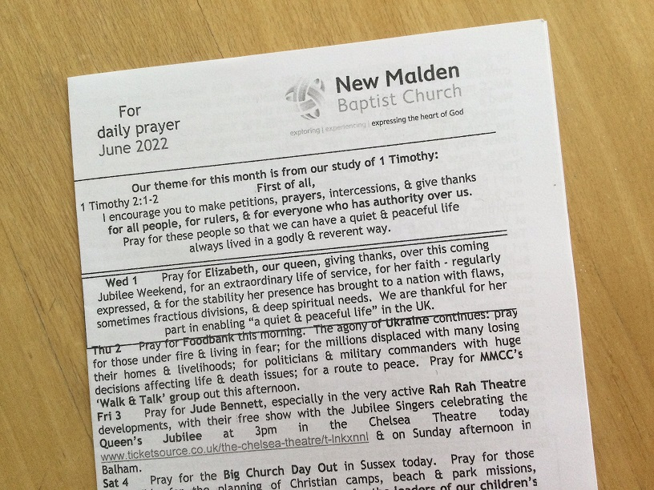

Slide 5
Paul’s 1st Letter to Timothy

Slide 6
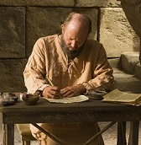
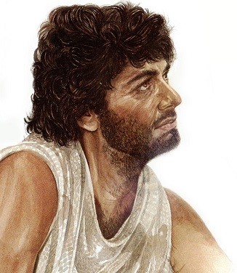
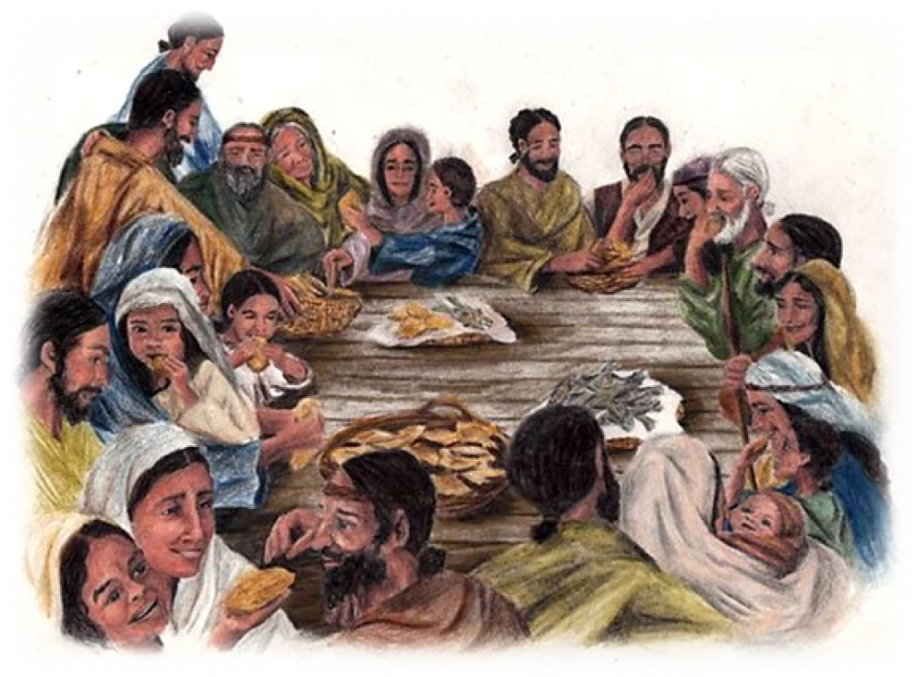
Paul’s 1st letter to Timothy
1
Watch out for false teaching!
1
Remember the Lord’s
grace & patience
Support for
Timothy’s
leadership of
the church
in Ephesus

Slide 7
Paul’s 1st letter to Timothy
2
Worship
Guidance for times of fellowship & teaching together
1

Slide 8
1 Timothy 2
1 I urge, then, first of all, that petitions, prayers, intercession
& thanksgiving be made for all people –
2 for kings & all those in authority, that we may live
peaceful & quiet lives in all godliness & holiness.
3 This is good, and pleases God our Saviour,
who wants all people to be saved
and to come to a knowledge of the truth.
5 For there is one God and one mediator
between God and mankind, the man Christ Jesus,
who gave himself as a ransom for all people…
7 And for this purpose
I was appointed a herald & an apostle …
and a true & faithful teacher of the Gentiles.

Slide 9
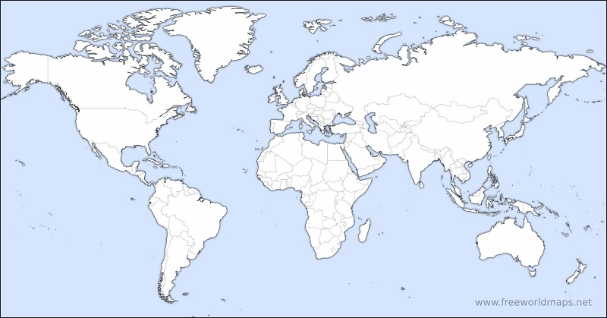
Called to be God’s holy people,
together with all those everywhere
who call on the name of our Lord Jesus Christ

Slide 10
1 Timothy 2
1 I urge, then, first of all, that petitions, prayers, intercession
& thanksgiving be made for all people –
2 for kings & all those in authority, that we may live
peaceful & quiet lives in all godliness & holiness.
3 This is good, and pleases God our Saviour,
who wants all people to be saved
and to come to a knowledge of the truth.
5 For there is one God and one mediator
between God & mankind, the man Christ Jesus,
who gave himself as a ransom for all people…
7 And for this purpose
I was appointed a herald & an apostle …
and a true & faithful teacher of the Gentiles.

Slide 11
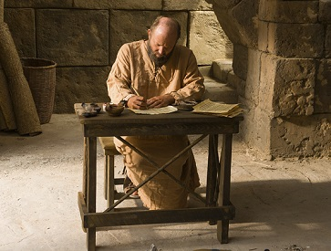
1 Timothy 2
1 I urge, then, first of all, that petitions, prayers, intercession
& thanksgiving be made for all people –
2 for kings & all those in authority, that we may live
peaceful & quiet lives in all godliness & holiness.
3 This is good, and pleases God our Saviour,
who wants all people to be saved
and to come to a knowledge of the truth.
For there is one God & one mediator
between God & mankind,
the man Christ Jesus, who
gave himself as a ransom for all people…
And for this purpose
I was appointed a herald & an apostle …
and a true & faithful teacher of the Gentiles.

Slide 12
There is
one God & one mediator
between
God & mankind,
the man Christ Jesus,
who gave himself as
a ransom
for
all people

Slide 14
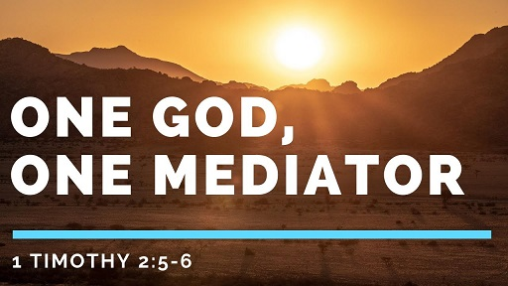

Slide 15
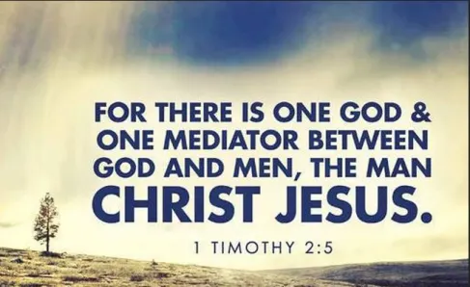
Jerusalem today 02
Notes:
0

Slide 16
1 Timothy 2
1 I urge, then, first of all, that
petitions, prayers, intercession
& thanksgiving be made for all people –
2 for kings & all those in authority, that we may live peaceful and quiet lives in all godliness & holiness.
3 This is good, and pleases God our Saviour,
who wants all people to be saved
and to come to a knowledge of the truth.
5 For there is one God & one mediator
between God & mankind, the man Christ Jesus,
who gave himself as a ransom for all people…
7 And for this purpose
I was appointed a herald & an apostle …
and a true & faithful teacher of the Gentiles.

Slide 17
1 Timothy 2
1 I urge, then, first of all, that petitions, prayers, intercession
& thanksgiving be made for all people –
2 for kings & all those in authority, that we may live peaceful and quiet lives in all godliness & holiness.
3 This is good, and pleases God our Saviour,
wants all people to be saved
& to come to a knowledge of the truth.
5 For there is one God & one mediator
between God & mankind, the man Christ Jesus,
who gave himself as a ransom for all people…
7 And for this purpose
I was appointed a herald & an apostle …
and a true & faithful teacher of the Gentiles.

Slide 18
1 Timothy 2
1 I urge, then, first of all, that petitions, prayers, intercession
& thanksgiving be made for all people –
2 for kings & all those in authority, that we may live peaceful and quiet lives in all godliness & holiness.
3 This is good, and pleases
God our Saviour,
wants all people to be saved
& to come to a knowledge of the truth.
5 For there is one God & one mediator
between God & mankind, the man Christ Jesus,
who gave himself as a ransom for all people…
7 And for this purpose
I was appointed a herald & an apostle …
and a true & faithful teacher of the Gentiles.

Slide 19
1 Timothy 2
1 I urge, then, first of all, that petitions, prayers, intercession
& thanksgiving be made for all people –
2 for kings & all those in authority,
that we may live peaceful and quiet lives
in all godliness & holiness.
3 This is good, and pleases God our Saviour,
who wants all people to be saved
and to come to a knowledge of the truth.
5 For there is one God & one mediator
between God & mankind, the man Christ Jesus,
who gave himself as a ransom for all people…
7 And for this purpose
I was appointed a herald & an apostle …
and a true & faithful teacher of the Gentiles.

Slide 20
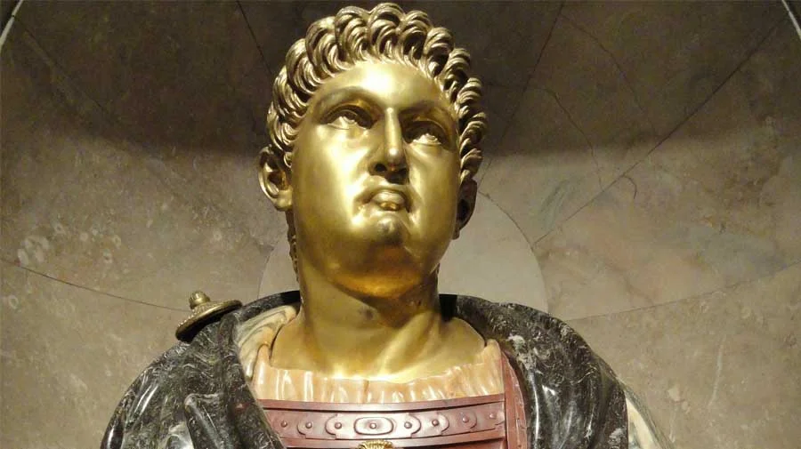
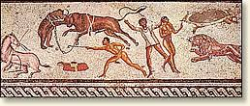
Emperor Nero
Dictator
Rome
AD 54-60

Slide 21
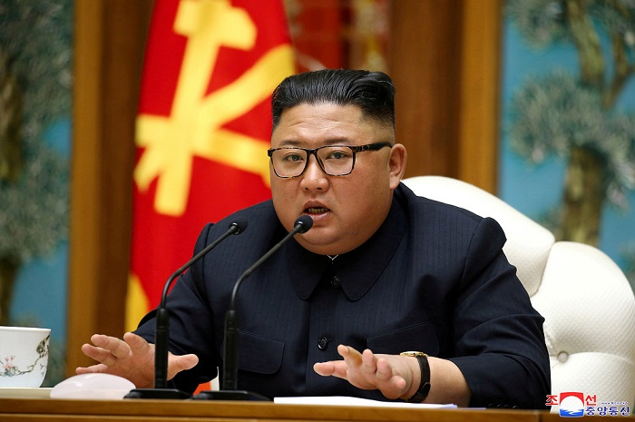
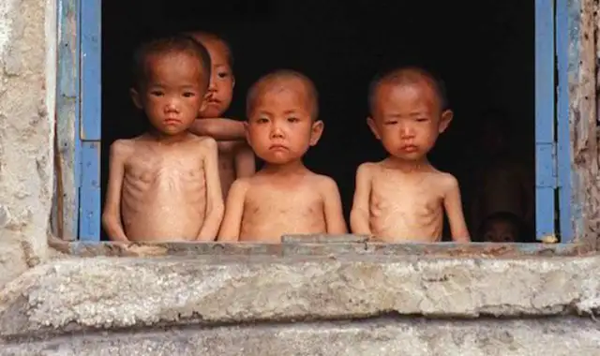
Kim Jong Un
Dictator
North Korea
2011 - ?

Slide 22
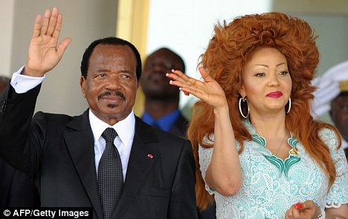
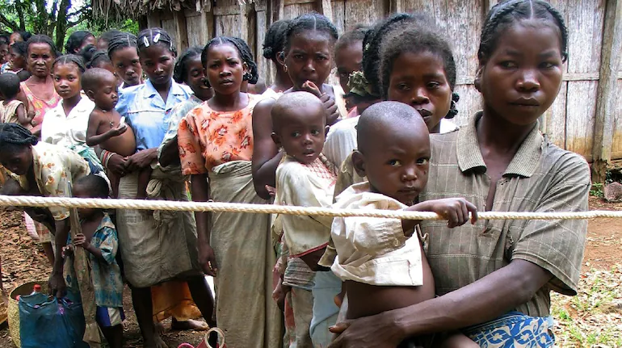
Paul Biya
Dictator
Cameroon
1982 - ?

Slide 23
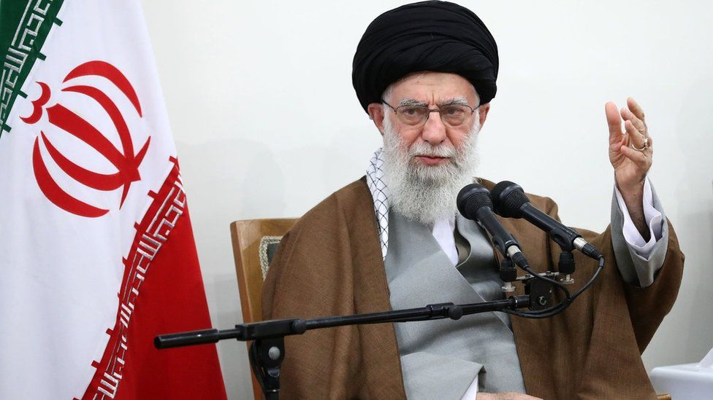
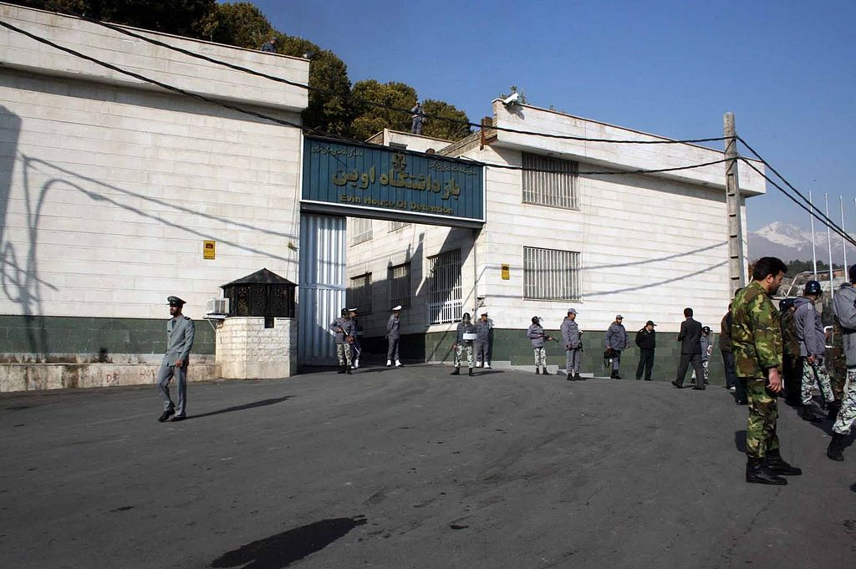
Ali Khamenei
Dictator
Iran
1989 - ?

Slide 24
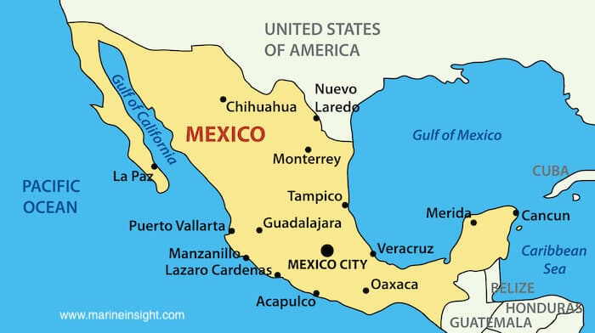
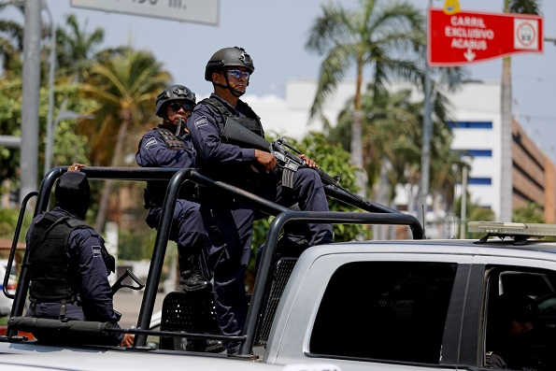
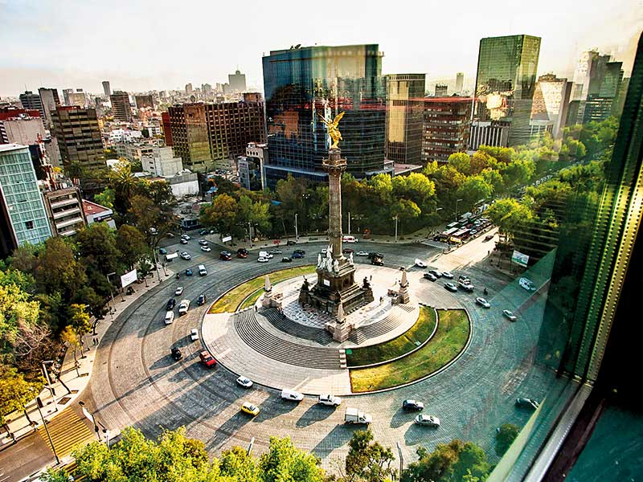
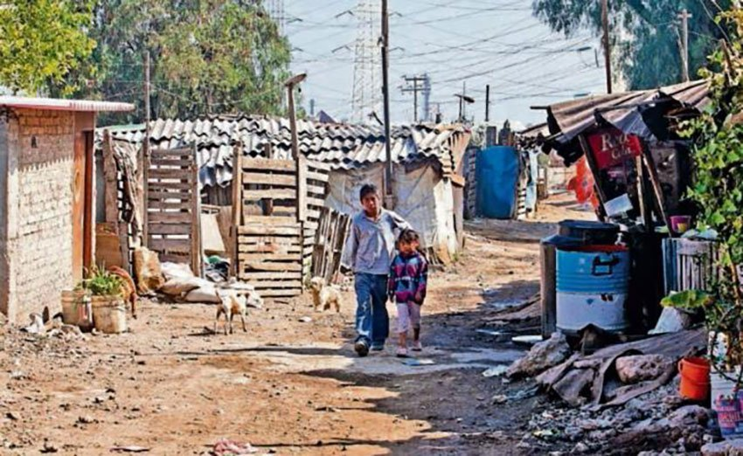

Slide 25
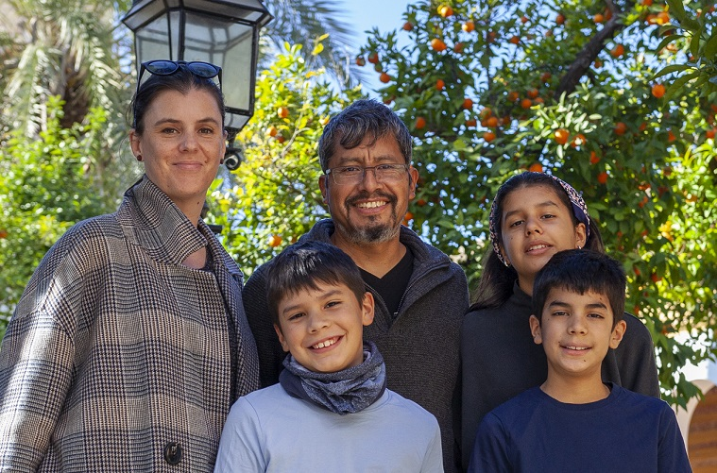
There was something that felt different on this trip —to be expected after almost 8 years of living in Mexico—the sense of looking in on ‘first world’ problems from outside. The common perception in Mexico is that life in the UK — or any other ‘richer’ country — is more desirable than living in Mexico.
But we didn’t see it that way on this trip.

Slide 26
True, infrastructure, health services & education may be more established, perhaps fairer, but there are still cultural weaknesses, social downfalls & ideol-ogical challenges that make life hard for individuals. Each country & culture has its own problems,
& at their core — no matter what part of the world— we find the same causes: sin, brokenness & evil.

Slide 27
To all of these problems the only really satisfying answer comes in Jesus Christ. But somehow, during our visit, listening to your stories, we felt that living & sharing the Gospel where you are is harder.
So we left with a sense that we have the easier task, & with a real burden to pray
for you & the church in your part of the world.

Slide 29
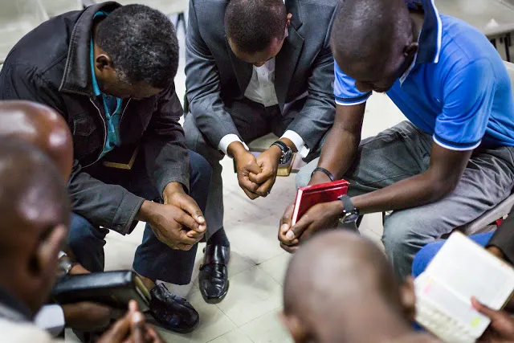
1 Timothy 2:8-10
8 Therefore I want the men everywhere
to pray,
lifting up holy hands
without anger or disputing.

Slide 30
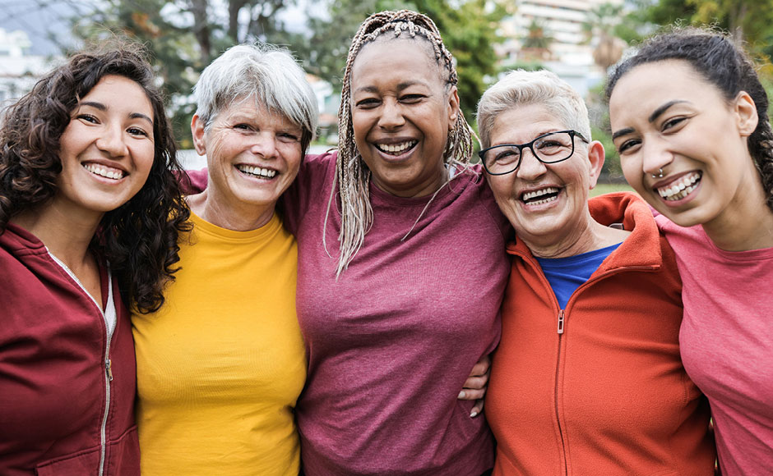
1 Timothy 2
9 I also want the women to dress modestly,
with decency and propriety,
adorning themselves,
not with elaborate hairstyles
or gold or pearls or expensive clothes,
10 but with good deeds,
appropriate for women who profess to worship God.

Slide 31
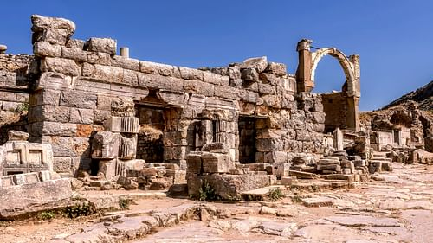
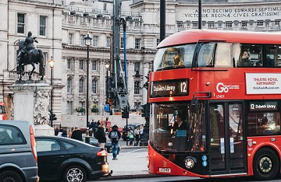
How does a letter written to …
1st century
Ephesus
become relevant for …
21st century
London
?

Slide 32
1 Timothy 2:8
Therefore I want
the men
everywhere to pray
lifting up holy hands
without anger
or disputing
unchanging principle
changing
culture
unchanging principle

Slide 33
1 Timothy 2:9-10
I also want the women
to dress modestly, with
decency & propriety,
adorning themselves, not
with elaborate hairstyles or gold
or pearls or expensive clothes
but with good deeds
unchanging principle
changing
culture
unchanging principle

Slide 34
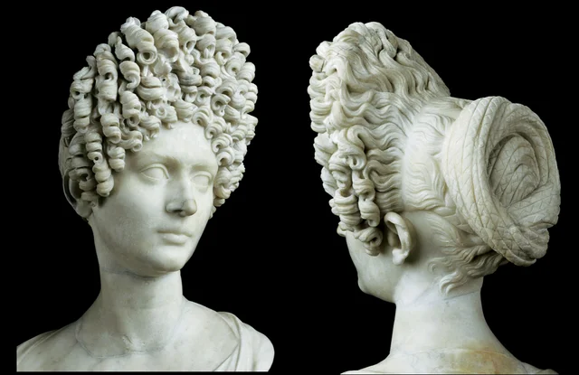

Slide 35
1 Timothy 2 :11-15
11 A woman should learn in quietness & full submission.
12 I do not permit a woman to teach
or to assume authority over a man; she must be quiet.
13 For Adam was formed first, then Eve.
14 And Adam was not the one deceived; it was the woman who was deceived and became a sinner.
15 But women will be saved through childbearing – if they continue in faith, love and holiness with propriety.

Slide 37
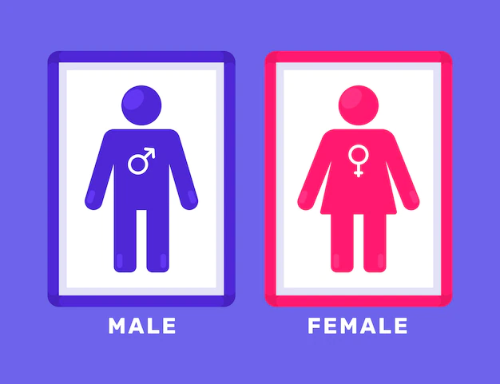
Galatians 3:26-28
…In Christ Jesus
you are all children of God through faith…
There is neither Jew nor Gentile,
neither slave nor free,
nor is there male & female,
for you are all one in Christ Jesus.

Slide 39
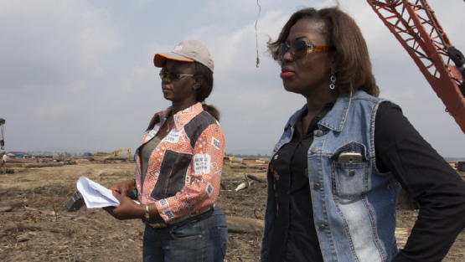
Reforms to enhance gender equality
in the Democratic Republic of Congo:
From advocacy to implementation

Slide 40
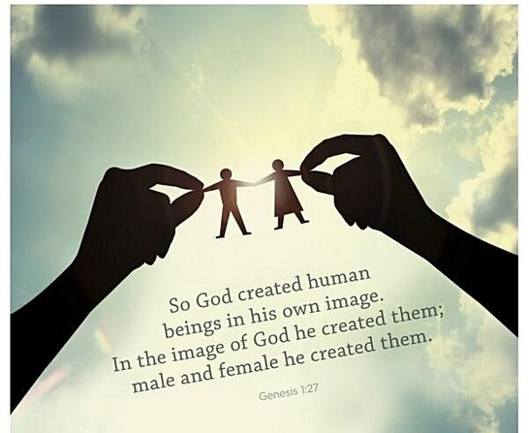

Slide 41
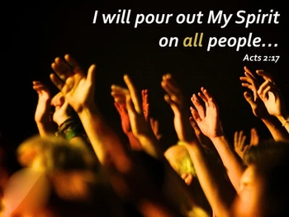

Slide 42
Acts 2:17-18
Your sons & daughters will prophesy,
your young men will see visions,
your old men will dream dreams. Even on my servants,
both
men & women,
I will pour out my Spirit in those days, &
they will prophesy.

Slide 43
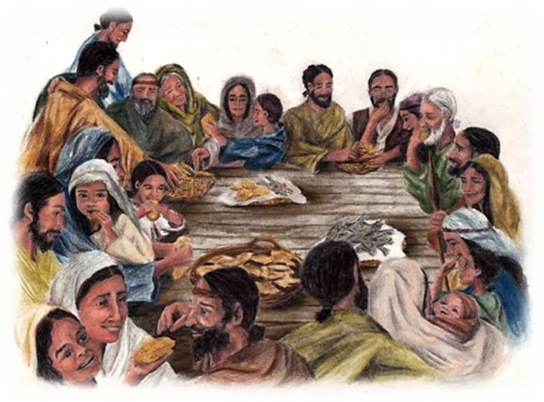
1 Corinthians 11:5
Every woman
who prays or prophesies
with her head uncovered dishonours her head
Acts 21:6-9
Leaving the next day, we reached Caesarea & stayed at the house of Philip the evangelist…
He had four unmarried daughters
who prophesied.

Slide 44
1 Timothy 2 :12
I do not permit a woman to teach
or to assume authority over a man;
she must be quiet.
not to
‘dominate’
to be
‘submissive’

Slide 45
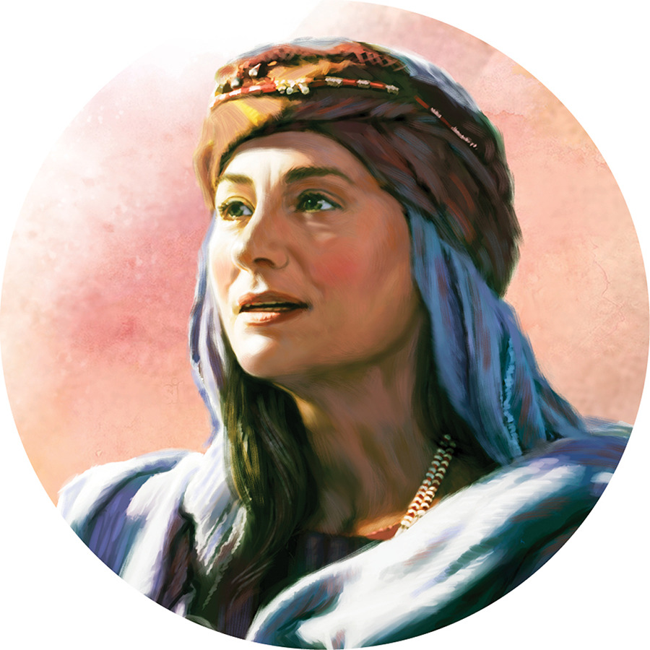
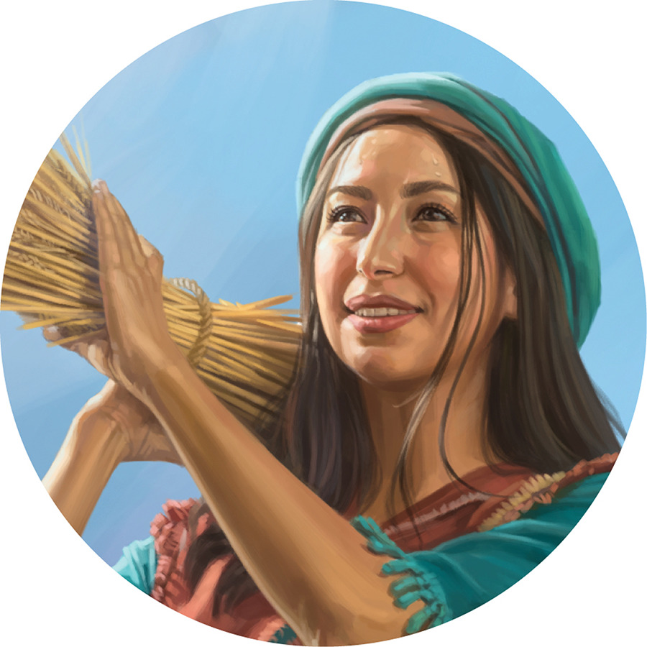
Women in the Old Testament
Deborah
– prophetess & judge
Esther
– who saved her people
Ruth
– selfless immigrant
& ancestor of Christ

Slide 46
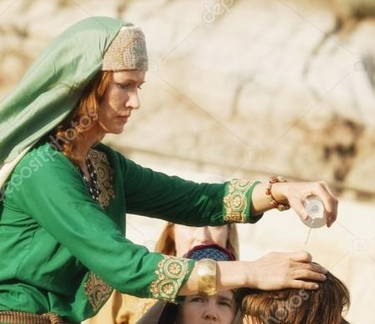
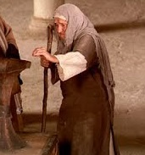
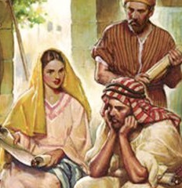
Women in the New Testament
The woman who anointed Jesus
- model of true values
The woman who gave all
– model of sacrificial giving
Priscilla with her husband
training Apollos the preacher

Slide 48
“Women see parts of the world men often miss”
“All of these books written by women
move into corners, fears and experiences
my favourite male writers avoid.”

Slide 49
“Men have traditionally not been encouraged
to talk about their emotional life. So they bounce off into fantasy versions of the working life such as stories about soldiers or spies”
“I like the degree to which women observe.”
“Men jump away from an area
that they find hard to talk about,
& they’re not quite sure of the words.”

