Slide 1
1 Timothy 6: 2b-10

Slide 3
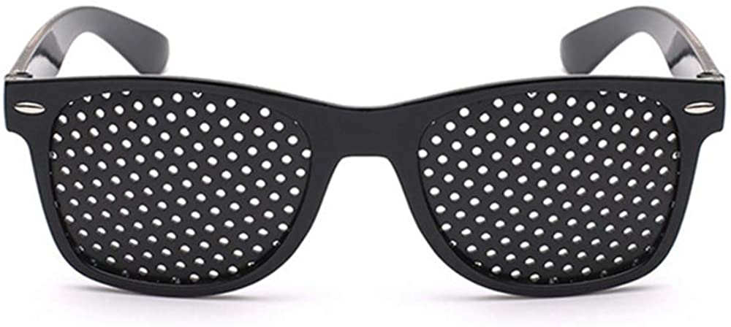

Slide 4
These are the things you are to teach and insist on. ³ If anyone teaches otherwise and does not agree to the sound instruction of our Lord Jesus Christ and to godly teaching, ⁴ they are conceited and understand nothing. They have an unhealthy interest in controversies and quarrels about words that result in envy, strife, malicious talk, evil suspicions ⁵ and constant friction between people of corrupt mind, who have been robbed of the truth and who think that godliness is a means to financial gain.

Slide 5
⁶ But godliness with contentment is great gain. ⁷ For we brought nothing into the world, and we can take nothing out of it. ⁸ But if we have food and clothing, we will be content with that.
⁹ Those who want to get rich fall into temptation and a trap and into many foolish and harmful desires that plunge people into ruin and destruction. ¹⁰ For the love of money is a root of all kinds of evil. Some people, eager for money, have wandered from the faith and pierced themselves with many griefs.

Slide 6
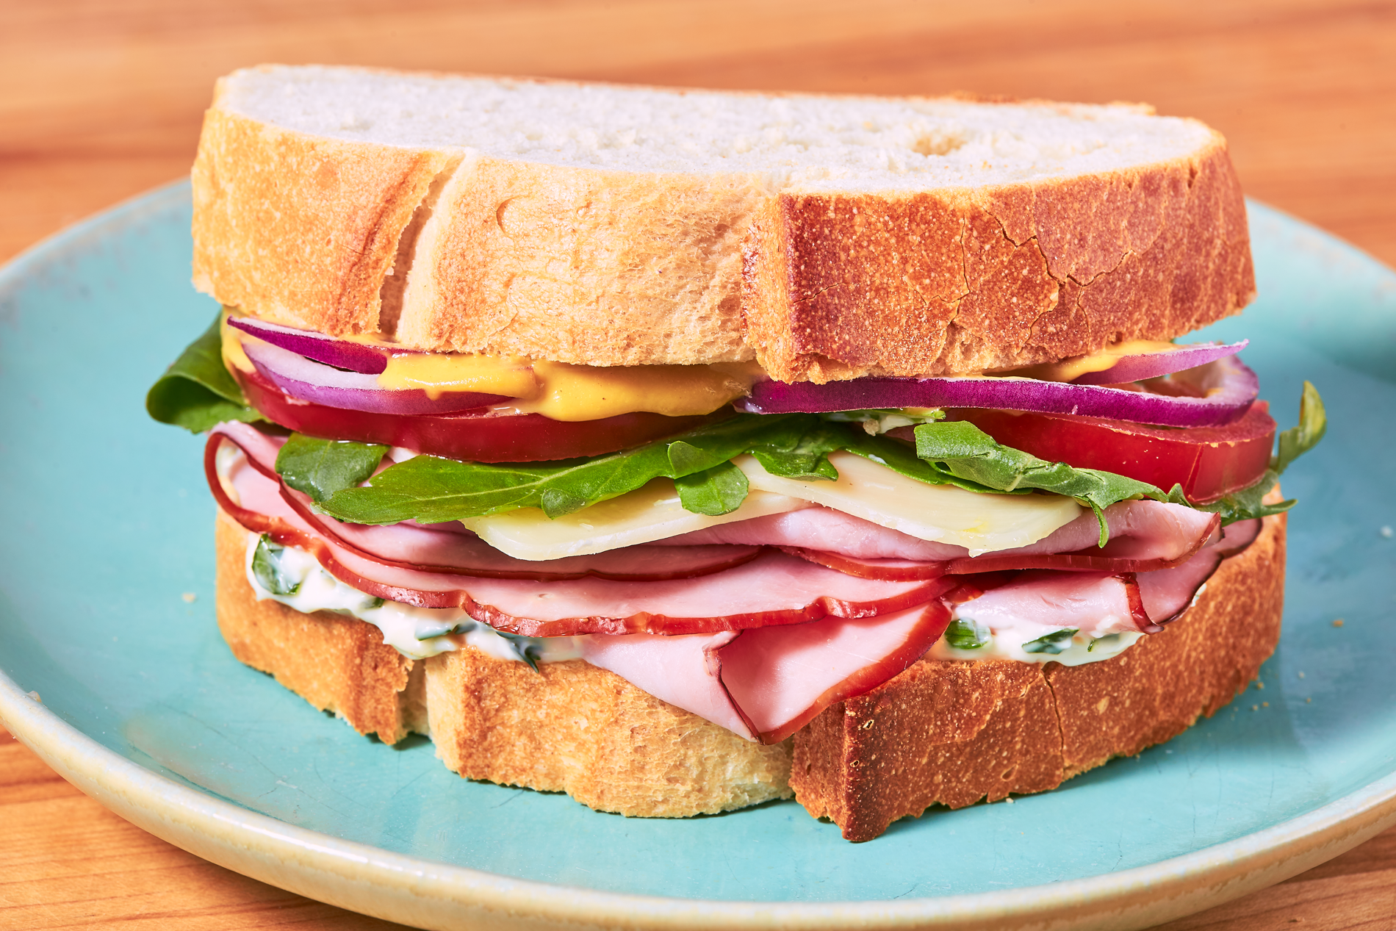

Slide 7
Something to:
Verses 9-10
Avoid
Verses 6-8
Seek
Verses 3-5
Avoid

Slide 8
V 3-5 – “Know it alls”

Slide 9
If anyone teaches false doctrines and does not agree to the sound instruction of our Lord Jesus Christ and to godly teaching, he is conceited and understands nothing. He has an unhealthy interest in controversies and quarrels about words that result in envy, strife, malicious talk, evil suspicions and constant friction between people of corrupt mind, who have been robbed of the truth and who think that godliness is a means to financial gain.

Slide 10
“Christ Jesus came into the world to save sinners”
Ch 1:15
“Christ was revealed in a human body
and vindicated by the Spirit.
He was seen by angels
and announced to the nations.
He was believed in throughout the world
and taken to heaven in glory.
Ch 3:16

Slide 11
V 3-5 – “Know it alls”

Slide 12
“Morbid fondness for controversy, protracted wrangling,
wearing discussion,
perpetual friction”.

Slide 13
V 3-5 – “Know it alls”

Slide 14
V 9-10 – “Money lovers”
V 3-5 – “Know it alls”

Slide 15
Those who want to get rich fall into temptation and a trap and into many foolish and harmful desires that plunge people into ruin and destruction. For the love of money is a root of all kinds of evil. Some people, eager for money, have wandered from the faith and pierced themselves with many griefs.

Slide 16
Money, in truth, is one of the most unsatisfying of possessions. It takes away some cares, no doubt; but it brings with it quite as many cares as it takes away. There is trouble in the getting of it. There is anxiety in the keeping of it. There are temptations in the use of it. There is guilt in the abuse of it. There is sorrow in the losing of it. There is perplexity in the disposing of it. Two-thirds of all the strifes, quarrels, and lawsuits in the world arise from one simple cause—money!
Bishop Ryle

Slide 17
V 9-10 – “Money lovers”
V 3-5 – “Know it alls”

Slide 18
“Money lovers”
The filling!
“Know it alls”

Slide 19
But godliness with contentment is great gain. 7 For we brought nothing into the world, and we can take nothing out of it. 8 But if we have food and clothing, we will be content with that.

Slide 20
“Money lovers”
Godliness, Contentment,
Eternal perspective, Gratitude
“Know it alls”

Slide 21
Something to seek:
Pursue godliness
“godliness can be defined as devotion to God which results in a life that is pleasing to him”
Jerry Bridges

Slide 22
Something to seek:
Pursue godliness
Develop contentment

Slide 23
I have learned to be content whatever the circumstances
Philippians 4:11
Keep your lives free from the love of money and be content with what you have, because God has said, ‘Never will I leave you; never will I forsake you.’
Hebrews 13:5

Slide 24
Something to seek:
Pursue godliness
Develop contentment
Grasp eternal perspective

Slide 25
No eye has seen, no ear has heard,
and no mind has imagined
what God has prepared
for those who love him
1 Corinthians 2:9

Slide 26
Something to seek:
Pursue godliness
Develop contentment
Grasp eternal perspective
Cultivate gratitude

Slide 27
Godliness
Is this choice, in this moment going to help me draw closer to or further from God?

Slide 28
Contentment
Does this advert/action threaten my peace of mind and make me want more?

Slide 29
Eternal Perspective
How would I view this action or attitude if I was in heaven?

Slide 30
Gratitude
What can I be grateful for in this moment in this situation?

Slide 31
“Money lovers”
Godliness, Contentment,
Eternal perspective, Gratitude
“Know it alls”

