Slide 1
Joshua 3 & 4
Entering the Promised Land

Slide 2
God spoke to Abraham and told him
“to your offspring I will give this land” (Genesis 12:7)
However, before they could cross over and enter the land that the Lord their God was giving them, they were required to do three things.

Slide 3
1. Prepare
Prepare physically – Joshua 1:10-11
10 So Joshua ordered the officers of the people: 11 “Go through the camp and tell the people, ‘Get your provisions ready. Three days from now you will cross the Jordan here to go in and take possession of the land the LORD your God is giving you for your own.’”

Slide 4
1. Prepare
Prepare spiritually – Joshua 3:5
10 So Joshua ordered the officers of the people: 11 “Go through the camp and tell the people, ‘Get your provisions ready. Three days from now you will cross the Jordan here to go in and take possession of the land the LORD your God is giving you for your own.’”

Slide 5
2. Follow
Joshua 3:2-3
2 After three days the officers went throughout the camp, 3 giving orders to the people: “When you see the ark of the covenant of the LORD your God, and the Levitical priests carrying it, you are to move out from your positions and follow it.

Slide 6
14 So when the people broke camp to cross the Jordan, the priests carrying the ark of the covenant went ahead of them. 15 Now the Jordan is at flood stage all during harvest. Yet as soon as the priests who carried the ark reached the Jordan and their feet touched the water’s edge, 16 the water from upstream stopped flowing. It piled up in a heap a great distance away, at a town called Adam in the vicinity of Zarethan, while the water flowing down to the Sea of the Arabah (that is, the Dead Sea) was completely cut off. So the people crossed over opposite Jericho. 17 The priests who carried the ark of the covenant of the LORD stopped in the middle of the Jordan and stood on dry ground, while all Israel passed by until the whole nation had completed the crossing on dry ground.

Slide 7
3. Remember
19 On the tenth day of the first month the people went up from the Jordan and camped at Gilgal on the eastern border of Jericho. 20 And Joshua set up at Gilgal the twelve stones they had taken out of the Jordan. 21 He said to the Israelites, “In the future when your descendants ask their parents, ‘What do these stones mean?’ 22 tell them, ‘Israel crossed the Jordan on dry ground.’ 23 For the LORD your God dried up the Jordan before you until you had crossed over.

Slide 8
The LORD your God did to the Jordan what he had done to the Red Sea[a] when he dried it up before us until we had crossed over. 24 He did this so that all the peoples of the earth might know that the hand of the LORD is powerful and so that you might always fear the LORD your God.”
God instructed Joshua and the people to make this memorial as a reminder of what he had done and his promise of ongoing deliverance & provision for them.

Slide 9
It might seem incredible that a whole nation whom had witnessed a great miracle would need such a reminder? Sadly, as we often see in the story of God’s people down the ages, they seem to forgot his ways and miracles he performs.
It wasn’t just a reminder to the Israelites of God’s power and presence but a reminder to their enemies.

Slide 10
5 Now when all the Amorite kings west of the Jordan and all the Canaanite kings along the coast heard how the LORD had dried up the Jordan before the Israelites until they[a] had crossed over, their hearts melted in fear and they no longer had the courage to face the Israelites

Slide 11
We too are on a journey.
…On our way to the Promised Land – Heaven.
A New Heaven and a New Earth – Revelation 21: 1-5
21 Then I saw “a new heaven and a new earth,” for the first heaven and the first earth had passed away, and there was no longer any sea. 2 I saw the Holy City, the new Jerusalem, coming down out of heaven from God, prepared as a bride beautifully dressed for her husband. 3 And I heard a loud voice from the throne saying, “Look! God’s dwelling

Slide 12
place is now among the people, and he will dwell with them. They will be his people, and God himself will be with them and be their God. 4 ‘He will wipe every tear from their eyes. There will be no more death' or mourning or crying or pain, for the old order of things has passed away.”
5 He who was seated on the throne said, “I am making everything new!”

Slide 13
And I want to encourage each of us to daily…
Prepare – Consecrate ourselves
Follow – Our Lord Jesus, wherever he leads.
Remember – His goodness, his faithfulness and his provision for the journey.
When we do these, we will see miracles

Slide 14
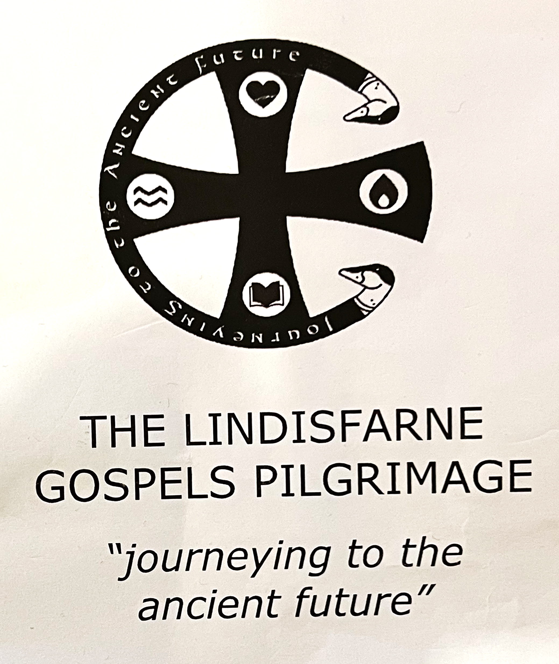

Slide 15
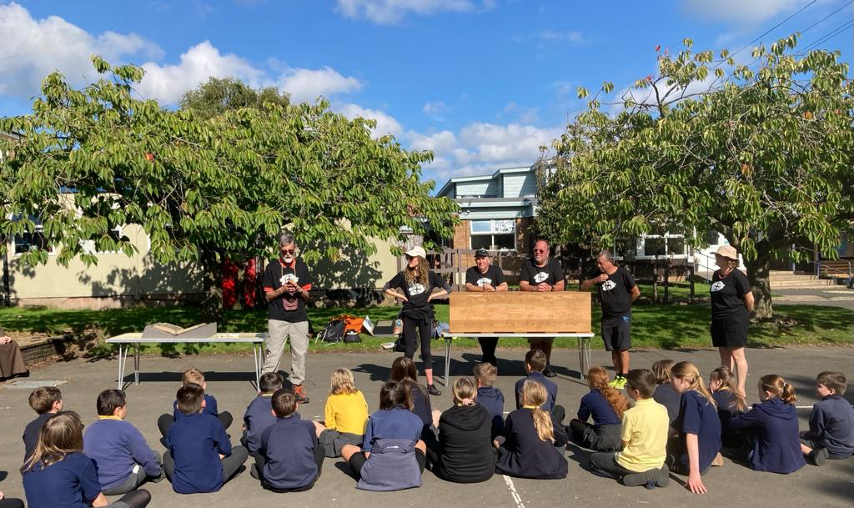

Slide 16
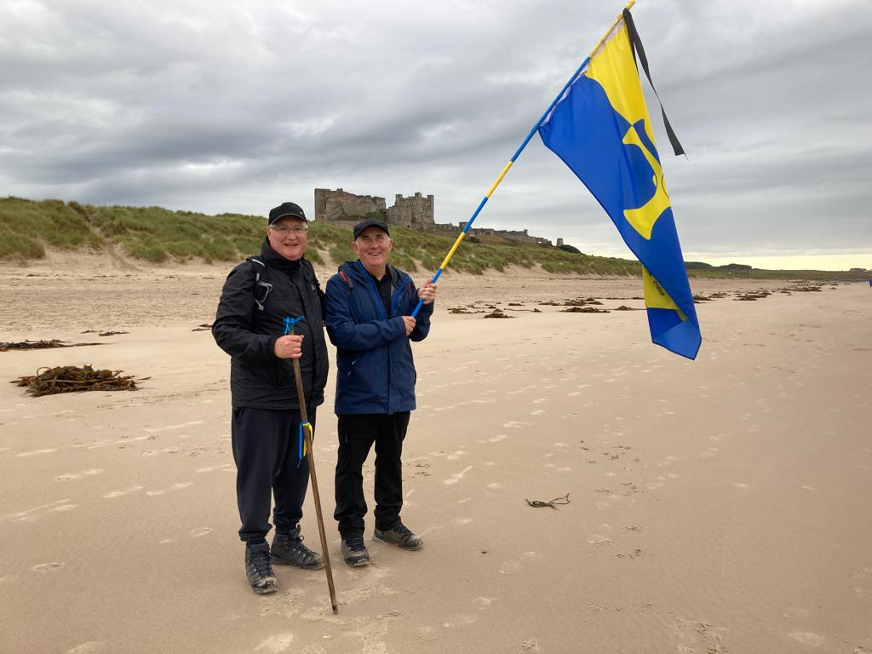
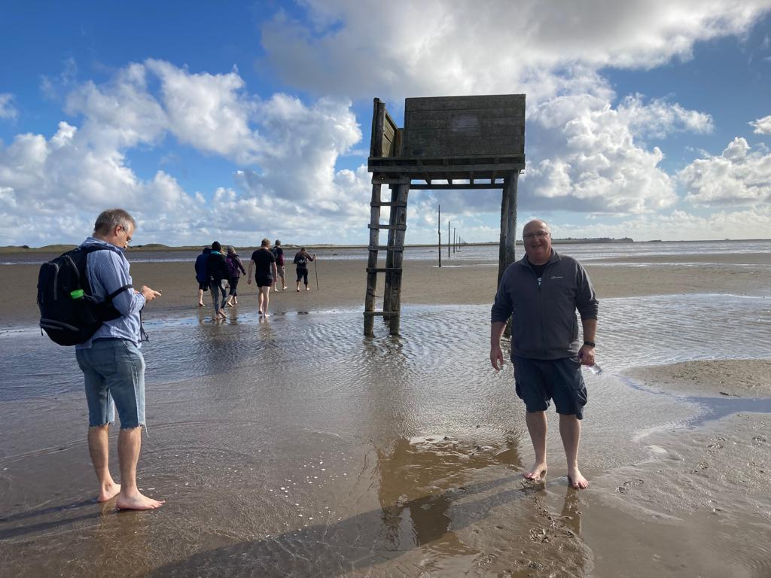

Slide 17
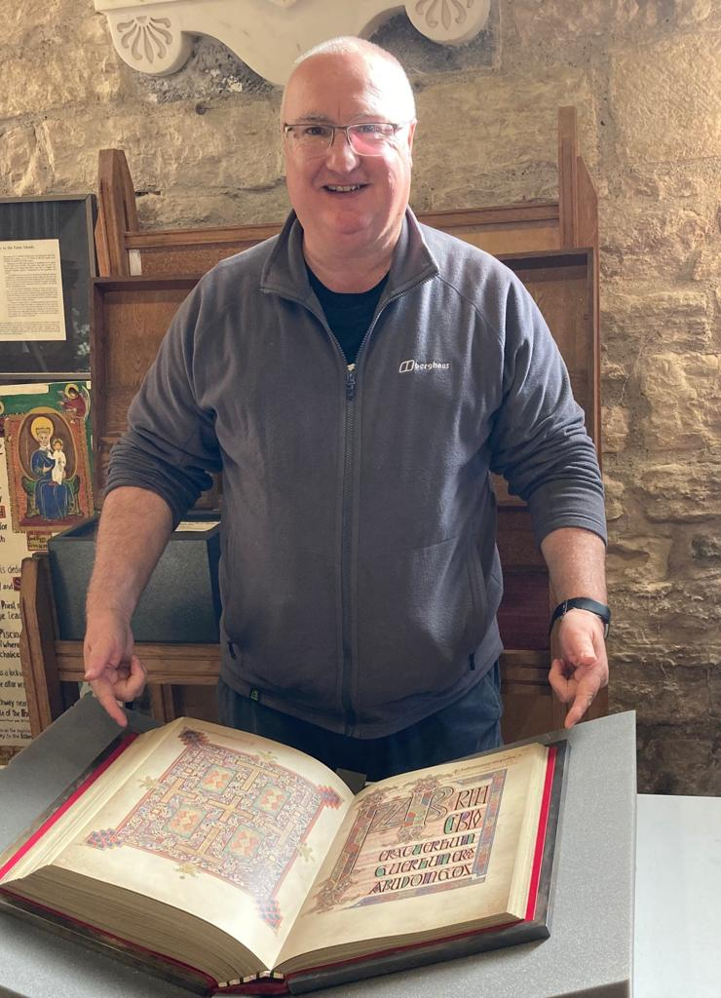
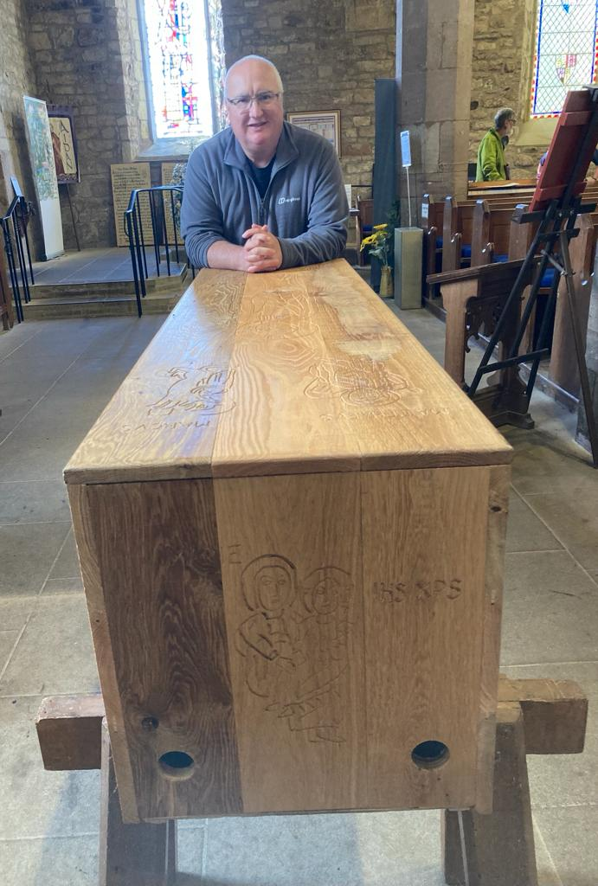
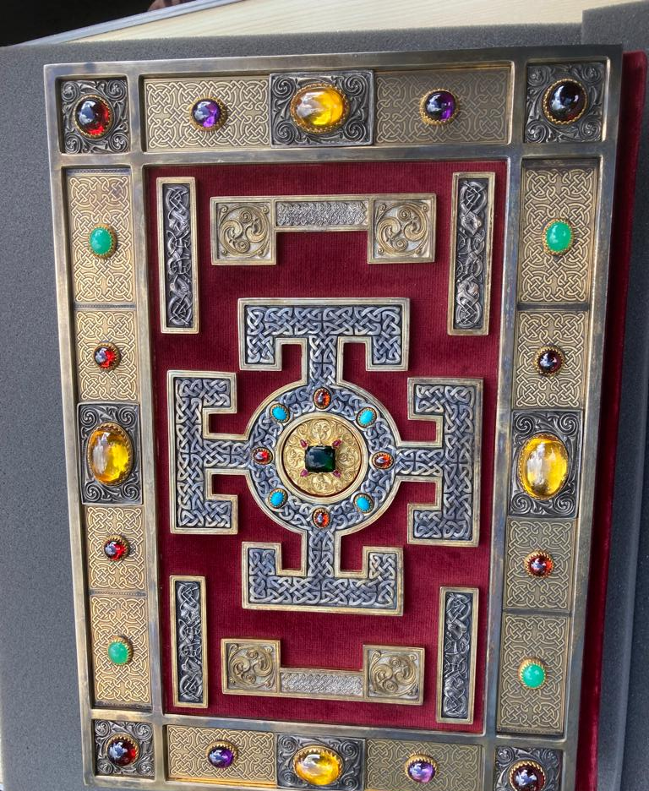

Slide 18
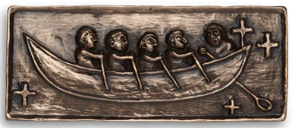
The Brendan Covenant
Lord, we will trust You.
Help us to journey beyond the familiar
And into the unknown.
Give us the faith to leave old ways And break fresh ground with You. Christ of the mysteries, can we trust You To be stronger than each storm we face?

Slide 19
We choose to live beyond regret
And let You recreate our lives together.
We know we will see new things birthed
If only we trust you.
Amidst all the uncertainty
We believe You will make a way for us
and provide for us,
If only we trust You.
We know that our times are always in Your hand
And that you will lead us in the dark times,
If only we trust You.

Slide 20
We will believe You for our future,
Chapter by chapter, until all the story is written.
Lord, we will trust You.
We accept the responsibility, We will hear and obey
And trust it is Your voice we hear,
The call of the Spirit,
The cry of the Bird of Heaven
This is a “Yes!” to risky living.

