Slide 1
Walls come tumbling down
Joshua 5:13 - 6:25

Slide 2
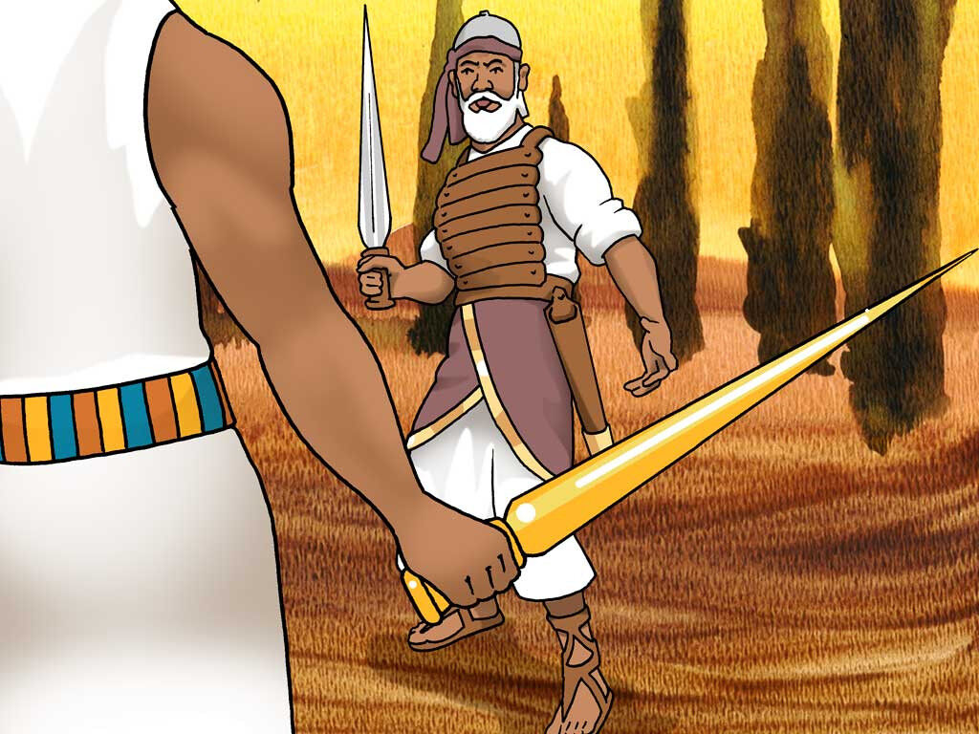
Joshua trusted in the Lord (the man with a drawn sword).
He humbled himself, bowed down, sought his instruction and worshipped the Lord.
Joshua 5:13-15

Slide 3
Joshua trusted in the promise
Before a finger was lifted the promise of victory and deliverance was given.
Joshua 6:2

Slide 4
Joshua trusted in the plan.
It appeared a crazy plan, difficult and disturbing plan but Joshua & the people obeyed.
Joshua 6:3-5 – 6:17-19

Slide 6
…As Israel faced the formidable walls of Jericho, we too can face walls and obstacles in our lives.
...As believer’s in Jesus we are in a spiritual battle. (Ephesians 6:10-11)
…And like Joshua we can trust.

Slide 7
We can trust in:
the person of Jesus
the promises of Jesus
the plan of Jesus

