Slide 1
Trusting in the promises of God

Slide 2
MEMORY VERSE
“Be strong and courageous. Do not be afraid; do not be discouraged, for the LORD your God will be with you wherever you go.”
Joshua 1:9

Slide 3
Joshua 20 & 21

Slide 4
The Lord God is faithful to all his promises and deserves our whole-hearted worship and praise!
Joshua 20 & 21

Slide 5
Joshua 20 - Cities of refuge…
Then the Lord said to Joshua: ² “Tell the Israelites to designate the cities of refuge, as I instructed you through Moses, ³ so that anyone who kills a person accidentally and unintentionally may flee there and find protection from the avenger of blood. ⁴ When they flee to one of these cities, they are to stand in the entrance of the city gate and state their case before the elders of that city. Then the elders are to admit the fugitive into their city and provide a place to live among them.

Slide 6
Joshua 20 - Cities of refuge…
If the avenger of blood comes in pursuit, the elders must not surrender the fugitive, because the fugitive killed their neighbour unintentionally and without malice aforethought. ⁶ They are to stay in that city until they have stood trial before the assembly and until the death of the high priest who is serving at that time. Then they may go back to their own home in the town from which they fled.”

Slide 7
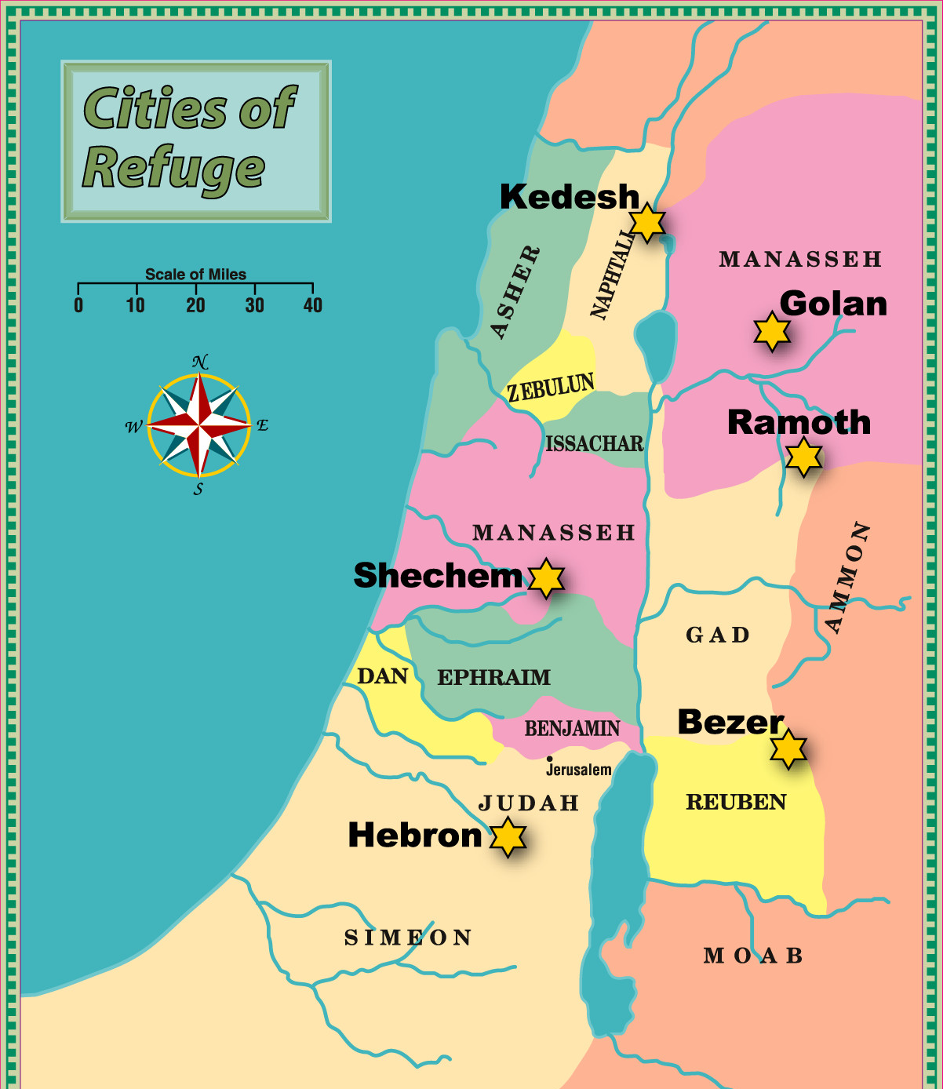
Cities of refuge…

Slide 8
Cities of refuge…
6 in total – 3 west of the Jordan, 3 east
As outlined to Moses in Deut 19 and Numbers 35
All home to the priestly tribe of Levi

Slide 9
Cities of refuge…
Judgment made, refuge given if appropriate, justice ensured
Deliberately placed and spaced, so accessible to all
Available both to Israelites, and foreigners among them

Slide 10
Jesus as the New Testament fulfilment of …
Cities of refuge…
We are all guilty of sin
“The wages of sin is death” (Romans 6:23)
We all need a refuge from our sin

Slide 11
Jesus as the New Testament fulfilment of …
Cities of refuge…
Jesus is our “great high priest” (Heb 4:14), fully God, fully man
“a merciful and faithful high priest…that he might make atonement for the sins of the people.” (Heb 2:17)

Slide 12
Jesus as the New Testament fulfilment of …
Cities of refuge…
Through Jesus’s sacrifice we find freedom and forgiveness
Cities of refuge only provided shelter for the innocent
Refuge in Jesus is available to all, including the guilty

Slide 13
Jesus as the New Testament fulfilment of …
Cities of refuge…
Kedesh ~ holiness/consecration
Shechem ~ back/shoulder
Hebron ~ friendship
Bezer ~ fortress
Ramoth ~ the heights
Golan ~ rejoicing/exultation

Slide 14
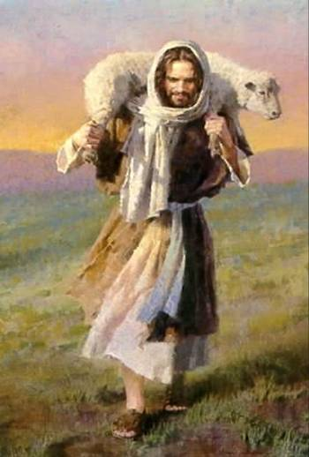
Jesus as the New Testament fulfilment of …
Cities of refuge…
Kedesh ~ holiness/consecration
Shechem ~ back/shoulder
Hebron ~ friendship
Bezer ~ fortress
Ramoth ~ the heights
Golan ~ rejoicing/exultation

Slide 15
Joshua 21 – Levitical cities…
Now the family heads of the Levites approached Eleazar the priest, Joshua son of Nun, and the heads of the other tribal families of Israel ² at Shiloh in Canaan and said to them, “The Lord commanded through Moses that you give us towns to live in, with pasturelands for our livestock.” ³ So, as the Lord had commanded, the Israelites gave the Levites the following towns and pasturelands out of their own inheritance:

Slide 16
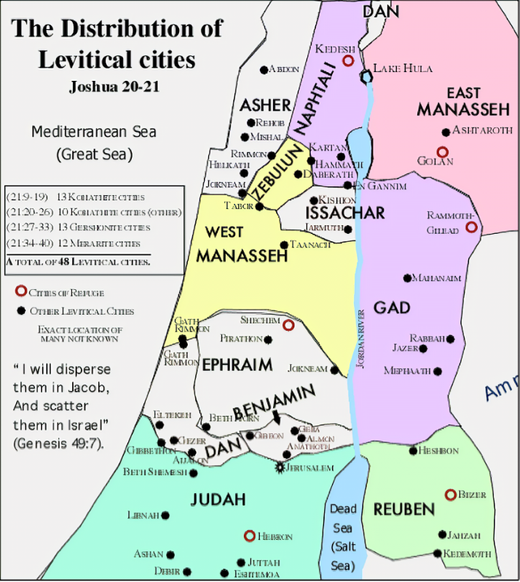
Joshua 21 – Levitical cities…

Slide 17
Joshua 21 – Levitical cities…
Distributed throughout the land - “easy access” for all
“Tithed” by the other tribes from their own inheritance
Some in land still to be claimed (Joshua 13:1-7)

Slide 18
Cities of refuge and Levitical cities…
APPLICATION…

Slide 19
Cities of refuge and Levitical cities…
APPLICATION…
Gathered church and Scattered church…

Slide 20
Cities of refuge and Levitical cities…
APPLICATION…
Gathered church and Scattered church…
“He has shown you, O mortal, what is good.
And what does the Lord require of you?
To act justly and to love mercy and to walk humbly with your God.”
Micah 6:8

Slide 21
Cities of refuge and Levitical cities…
APPLICATION…
Gathered church…
A place of refuge…
Justice and mercy
Free from human judgment
Real
A “haven”

Slide 22
Cities of refuge and Levitical cities…
APPLICATION…
Scattered church…
Image courtesy of LICC

Slide 23
Cities of refuge and Levitical cities…
APPLICATION…
Scattered church…
“Churches that understand the realities of the present future are shifting the target of ministry efforts from church activity to community transformation.”

Slide 24
Cities of refuge and Levitical cities…
APPLICATION…
Scattered church…
Motto: “I am a Levite whom Jesus has placed in my neighbourhood. I serve my Lord by serving my community in his name. That is what he has commanded me to do.”

Slide 25
Joshua 21:43-45 – God’s faithfulness to His promises…
So the Lord gave Israel all the land he had sworn to give their ancestors, and they took possession of it and settled there. The Lord gave them rest on every side, just as he had sworn to their ancestors. Not one of their enemies withstood them; the Lord gave all their enemies into their hands. Not one of all the Lord’s good promises to Israel failed; every one was fulfilled.

Slide 26
God’s faithfulness to His promises, fulfilled in Christ…
“For no matter how many promises God has made, they are “Yes” in Christ. And so through him the “Amen” is spoken by us to the glory of God.”
2 Corinthians 1:20

