Slide 1
Joshua 24
Who are you going to serve?

Slide 2
God is:
Sovereign

Slide 3
God is:
Sovereign
Grace filled or gracious

Slide 4
Psalm 62 v 11-12:
One thing God has spoken, two things I have heard: ‘Power belongs to you, God, and with you, Lord, is unfailing love’.

Slide 5
Honour the Lord and serve him wholeheartedly
A daily choice

Slide 6
I know that nothing good lives in me, that is, in my sinful nature. I want to do what is right, but I can’t. I want to do what is good, but I don’t. I don’t want to do what is wrong, but I do it anyway…
I have discovered this principle of life—that when I want to do what is right, I inevitably do what is wrong. I love God’s law with all my heart. But there is another power within me that is at war with my mind. This power makes me a slave to the sin that is still within me.
Oh, what a miserable person I am! Who will free me from this life that is dominated by sin and death?
Romans 7: 18-24

Slide 7
Thank God!
The answer is in Jesus Christ our Lord.
Romans 7: 25

Slide 8
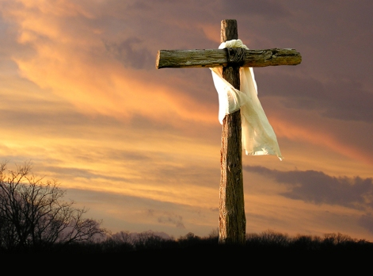
Joshua of New Testament
Jesus

