Slide 1
Whom are we following?
- The promised Messiah
- The beloved Son
- The Bringer of Good News

Slide 2
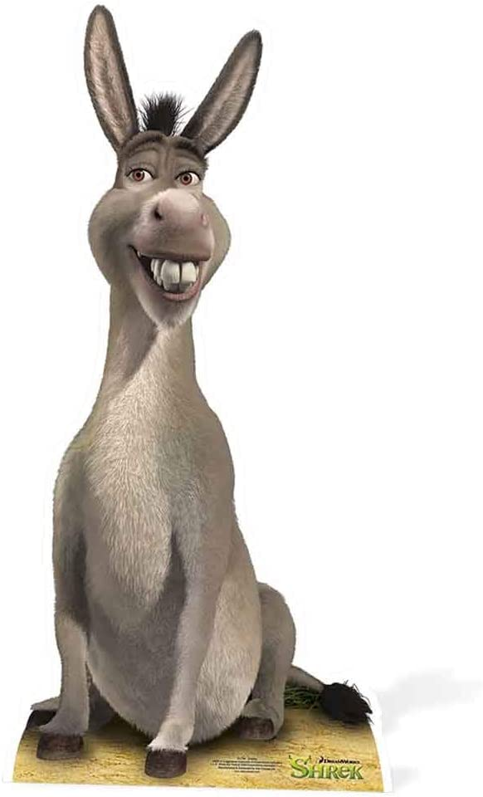
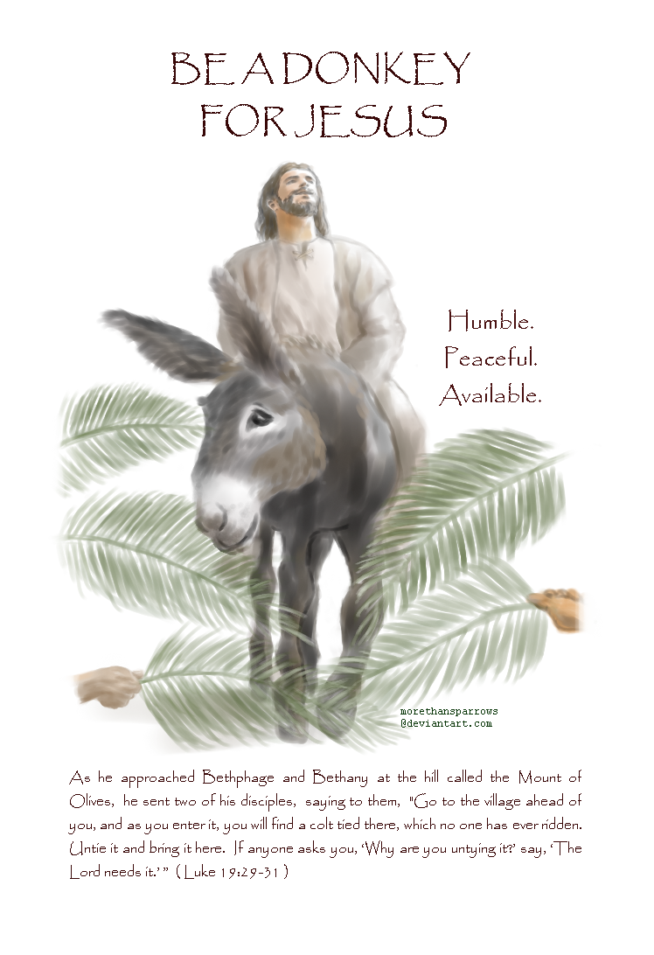

Slide 3
Jesus…said
The time has come.
The kingdom of God has come near. Repent!
Believe the good news!
(Mark 1:15, NIV)

Slide 4
Jesus…
Teaching in their synagogues, proclaiming the good news of the kingdom, and healing every disease and sickness among the people!
(Matthew 4:23, NIV)

Slide 5
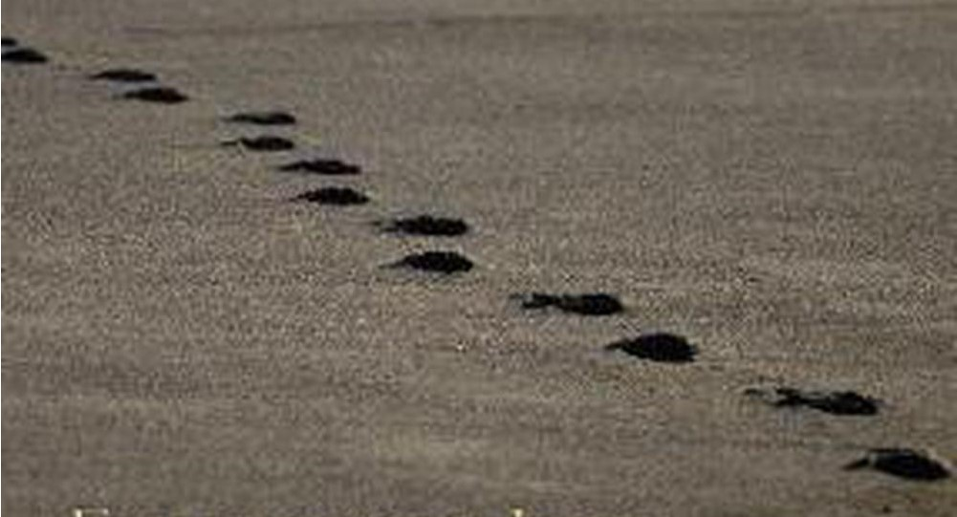
The good news of the kingdom of God
Jesus answered, “My kingdom is not of this world. (John 18:36)
God has delivered us from the domain of darkness and transferred us to the kingdom of his beloved Son. (Colossians 1:13)
For the kingdom of God is not a matter of eating and drinking but of righteousness and peace and joy in the Holy Spirit. (Romans 14:17)

Slide 6
The good news of the kingdom of God
Jesus answered, “My kingdom is not of this world. (John 18:36)
God has delivered us from the domain of darkness and transferred us to the kingdom of his beloved Son. (Colossians 1:13)
For the kingdom of God is not a matter of eating and drinking but of righteousness and peace and joy in the Holy Spirit. (Romans 14:17)

Slide 7
The kingdom of the world | Name | The kingdom of God
The devil | Ruler | Jesus Christ
Darkness | Territory | Light
Slavery | People | Freedom
Lies | Language | Truth
No… The blind, The oppressed | Health care | Healed and cared for by the power of the Holy Spirit
No… The poor, The prisoner | Welfare | Being fed, Being released
By Fear | Security | By Grace
Concentrate on Eating and Drinking… | Life style | righteousness and peace and joy in the Holy Spirit
Flesh | Existence | Spirit
Then
.
.
.
Before Christ
.
.
Now
.
.
.
After Christ
.
.

Slide 8
The devil led him up to a high place and showed him in an instant all the kingdoms of the world. And he said to him, “I will give you all their authority and splendour; it has been given to me, and I can give it to anyone I want to. If you worship me, it will all be yours.”
(Luke 4:5-7, NIV)

Slide 9
Jesus replied, “Very truly I tell you, no one can see the kingdom of God unless they are born again.”(John 3:3)
Jesus answered, “Very truly I tell you, no one can enter the kingdom of God unless they are born of water and the Spirit. (John 3:5)
I have spoken to you of earthly things, and you do not believe; how then will you believe if I speak heavenly things?
(John 3:12)

Slide 10
The Spirit of the Sovereign Lord is on me, because the Lord has anointed me
to proclaim good news to the poor.
He has sent me to bind up the broken-hearted,
to proclaim freedom for the captives and release from darkness for the prisoners
(Isaiah 61:1, NIV)

Slide 11
Jesus…said
The time has come.
The kingdom of God has come near. Repent!
Believe the good news!
(Mark 1:15, NIV)

Slide 12
The acts of the flesh are obvious: sexual immorality, impurity and debauchery; idolatry and witchcraft; hatred, discord, jealousy, fits of rage, selfish ambition, dissensions, factions and envy; drunkenness, orgies, and the like. I warn you, as I did before, that those who live like this will not inherit the kingdom of God.
(Galatians 5:19-21,NIV)

Slide 13
I have been crucified with Christ and
I no longer live, but Christ lives in me.
The life I now live in the body, I live by faith
in the Son of God,
who loved me and gave himself for me.
(Galatians 2:20, NIV)

Slide 15
Jesus said …
I am the resurrection and the life. The one who believes in me will live, even though they die.
(John 11:25, NIV)

Slide 16
Jesus said…
The time has come.
The kingdom of God has come near. Repent!
Believe the good news!
(Mark 1:15, NIV)

Slide 17
Bring the good news to people…
By teaching
By reaching out
By healing

Slide 18
Bring the good news to people…
As always please pray that Father God would have authority over who comes through our doors, that those who come will sense the Lord’s Presence with us,
be touched by Him, and that we’d have wisdom and insight as to what approach each person needs.
- Warm Welcome Prayer Team, WhatsApp, 6:48am

Slide 19
A man scatters seed on the ground.
Night and day, whether he sleeps or gets up, the seed sprouts and grows, though he does not know how. All by itself the soil produces grain—first the stalk, then the head, then the full kernel in the head. As soon as the grain is ripe, he puts the sickle to it, because the harvest has come.”
(Mark 4:26-29, NIV)

Slide 20
Jesus said…
The time has come.
The kingdom of God has come near. Repent!
Believe the good news!
(Mark 1:15, NIV)

