Slide 1
Jesus Announces the Good News Mark 1 v 14-28
14 After John was put in prison, Jesus went into Galilee, proclaiming the good news of God. 15 “The time has come,” he said. “The kingdom of God has come near. Repent and believe the good news!”
Jesus Calls His First Disciples
16 As Jesus walked beside the Sea of Galilee, he saw Simon and his brother Andrew casting a net into the lake, for they were fishermen. 17 “Come, follow me,” Jesus said, “and I will send you out to fish for people.” 18 At once they left their nets and followed him.
19 When he had gone a little farther, he saw James son of Zebedee and his brother John in a boat, preparing their nets. 20 Without delay he called them, and they left their father Zebedee in the boat with the hired men and followed him.

Slide 2
Jesus Drives Out an Impure Spirit
21 They went to Capernaum, and when the Sabbath came, Jesus went into the synagogue and began to teach. 22 The people were amazed at his teaching, because he taught them as one who had authority, not as the teachers of the law. 23 Just then a man in their synagogue who was possessed by an impure spirit cried out, 24 “What do you want with us, Jesus of Nazareth? Have you come to destroy us? I know who you are—the Holy One of God!”
25 “Be quiet!” said Jesus sternly. “Come out of him!” 26 The impure spirit shook the man violently and came out of him with a shriek.
27 The people were all so amazed that they asked each other, “What is this? A new teaching—and with authority! He even gives orders to impure spirits and they obey him.” 28 News about him spread quickly over the whole region of Galilee.

Slide 3
“Preachers should remember that the capacity of the mind to absorb is limited to what the seat can endure”

Slide 4
Whom are we following?
Jesus the Disciple Maker
Mark 1 v 9-28

Slide 5
You’ve done WHAT?

Slide 6
You’ve done WHAT?
“At once, they left their nets and followed him” v 18
“ They left their father in the boat and followed him” v 20

Slide 7
AUTHORITY
The Disciples see Jesus’ authority
The Disciples give up their own authority
The Disciples receive Jesus’ authority

Slide 8
The Disciples see Jesus’ authority
“The people were amazed at his teaching , because he taught them as one who had authority” v 22
The people asked each other - What is this ? A new teaching ? And with authority! v 27

Slide 9
What is Authority like?
What words describe it?

Slide 10
What is Authority like?
What words describe it?
Powerful,
Forceful,
Magnetic,
Charismatic
Convincing,
Compelling
Real,

Slide 11
The Disciples see Jesus’ authority
“The Spirit of the Lord is on me, because he has anointed me to proclaim good news to the poor.
He has sent me to proclaim freedom for the prisoners and recovery of sight for the blind, to set the oppressed free, to proclaim the year of the Lord's favour.”
Isaiah 61 v 1,2 Luke 4 v 1,2

Slide 12
The Disciples see Jesus’ authority
Over evil spirits …Mark 1 v 27, Luke 4 v 36
Over nature … Mark 4 v 41
Over the sick … Mark 5 v 42
Over sin Mark 2 v 10

Slide 13
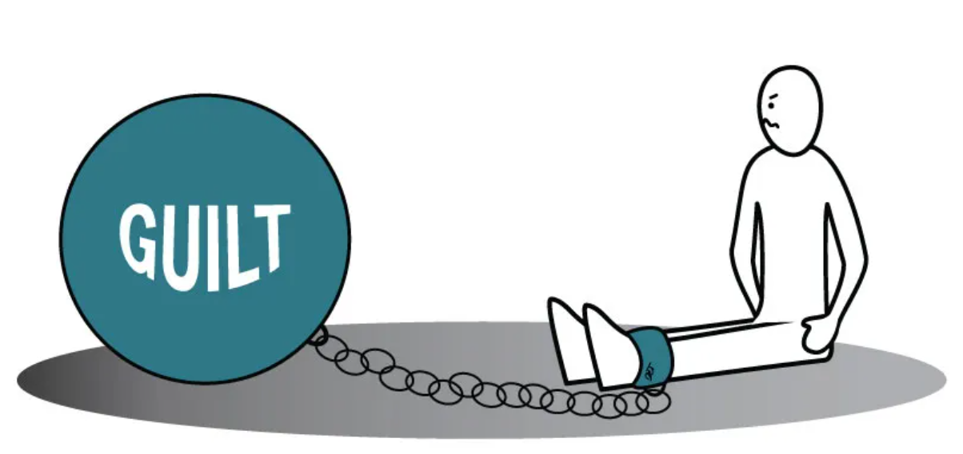
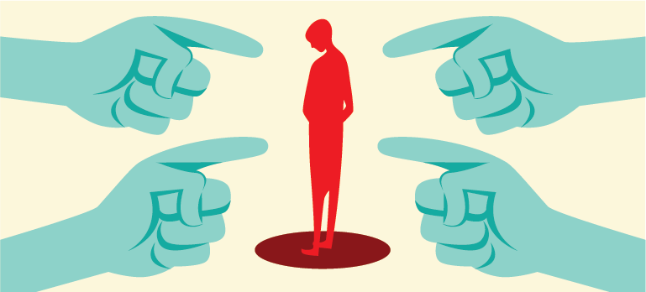
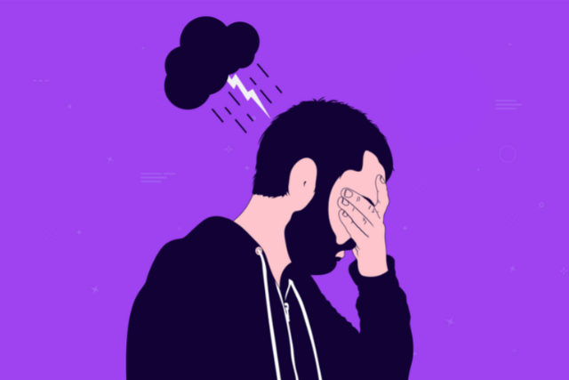

Slide 14
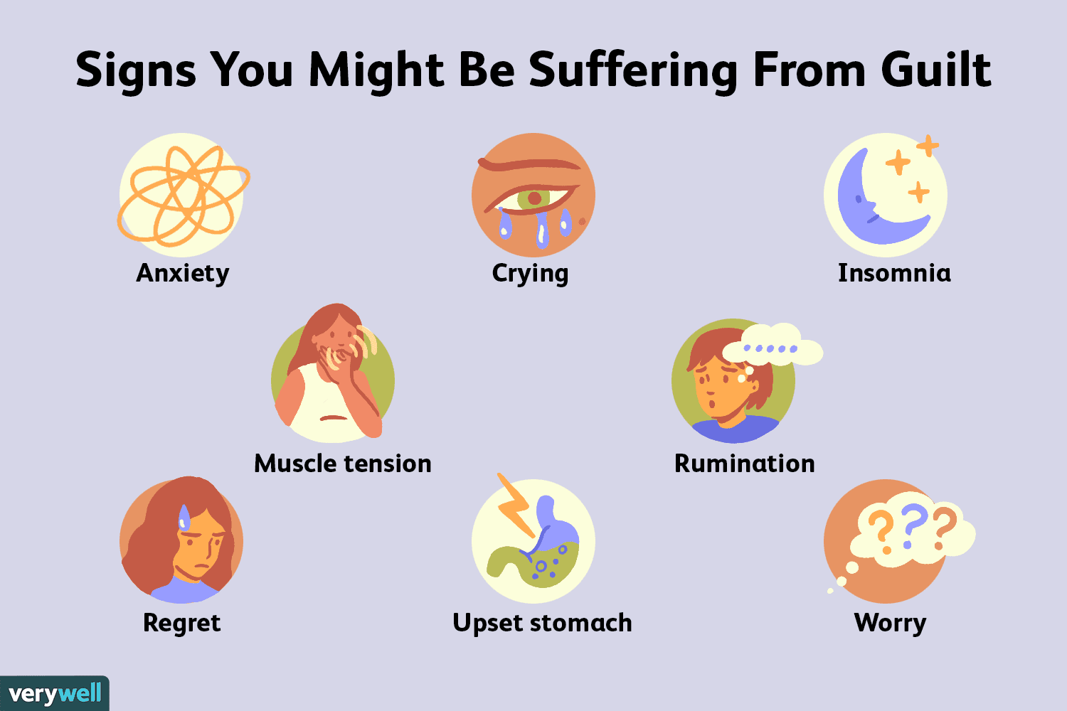

Slide 15
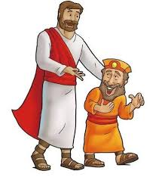
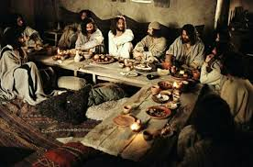
And Levi got up and followed him… Mark 2 v 14
I have not come to call the righteous but sinners Mark 2 v 18

Slide 16
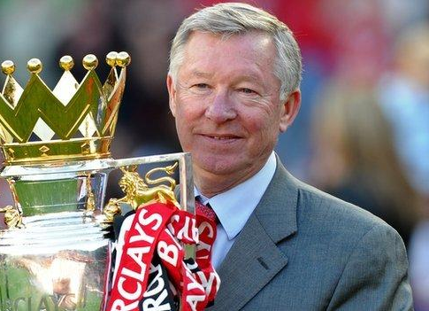

Slide 17
AUTHORITY
The Disciples see Jesus’ authority
The Disciples give up their authority
The Disciples receive Jesus’ authority

Slide 18
The Disciples give up their authority
“Foxes have holes and birds of the air have nests but the Son of Man has nowhere to lay his head” Matthew 8 v 20
Go, sell and give everything you have to the poor and you will have treasure in heaven Mark 10 v 17-27
“ whoever loves father or mother more than me is not fit to be my disciple Matthew 10 v 37

Slide 19
The Disciples give up their authority
Luke 9 v 59-62
He said, “Certainly, but first excuse me for a couple of days, please. I have to make arrangements for my father’s funeral.”
⁶⁰ Jesus refused. “First things first. Your business is life, not death. And life is urgent: Announce God’s kingdom!”
⁶¹ Then another said, “I’m ready to follow you, Master, but first excuse me while I get things straightened out at home.”
⁶² Jesus said, “No procrastination. No backward looks. You can’t put God’s kingdom off till tomorrow. Seize the day.”

Slide 20
The Disciples give up their authority
‘If anyone would come after me, he must deny himself, and take us his cross and follow me. For whoever wants to save his life will lose it but whoever loses his life for me and for the gospel will save it. What good is it for a man to gain the whole world but forfeit his soul’ Mark 8 v 34

Slide 21
The Disciples give up their authority
Estimated Christian deaths through persecution
5,898
Up 24% in one year

Slide 22
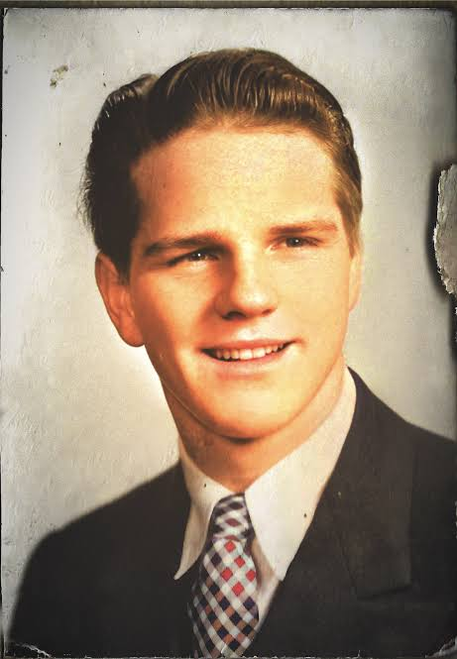
The Disciples give up their authority
“ He is no fool who gives up what he cannot keep…
….To gain what he cannot lose”
Jim Eliot 1927-1956

Slide 23
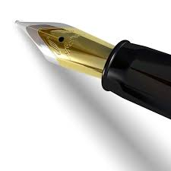
The Disciples give up their authority
Author
Authority
Who is writing our life plans?

Slide 24
AUTHORITY
The Disciples see Jesus’ authority
The Disciples give up their authority
The Disciples receive Jesus’ authority

Slide 25
The Disciples receive Jesus’ authority
Come, Follow me and I will make you fishers of men. Mark 1 v 16
He sent them out two by two and gave them authority over evil spirits Mark 6 v 6 -12
All authority is given to me.. Therefore go and make disciples .. And surely I am with you always Matthew 28 v 16-20

Slide 26
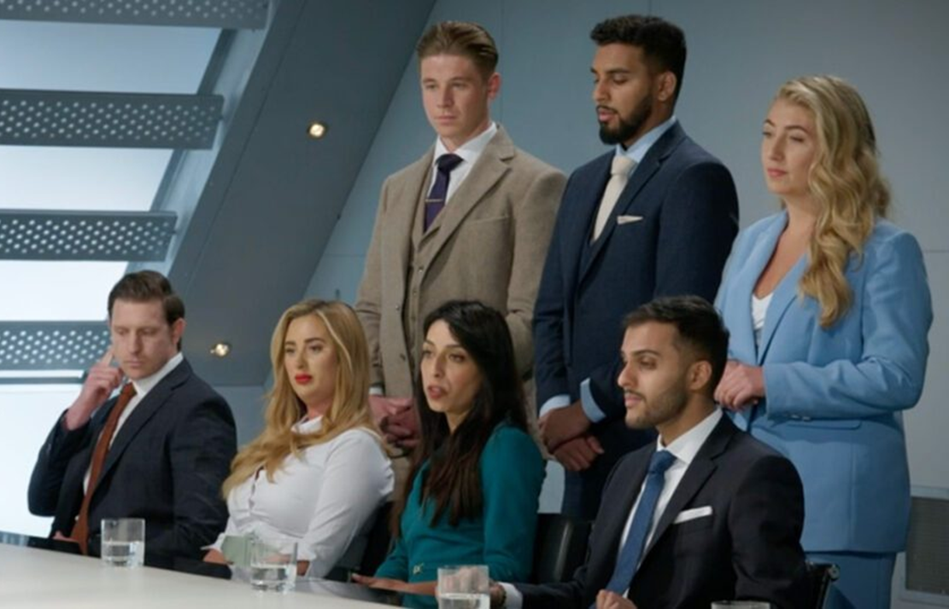
The Disciples receive Jesus’ authority

Slide 27
The Disciples receive Jesus’ authority
“The preliminary call of Jesus’ team was to be with him, rather than to do things for him
Let’s do what God asks us to do today and then let him do what only he can do. Seemingly insignificant moments of kindness revolutionalise lives, A sentence or two about God becomes a lighthouse to a storm sick traveller. Small seeds grow into great trees. It’s by his Spirit not by our sweat”
We are not called to make waves, but rather like Jesus himself, were invited to surf the waves the Father makes”
Jeff Lucas

Slide 28
AUTHORITY
The Disciples see Jesus’ authority – the authority of the King
The Disciples give up their authority to follow him
The Disciples receive Jesus’ authority to carry that authority into deeper , plentiful fishing grounds

Slide 29
You’ve done WHAT?
What an Opportunity I had!
To see Jesus’ authority changing lives

Slide 30
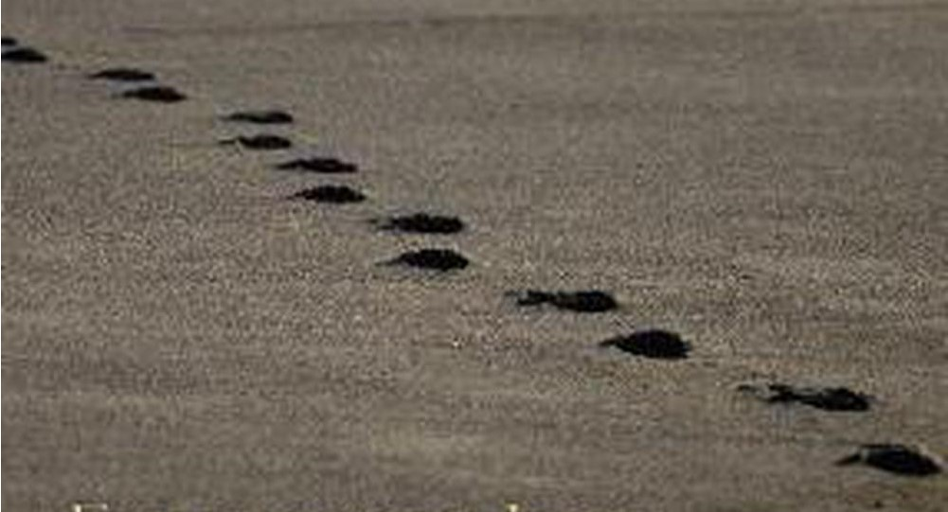

Slide 31
Text…

Slide 33
Text…

