Slide 1
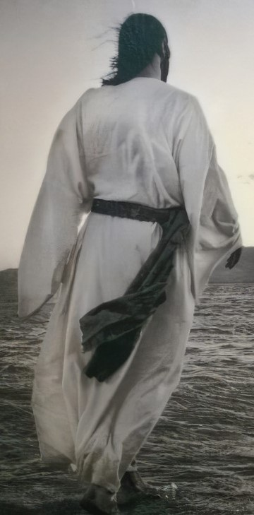
Whom are we following?
Jesus the healer

Slide 2
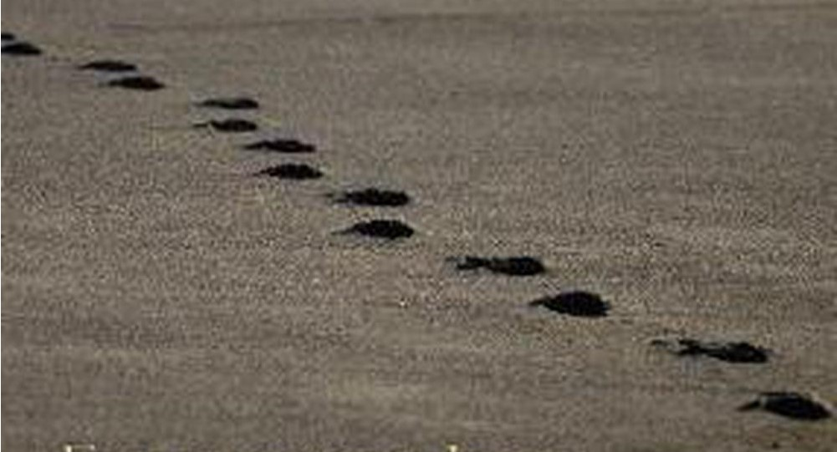
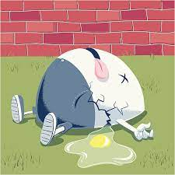

Slide 3
Jesus came…
The Kingdom come near
1. Preaching
2. Teaching
3. Healing

Slide 4
The Kingdom is…
“…God’s creation healed”
(Hans Kung, Swiss Priest)

Slide 5
The Kingdom come near…
Mark | Healing
1:21-28 | Drives out unclean spirit in synagogue
1:29-31 | Heals Simon-Peter’s mother-in-law of a fever
1:32-34 | Heals and drives out demons for many in the village and
1:40-45 | Heals a man of leprosy
2:1-12 | Heals the paralytic
3:1-6 | Heals the man with a shrivelled hand
5:1-20 | Heals the demoniac
5:21-34 | Heals the woman haemorrhaging
5:35-43 | Raises Jairus’s daughter from the dead
7:24-34 | Heals the Syrophoenician woman’s daughter
7:31-37 | Heals man deaf and mute
8:22-26 | Restores sight to the blind man at Bethsaida
9:14-29 | Drives out impure spirit from a boy
10:46-52 | Gives sight to blind Bartimaeus on road to Jerusalem

Slide 6
“The Kingdom come near…”
Option A: It is about to come and we better get ready
Option B: It is already here and you better grab hold of it
The tension: already-not yet

Slide 7
Living in the tension (Mark 1:40-41)
The leper: “If you are willing, you can make me well”
King Jesus: full of compassion and authority

Slide 8
Our prayer: “Your kingdom come, your will be done on earth as in heaven”

