Slide 1
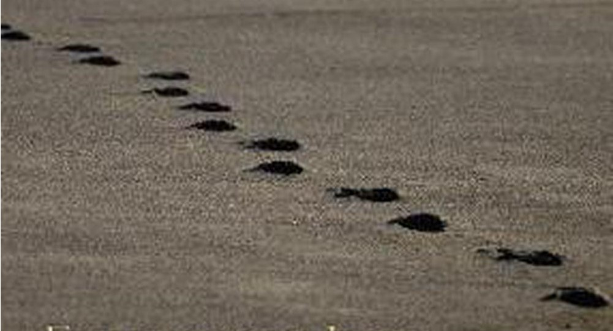
Fish

Slide 2
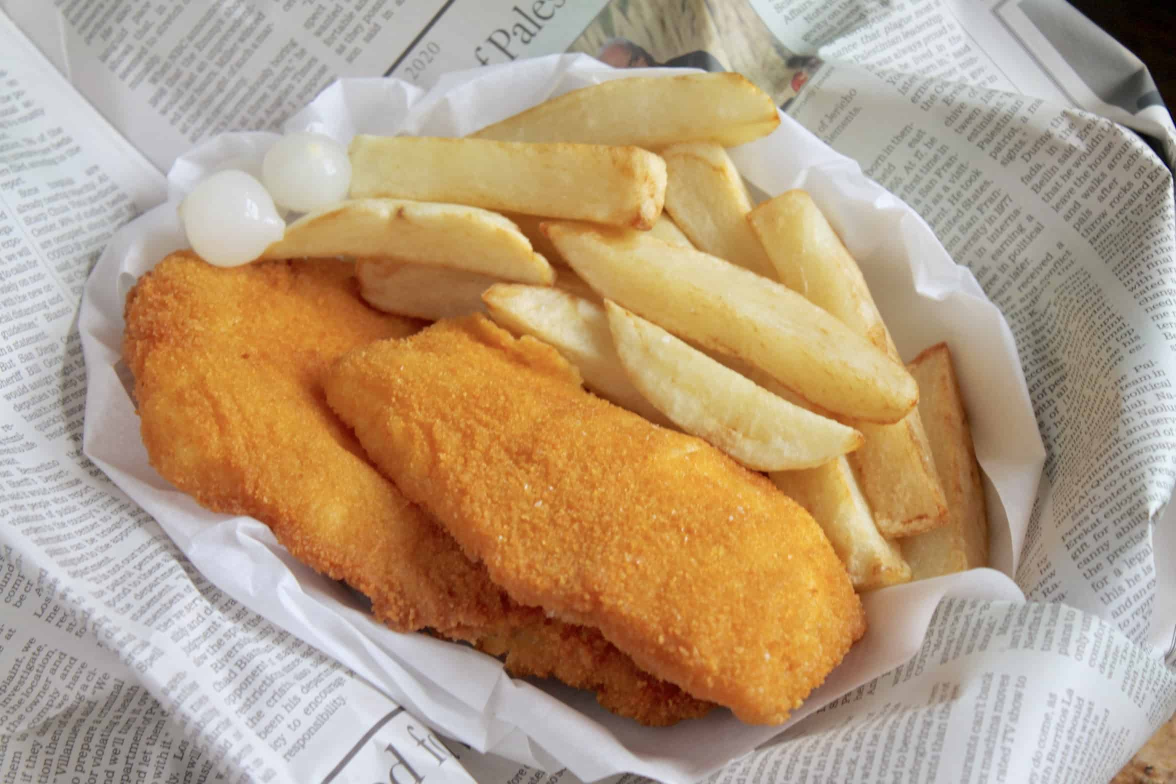
Fish
Chips

Slide 3
Sausage

Slide 4
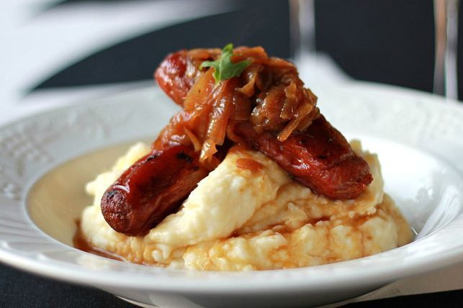
Sausage
Mash

Slide 5
Ant

Slide 6
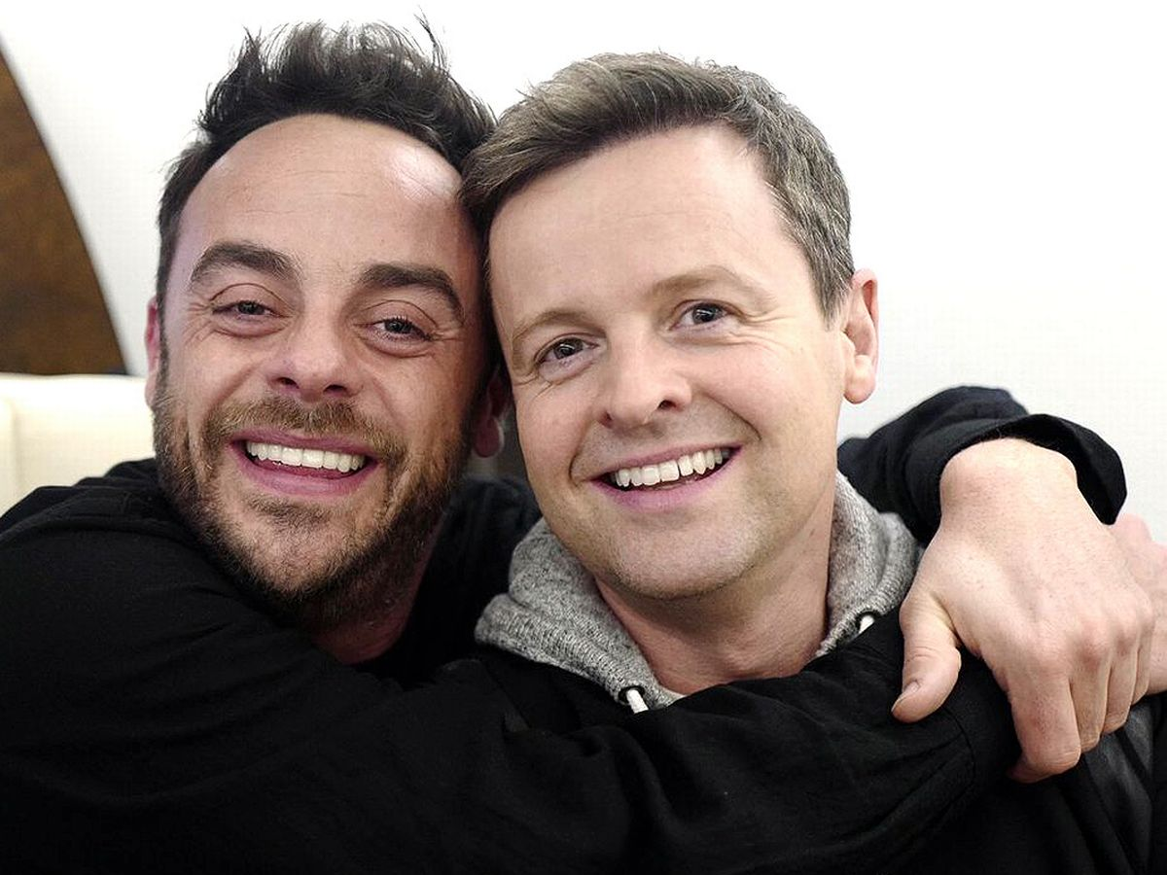
Ant
Dec

Slide 7
Romeo

Slide 8
Romeo
Juliet

Slide 9
Jesus
???

Slide 10
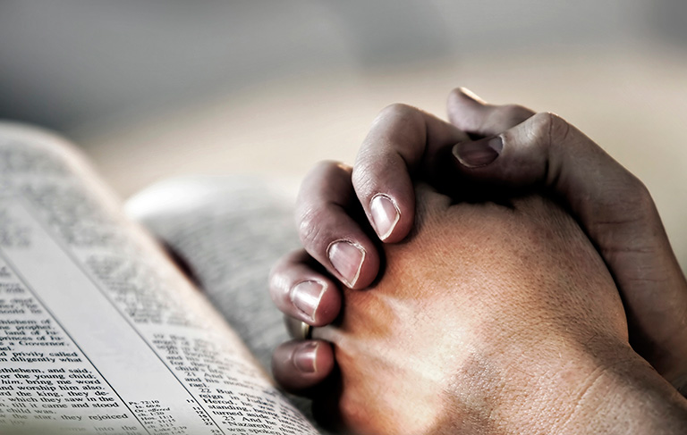
Jesus
Prayer

Slide 11
Whom are we following?
Jesus the pray-er

Slide 12
That evening after sunset the people brought to Jesus all the sick and demon-possessed. The whole town gathered at the door, and Jesus healed many who had various diseases. He also drove out many demons, but he would not let the demons speak because they knew who he was.
Very early in the morning, while it was still dark, Jesus got up, left the house and went off to a solitary place, where he prayed. Simon and his companions went to look for him, and when they found him, they exclaimed: “Everyone is looking for you!”
Jesus replied, “Let us go somewhere else—to the nearby villages—so I can preach there also. That is why I have come.”
Mark 1:32-38

Slide 13
“On this occasion after a day of intense excitement, with the news of God’s kingdom going public with a bang, Jesus knew his need of a God given sense of direction and inner strength.”
Tom Wright Mark for Everyone p 15

Slide 14
Jesus prayed
Key moments: | At his baptism
 | Before choosing the disciples
 | Before His trial & execution
Throughout the day: | Before day started
 | At end of day
 | During night
Prayed for: | Himself
 | disciples
 | All believers
Prayed about: | miracles
 | vision
 | strength

Slide 15
Jesus came…
The Kingdom come near
1. Preaching
2. Teaching
3. Healing

Slide 16
Jesus came…
The Kingdom come near
1. Preaching
2. Teaching
3. Healing
Prayer

Slide 17
Jesus… went away to a secluded place and was praying there… Mark 1:35
After He had sent the crowds away, Jesus went up on the mountain by Himself to pray, and when it was evening, He was there alone. Matthew 14:23
At this time, Jesus went off to the mountain to pray…and he spent the whole night in prayer to God. Luke 6:12
Jesus often slipped away to the wilderness to pray. Luke 5:16

Slide 19
“Prayer doesn’t begin with us; it begins with God. It doesn’t start with speaking; it starts with seeing. As Philip Yancy writes: Prayer is the act of seeing reality from God’s point of view”
Tyler Staton p 34.

Slide 20
Jesus prayed
After healing many people | Renewed vision and purpose … Let us go somewhere else so I can preach there also. That is why I have come.
At His baptism | As He was praying, the Holy spirit descended… and a voice came from heaven…
Before calling the disciples | Jesus spent the night praying to God.. When morning came He chose 12 of them
The transfiguration | As He was praying His face changed.. Glorious splendour – voice from heaven
Before His trial | He knelt down and prayed– Father if you are willing take this cup from me, but not my will, yours be done …

Slide 21
One day Jesus was praying in a certain place. When he finished, one of his disciples said to him, “Lord, teach us to pray, just as John taught his disciples.”
Luke 11:1-2

Slide 22
One day Jesus was praying in a certain place. When he finished, one of his disciples said to him, “Lord, teach us to pray, just as John taught his disciples.”
Luke 11:1-2
Our Father

Slide 23
“My prayer is not for them alone. I pray also for those who will believe in me through their message, that all of them may be one, Father, just as you are in me and I am in you. May they also be in us so that the world may believe that you have sent me.
John 17:20-21

Slide 24
Who then is the one who condemns? No one. Christ Jesus who died—more than that, who was raised to life—is at the right hand of God and is also interceding for us? Romans 8:34
Therefore he is able to save completely those who come to God through him, because he always lives to intercede for them. Hebrews 7:25

Slide 26
The Kingdom is…
“…God’s creation healed”
(Hans Kung, Swiss Priest)

Slide 27
“The Kingdom come near…”
Option A: It is about to come and we better get ready
Option B: It is already here and you better grab hold of it
The tension: already-not yet

Slide 28
The Kingdom come near…
Mark | Healing
1:21-28 | Drives out unclean spirit in synagogue
1:29-31 | Heals Simon-Peter’s mother-in-law of a fever
1:32-34 | Heals and drives out demons for many in the village and
1:40-45 | Heals a man of leprosy
2:1-12 | Heals the paralytic
3:1-6 | Heals the man with a shrivelled hand
5:1-20 | Heals the demoniac
5:21-34 | Heals the woman haemorrhaging
5:35-43 | Raises Jairus’s daughter from the dead
7:24-34 | Heals the Syrophoenician woman’s daughter
7:31-37 | Heals man deaf and mute
8:22-26 | Restores sight to the blind man at Bethsaida
9:14-29 | Drives out impure spirit from a boy
10:46-52 | Gives sight to blind Bartimaeus on road to Jerusalem

Slide 29
Living in the tension (Mark 1:40-41)
The leper: “If you are willing, you can make me well”
King Jesus: full of compassion and authority

Slide 30
Our prayer: “Your kingdom come, your will be done on earth as in heaven”

Slide 31
