Slide 1
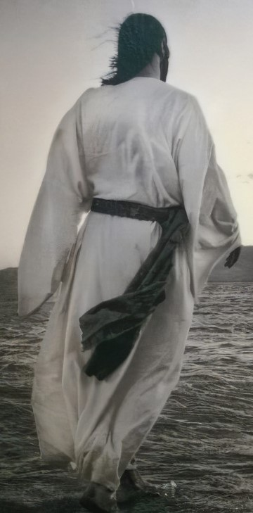
Whom are we following?
Jesus…

Slide 2
Whom are we following?
Jesus …
The Promised Messiah
God’s Beloved Son
The Bringer of Good News
The maker of disciples
The ultimate spiritual authority
The great preacher, teacher and healer
The Pray-er

Slide 3
Mark 1…
Four statements of Jesus
1. ‘The kingdom of God has come near. Repent and believe the good news!’ (Mark 1:15)
=
Kingdom mission proclaimed

Slide 4
Mark 1…
Four statements of Jesus
2. ‘Come, follow me,’ Jesus said, ‘and I will send you out to fish for people.’ (Mark 1:17)
=
Kingdom mission shared

Slide 5
Mark 1…
Four statements of Jesus
3. ‘Be quiet! Come out of him’ (Mark 1:25)
=
Kingdom mission demonstrated

Slide 6
Mark 1…
Four statements of Jesus
4. ‘Let us go somewhere else—to the nearby villages—so I can preach there also. That is why I have come.’ (Mark 1:38)
=
Shared Kingdom mission confirmed

Slide 7
³⁵ Very early in the morning, while it was still dark, Jesus got up, left the house and went off to a solitary place, where he prayed. ³⁶ Simon and his companions went to look for him, ³⁷ and when they found him, they exclaimed: “Everyone is looking for you!”
³⁸ Jesus replied, “Let us go somewhere else—to the nearby villages—so I can preach there also. That is why I have come.” ³⁹ So he travelled throughout Galilee, preaching in their synagogues and driving out demons.

Slide 8
Jesus…
1. Confidence in his call

Slide 9
Jesus…
1. Confidence in his call
³⁶ Simon and his companions went to look for him, ³⁷ and when they found him, they exclaimed: “Everyone is looking for you!”
³⁸ Jesus replied, “Let us go somewhere else—to the nearby villages—so I can preach there also. That is why I have come.” ³⁹ So he travelled throughout Galilee, preaching in their synagogues and driving out demons.

Slide 10
Jesus…
Confidence in his call
…embedded in Scripture
Prepare the way for the Lord! (Isaiah 40:3 + Mark 1:3)
The Spirit of the Lord is on me because he has anointed me to proclaim good news to the poor…freedom for the prisoners and recovery of sight for the blind, to set the oppressed free and to proclaim the year of the Lord’s favour (Isaiah 61:1-3 + Luke 4:18-19)

Slide 11
Jesus…
Confidence in his call
… demonstrated by the anointing of the Holy Spirit at baptism
Just as Jesus was coming up out of the water, he saw heaven being torn open and the Holy Spirit descending on him like a dove. And a voice came from heaven: “You are my Son, whom I love; with you I am well pleased.” (Mark 1:10-11)

Slide 12
Jesus…
Confidence in his call
…confirmed by time spent alone with his Father in prayer
Very early in the morning, while it was still dark, Jesus got up, left the house and went off to a solitary place, where he prayed. (Mark 1:10-11)

Slide 13
Us…
Confidence in our call
embedded in Scripture
Pilgrims, priests, prophets (1 Peter 2:9-12)
The Great Commission (Matt 20:19-20)

Slide 14
Us…
Confidence in our call
received through the Holy Spirit
“As the Father has sent me, I am sending you.” And with that he breathed on them and said, “Receive the Holy Spirit.” (John 20:21-22)
Promise and Pentecost (Acts 1:8, 2:1-4)

Slide 15
Us…
Confidence in our call
confirmed through prayer
Praying as Jesus did (Matt 6:9-13)

Slide 16
Jesus + Us…
Confidence in our call to share in his Kingdom mission

Slide 17
Jesus…
2. Committed to companionship

Slide 18
Jesus…
2. Committed to companionship
³⁸ Jesus replied, “Let us go somewhere else—to the nearby villages—so I can preach there also. That is why I have come.” ³⁹ So he travelled throughout Galilee, preaching in their synagogues and driving out demons.

Slide 19
Jesus…
2. Committed to companionship, with…
Disciples
Tax collectors and sinners
Children
Outsiders
Crowds

Slide 20
Jesus…
2. Committed to companionship, with…
You
Me
Us

Slide 21
Us…
Called to companionship…
But not immune to loneliness…

Slide 22
Jesus…
Committed to companionship…
But not immune to loneliness…
‘My God, my God, why have you forsaken me?’ (Mark 15:34)

Slide 23
Jesus + Us…
A ministry of companionship…
Are you being called to this ministry?...

Slide 24
Jesus…
3. Continuation of Kingdom mission…

Slide 25
Jesus…
3. Continuation of Kingdom mission…
³⁸ Jesus replied, “Let us go somewhere else—to the nearby villages—so I can preach there also. That is why I have come.” ³⁹ So he travelled throughout Galilee, preaching in their synagogues and driving out demons.

Slide 26
Jesus…
3. Continuation of Kingdom mission…
Kingdom proclaimed + demonstrated…
Through Galilee, through Judea…
And on…

Slide 27
Jesus…
Good news!…
Kingdom +

Slide 28
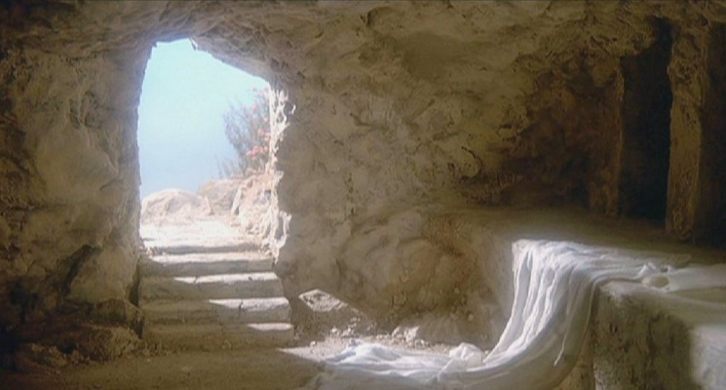
Jesus…
Kingdom mission fulfilled!!…
+

Slide 29
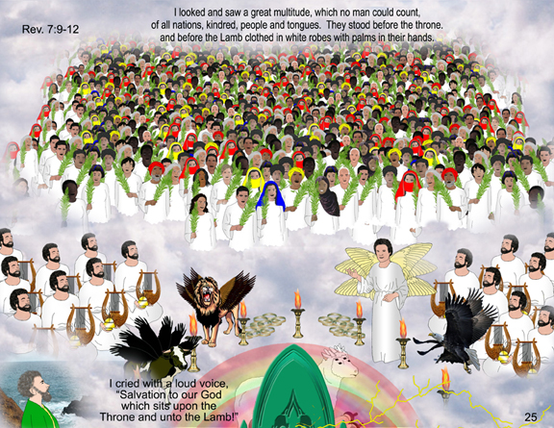
Jesus + Us…
Fulfilled Kingdom mission shared!!!…
=
+

Slide 30
