Slide 2
https://www.youtube.com/watch?v=MI9V8owRTA4

Slide 3
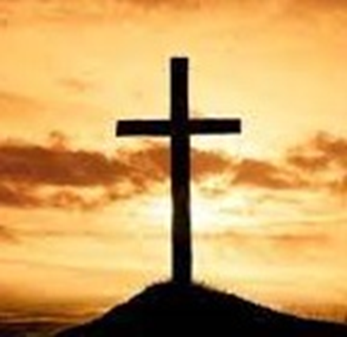
Where you there when
they crucified my Lord?

Slide 4
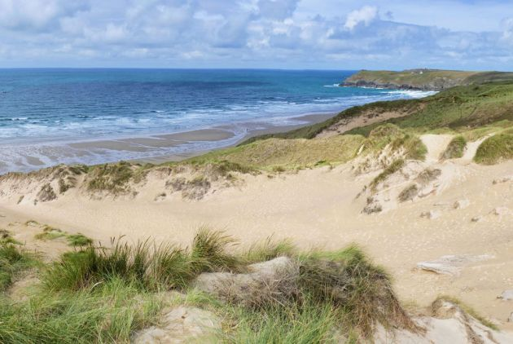

Slide 5
You have died with Christ
Colossians 2:20
You have died
- your life is hidden with Christ in God.
Colossians 3:3
Since we have died with Christ,
we believe that we will also live with him.
Romans 6:8

Slide 6
Where you there when
God raised him
from the tomb?

Slide 7
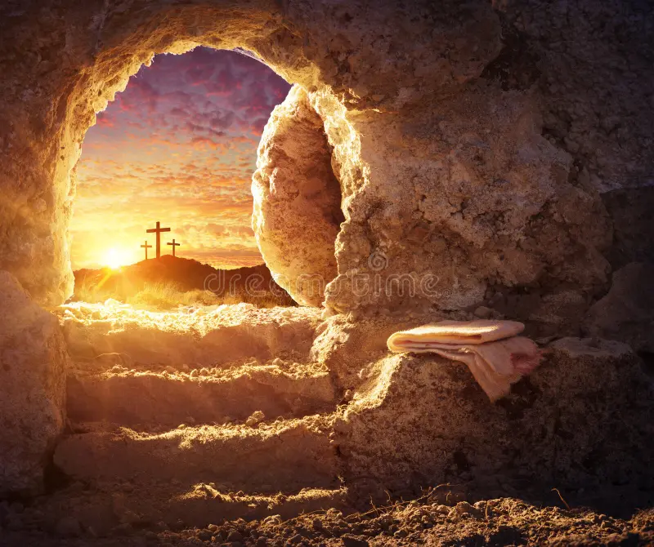
God raised us
from death to life
with Christ Jesus
Ephesians 2:6
You have been
raised to life
with Christ…
Colossians 3:1

Slide 8
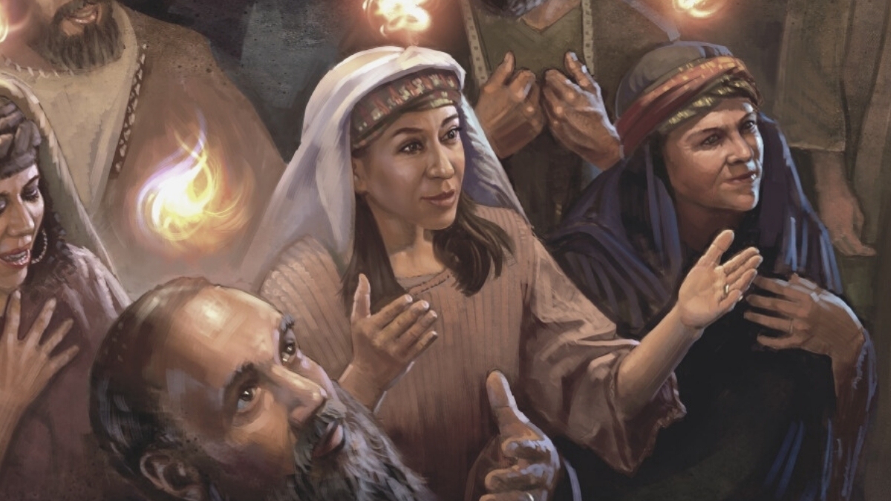

Slide 10
How?

Slide 11
…because the
Holy Spirit
was given
to His Church
at
PENTECOST

Slide 12
What happened at Pentecost?
God links our lives to
the death & resurrection of Jesus

Slide 13
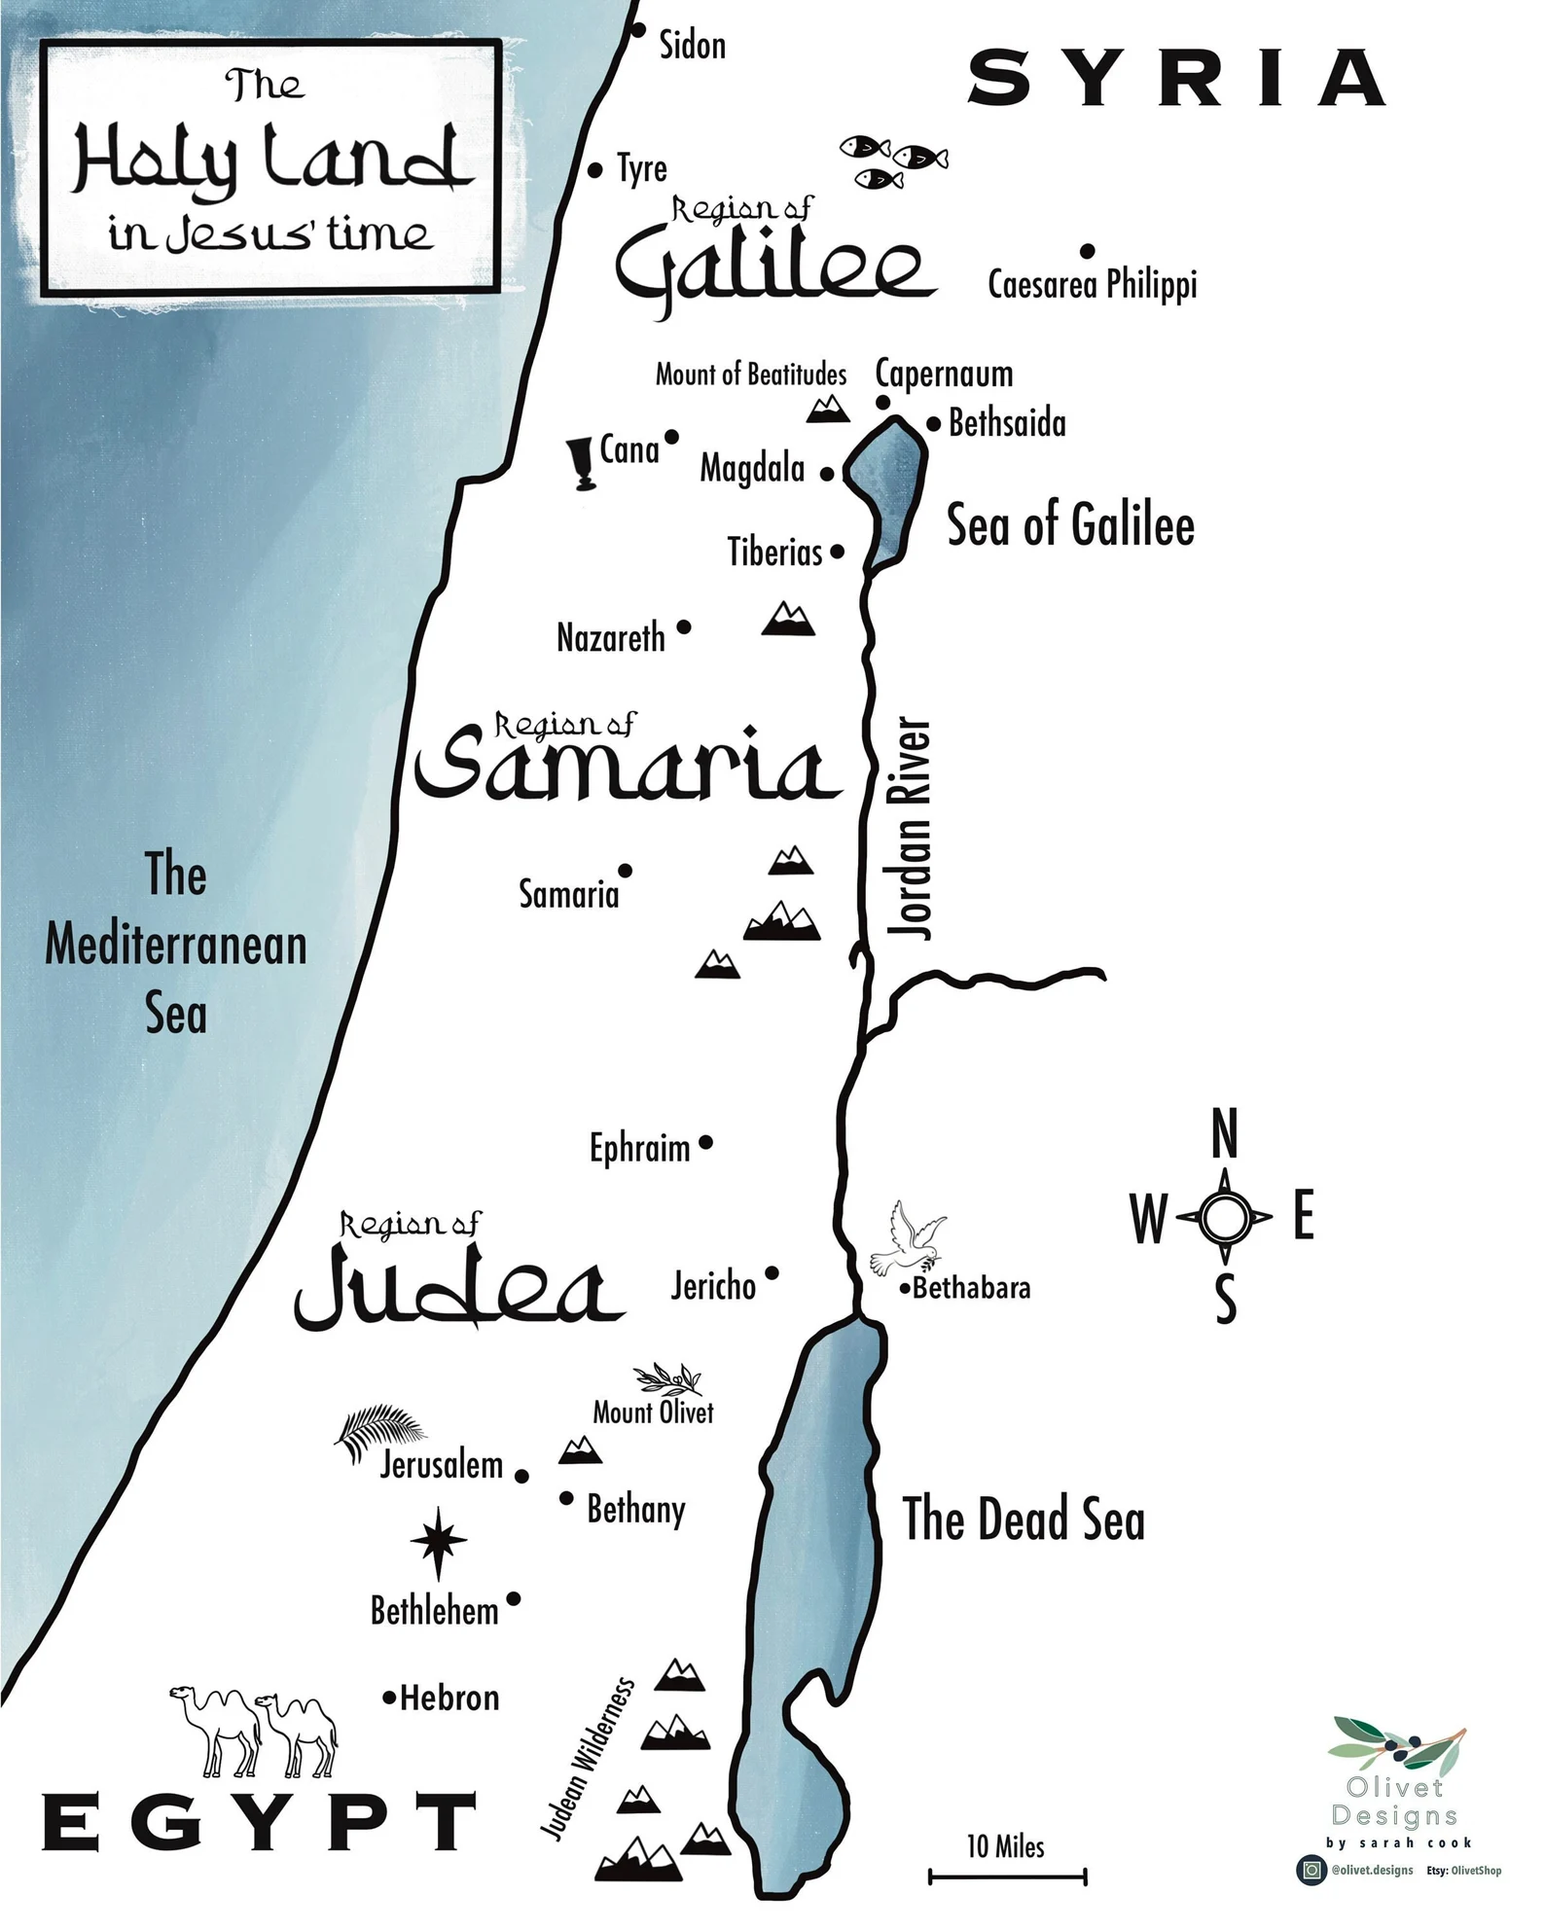
Baptism

Slide 14
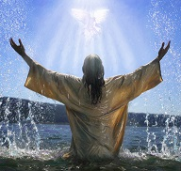
Baptism
The
Holy Spirit came down
on
Jesus
like a dove

Slide 15
Temptation
Baptism

Slide 16
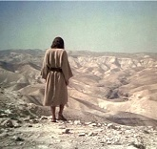
Baptism
Temptation
The
Holy Spirit came down
on
Jesus
like a dove
Full of the
Holy Spirit
… led by the
Spirit
into
the desert

Slide 17
Nazareth
Temptation
Baptism

Slide 18
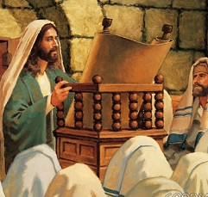
Baptism
Temptation
Nazareth
The
Holy Spirit came down
on
Jesus
like a dove
Full of the
Holy Spirit
… led by the
Spirit
into
the desert
‘The Spirit
of the Lord
is on me…
anointed
to proclaim good news…’

Slide 19
Jesus,
on Earth,
depended on the
anointing, inspiration,
strength, & wisdom…
of the
Holy Spirit
…& He is our model & example!

Slide 20
Their new loyalty
When the day of Pentecost came,
they were all together in one place.
Suddenly a sound like the blowing of
a violent wind came from heaven
and filled the whole house where they were sitting.
They saw what seemed to be tongues of fire
that separated
and came to rest on each of them.
All of them were filled with the Holy Spirit
and began to speak in other tongues
as the Spirit enabled them.
Jedan Bog, jedna ljubav

Slide 21
Now there were staying in Jerusalem
God-fearing Jews
from every nation under heaven.
When they heard this sound,
a crowd came together in bewilderment,
because each one heard
their own language being spoken.
Utterly amazed, they asked:
‘Aren’t all these who are speaking Galileans?
Then how is it that each of us
hears them in our native language?

Slide 22
Their new loyalty
Parthians, Medes & Elamites; residents of Mesopotamia, Judea & Cappadocia,
Pontus and Asia, Phrygia & Pamphylia,
Egypt and the parts of Libya near Cyrene;
visitors from Rome
(both Jews and converts to Judaism);
Cretans and Arabs –
we hear them declaring the wonders of God
in our own tongues!’
Jedan Bog, jedna ljubav

Slide 23
Their new loyalty
Amazed and perplexed,
they asked one another,
‘What does this mean?’
Some, however,
made fun of them and said,
‘They have had too much wine.’
Jedan Bog, jedna ljubav

Slide 24
Their new loyalty
Then Peter stood up with the Eleven, raised his voice and addressed the crowd:
‘Fellow Jews
& all of you who live in Jerusalem,
let me explain this to you;
listen carefully to what I say.
These people are not drunk, as you suppose.
It’s only nine in the morning!
No, this is what was spoken
by the prophet Joel:
Jedan Bog, jedna ljubav

Slide 25
‘In the last days,
God says,
I will pour out my Spirit on all people.
Your sons and daughters will prophesy,
your young men will see visions,
your old men will dream dreams.
Even on my servants, both men and women,
I will pour out my Spirit
in those days,
and they will prophesy.’

Slide 26
‘I will show
wonders in the heavens above
& signs on the earth below,
blood and fire and billows of smoke.
The sun will be turned to darkness
and the moon to blood
before the coming of
the great and glorious day of the Lord.’
‘And
everyone who calls on
the name of the Lord
will be saved.’

Slide 27
Did Peter
& the disciples
expect
what happened
at Pentecost?

Slide 29
What happened at Pentecost?
God links our lives to the
death & resurrection of Jesus
God had prepared for this event

Slide 30
God had prepared for this event…
by special feasts giving
a programme of his care & salvation

Slide 33
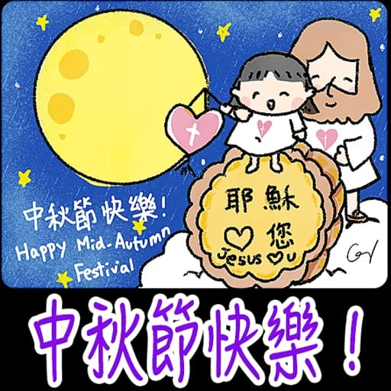

Slide 34
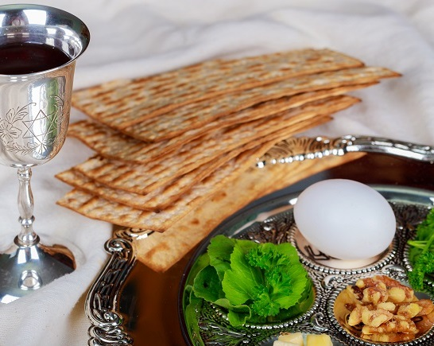
Lessons from Horeb
The 3 great Jewish
HARVEST FESTIVALS
Barley harvest
March-April
Wheat harvest
May-June
Fruit harvest
Sept-Oct
‘Passover’

Slide 35
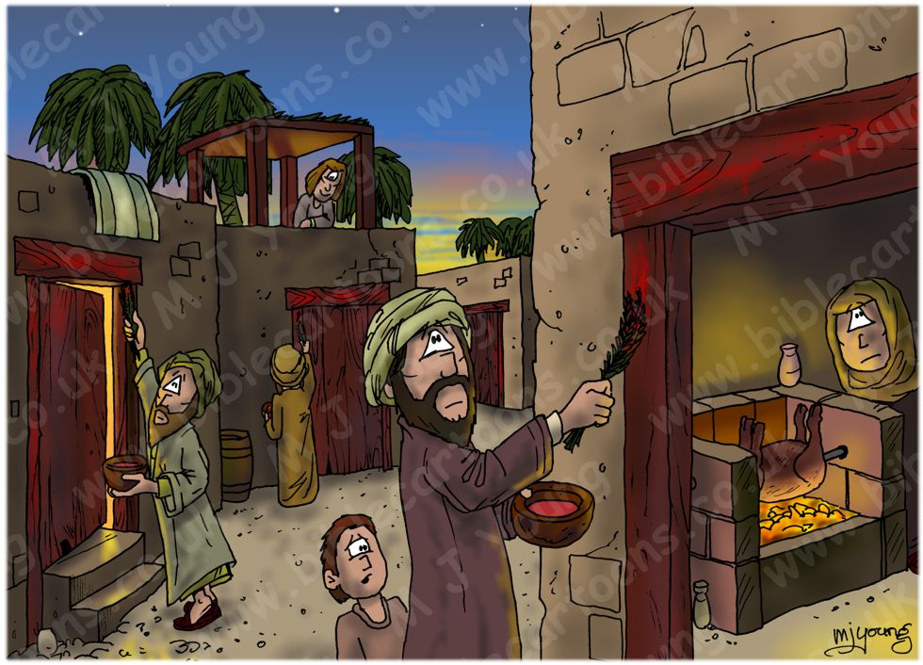
‘PASSOVER’

Slide 36
‘Rescued
from being prisoners’

Slide 37
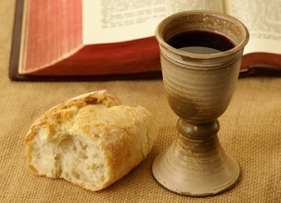
‘PASSOVER’
‘Rescue
from prison’
‘Rescue
from sin’

Slide 38
Lessons from Horeb
The 3 great Jewish
HARVEST FESTIVALS
Barley harvest
March-April
Wheat harvest
May-June
‘Passover’
‘First fruits’
‘Weeks’
‘Harvest’
EASTER
PENTECOST

Slide 39
Lessons from Horeb
The 3 great Jewish
HARVEST FESTIVALS
Barley harvest
March-April
Wheat harvest
May-June
‘Passover’
‘First fruits’
GIVING OF
THE LAW
PENTECOST

Slide 40
Exodus 19:16-19
On the morning
of the third day
there was thunder & lightning,
with a thick cloud over the mountain,
and a very loud trumpet blast.
Everyone in the camp trembled.
Then Moses led the people out of the camp
to meet with God…

Slide 41
Mount Sinai was covered with smoke,
because the LORD descended on it in fire…
and the whole mountain trembled violently.
As the sound of the trumpet
grew louder and louder,
Moses spoke and
the voice of God answered him.

Slide 42
And God spoke
all these words:
“I am the LORD your God…
You shall have no other gods but me…
You shall not make yourself an image…
Honour your father & mother…
You shall not murder…
You shall not commit adultery…”

Slide 43
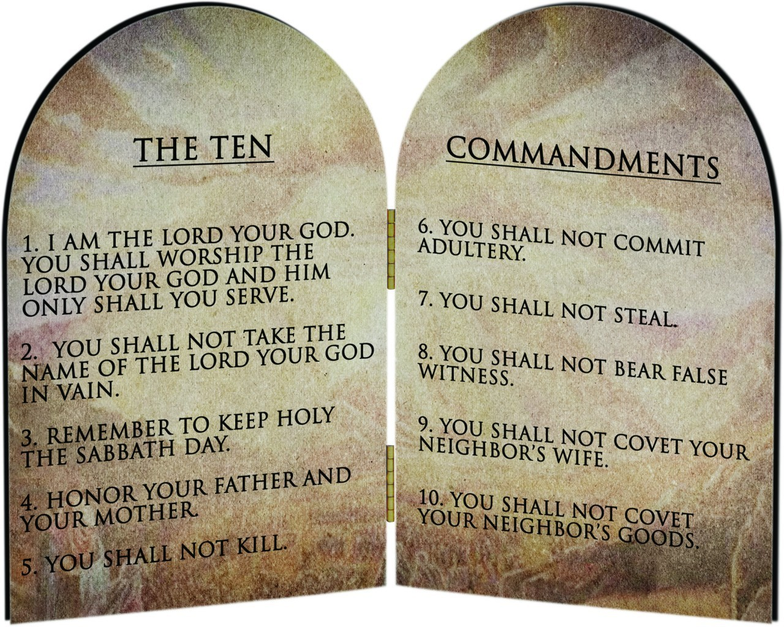
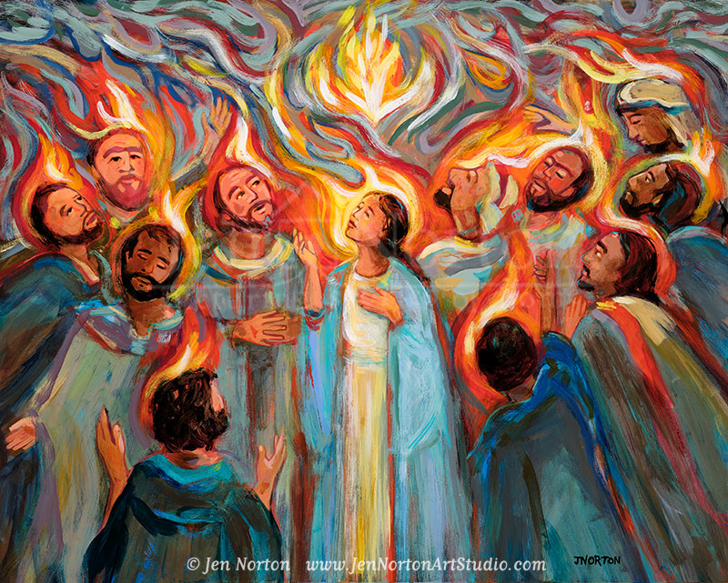
In Exodus 19-20…
in storm & lightning
God gave his Law to his people
…but people’s hearts were not changed
In Acts 2
in wind & fire
God gave his Spirit to his people

Slide 44
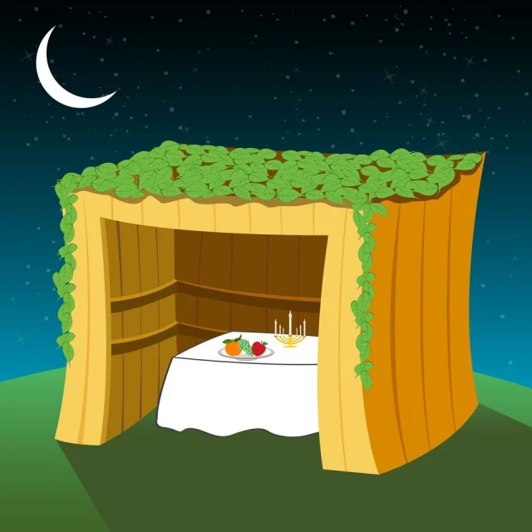
Lessons from Horeb
The 3 great Jewish
HARVEST FESTIVALS
Barley harvest
March-April
Wheat harvest
May-June
Fruit harvest
Sept-Oct
‘Booths’
?

Slide 45
Lessons from Horeb
The 3 great Jewish
HARVEST FESTIVALS
‘First fruits’
PENTECOST

Slide 46
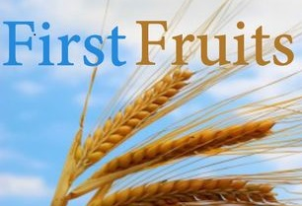
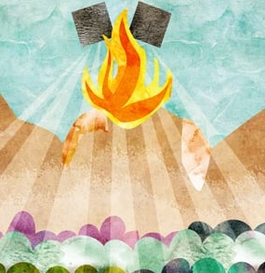
‘First fruits’
‘Giving
of
the Law
’
Giving of the
Holy Spirit

Slide 47
God links our lives to the
death & resurrection of Jesus
God had prepared for this event…
by special feasts giving
a programme of his care & salvation
by special promises preparing
for the coming of the Holy Spirit

Slide 49
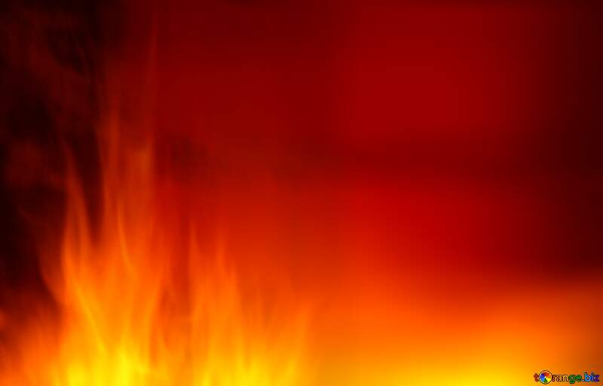
Ezekiel 36:26-27
I will also put a new spirit in you
to change your way of thinking.
I will take out the heart of stone
from your body
and give you a tender, human heart.
I will put my Spirit inside you
and change you
so that you will obey my laws.
You will carefully obey my commands.

Slide 50
God links our lives to the
death & resurrection of Jesus
God had prepared for this event
And what were the results of Pentecost?
Lives changed into the likeness of Christ

Slide 51
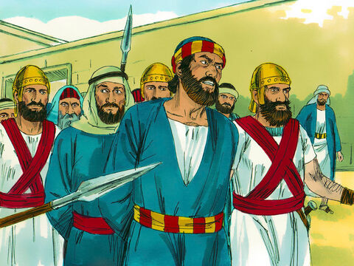
The Spirit
changed the lives of
the first disciples

Slide 52
Acts 12
King Herod
began to persecute
some members of the church.
He had
James,
the brother of John,
put to death by the sword.
When he saw that this pleased the Jews,
he went ahead and had
Peter
arrested.

Slide 53
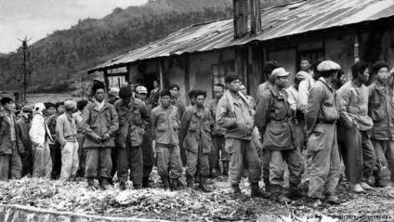
Pentecost
changes the lives of
disciples of Jesus today

Slide 54
God gives all Christians
the fruit of his Spirit
which changes
our
character
God gives all Christians
the gifts of his Spirit
which build
His
Church

Slide 55
Whoever does not have
the Spirit of Christ
does not belong to Christ.
But if Christ lives in you,
the Spirit is life for you
because you have been put right with God
Romans 8:9-10
For those who are led by
the Spirit of God
are
the children of God.
Romans 8:14

Slide 56
God links our lives to the
death & resurrection of Jesus
God had prepared for this event
And what were the results of Pentecost?
Lives changed into the likeness of Christ
People from every language
united in Christ

Slide 57
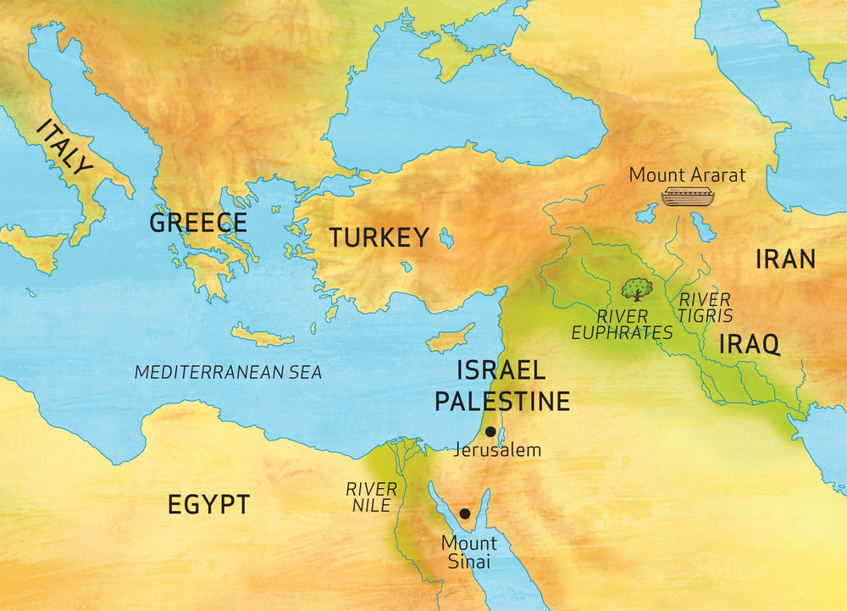
Rome
Asia
Pontus
Medes
Phrygia
Cappadocia
Elamites
Cretans
Pamphylia
Mesopotamia
Parthians
Cyrene
Judea
Arabs
Egypt

Slide 58
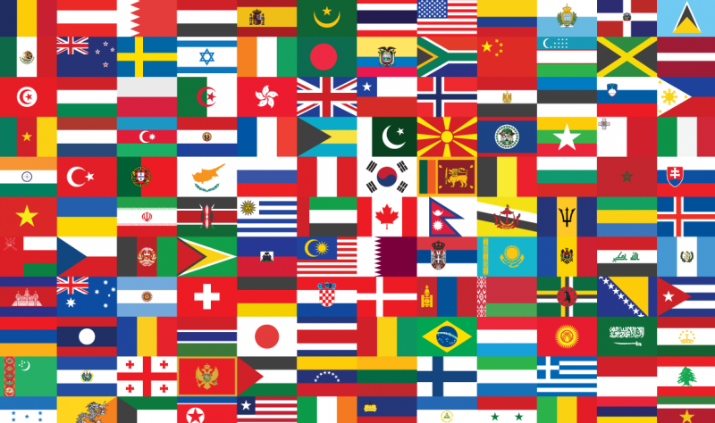

Slide 59
Galatians 3:26-28
You were all baptized into Christ…
You are all children of God
through faith in Christ Jesus.
Now, in Christ,
there is no difference between Jew & Greek. there is no difference between slaves & free
there is no difference between male & female.
You are all one in Christ Jesus.

Slide 60
Lessons from Horeb
The 3 great Jewish HARVEST FESTIVALS
‘Booths’ or
‘tents’ or
‘tabernacles’
‘Passover’
‘First fruits’
EASTER
PENTECOST
?

Slide 61
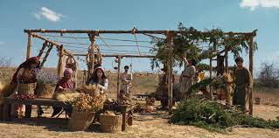
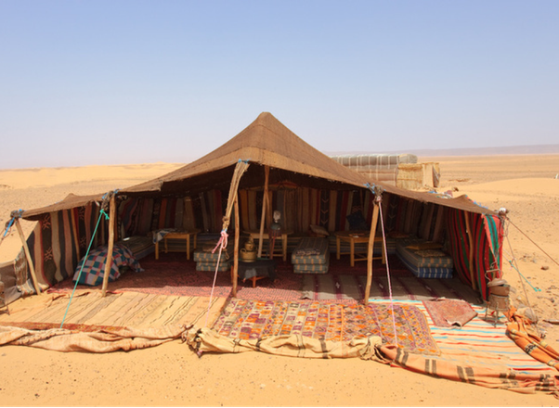
Temporary
tents
or
booths…
…to remember their 40 years
in the desert
with Moses

Slide 63
