Slide 1


Slide 2
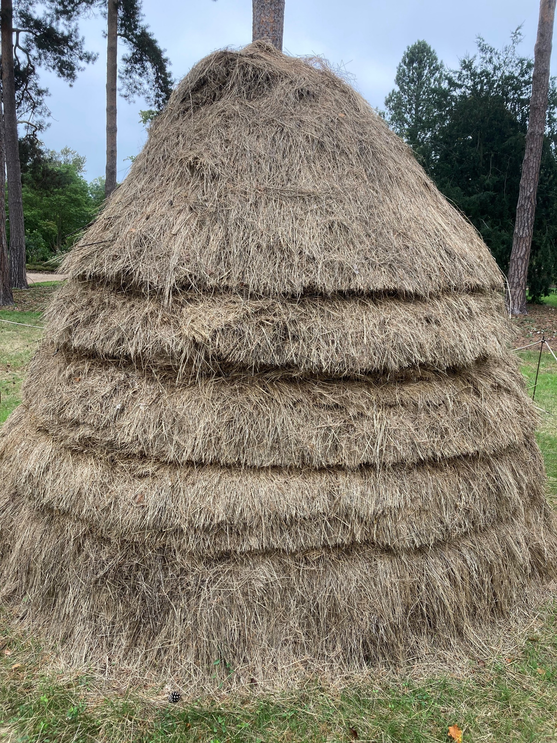

Slide 3
“The church”…

Slide 4
“The church”…
…“storehouses”

Slide 5


MALACHI 3:6-10
⁶ ‘I the Lord do not change. So you, the descendants of Jacob, are not destroyed. ⁷ Ever since the time of your ancestors you have turned away from my decrees and have not kept them. Return to me, and I will return to you,’ says the Lord Almighty.
‘But you ask, “How are we to return?”
⁸ ‘Will a mere mortal rob God? Yet you rob me.
‘But you ask, “How are we robbing you?”

Slide 6
MALACHI 3:6-10
‘In tithes and offerings. ⁹ You are under a curse – your whole nation – because you are robbing me. ¹⁰ Bring the whole tithe into the storehouse, that there may be food in my house. Test me in this,’ says the Lord Almighty, ‘and see if I will not throw open the floodgates of heaven and pour out so much blessing that there will not be room enough to store it. ¹¹ I will prevent pests from devouring your crops, and the vines in your fields will not drop their fruit before it is ripe,’ says the Lord Almighty. ¹² ‘Then all the nations will call you blessed, for yours will be a delightful land,’ says the Lord Almighty.

Slide 7
MALACHI
The final book of the Old Testament
The final prophetic revelation for approximately 400 years
Malachi means “my messenger”
A message of rebuke, of warning and of judgment…
… but also the promise of blessing and of restoration…
…through the coming of the great, Messianic, King.
A prophecy issued in the context of love by a God who is to be honoured and feared.

Slide 8
MALACHI 3:10
¹⁰ Bring the whole tithe into the storehouse, that there may be food in my house. Test me in this,’ says the Lord Almighty, ‘and see if I will not throw open the floodgates of heaven and pour out so much blessing that there will not be room enough to store it.

Slide 9
MALACHI 3:10
¹⁰ Bring the whole tithe into the storehouse, that there may be food in my house. Test me in this,’ says the Lord Almighty, ‘and see if I will not throw open the floodgates of heaven and pour out so much blessing that there will not be room enough to store it.

Slide 10
MALACHI 3:8b-10
‘In tithes and offerings. ⁹ You are under a curse – your whole nation – because you are robbing me. ¹⁰ Bring the whole tithe into the storehouse, that there may be food in my house. Test me in this,’ says the Lord Almighty, ‘and see if I will not throw open the floodgates of heaven and pour out so much blessing that there will not be room enough to store it.

Slide 11
2 CORINTHIANS 9:6-8
⁶ Remember this: whoever sows sparingly will also reap sparingly, and whoever sows generously will also reap generously. ⁷ Each of you should give what you have decided in your heart to give, not reluctantly or under compulsion, for God loves a cheerful giver. ⁸ And God is able to bless you abundantly, so that in all things at all times, having all that you need, you will abound in every good work.

Slide 12
MALACHI 3:6
‘I the Lord do not change. So you, the descendants of Jacob, are not destroyed.

Slide 13


Slide 14
MALACHI 3:10
¹⁰ Bring the whole tithe into the storehouse, that there may be food in my house. Test me in this,’ says the Lord Almighty, ‘and see if I will not throw open the floodgates of heaven and pour out so much blessing that there will not be room enough to store it.

Slide 16
ACTS 3:1-10
The time of prayer was about three o'clock in the afternoon, and Peter and John were going into the temple. ² A man who had been born lame was being carried to the temple door. Each day he was placed beside this door, known as the Beautiful Gate. He sat there and begged from the people who were going in.
³ The man saw Peter and John entering the temple, and he asked them for money. ⁴ But they looked straight at him and said, “Look up at us!”
⁵ The man stared at them and thought he was going to get something.

Slide 17
ACTS 3:1-10
⁶ But Peter said, “I don't have any silver or gold! But I will give you what I do have. In the name of Jesus Christ from Nazareth, get up and start walking.” ⁷ Peter then took him by the right hand and helped him up.
At once the man's feet and ankles became strong, ⁸ and he jumped up and started walking. He went with Peter and John into the temple, walking and jumping and praising God. ⁹ Everyone saw him walking around and praising God. ¹⁰ They knew he was the beggar who had been lying beside the Beautiful Gate, and they were completely surprised. They could not imagine what had happened to the man.

Slide 18
ACTS 3:1-10
⁶ But Peter said, “I don't have any silver or gold! But I will give you what I do have. In the name of Jesus Christ from Nazareth, get up and start walking.” ⁷ Peter then took him by the right hand and helped him up.
At once the man's feet and ankles became strong, ⁸ and he jumped up and started walking. He went with Peter and John into the temple, walking and jumping and praising God. ⁹ Everyone saw him walking around and praising God. ¹⁰ They knew he was the beggar who had been lying beside the Beautiful Gate, and they were completely surprised. They could not imagine what had happened to the man.

Slide 19
ACTS 3:1-10
⁶ But Peter said, “I don't have any silver or gold! But I will give you what I do have. In the name of Jesus Christ from Nazareth, get up and start walking.” ⁷ Peter then took him by the right hand and helped him up.
At once the man's feet and ankles became strong, ⁸ and he jumped up and started walking. He went with Peter and John into the temple, walking and jumping and praising God. ⁹ Everyone saw him walking around and praising God. ¹⁰ They knew he was the beggar who had been lying beside the Beautiful Gate, and they were completely surprised. They could not imagine what had happened to the man.

Slide 20
MALACHI 3 AND ACTS 3
What is God asking us to bring to him?
How is God challenging you to love him more and to live generously for him?

Slide 22
