Slide 1
A day in the life of Peter and John

Slide 3
Peter’s offence
Jesus was alive
God was bringing in His new Kingdom
Threatened all the Sanhedrin stood for

Slide 4
Tom Wright: the Priests realised that the gospel message meant their power and prestige would be upstaged and overturned – in a way they understood the implications of the gospel message better than we do, but they didn’t like what they understood!!

Slide 5
Be on your guard; you will be handed over to the local councils and be flogged in the synagogues.
Matthew 10:17
Remember what I told you: ‘A servant is not greater than his master.’ If they persecuted me, they will persecute you also.
John 15:20

Slide 6
Peter’s boldness
Been with Jesus
Empowered by Holy Spirit

Slide 7
Peter’s reaction
Share with church
Pray

Slide 8
Believers prayer
God is sovereign
Creation and enemies
God can give them boldness through power of Holy Spirit

Slide 9
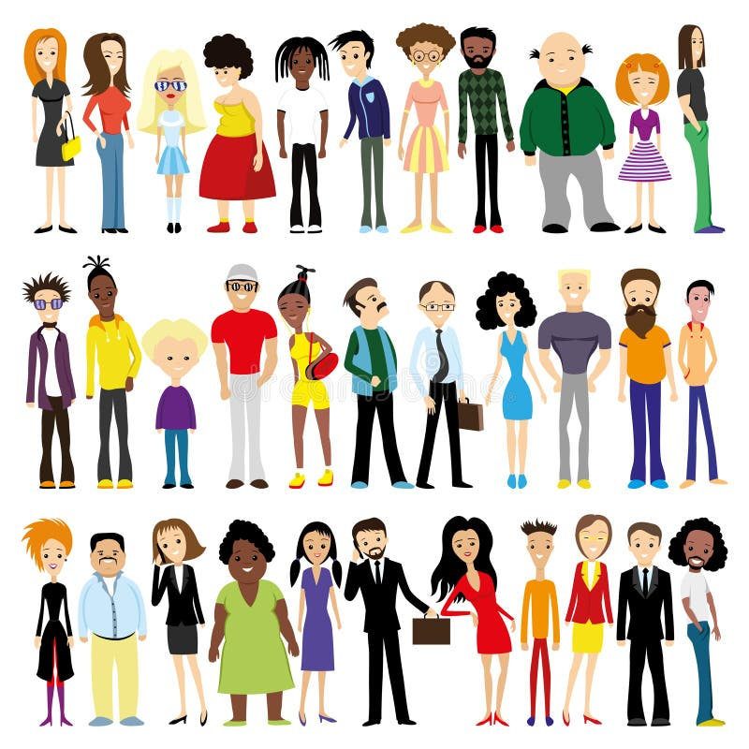
What is your story?

Slide 10
What does opposition look like today?
Persecution
Apathy

Slide 11
How do we respond?
Spend time with Jesus
Seek wisdom of Holy Spirit
Be part of a praying community

